Slide 1
SEMINARY
Old Testament

Slide 2
“Solomon marries many wives outside the covenant, and they turn his heart away from God”

Slide 3
1 Kings 11:1-2
1 But king Solomon loved many strange women, together with the daughter of Pharaoh, women of the Moabites, Ammonites, Edomites, Zidonians, and Hittites;
2 Of the nations concerning which the Lord said unto the children of Israel, Ye shall not go in to them, neither shall they come in unto you: for surely they will turn away your heart after their gods: Solomon clave unto these in love.
What warning had the Lord previously given about what would happen to Israelites who married outside of the covenant?

Slide 4
1 Kings 11:3-8
3 And he had seven hundred wives, princesses, and three hundred concubines: and his wives turned away his heart.
4 For it came to pass, when Solomon was old, that his wives turned away his heart after other gods: and his heart was not perfect with the Lord his God, as was the heart of David his father.
5 For Solomon went after Ashtoreth the goddess of the Zidonians, and after Milcom the abomination of the Ammonites.
6 And Solomon did evil in the sight of the Lord, and went not fully after the Lord, as did David his father.
7 Then did Solomon build an high place for Chemosh, the abomination of Moab, in the hill that is before Jerusalem, and for Molech, the abomination of the children of Ammon.
8 And likewise did he for all his strange wives, which burnt incense and sacrificed unto their gods.
How did Solomon’s choice to marry outside of the covenant affect him?
What principle can we learn from these verses about why marriage is important?
Who we choose to marry has a profound influence on the decisions we make.

Slide 5
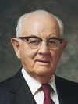
“Marriage is perhaps the most vital of all the decisions and has the most far-reaching effects, for it has to do not only with immediate happiness, but also with eternal joys. It affects not only the two people involved, but also their families and particularly their children and their children’s children down through the many generations” (Spencer W. Kimball, “Oneness in Marriage,” Ensign, Mar. 1977, 3).
President
Spencer W. Kimball
Why do you want to marry someone who will help you stay faithful to the Lord?

Slide 6
1 Kings 11:9-13
9 ¶ And the Lord was angry with Solomon, because his heart was turned from the Lord God of Israel, which had appeared unto him twice,
10 And had commanded him concerning this thing, that he should not go after other gods: but he kept not that which the Lord commanded.
11 Wherefore the Lord said unto Solomon, Forasmuch as this is done of thee, and thou hast not kept my covenant and my statutes, which I have commanded thee, I will surely rend the kingdom from thee, and will give it to thy servant.
12 Notwithstanding in thy days I will not do it for David thy father’s sake: but I will rend it out of the hand of thy son.
13 Howbeit I will not rend away all the kingdom; but will give one tribe to thy son for David my servant’s sake, and for Jerusalem’s sake which I have chosen.
What happened as a result of Solomon’s disobedience?

Slide 7
1 Kings 11:26-28
26 ¶ And Jeroboam the son of Nebat, an Ephrathite of Zereda, Solomon’s servant, whose mother’s name was Zeruah, a widow woman, even he lifted up his hand against the king.
27 And this was the cause that he lifted up his hand against the king: Solomon built Millo, and repaired the breaches of the city of David his father.
28 And the man Jeroboam was a mighty man of valour: and Solomon seeing the young man that he was industrious, he made him ruler over all the charge of the house of Joseph.
What kind of a person was Jeroboam?
1 Kings 11:37-38
37 And I will take thee, and thou shalt reign according to all that thy soul desireth, and shalt be king over Israel.
38 And it shall be, if thou wilt hearken unto all that I command thee, and wilt walk in my ways, and do that is right in my sight, to keep my statutes and my commandments, as David my servant did; that I will be with thee, and build thee a sure house, as I built for David, and will give Israel unto thee.

Slide 8
1 Kings 12:1-24
“After Rehoboam vows to continue to make his people’s burdens heavy, ten of the tribes revolt against him”

Slide 9
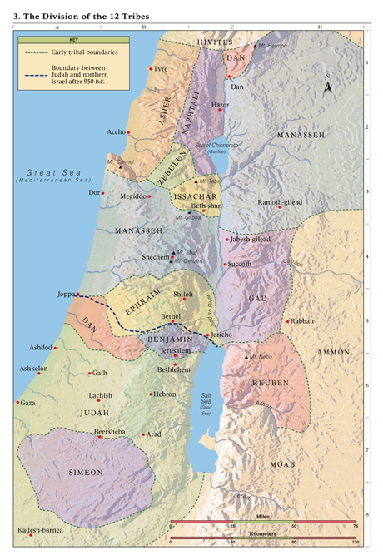

Slide 10
1 Kings 12:25-14:31
“Jeroboam and Rehoboam practice idolatry in their kingdoms”

Slide 11
Northern Kingdom
1 Kings 12:25-14:20
Southern Kingdom
1 Kings 14:21-31
1 Kings 14:7-9, 14-16.
1 Kings 14:21-24.
7 Go, tell Jeroboam, Thus saith the Lord God of Israel, Forasmuch as I exalted thee from among the people, and made thee prince over my people Israel,
8 And rent the kingdom away from the house of David, and gave it thee: and yet thou hast not been as my servant David, who kept my commandments, and who followed me with all his heart, to do that only which was right in mine eyes;
9 But hast done evil above all that were before thee: for thou hast gone and made thee other gods, and molten images, to provoke me to anger, and hast cast me behind thy back:
14 Moreover the Lord shall raise him up a king over Israel, who shall cut off the house of Jeroboam that day: but what? even now.
15 For the Lord shall smite Israel, as a reed is shaken in the water, and he shall root up Israel out of this good land, which he gave to their fathers, and shall scatter them beyond the river, because they have made their groves, provoking the Lord to anger.
16 And he shall give Israel up because of the sins of Jeroboam, who did sin, and who made Israel to sin.
21 ¶ And Rehoboam the son of Solomon reigned in Judah. Rehoboam was forty and one years old when he began to reign, and he reigned seventeen years in Jerusalem, the city which the Lord did choose out of all the tribes of Israel, to put his name there. And his mother’s name was Naamah an Ammonitess.
22 And Judah did evil in the sight of the Lord, and they provoked him to jealousy with their sins which they had committed, above all that their fathers had done.
23 For they also built them high places, and images, and groves, on every high hill, and under every green tree.
24 And there were also sodomites in the land: and they did according to all the abominations of the nations which the Lord cast out before the children of Israel.
How did worshipping false gods affect the people in the Southern Kingdom of Judah?

Slide 12
1 Kings 15-16
“A series of wicked and righteous kings rule over Judah and Israel for many years”

