Slide 1
SEMINARY
Old Testament

Slide 2
LESSON 91
2 Samuel 11:1-12:9

Slide 3
2 Samuel 11:1-5
“David commits adultery
with Bathsheba”

Slide 4
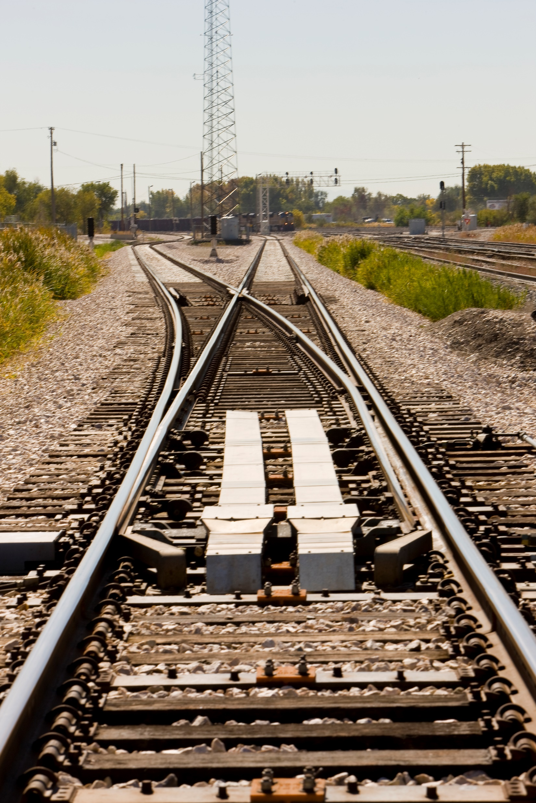
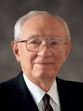
“We discovered that a baggage car that belonged in Newark, New Jersey, was in fact in New Orleans, Louisiana—1,500 miles from its destination. Just the three-inch movement of the switch in the St. Louis yard by a careless employee had started it on the wrong track, and the distance from its true destination increased dramatically. That is the way it is with our lives. Instead of following a steady course, we are pulled by some mistaken idea in another direction. The movement away from our original destination may be ever so small, but, if continued, that very small movement becomes a great gap and we find ourselves far from where we intended to go” (Gordon B. Hinckley, “Words of the Prophet: Seek Learning,” New Era, Sept. 2007, 2).
President
Gordon B. Hinckley
What do you think a switch point could represent in our lives?

Slide 5
2 Samuel 11:1-5
1 And it came to pass, after the year was expired, at the time when kings go forth to battle, that David sent Joab, and his servants with him, and all Israel; and they destroyed the children of Ammon, and besieged Rabbah. But David tarried still at Jerusalem.
2 ¶ And it came to pass in an eveningtide, that David arose from off his bed, and walked upon the roof of the king’s house: and from the roof he saw a woman washing herself; and the woman was very beautiful to look upon.
3 And David sent and inquired after the woman. And one said, Is not this Bath-sheba, the daughter of Eliam, the wife of Uriah the Hittite?
4 And David sent messengers, and took her; and she came in unto him, and he lay with her; for she was purified from her uncleanness: and she returned unto her house.
5 And the woman conceived, and sent and told David, and said, I am with child.
What were some of the decisions David made that led him in the wrong direction?

Slide 6
Tarried at Jerusalem instead of going to battle (verse 1);
Looked upon a woman washing herself (verse 2);
Inquired after her (verse 3);
Brought Bathsheba to his house even though he knew she was married (verse 4);
Committed adultery (verse 4).
What can we learn from David’s choice to stay home when it was time for kings to be with their soldiers in battle?
If we are not where we should be, we can become more susceptible to temptation.
What righteous choice could David have made when he first saw Bathsheba washing herself?
What does the phrase “the woman was very beautiful to look upon” in verse 2 imply that David chose to do?
At what other points could David have controlled his lustful desires and corrected the direction he was heading?
What principle can we learn from David’s choice to entertain lustful desires?
If we choose to entertain lustful desires, we become susceptible to serious sins.

Slide 7
“Pornography in all forms is especially dangerous and addictive. What may begin as an unexpected exposure or a curious exploration can become a destructive habit. Use of pornography is a serious sin and can lead to other sexual transgression. Avoid pornography at all costs. … It causes you to lose the guidance of the Spirit and can damage your ability to have a normal relationship with others, especially your future spouse. It limits your ability to feel true love. If you encounter pornography, turn away from it immediately.
“If you are involved in pornography, cease now. Seek the help you need. Your parents and bishop can help you take the steps necessary to repent and rid yourself of this destructive habit”

Slide 9
2 Samuel 11:6-27
“David attempts to hide his sin”

Slide 10
What would you counsel David to do?
2 Samuel 11:6-13
6 ¶ And David sent to Joab, saying, Send me Uriah the Hittite. And Joab sent Uriah to David.
7 And when Uriah was come unto him, David demanded of him how Joab did, and how the people did, and how the war prospered.
8 And David said to Uriah, Go down to thy house, and wash thy feet. And Uriah departed out of the king’s house, and there followed him a mess of meat from the king.
9 But Uriah slept at the door of the king’s house with all the servants of his lord, and went not down to his house.
10 And when they had told David, saying, Uriah went not down unto his house, David said unto Uriah, Camest thou not from thyjourney? why then didst thou not go down unto thine house?
11 And Uriah said unto David, The ark, and Israel, and Judah, abide in tents; and my lord Joab, and the servants of my lord, are encamped in the open fields; shall I then go into mine house, to eat and to drink, and to lie with my wife? as thou livest, and as thy soul liveth, I will not do this thing.
12 And David said to Uriah, Tarry here to day also, and to morrow I will let thee depart. So Uriah abode in Jerusalem that day, and the morrow.
13 And when David had called him, he did eat and drink before him; and he made him drunk: and at even he went out to lie on his bed with the servants of his lord, but went not down to his house.

Slide 11
Why do you think David was trying to persuade Uriah to go home?
Why did Uriah refuse to go home?
Which were motivated by devotion to Israel, contrast with David’s actions?
2 Samuel 11:14-17
14 ¶ And it came to pass in the morning, that David wrote a letter to Joab, and sent it by the hand of Uriah.
15 And he wrote in the letter, saying, Set ye Uriah in the forefront of the hottest battle, and retire ye from him, that he may be smitten, and die.
16 And it came to pass, when Joab observed the city, that he assigned Uriah unto a place where he knew that valiant men were.
17 And the men of the city went out, and fought with Joab: and there fell some of the people of the servants of David; and Uriah the Hittite died also.
What sin did David commit in order to hide his adultery?
What can we learn from David’s attempt to hide his sin?
Seeking to hide our sins can lead to additional and more serious sins.

Slide 12
2 Samuel 11:26-27.
26 ¶ And when the wife of Uriah heard that Uriah her husband was dead, she mourned for her husband.
27 And when the mourning was past, David sent and fetched her to his house, and she became his wife, and bare him a son. But the thing that David had done displeased the Lord.
What did David do after Uriah was dead?
What do we learn from verse 27 that counters the idea that one can successfully sin in secret?

Slide 13
2 Samuel 12:1-9
“David’s sins are exposed, and he experiences serious consequences”

Slide 14
What does it mean in verse 4 that the rich man “took the poor man’s lamb, and dressed it”?
Why was this a cruel thing for the rich man to do?
2 Samuel 12:5-6
5 And David’s anger was greatly kindled against the man; and he said to Nathan, As the Lord liveth, the man that hath done this thing shall surely die:
6 And he shall restore the lamb fourfold, because he did this thing, and because he had no pity.
What punishment did King David propose for the rich man who stole the poor man’s lamb?
2 Samuel 12:7-9
7 ¶ And Nathan said to David, Thou art the man. Thus saith the Lord God of Israel, I anointed thee king over Israel, and I delivered thee out of the hand of Saul;
8 And I gave thee thy master’s house, and thy master’s wives into thy bosom, and gave thee the house of Israel and of Judah; and if that had been too little, I would moreover have given unto thee such and such things.
9 Wherefore hast thou despised the commandment of the Lord, to do evil in his sight? thou hast killed Uriah the Hittite with the sword, and hast taken his wife to be thy wife, and hast slain him with the sword of the children of Ammon.

Slide 15
How might you have felt when the prophet Nathan said, “Thou art the man”? Why?
How was David like the rich man in the parable?
What can we learn from this account of Nathan exposing David’s sins?
We cannot hide our sins from God.
Why do you think it is important that we admit our mistakes and sins and correct them early?

