Slide 1
SEMINARY
Old Testament

Slide 2
LESSON 83
1 Samuel 4–8

Slide 3
1 Samuel 4
“The Philistines defeat the Israelites and take the ark of God”

Slide 4
When will you need the Lord’s help today?
1 Samuel 4:1-2
1 And the word of Samuel came to all Israel. Now Israel went out against the Philistines to battle, and pitched beside Eben-ezer: and the Philistines pitched in Aphek.
2 And the Philistines put themselves in array against Israel: and when they joined battle, Israel was smitten before the Philistines: and they slew of the army in the field about four thousand men.
What would you tell them to help them after that difficult experience?
1 Samuel 4:3
¶ And when the people were come into the camp, the elders of Israel said, Wherefore hath the Lord smitten us to day before the Philistines? Let us fetch the ark of the covenant of the Lord out of Shiloh unto us, that, when it cometh among us, it may save us out of the hand of our enemies.
What did the leaders of Israel say the Israelites should do?

Slide 5
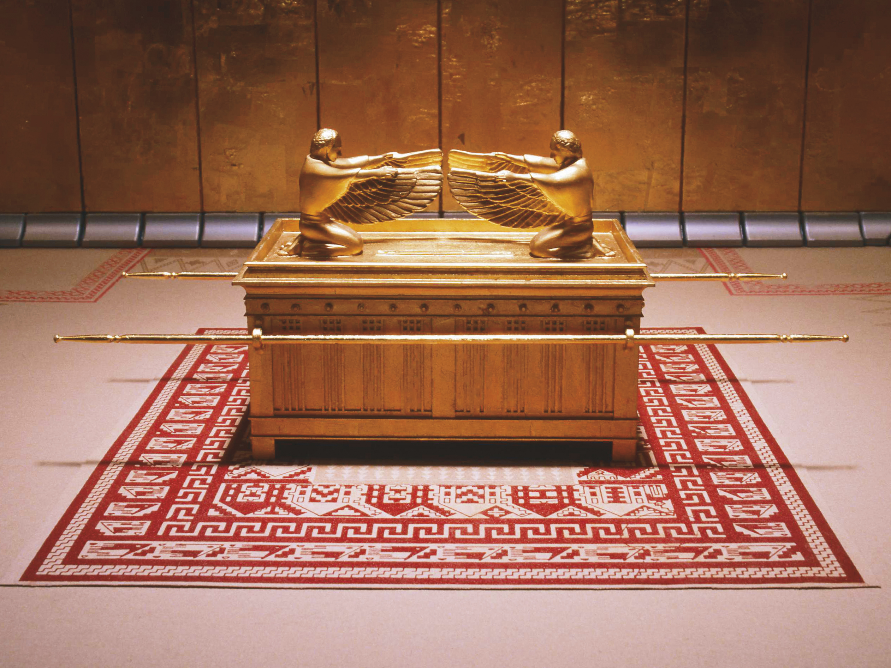
What did the elders of Israel believe the ark could do?
What does their statement that “it may save us” show about their faith in the Lord?

Slide 6
1 Samuel 4:10-11
10 ¶ And the Philistines fought, and Israel was smitten, and they fled every man into his tent: and there was a very great slaughter; for there fell of Israel thirty thousand footmen.
11 And the ark of God was taken; and the two sons of Eli, Hophni and Phinehas, were slain.
What happened to the Israelite army?
Why do you think the Israelites were defeated even though they had the ark of the covenant with them?
What principles about receiving the Lord’s help can we learn from the Israelites’ mistakes?
In order to receive the Lord’s help, we must place our faith in Him and obey His commandments.
What are some things we can do to show the Lord that our faith is placed in Him?

Slide 7
1 Samuel 5-7
“The Philistines return the ark, and
the Israelites repent”

Slide 8
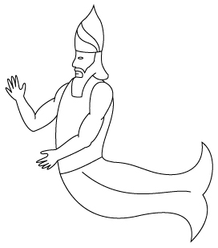
1 Samuel 5:3-5
3 ¶ And when they of Ashdod arose early on the morrow, behold, Dagon was fallen upon his face to the earth before the ark of the Lord. And they took Dagon, and set him in his place again.
4 And when they arose early on the morrow morning, behold, Dagon was fallen upon his face to the ground before the ark of the Lord; and the head of Dagon and both the palms of his hands were cut off upon the threshold; only the stump of Dagon was left to him.
5 Therefore neither the priests of Dagon, nor any that come into Dagon’s house, tread on the threshold of Dagon in Ashdod unto this day.
What happened to the image of Dagon?

Slide 9
1 Samuel 5:6
But the hand of the Lord was heavy upon them of Ashdod, and he destroyed them, and smote them with emerods, even Ashdod and the coasts thereof.
1 Samuel 7:3
¶ And Samuel spake unto all the house of Israel, saying, If ye do return unto the Lord with all your hearts, then put away the strange gods and Ashtaroth from among you, and prepare your hearts unto the Lord, and serve him only: and he will deliver you out of the hand of the Philistines.
What do you think it means to “return unto the Lord with all your hearts” (1 Samuel 7:3)?
To sincerely repent, we must …
What did Samuel teach the Israelites they must do to sincerely repent?
What can this teach us about repentance?

Slide 10
To sincerely repent, we must
forsake our sins …
1 Samuel 7:4-6
4 Then the children of Israel did put away Baalim and Ashtaroth, and served the Lord only.
5 And Samuel said, Gather all Israel to Mizpeh, and I will pray for you unto the Lord.
6 And they gathered together to Mizpeh, and drew water, and poured it out before the Lord, and fasted on that day, and said there, We have sinned against the Lord. And Samuel judged the children of Israel in Mizpeh.
What else did the Israelites do to repent?
To sincerely repent, we must forsake our sins
and confess them to the Lord.

Slide 11
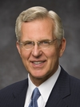
“Confessing and forsaking are powerful concepts. They are much more than a casual ‘I admit it; I’m sorry.’ Confession is a deep, sometimes agonizing acknowledgment of error and offense to God and man” (D. Todd Christofferson, “The Divine Gift of Repentance,” Ensign or Liahona, Nov. 2011, 40).
Elder
D. Todd Christofferson
How does confessing our sins help us turn away from sin and turn to God for forgiveness?
1 Samuel 7:9-13
9 ¶ And Samuel took a sucking lamb, and offered it for a burnt offering wholly unto the Lord: and Samuel cried unto the Lord for Israel; and the Lord heard him.
10 And as Samuel was offering up the burnt offering, the Philistines drew near to battle against Israel: but the Lord thundered with a great thunder on that day upon the Philistines, and discomfited them; and they were smitten before Israel.
11 And the men of Israel went out of Mizpeh, and pursued the Philistines, and smote them, until they came under Beth-car.
12 Then Samuel took a stone, and set it between Mizpeh and Shen, and called the name of it Eben-ezer, saying, Hitherto hath the Lord helped us.
13 ¶ So the Philistines were subdued, and they came no more into the coast of Israel: and the hand of the Lord was against the Philistines all the days of Samuel.

Slide 12
How was this battle different from the previous battles the Israelites fought against the Philistines?
How do you think the Israelites’ repentance affected the outcome of this battle?

