Slide 1
SEMINARY
Old Testament

Slide 2
LESSON 74
Joshua 6–10

Slide 3
Joshua 6
“Israel destroys the city of Jericho according to the Lord’s commands”

Slide 4
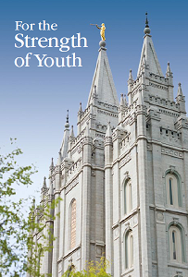
“You should not date until you are at least 16 years old. … Avoid going on frequent dates with the same person.”
“Do not disfigure yourself with tattoos or body piercings. Young women, if you desire to have your ears pierced, wear only one pair of earrings.”
“Honoring the Sabbath day includes attending all your Church meetings. … Sunday is not a day for shopping, recreation, or athletic events.”

Slide 5
What other commandments or standards has the Lord given that some may question the importance of?
Joshua 6:1-5.
1 Now Jericho was straitly shut up because of the children of Israel: none went out, and none came in.
2 And the Lord said unto Joshua, See, I have given into thine hand Jericho, and the king thereof, and the mighty men of valour.
3 And ye shall compass the city, all ye men of war, and go round about the city once. Thus shalt thou do six days.
4 And seven priests shall bear before the ark seven trumpets of rams’ horns: and the seventh day ye shall compass the city seven times, and the priests shall blow with the trumpets.
5 And it shall come to pass, that when they make a long blast with the ram’s horn, and when ye hear the sound of the trumpet, all the people shall shout with a great shout; and the wall of the city shall fall down flat, and the people shall ascend up every man straight before him.

Slide 6
What did the Lord instruct the Israelites to do?
What might seem strange to you about these instructions?
What do you think the soldiers could have been thinking that first night as they finished walking around Jericho and then returned to camp?
Joshua 6:12-15
12 ¶ And Joshua rose early in the morning, and the priests took up the ark of the Lord.
13 And seven priests bearing seven trumpets of rams’ horns before the ark of the Lord went on continually, and blew with the trumpets: and the armed men went before them; but the rearward came after the ark of the Lord, the priests going on, and blowing with the trumpets.
14 And the second day they compassed the city once, and returned into the camp: so they did six days.
15 And it came to pass on the seventh day, that they rose early about the dawning of the day, and compassed the city after the same manner seven times: only on that day they compassed the city seven times.
How did the Israelites show faith?

Slide 7
Joshua 6:16, 20-21, 27.
16 And it came to pass at the seventh time, when the priests blew with the trumpets, Joshua said unto the people, Shout; for the Lord hath given you the city.
20 So the people shouted when the priests blew with the trumpets: and it came to pass, when the people heard the sound of the trumpet, and the people shouted with a great shout, that the wall fell down flat, so that the people went up into the city, every man straight before him, and they took the city.
21 And they utterly destroyed all that was in the city, both man and woman, young and old, and ox, and sheep, and ass, with the edge of the sword.
27 So the Lord was with Joshua; and his fame was noised throughout all the country.
What happened because Joshua and the Israelites obeyed with exactness?
What principles would you have learned from this experience of following the Lord’s commands?
By having faith in the Lord, we are able to obey His commandments, even when we do not fully understand the purposes for them. As we act in faith to obey the Lord with exactness, He will be with us and help us do things we could not do by ourselves.

Slide 8
When have you shown faith in the Lord by choosing to obey His commandments even when you did not understand the purposes for them?
How have you felt blessed as you have sought to obey the Lord with exactness?

Slide 9
Joshua 6:17-19.
17 ¶ And the city shall be accursed, even it, and all that are therein, to the Lord: only Rahab the harlot shall live, she and all that are with her in the house, because she hid the messengers that we sent.
18 And ye, in any wise keep yourselves from the accursed thing, lest ye make yourselves accursed, when ye take of the accursed thing, and make the camp of Israel a curse, and trouble it.
19 But all the silver, and gold, and vessels of brass and iron, are consecrated unto the Lord: they shall come into the treasury of the Lord.
What did Joshua instruct the Israelites to do with all that was in Jericho?
What would be the consequence if an Israelite took something that was accursed?

Slide 10
Joshua 7
“Achan’s disobedience leads to Israel’s defeat by the people of Ai”

Slide 11
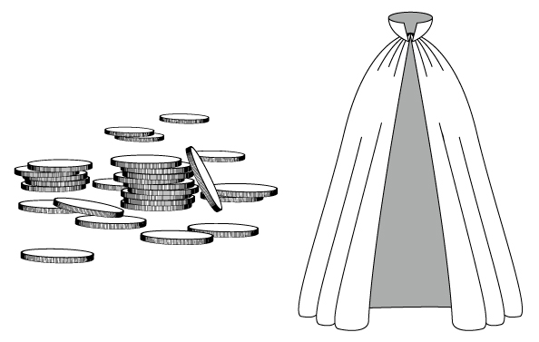
What might you have wanted to do if you saw some valuable items in Jericho?
Joshua 7:1
But the children of Israel committed a trespass in the accursed thing: for Achan, the son of Carmi, the son of Zabdi, the son of Zerah, of the tribe of Judah, took of the accursed thing: and the anger of the Lord was kindled against the children of Israel.
What choice did Achan make? What was wrong with his choice?

Slide 12
Joshua 7:2-5
2 And Joshua sent men from Jericho to Ai, which is beside Beth-aven, on the east side of Beth-el, and spake unto them, saying, Go up and view the country. And the men went up and viewed Ai.
3 And they returned to Joshua, and said unto him, Let not all the people go up; but let about two or three thousand men go up and smite Ai; and make not all the people to labour thither; for they are but few.
4 So there went up thither of the people about three thousand men: and they fled before the men of Ai.
5 And the men of Ai smote of them about thirty and six men: for they chased them from before the gate even unto Shebarim, and smote them in the going down: wherefore the hearts of the people melted, and became as water.
Why did the Israelites send fewer soldiers against the city of Ai than they sent against Jericho?
How many Israelites died in the battle against the men of Ai?

Slide 13
Joshua 7:11-12
11 Israel hath sinned, and they have also transgressed my covenant which I commanded them: for they have even taken of the accursed thing, and have also stolen, and dissembled also, and they have put it even among their own stuff.
12 Therefore the children of Israel could not stand before their enemies, but turned their backs before their enemies, because they were accursed: neither will I be with you any more, except ye destroy the accursed from among you.
Why could Israel “not stand before their enemies” (verse 12)?
How did Achan’s choice affect the rest of the children of Israel?
What principle can we learn from this account about the consequences of choosing to disobey the Lord?
If we choose to disobey the commandments, it brings negative consequences upon ourselves and others.

Slide 14
Joshua 7:13
Up, sanctify the people, and say, Sanctify yourselves against to morrow: for thus saith the Lord God of Israel, There is an accursed thing in the midst of thee, O Israel: thou canst not stand before thine enemies, until ye take away the accursed thing from among you.
What did the Lord command the Israelites to do?
Joshua 7:19-21
19 And Joshua said unto Achan, My son, give, I pray thee, glory to the Lord God of Israel, and make confession unto him; and tell me now what thou hast done; hide it not from me.
20 And Achan answered Joshua, and said, Indeed I have sinned against the Lord God of Israel, and thus and thus have I done:
21 When I saw among the spoils a goodly Babylonish garment, and two hundred shekels of silver, and a wedge of gold of fifty shekels weight, then I coveted them, and took them; and, behold, they are hid in the earth in the midst of my tent, and the silver under it.

Slide 15
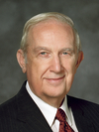
What truth can we learn from Joshua’s words to Achan that applies to us today?
We cannot hide our sins from the Lord.
“Do not take comfort in the fact that your transgressions are not known by others. That is like an ostrich with his head buried in the sand. He sees only darkness and feels comfortably hidden. In reality he is ridiculously conspicuous. Likewise our every act is seen by our Father in Heaven and His Beloved Son” (Richard G. Scott, “Finding Forgiveness,” Ensign, May 1995, 77).
Elder
Richard G. Scott
How can understanding that we cannot hide our sins from the Lord affect our choices?

Slide 16
Joshua 8-10
“The Lord helps Israel defeat the people of Ai and the Amorites”

Slide 17
Joshua 10:42
And all these kings and their land did Joshua take at one time, because the Lord God of Israel fought for Israel.

