Slide 1
SEMINARY
Old Testament

Slide 2
LESSON 157
Zechariah 9-11
“Zechariah prophesies that the Messiah will come to Jerusalem and be rejected by His people”

Slide 3
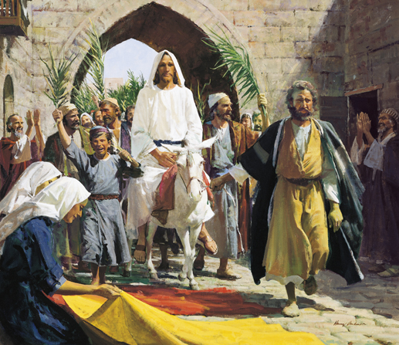
LESSON 157
Why do you think the people in this picture are rejoicing?
Zechariah 9:9
¶ Rejoice greatly, O daughter of Zion; shout, O daughter of Jerusalem: behold, thy King cometh unto thee: he is just, and having salvation; lowly, and riding upon an ass, and upon a colt the foal of an ass.
Why did the people of Jerusalem rejoice?
What might have been significant about Jesus Christ entering Jerusalem riding a donkey rather than a large, majestic horse?

Slide 4
LESSON 157
Zechariah 9:10-12
10 And I will cut off the chariot from Ephraim, and the horse from Jerusalem, and the battle bow shall be cut off: and he shall speak peace unto the heathen: and his dominion shall be from sea even to sea, and from the river even to the ends of the earth.
11 As for thee also, by the blood of thy covenant I have sent forth thy prisoners out of the pit wherein is no water.
12 ¶ Turn you to the strong hold, ye prisoners of hope: even to day do I declare that I will render double unto thee;
Why did some of you not notice the picture?
Why might some people today not find Jesus Christ and His gospel?
What will the Lord do for “the heathen”?
In what ways might Jesus Christ speak or bring peace to “the heathen”?
What makes it possible for the prisoners to be freed?

Slide 5
LESSON 157
Elder Bruce R. McConkie of the Quorum of the Twelve Apostles:
“‘By the blood of thy covenant’﻿—that is, because of the gospel covenant, which is efficacious because of the shedding of the blood of Christ﻿—‘I have sent forth thy prisoners out of the pit wherein is no water.’ (Zech. 9:11–16.) ‘Wherein is no water’﻿—how aptly and succinctly this crystallizes the thought that the saving water, which is baptism, is an earthly ordinance and cannot be performed by spirit beings while they dwell in the spirit world” (The Promised Messiah: The First Coming of Christ [1978], 241).
What are the prisoners delivered from?
What makes their deliverance possible?
How would you summarize the truth we learn from Zechariah 9:11?
Because of the Atonement of Jesus Christ, salvation is available to all mankind, and those who have died without having been baptized can be freed from spirit prison.

Slide 6
LESSON 157
Elder D. Todd Christofferson of the Quorum of the Twelve Apostles:
“While yet in life, Jesus prophesied that He would also preach to the dead. Peter tells us this happened in the interval between the Savior’s Crucifixion and Resurrection (see 1 Peter 3:18–19). President Joseph F. Smith … witnessed in vision that the Savior visited the spirit world and ‘from among the righteous [spirits], he organized his forces and appointed messengers, clothed with power and authority, and commissioned them to go forth and carry the light of the gospel to them that were in darkness. …
“‘These were taught faith in God, repentance from sin, vicarious baptism for the remission of sins, [and] the gift of the Holy Ghost by the laying on of hands’ (D&C 138:30, 33). …
“… Jesus Christ is the divine Redeemer of all mankind. His grace and promises reach even those who in life do not find Him. Because of Him, the prisoners shall indeed go free” (“Why Do We Baptize for the Dead?” New Era, Mar. 2009, 2, 5).
How can we help our deceased ancestors receive the ordinances necessary for salvation?
What feelings have you had as you have performed family history and temple work?

Slide 7
LESSON 157
Zechariah 12-14
“Jesus Christ will deliver Jerusalem from the nations that will gather to fight against it”

Slide 8
LESSON 157
In what ways will the Second Coming of Jesus Christ be different from His mortal ministry?
Zechariah 12:2-3
2 Behold, I will make Jerusalem a cup of trembling unto all the people round about, when they shall be in the siege both against Judah and against Jerusalem.
3 ¶ And in that day will I make Jerusalem a burdensome stone for all people: all that burden themselves with it shall be cut in pieces, though all the people of the earth be gathered together against it.
Whom would all nations gather against in this battle?
Zechariah 12:8-9
8 In that day shall the Lord defend the inhabitants of Jerusalem; and he that is feeble among them at that day shall be as David; and the house of David shall be as God, as the angel of the Lord before them.
9 ¶ And it shall come to pass in that day, that I will seek to destroy all the nations that come against Jerusalem.
What will the Lord do for the people of Jerusalem?

Slide 9
LESSON 157
Zechariah 14:3-6
3 Then shall the Lord go forth, and fight against those nations, as when he fought in the day of battle.
4 ¶ And his feet shall stand in that day upon the mount of Olives, which is before Jerusalem on the east, and the mount of Olives shall cleave in the midst thereof toward the east and toward the west, and there shall be a very great valley; and half of the mountain shall remove toward the north, and half of it toward the south.
5 And ye shall flee to the valley of the mountains; for the valley of the mountains shall reach unto Azal: yea, ye shall flee, like as ye fled from before the earthquake in the days of Uzziah king of Judah: and the Lord my God shall come, and all the saints with thee.
6 And one shall say unto him, What are these wounds in thine hands? Then he shall answer, Those with which I was wounded in the house of my friends.
What will Jesus Christ do to deliver His people?
What will the Jews notice about Jesus Christ’s appearance when He comes to deliver them from their enemies?

Slide 10
LESSON 157
Doctrine and Covenants 45:51-52
51 And then shall the Jews look upon me and say: What are these wounds in thine hands and in thy feet?
52 Then shall they know that I am the Lord; for I will say unto them: These wounds are the wounds with which I was wounded in the house of my friends. I am he who was lifted up. I am Jesus that was crucified. I am the Son of God.
What will the Jews realize at the Second Coming?
At the Second Coming, the Jews at Jerusalem will recognize Jesus Christ as the Messiah.
What do you think this moment will be like for the Jews?

Slide 11
LESSON 157
Zechariah 14:6–9
6 And it shall come to pass in that day, that the light shall not be clear, nor dark:
7 But it shall be one day which shall be known to the Lord, not day, nor night: but it shall come to pass, that at evening time it shall be light.
8 And it shall be in that day, that living waters shall go out from Jerusalem; half of them toward the former sea, and half of them toward the hinder sea: in summer and in winter shall it be.
9 And the Lord shall be king over all the earth: in that day shall there be one Lord, and his name one.
What do we learn about Jesus Christ in verse 9?
Jesus Christ will be King over all the earth.
How can we benefit now from knowing that one day Jesus Christ will reign over all the earth?

Slide 12
LESSON 157

