Slide 1
SEMINARY
Old Testament

Slide 2
LESSON 154
Nahum, Habakkuk, Zephaniah

Slide 3
LESSON 154
Nahum 1-3
“Nahum prophesies of the downfall of Nineveh, the capital city of Assyria”

Slide 4
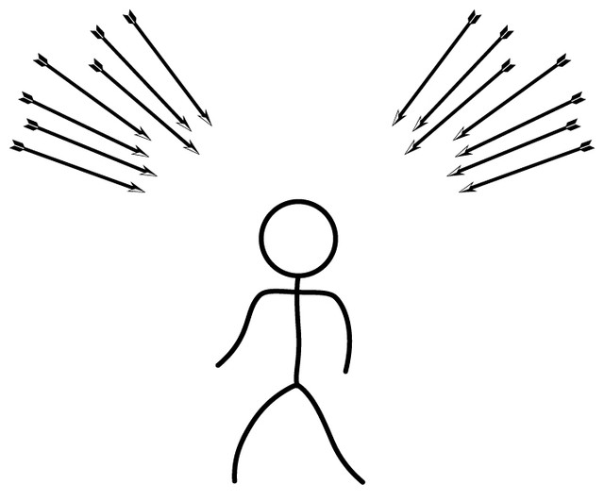
LESSON 154
What are some of the evils and perils that threaten us in our day?

Slide 5
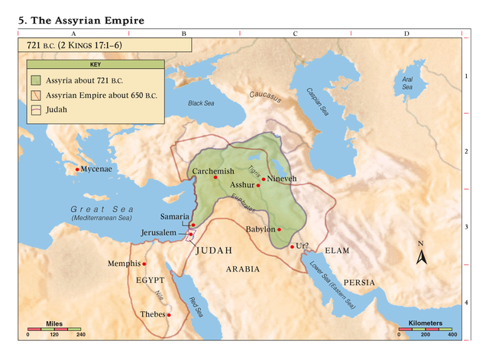
LESSON 154
Nahum 1:1-8.
1 The burden of Nineveh. The book of the vision of Nahum the Elkoshite.
2 God is jealous, and the Lord revengeth; the Lord revengeth, and is furious; the Lord will take vengeance on his adversaries, and he reserveth wrath for his enemies.
3 The Lord is slow to anger, and great in power, and will not at all acquit the wicked: the Lord hath his way in the whirlwind and in the storm, and the clouds are the dust of his feet.
4 He rebuketh the sea, and maketh it dry, and drieth up all the rivers: Bashan languisheth, and Carmel, and the flower of Lebanon languisheth.
5 The mountains quake at him, and the hills melt, and the earth is burned at his presence, yea, the world, and all that dwell therein.
6 Who can stand before his indignation? and who can abide in the fierceness of his anger? his fury is poured out like fire, and the rocks are thrown down by him.
7 The Lord is good, a strong hold in the day of trouble; and he knoweth them that trust in him.
8 But with an overrunning flood he will make an utter end of the place thereof, and darkness shall pursue his enemies.
How did the Lord feel about Nineveh?
Why do you think the Lord was angry with the people of Nineveh?

Slide 6
LESSON 154
What will the Lord be for those who trust Him?
The Lord is a stronghold in the day of trouble, and He knows those who trust Him
What does it mean to trust in the Lord?
Nahum 1:15
Behold upon the mountains the feet of him that bringeth good tidings, that publisheth peace! O Judah, keep thy solemn feasts, perform thy vows: for the wicked shall no more pass through thee; he is utterly cut off.
What was Nahum’s counsel to the people?
How might the observance of these feasts and rituals help the people develop trust in the Lord so they could be protected by Him?

Slide 7
LESSON 154
Habakkuk 1-3
“Habakkuk wonders at the power of the Lord and the coming destruction of Jerusalem”

Slide 8
LESSON 154
Habakkuk 3:17-19
17 ¶ Although the fig tree shall not blossom, neither shall fruit be in the vines; the labour of the olive shall fail, and the fields shall yield no meat; the flock shall be cut off from the fold, and there shall be no herd in the stalls:
18 Yet I will rejoice in the Lord, I will joy in the God of my salvation.
19 The Lord God is my strength, and he will make my feet like hinds’ feet, and he will make me to walk upon mine high places. To the chief singer on my stringed instruments.
How do these verses relate to the principle written on the board?

Slide 9
LESSON 154
Zephaniah 1-3
“Zephaniah prophesies of the destruction of Jerusalem as a type of the Second Coming”

Slide 10
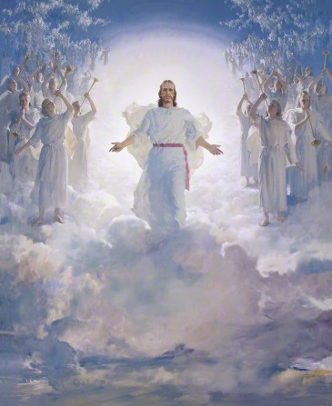
LESSON 154
School test
Date
Audition
Performance
Athletic meet or game
Mission
Patriarchal blessing
General conference
Zephaniah 1:14-15
14 The great day of the Lord is near, it is near, and hasteth greatly, even the voice of the day of the Lord: the mighty man shall cry there bitterly.
15 That day is a day of wrath, a day of trouble and distress, a day of wasteness and desolation, a day of darkness and gloominess, a day of clouds and thick darkness,

Slide 11
LESSON 154
Zephaniah 2:1–3
1 Gather yourselves together, yea, gather together, O nation not desired;
2 Before the decree bring forth, before the day pass as the chaff, before the fierce anger of the Lord come upon you, before the day of the Lord’s anger come upon you.
3 Seek ye the Lord, all ye meek of the earth, which have wrought his judgment; seek righteousness, seek meekness: it may be ye shall be hid in the day of the Lord’s anger.
What did the Lord counsel the Jews to do before the day of the Lord’s anger?
What is meekness?
President Gordon B. Hinckley:
What principle do these verses teach that can help us prepare for the day of the Lord’s Second Coming?
“Meekness implies a spirit of gratitude as opposed to an attitude of self-sufficiency, an acknowledgment of a greater power beyond oneself, a recognition of God, and an acceptance of his commandments” (“With All Thy Getting Get Understanding,” Ensign, Aug. 1988, 3–4).
How do you think we can be more righteous and meek?

Slide 12
LESSON 154
Zephaniah 3:17-20
17 The Lord thy God in the midst of thee is mighty; he will save, he will rejoice over thee with joy; he will rest in his love, he will joy over thee with singing.
18 I will gather them that are sorrowful for the solemn assembly, who are of thee, to whom the reproach of it was a burden.
19 Behold, at that time I will undo all that afflict thee: and I will save her that halteth, and gather her that was driven out; and I will get them praise and fame in every land where they have been put to shame.
20 At that time will I bring you again, even in the time that I gather you: for I will make you a name and a praise among all people of the earth, when I turn back your captivity before your eyes, saith the Lord.
What did the Lord promise to those who wait upon Him faithfully?
What principle can we learn from these verses about waiting upon the Lord?
If we will wait upon the Lord, He will deliver us from our sorrows, afflictions, and captivity.

Slide 13
LESSON 154

