Slide 1
SEMINARY
Old Testament

Slide 2
LESSON 152
Jonah

Slide 3
LESSON 152
Jonah 1–2
“Jonah flees from the Lord’s call to
preach in Nineveh”

Slide 4
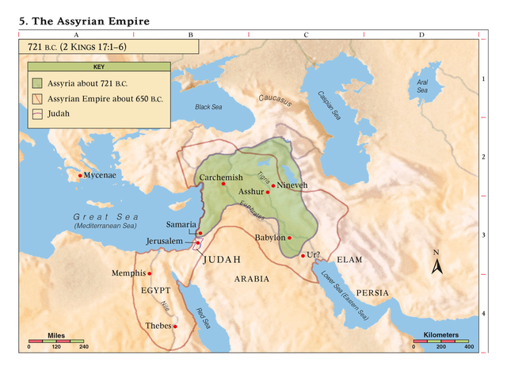
LESSON 152
Jonah 1:1-2
1 Now the word of the Lord came unto Jonah the son of Amittai, saying,
2 Arise, go to Nineveh, that great city, and cry against it; for their wickedness is come up before me.
What did the Lord call Jonah to do?
What thoughts or feelings might you have had about preaching in Nineveh?

Slide 5
LESSON 152
Jonah 1:3
But Jonah rose up to flee unto Tarshish from the presence of the Lord, and went down to Joppa; and he found a ship going to Tarshish: so he paid the fare thereof, and went down into it, to go with them unto Tarshish from the presence of the Lord.
What did Jonah do?
How do you think he felt about his call to go to Nineveh?
Jonah 1:4
¶ But the Lord sent out a great wind into the sea, and there was a mighty tempest in the sea, so that the ship was like to be broken.

Slide 6
LESSON 152
Jonah 1:10-12
10 Then were the men exceedingly afraid, and said unto him, Why hast thou done this? For the men knew that he fled from the presence of the Lord, because he had told them.
11 ¶ Then said they unto him, What shall we do unto thee, that the sea may be calm unto us? for the sea wrought, and was tempestuous.
12 And he said unto them, Take me up, and cast me forth into the sea; so shall the sea be calm unto you: for I know that for my sake this great tempest is upon you.
What was the cause of the storm?
What did Jonah instruct the men on the boat to do?
What can we learn from this account about trying to avoid the responsibilities the Lord has given us?
The Lord will hold us accountable for the responsibilities He gives us, even if we try to avoid them.
What are some responsibilities the Lord gives people today that they may try to avoid?
What are some consequences that can come to individuals who try to avoid these responsibilities?

Slide 7
LESSON 152
Jonah 2:1-9.
1 Then Jonah prayed unto the Lord his God out of the fish’s belly,
2 And said, I cried by reason of mine affliction unto the Lord, and he heard me; out of the belly of hell cried I, and thou heardest my voice.
3 For thou hadst cast me into the deep, in the midst of the seas; and the floods compassed me about: all thy billows and thy waves passed over me.
4 Then I said, I am cast out of thy sight; yet I will look again toward thy holy temple.
5 The waters compassed me about, even to the soul: the depth closed me round about, the weeds were wrapped about my head.
6 I went down to the bottoms of the mountains; the earth with her bars was about me for ever: yet hast thou brought up my life from corruption, O Lord my God.
7 When my soul fainted within me I remembered the Lord: and my prayer came in unto thee, into thine holy temple.
8 They that observe lying vanities forsake their own mercy.
9 But I will sacrifice unto thee with the voice of thanksgiving; I will pay that that I have vowed. Salvation is of the Lord.
What phrases indicate Jonah’s willingness to repent?

Slide 8
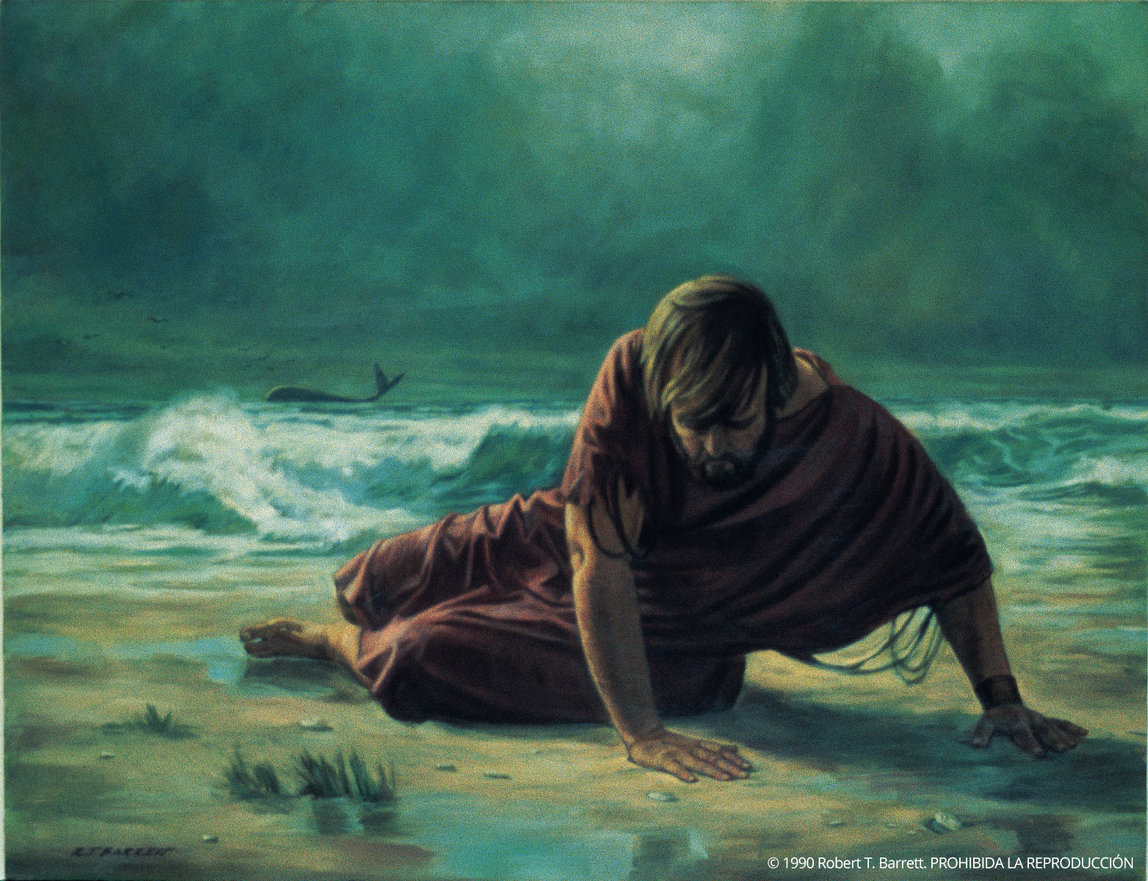
LESSON 152
How do these phrases indicate Jonah’s willingness to repent?

Slide 9
LESSON 152
Jonah 2:10
¶ And the Lord spake unto the fish, and it vomited out Jonah upon the dry land.
How did the Lord show mercy to Jonah?
What principle can we learn from this chapter?
If we cry unto the Lord and repent when we have sinned, we can receive His mercy.
President James E. Faust of the First Presidency:
“Many of us backslide, many stumble, and I believe firmly in the gospel of the second chance. But the gospel of the second chance means that having once been found weak, … thereafter we become steadfast” (“Stand Up and Be Counted,” Ensign, Feb. 1982, 71).

Slide 10
LESSON 152
Jonah 3
“Jonah fulfills his mission to Nineveh”

Slide 11
LESSON 152
Jonah 3:1-4
1 And the word of the Lord came unto Jonah the second time, saying,
2 Arise, go unto Nineveh, that great city, and preach unto it the preaching that I bid thee.
3 So Jonah arose, and went unto Nineveh, according to the word of the Lord. Now Nineveh was an exceeding great city of three days’ journey.
4 And Jonah began to enter into the city a day’s journey, and he cried, and said, Yet forty days, and Nineveh shall be overthrown.
How did the Lord give Jonah a second chance?
How did Jonah respond this time?
Jonah 3:5, 10
5 ¶ So the people of Nineveh believed God, and proclaimed a fast, and put on sackcloth, from the greatest of them even to the least of them.
10 ¶ And God saw their works, that they turned from their evil way; and God repented of the evil, that he had said that he would do unto them; and he did it not.
What did the people of Nineveh do?

Slide 12
LESSON 152
Jonah 4
“Jonah learns about God’s love for the
people of Nineveh”

Slide 13
LESSON 152
Jonah 4:1-3
1 But it displeased Jonah exceedingly, and he was very angry.
2 And he prayed unto the Lord, and said, I pray thee, O Lord, was not this my saying, when I was yet in my country? Therefore I fled before unto Tarshish: for I knew that thou art a gracious God, and merciful, slow to anger, and of great kindness, and repentest thee of the evil.
3 Therefore now, O Lord, take, I beseech thee, my life from me; for it is better for me to die than to live.
What feelings did Jonah have?
What blessing did Jonah want to deny the people of Nineveh after he had received that same blessing?

Slide 14
LESSON 152
Jonah 4:10–11
10 Then said the Lord, Thou hast had pity on the gourd, for the which thou hast not laboured, neither madest it grow; which came up in a night, and perished in a night:
11 And should not I spare Nineveh, that great city, wherein are more than six score thousand persons that cannot discern between their right hand and their left hand; and also much cattle?
How did the Lord use Jonah’s experience with the gourd to teach Jonah about His feelings for the people of Nineveh?
What must we do to become like the Lord?
To become like the Lord, we must learn to love and forgive others as He does.

Slide 15
LESSON 152
Elder Dieter F. Uchtdorf of the First Presidency:
“When it comes to hating, gossiping, ignoring, ridiculing, holding grudges, or wanting to cause harm, please apply the following:
“Stop it!
“It’s that simple. We simply have to stop judging others and replace judgmental thoughts and feelings with a heart full of love for God and His children. …
“Because we all depend on the mercy of God, how can we deny to others any measure of the grace we so desperately desire for ourselves? …
“The pure love of Christ can remove the scales of resentment and wrath from our eyes, allowing us to see others the way our Heavenly Father sees us: as flawed and imperfect mortals who have potential and worth far beyond our capacity to imagine. Because God loves us so much, we too must love and forgive each other” (“The Merciful Obtain Mercy,” Ensign or Liahona, May 2012, 75–76).
When have you tried to love and forgive as the Lord does? How were you blessed for doing so?

Slide 16
LESSON 152

