Slide 1
SEMINARY
Old Testament

Slide 2
LESSON 151
Obadiah

Slide 3
LESSON 151
Obadiah 1:1–16
“Obadiah prophesies of Edom’s
destruction”

Slide 4
LESSON 151
A young man is very intelligent and talented and feels that he can succeed in life without the Lord’s help.
A young woman continues to associate with a group of friends who appear to like her, despite her parents’ concern that these friends do not have her best interests in mind.
A young woman feels resentful when a classmate receives an award and recognition that she hoped to get.

Slide 5
LESSON 151
Obadiah 1:1,3-4
The vision of Obadiah. Thus saith the Lord God concerning Edom; We have heard a rumour from the Lord, and an ambassador is sent among the heathen, Arise ye, and let us rise up against her in battle.
3 ¶ The pride of thine heart hath deceived thee, thou that dwellest in the clefts of the rock, whose habitation is high; that saith in his heart, Who shall bring me down to the ground?
4 Though thou exalt thyself as the eagle, and though thou set thy nest among the stars, thence will I bring thee down, saith the Lord.
What had deceived the Edomites?
What had their pride led them to believe?
What did the Lord say He would do to the Edomites?
What can we learn from the Edomites about the danger of yielding to pride?
Yielding to pride can cause us to be deceived.
How is this an example of the ways in which pride can deceive us?
What are other examples of how yielding to pride can deceive and misguide us?

Slide 6
LESSON 151
“Pride is the great sin of self-elevation. …
“… It leads some to revel in their own perceived self-worth, accomplishments, talents, wealth, or position. They count these blessings as evidence of being ‘chosen,’ ‘superior,’ or ‘more righteous’ than others. …
“For others, pride turns to envy: they look bitterly at those who have better positions, more talents, or greater possessions than they do. They seek to hurt, diminish, and tear down others in a misguided and unworthy attempt at self-elevation. When those they envy stumble or suffer, they secretly cheer” (“Pride and the Priesthood,” Ensign or Liahona, Nov. 2010, 56).
How can elevating ourselves above others cause us to be deceived?
What can we do to avoid being deceived into putting ourselves above others?

Slide 7
LESSON 151
Obadiah 1:10
¶ For thy violence against thy brother Jacob shame shall cover thee, and thou shalt be cut off for ever.
Why would Edom be cut off?
How do you think the phrase “thy brother Jacob” might have helped the Edomites understand how they should have treated the Israelites?
Obadiah 1:11–14.
11 In the day that thou stoodest on the other side, in the day that the strangers carried away captive his forces, and foreigners entered into his gates, and cast lots upon Jerusalem, even thou wast as one of them.
12 But thou shouldest not have looked on the day of thy brother in the day that he became a stranger; neither shouldest thou have rejoiced over the children of Judah in the day of their destruction; neither shouldest thou have spoken proudly in the day of distress.
13 Thou shouldest not have entered into the gate of my people in the day of their calamity; yea, thou shouldest not have looked on their affliction in the day of their calamity, nor have laid hands on their substance in the day of their calamity;
14 Neither shouldest thou have stood in the crossway, to cut off those of his that did escape; neither shouldest thou have delivered up those of his that did remain in the day of distress.
What had the Edomites done to the Jews and their property?

Slide 8
LESSON 151
Obadiah 1:15
For the day of the Lord is near upon all the heathen: as thou hast done, it shall be done unto thee: thy reward shall return upon thine own head.
How would you explain the meaning of the phrase “as thou hast done, it shall be done unto thee”?
What truth can we learn from verse 15 about how the Lord will judge us?
the Lord will judge us according to the way we have judged and treated others.
Alma 41:14
Therefore, my son, see that you are merciful unto your brethren; deal justly, judge righteously, and do good continually; and if ye do all these things then shall ye receive your reward; yea, ye shall have mercy restored unto you again; ye shall have justice restored unto you again; ye shall have a righteous judgment restored unto you again; and ye shall have good rewarded unto you again.
How do Alma’s teachings relate to the truth on the board?

Slide 9
LESSON 151
Obadiah 1:17-21
“Obadiah prophesies of the Israelites’ return to their lands and of saviors on Mount Zion”

Slide 10
LESSON 151
Have you ever used one of these objects to help save someone?
Has anyone ever used one of these objects to save you?
Obadiah 1:17
¶ But upon mount Zion shall be deliverance, and there shall be holiness; and the house of Jacob shall possess their possessions.
What did Obadiah prophesy would happen upon Mount Zion?

Slide 11
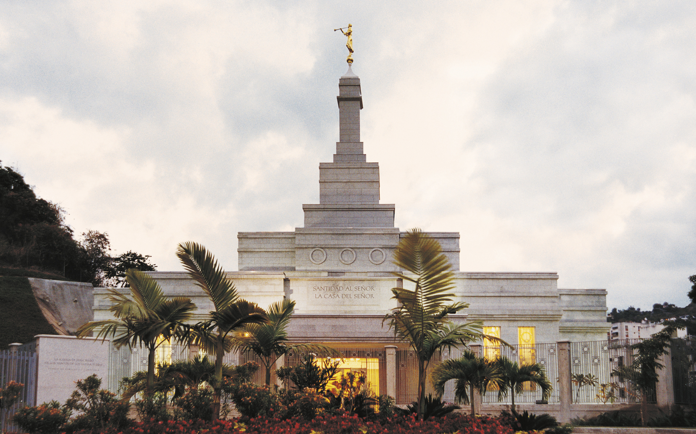
LESSON 151
Obadiah 1:21
And saviours shall come up on mount Zion to judge the mount of Esau; and the kingdom shall be the Lord’s.
Who did Obadiah prophesy would come upon Mount Zion?

Slide 12
LESSON 151
Prophet Joseph Smith.
“But how are they to become saviors on Mount Zion? By building their temples, erecting their baptismal fonts, and going forth and receiving all the ordinances, baptisms, confirmations, washings, anointings, ordinations and sealing powers upon their heads, in behalf of all their progenitors who are dead, and redeem them that they may come forth in the first resurrection and be exalted to thrones of glory with them” (Teachings of Presidents of the Church: Joseph Smith [2007], 473).
How can we become saviors on Mount Zion?
We become saviors on Mount Zion as we identify our deceased family members and perform ordinances for them in the temple.
How are we like the Savior when we participate in family history and temple work?

Slide 13
LESSON 151
What are your thoughts and feelings about helping to rescue and save family members who died without the blessings or ordinances of the gospel?
What blessings have you and your family received by acting as saviors in behalf of your ancestors?

Slide 14
LESSON 151

