Slide 1
SEMINARY
Old Testament

Slide 2
LESSON 147
Daniel 6–12

Slide 3
LESSON 147
Daniel 6
“Daniel is cast into the den of lions for praying to God, and God delivers him”

Slide 4
LESSON 147
At age 19, Joseph F. Smith returned home from his first mission and joined a wagon train. One evening, a group of “drunken men rode into the camp on horseback, cursing and swearing and threatening to kill any ‘Mormons’ that came within their path.” Joseph’s “first thought was to … seek shelter in the trees and in flight [as others had done]. Then the thought came to him, ‘Why should I run from these fellows?’ With that thought in mind he boldly marched up … to the campfire.” One of the drunk men, waving a pistol and pointing at Joseph, “demanded in a loud, angry voice, ‘Are you a “Mormon”?’
“Without a moment of hesitation and looking the ruffian in the eye, Joseph F. Smith boldly answered, ‘Yes, siree; dyed in the wool; true blue, through and through.’”
Joseph’s response “completely disarmed the belligerent man, and in his bewilderment, he grasped [Joseph] by the hand and said:
“‘Well, you are the [blankety-blank] pleasantest man I ever met! Shake hands, young fellow, I am glad to see a man that stands up for his convictions’” (Life of Joseph F. Smith, comp. Joseph Fielding Smith [1938], 187–89).
How did Joseph F. Smith show his faithfulness to the Lord? What about his situation might have made it difficult to do so?
What are some situations today in which it might be difficult to show your faithfulness to the Lord?

Slide 5
LESSON 147
Daniel 6:1–3
1 It pleased Darius to set over the kingdom an hundred and twenty princes, which should be over the whole kingdom;
2 And over these three presidents; of whom Daniel was first: that the princes might give accounts unto them, and the king should have no damage.
3 Then this Daniel was preferred above the presidents and princes, because an excellent spirit was in him; and the king thought to set him over the whole realm.
How did Darius organize his government? What position was Daniel given?
Why was Daniel preferred above the other leaders?
What do you think it means that Daniel had “an excellent spirit” (Daniel 6:3)?

Slide 6
LESSON 147
Daniel 6:6–9
6 Then these presidents and princes assembled together to the king, and said thus unto him, King Darius, live for ever.
7 All the presidents of the kingdom, the governors, and the princes, the counsellors, and the captains, have consulted together to establish a royal statute, and to make a firm decree, that whosoever shall ask a petition of any God or man for thirty days, save of thee, O king, he shall be cast into the den of lions.
8 Now, O king, establish the decree, and sign the writing, that it be not changed, according to the law of the Medes and Persians, which altereth not.
9 Wherefore king Darius signed the writing and the decree.
What was the decree that the other leaders convinced Darius to establish?
Who did these leaders say had consulted together to propose this decree?
How did this give Darius a false impression?
What problem did this decree create for Daniel?

Slide 7
LESSON 147
Daniel 6:10
¶ Now when Daniel knew that the writing was signed, he went into his house; and his windows being open in his chamber toward Jerusalem, he kneeled upon his knees three times a day, and prayed, and gave thanks before his God, as he did aforetime.
How did Daniel respond to this decree?
What action indicates that Daniel was not afraid to be seen or heard obeying the Lord instead of the king’s decree?
How would Daniel have been unfaithful to the Lord if he had obeyed the king’s decree?

Slide 8
LESSON 147
Daniel 6:15–17
15 Then these men assembled unto the king, and said unto the king, Know, O king, that the law of the Medes and Persians is, That no decree nor statute which the king establisheth may be changed.
16 Then the king commanded, and they brought Daniel, and cast him into the den of lions. Now the king spake and said unto Daniel, Thy God whom thou servest continually, he will deliver thee.
17 And a stone was brought, and laid upon the mouth of the den; and the king sealed it with his own signet, and with the signet of his lords; that the purpose might not be changed concerning Daniel.
What did Darius say to him?
What did the Lord do to deliver Daniel from the lions’ den?

Slide 9
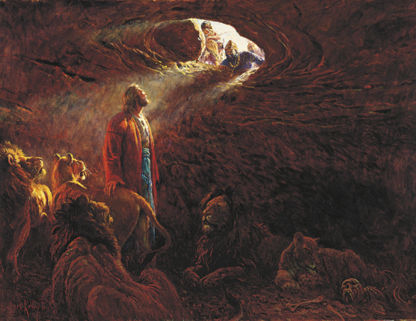
LESSON 147
What principle can we learn from Daniel’s example?
if we are continually faithful to the Lord, He will help us through challenges we may experience as a result of our faithfulness.
What do you think it means to be continually faithful to the Lord?

Slide 10
LESSON 147
Why would we choose to be faithful to the Lord if we knew we might experience some of these challenges as a result?
When has the Lord helped you or someone you know endure or overcome a challenge that came as a result of being faithful to Him?
Daniel 6:25-28
25 ¶ Then king Darius wrote unto all people, nations, and languages, that dwell in all the earth; Peace be multiplied unto you.
26 I make a decree, That in every dominion of my kingdom men tremble and fear before the God of Daniel: for he is the living God, and steadfast for ever, and his kingdom that which shall not be destroyed, and his dominion shall be even unto the end.
27 He delivereth and rescueth, and he worketh signs and wonders in heaven and in earth, who hath delivered Daniel from the power of the lions.
28 So this Daniel prospered in the reign of Darius, and in the reign of Cyrus the Persian.
Who was affected by Daniel’s fearless decision to obey the Lord?
What can happen if we are not afraid to show our obedience to the Lord?
if we are not afraid to show our obedience to the Lord, we can help others believe in Him.

Slide 11
LESSON 147
Daniel 7–12
“Daniel sees visions of the future, including events in the last days”

Slide 12
LESSON 147
Daniel 7:9
¶ I beheld till the thrones were cast down, and the Ancient of days did sit, whose garment was white as snow, and the hair of his head like the pure wool: his throne was like the fiery flame, and his wheels as burning fire.
What did Daniel see would happen to the “thrones,” or worldly governments?
Daniel 7:18, 27
18 But the saints of the most High shall take the kingdom, and possess the kingdom for ever, even for ever and ever.
27 And the kingdom and dominion, and the greatness of the kingdom under the whole heaven, shall be given to the people of the saints of the most High, whose kingdom is an everlasting kingdom, and all dominions shall serve and obey him.
Who will reign with the Savior in His kingdom on earth?
How can understanding that Jesus Christ will reign on the earth with His saints influence your decision to be faithful to Him?

Slide 13
LESSON 147

