Slide 1
SEMINARY
Old Testament

Slide 2
LESSON 145
Daniel 2

Slide 3
LESSON 145
Daniel 2:1–23
“Daniel prays about King Nebuchadnezzar’s dream, and Heavenly Father reveals it to him”

Slide 4
LESSON 145
What is an aspect of your life in which you need Heavenly Father’s help?
Daniel 2:1–3
1 And in the second year of the reign of Nebuchadnezzar Nebuchadnezzar dreamed dreams, wherewith his spirit was troubled, and his sleep brake from him.
2 Then the king commanded to call the magicians, and the astrologers, and the sorcerers, and the Chaldeans, for to shew the king his dreams. So they came and stood before the king.
3 And the king said unto them, I have dreamed a dream, and my spirit was troubled to know the dream.
What troubled Nebuchadnezzar?
What did he ask his wise men to do?

Slide 5
LESSON 145
c
Daniel 2:4–11.
4 Then spake the Chaldeans to the king in Syriack, O king, live for ever: tell thy servants the dream, and we will shew the interpretation.
5 The king answered and said to the Chaldeans, The thing is gone from me: if ye will not make known unto me the dream, with the interpretation thereof, ye shall be cut in pieces, and your houses shall be made a dunghill.
6 But if ye shew the dream, and the interpretation thereof, ye shall receive of me gifts and rewards and great honour: therefore shew me the dream, and the interpretation thereof.
7 They answered again and said, Let the king tell his servants the dream, and we will shew the interpretation of it.
8 The king answered and said, I know of certainty that ye would gain the time, because ye see the thing is gone from me.
9 But if ye will not make known unto me the dream, there is but one decree for you: for ye have prepared lying and corrupt words to speak before me, till the time be changed: therefore tell me the dream, and I shall know that ye can shew me the interpretation thereof.
10 ¶ The Chaldeans answered before the king, and said, There is not a man upon the earth that can shew the king’s matter: therefore there is no king, lord, nor ruler, that asked such things at any magician, or astrologer, or Chaldean.
11 And it is a rare thing that the king requireth, and there is none other that can shew it before the king, except the gods, whose dwelling is not with flesh.
Why were the wise men troubled by the king’s request?
Why did the king not reveal the dream to his wise men?

Slide 6
LESSON 145
Daniel 2:14–19
14 ¶ Then Daniel answered with counsel and wisdom to Arioch the captain of the king’s guard, which was gone forth to slay the wise men of Babylon:
15 He answered and said to Arioch the king’s captain, Why is the decree so hasty from the king? Then Arioch made the thing known to Daniel.
16 Then Daniel went in, and desired of the king that he would give him time, and that he would shew the king the interpretation.
17 Then Daniel went to his house, and made the thing known to Hananiah, Mishael, and Azariah, his companions:
18 That they would desire mercies of the God of heaven concerning this secret; that Daniel and his fellows should not perish with the rest of the wise men of Babylon.
19 ¶ Then was the secret revealed unto Daniel in a night vision. Then Daniel blessed the God of heaven.
What did Daniel and his friends do?
What happened after Daniel and his friends sought Heavenly Father’s help?
What principle can we learn from Daniel and his friends about receiving the wisdom and help we need from God?

Slide 7
LESSON 145
Daniel 2:24–49
“Daniel reveals to King Nebuchadnezzar the dream and its interpretation”

Slide 8
LESSON 145
Daniel 2:26–30
26 The king answered and said to Daniel, whose name was Belteshazzar, Art thou able to make known unto me the dream which I have seen, and the interpretation thereof?
27 Daniel answered in the presence of the king, and said, The secret which the king hath demanded cannot the wise men, the astrologers, the magicians, the soothsayers, shew unto the king;
28 But there is a God in heaven that revealeth secrets, and maketh known to the king Nebuchadnezzar what shall be in the latter days. Thy dream, and the visions of thy head upon thy bed, are these;
29 As for thee, O king, thy thoughts came into thy mind upon thy bed, what should come to pass hereafter: and he that revealeth secrets maketh known to thee what shall come to pass.
30 But as for me, this secret is not revealed to me for any wisdom that I have more than any living, but for their sakes that shall make known the interpretation to the king, and that thou mightest know the thoughts of thy heart.
How does what Daniel told the king compare to what the wise men had told the king (see verses 10–11)?
What is one reason why Heavenly Father reveals truth to His prophets?
Heavenly Father reveals truth to His prophets in order to bless His children.

Slide 9
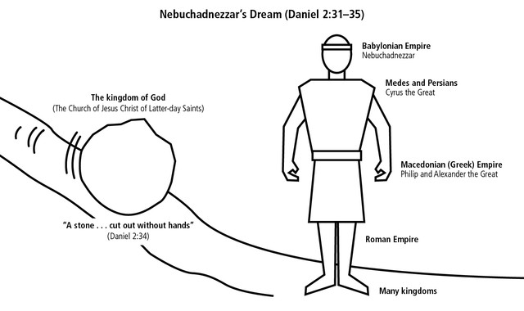
LESSON 145
What did the stone do to the image? What did the stone become?

Slide 10
LESSON 145
Daniel 2:37-40
37 Thou, O king, art a king of kings: for the God of heaven hath given thee a kingdom, power, and strength, and glory.
38 And wheresoever the children of men dwell, the beasts of the field and the fowls of the heaven hath he given into thine hand, and hath made thee ruler over them all. Thou art this head of gold.
39 And after thee shall arise another kingdom inferior to thee, and another third kingdom of brass, which shall bear rule over all the earth.
40 And the fourth kingdom shall be strong as iron: forasmuch as iron breaketh in pieces and subdueth all things: and as iron that breaketh all these, shall it break in pieces and bruise.
Who did Daniel say the head represented?
What else did Daniel reveal about the king’s dream?
What did Daniel reveal about the legs of iron?

Slide 11
LESSON 145
Daniel 2:44-45
The Church of Jesus Christ of Latter-day Saints
44 And in the days of these kings shall the God of heaven set up a kingdom, which shall never be destroyed: and the kingdom shall not be left to other people, but it shall break in pieces and consume all these kingdoms, and it shall stand for ever.
45 Forasmuch as thou sawest that the stone was cut out of the mountain without hands, and that it brake in pieces the iron, the brass, the clay, the silver, and the gold; the great God hath made known to the king what shall come to pass hereafter: and the dream is certain, and the interpretation thereof sure.
What did Daniel prophesy that God would do during the time of many kingdoms?
What does the stone cut out of the mountain without hands represent?
What has the Lord “committed unto man” that enables the gospel to fill the whole earth?
What might the phrase “cut out of the mountain without hands” mean in verse 45?
What do you think the phrase “it shall stand for ever” means in verse 44?

Slide 12
LESSON 145
Daniel 2:46–49
46 ¶ Then the king Nebuchadnezzar fell upon his face, and worshipped Daniel, and commanded that they should offer an oblation and sweet odours unto him.
47 The king answered unto Daniel, and said, Of a truth it is, that your God is a God of gods, and a Lord of kings, and a revealer of secrets, seeing thou couldest reveal this secret.
48 Then the king made Daniel a great man, and gave him many great gifts, and made him ruler over the whole province of Babylon, and chief of the governors over all the wise men of Babylon.
49 Then Daniel requested of the king, and he set Shadrach, Meshach, and Abed-nego, over the affairs of the province of Babylon: but Daniel sat in the gate of the king.
What did Nebuchadnezzar do for Daniel and his friends?

Slide 13
LESSON 145

