Slide 1
SEMINARY
Old Testament

Slide 2
LESSON 142
Ezekiel 37

Slide 3
LESSON 142
Ezekiel 37:1-14
“Ezekiel is shown examples of restoration﻿—the Resurrection and the gathering of the house of Israel”

Slide 4
LESSON 142
How has the condition of each object changed over time?
How might these objects represent what can happen to us physically or spiritually over time?
Ezekiel 37:1-2
1 The hand of the Lord was upon me, and carried me out in the spirit of the Lord, and set me down in the midst of the valley which was full of bones,
2 And caused me to pass by them round about: and, behold, there were very many in the open valley; and, lo, they were very dry.
What did Ezekiel see in the middle of the valley?
What questions would you have if you were in the midst of the valley of dry bones?

Slide 5
LESSON 142
Ezekiel 37:3
3 And he said unto me, Son of man, can these bones live? And I answered, O Lord God, thou knowest.
4 Again he said unto me, Prophesy upon these bones, and say unto them, O ye dry bones, hear the word of the Lord.
5 Thus saith the Lord God unto these bones; Behold, I will cause breath to enter into you, and ye shall live:
6 And I will lay sinews upon you, and will bring up flesh upon you, and cover you with skin, and put breath in you, and ye shall live; and ye shall know that I am the Lord.
What did the Lord say He would do with the bones?
Ezekiel 37:7-10
7 So I prophesied as I was commanded: and as I prophesied, there was a noise, and behold a shaking, and the bones came together, bone to his bone.
8 And when I beheld, lo, the sinews and the flesh came up upon them, and the skin covered them above: but there was no breath in them.
9 Then said he unto me, Prophesy unto the wind, prophesy, son of man, and say to the wind, Thus saith the Lord God; Come from the four winds, O breath, and breathe upon these slain, that they may live.
10 So I prophesied as he commanded me, and the breath came into them, and they lived, and stood up upon their feet, an exceeding great army.
What happened to the bones Ezekiel saw?

Slide 6
LESSON 142
Ezekiel 37:11-14.
11 ¶ Then he said unto me, Son of man, these bones are the whole house of Israel: behold, they say, Our bones are dried, and our hope is lost: we are cut off for our parts.
12 Therefore prophesy and say unto them, Thus saith the Lord God; Behold, O my people, I will open your graves, and cause you to come up out of your graves, and bring you into the land of Israel.
13 And ye shall know that I am the Lord, when I have opened your graves, O my people, and brought you up out of your graves,
14 And shall put my spirit in you, and ye shall live, and I shall place you in your own land: then shall ye know that I the Lord have spoken it, and performed it, saith the Lord.
What did the Lord say He would do for the house of Israel?
What doctrines about resurrection can we learn from these verses?
Jesus Christ has the power to resurrect us and when we are resurrected, our bodies will be made whole again.

Slide 7
LESSON 142
Elder Shayne M. Bowen of the Seventy:
“Remember as you attended the funeral of your loved one the feelings in your heart as you drove away from the cemetery and looked back to see that solitary casket﻿—wondering if your heart would break.
“I testify that because of Him, even our Savior, Jesus Christ, those feelings of sorrow, loneliness, and despair will one day be swallowed up in a fulness of joy. I testify that we can depend on Him and when He said:
“‘I will not leave you comfortless: I will come to you.
“‘Yet a little while, and the world seeth me no more; but ye see me: because I live, ye shall live also’ [John 14:18–19]. …
“I testify that on that bright, glorious morning of the First Resurrection, your loved ones and mine will come forth from the grave as promised by the Lord Himself and we will have a fulness of joy. Because He lives, they and we shall live also” (“Because I Live, Ye Shall Live Also,” Ensign or Liahona, Nov. 2012, 17).

Slide 8
LESSON 142
Ezekiel 37:15–28
“Ezekiel prophesies that the sticks of Judah and Joseph will be joined together”

Slide 9
LESSON 142
Ezekiel 37:15–17.
15 ¶ The word of the Lord came again unto me, saying,
16 Moreover, thou son of man, take thee one stick, and write upon it, For Judah, and for the children of Israel his companions: then take another stick, and write upon it, For Joseph, the stick of Ephraim, and for all the house of Israel his companions:
17 And join them one to another into one stick; and they shall become one in thine hand.
What did the Lord call the two sticks?
What is the stick of Judah?
What is the stick of Joseph?
What do you think it means that these two sticks or books of scripture “shall become one in thine hand” (verse 17)?

Slide 10
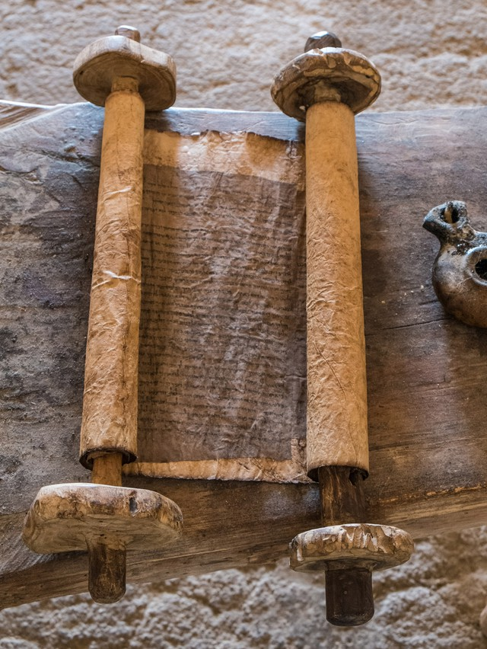
LESSON 142
1 Nephi 13:40
And the angel spake unto me, saying: These last records, which thou hast seen among the Gentiles, shall establish the truth of the first, which are of the twelve apostles of the Lamb, and shall make known the plain and precious things which have been taken away from them; and shall make known to all kindreds, tongues, and people, that the Lamb of God is the Son of the Eternal Father, and the Savior of the world; and that all men must come unto him, or they cannot be saved.
Based on what you have learned from Ezekiel 37:15–17 and 1 Nephi 13:40, what is the purpose of bringing together the Bible and the Book of Mormon?

Slide 11
LESSON 142
Ezekiel 37:17.
“They shall become one
in thine hand”

Slide 12
LESSON 142
President Boyd K. Packer of the Quorum of the Twelve Apostles
“The stick or record of Judah … and the stick or record of Ephraim … are now woven together in such a way that as you pore over one you are drawn to the other; as you learn from one you are enlightened by the other. They are indeed one in our hands. Ezekiel’s prophecy now stands fulfilled.
“With the passing of years, these scriptures will produce successive generations of faithful Christians who know the Lord Jesus Christ and are disposed to obey His will. …
“… The revelations will be opened to them as to no other in the history of the world. Into their hands now are placed the sticks of Joseph and of Judah. They will develop a gospel scholarship beyond that which their forebears could achieve. They will have the testimony that Jesus is the Christ and be competent to proclaim Him and to defend Him” (“Scriptures,” Ensign, Nov. 1982, 53).

Slide 13
LESSON 142

