Slide 1
SEMINARY
Old Testament

Slide 2
LESSON 139
Ezekiel 1–3

Slide 3
LESSON 139
Ezekiel 1
“Ezekiel sees the glory of God in vision”

Slide 4
LESSON 139
Elder Joseph B. Wirthlin of the Quorum of the Twelve Apostles.
“On December 26, 2004, a powerful earthquake struck off the coast of Indonesia, creating a deadly tsunami that killed more than 200,000 people. It was a terrible tragedy. In one day, millions of lives were forever changed.
“But there was one group of people who, although their village was destroyed, did not suffer a single casualty.
“The reason?
“They knew a tsunami was coming.
“The Moken people live in villages on islands off the coast of Thailand and Burma (Myanmar). A society of fishermen, their lives depend on the sea. For hundreds and perhaps thousands of years, their ancestors have studied the ocean, and they have passed their knowledge down from father to son.
“One thing in particular they were careful to teach was what to do when the ocean receded. According to their traditions, when that happened, the ‘Laboon’﻿—a wave that eats people﻿—would arrive soon after.
“When the elders of the village saw the dreaded signs, they shouted to everyone to run to high ground.
“Not everyone listened.
“One elderly fisherman said, ‘None of the kids believed me.’ In fact, his own daughter called him a liar. But the old fisherman would not relent until all had left the village and climbed to higher ground” (“Journey to Higher Ground,” Ensign or Liahona, Nov. 2005, 16).
Why do you think some people disbelieved the village elders’ warnings?
How do you think the people who disbelieved the warnings at first may have felt toward the village elders after the tsunami?

Slide 5
LESSON 139
Ezekiel 1:1, 3
1 Now it came to pass in the thirtieth year, in the fourth month, in the fifth day of the month, as I was among the captives by the river of Chebar, that the heavens were opened, and I saw visions of God.
3 The word of the Lord came expressly unto Ezekiel the priest, the son of Buzi, in the land of the Chaldeans by the river Chebar; and the hand of the Lord was there upon him.
What did Ezekiel see and experience while in captivity?
Ezekiel 1:26-28
26 ¶ And above the firmament that was over their heads was the likeness of a throne, as the appearance of a sapphire stone: and upon the likeness of the throne was the likeness as the appearance of a man above upon it.
27 And I saw as the colour of amber, as the appearance of fire round about within it, from the appearance of his loins even upward, and from the appearance of his loins even downward, I saw as it were the appearance of fire, and it had brightness round about.
28 As the appearance of the bow that is in the cloud in the day of rain, so was the appearance of the brightness round about. This was the appearance of the likeness of the glory of the Lord. And when I saw it, I fell upon my face, and I heard a voice of one that spake.
What words and phrases did Ezekiel use to describe the Lord and the throne He was sitting on?
Why do you think Ezekiel fell upon his face when He saw the Lord on His throne?

Slide 6
LESSON 139
Ezekiel 2-3
“The Lord calls Ezekiel to warn
the Israelites in exile”

Slide 7
LESSON 139
What entered into Ezekiel that helped him hear the Lord’s words?
What is the Spirit’s role in helping us hear and understand the Lord’s words?
Ezekiel 2:3-7
3 And he said unto me, Son of man, I send thee to the children of Israel, to a rebellious nation that hath rebelled against me: they and their fathers have transgressed against me, even unto this very day.
4 For they are impudent children and stiffhearted. I do send thee unto them; and thou shalt say unto them, Thus saith the Lord God.
5 And they, whether they will hear, or whether they will forbear, (for they are a rebellious house,) yet shall know that there hath been a prophet among them.
6 ¶ And thou, son of man, be not afraid of them, neither be afraid of their words, though briers and thorns be with thee, and thou dost dwell among scorpions: be not afraid of their words, nor be dismayed at their looks, though they be a rebellious house.
7 And thou shalt speak my words unto them, whether they will hear, or whether they will forbear: for they are most rebellious.
What did the Lord call Ezekiel to do?
What challenges would Ezekiel face as he taught them?
What can we learn from verse 7 about the role of a prophet?
prophets speak and teach the words the Lord has given them.

Slide 8
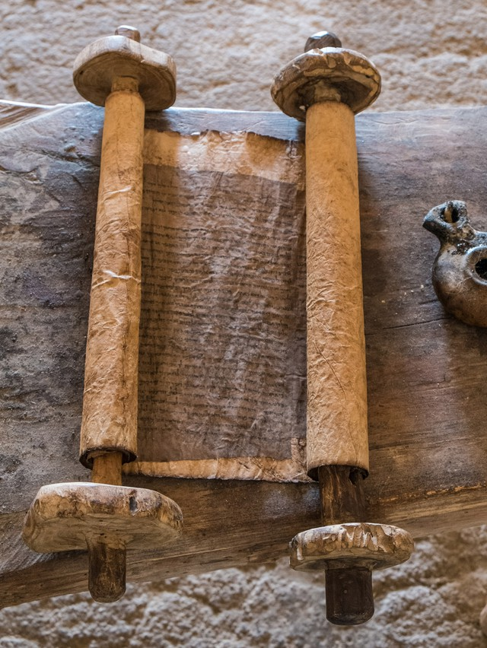
LESSON 139
Ezekiel 3:1-3
1 Moreover he said unto me, Son of man, eat that thou findest; eat this roll, and go speak unto the house of Israel.
2 So I opened my mouth, and he caused me to eat that roll.
3 And he said unto me, Son of man, cause thy belly to eat, and fill thy bowels with this roll that I give thee. Then did I eat it; and it was in my mouth as honey for sweetness.
What do you think eating the scroll represents?
How did Ezekiel describe the taste of the scroll?
Why do you think he would describe the scroll with God’s word written on it as sweet when it contained “lamentations, and mourning, and woe” (Ezekiel 2:10)?

Slide 9
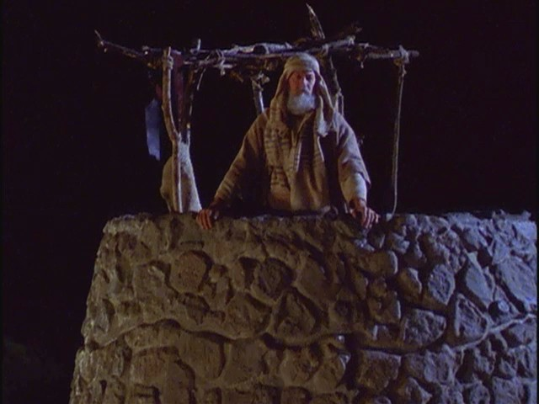
LESSON 139
Ezekiel 3:17
Son of man, I have made thee a watchman unto the house of Israel: therefore hear the word at my mouth, and give them warning from me.
What did the Lord liken Ezekiel to?
How are the responsibilities of a prophet similar to those of a watchman?
How might prophets be like watchmen for us?
If we heed the warnings of prophets, we can be prepared to face challenges and dangers that threaten us.

Slide 10
LESSON 139
President Henry B. Eyring of the
First Presidency:
“Because the Lord is kind, He calls servants to warn people of danger. That call to warn is made harder and more important by the fact that the warnings of most worth are about dangers that people don’t yet think are real” (“A Voice of Warning,” Ensign, Nov. 1998, 32).
Why are prophetic warnings so important for us to follow today?
What are some warnings prophets have given us recently?
How can following this prophetic warning protect you from danger?

Slide 11
LESSON 139
Ezekiel 3:18–21
18 When I say unto the wicked, Thou shalt surely die; and thou givest him not warning, nor speakest to warn the wicked from his wicked way, to save his life; the same wicked man shall die in his iniquity; but his blood will I require at thine hand.
19 Yet if thou warn the wicked, and he turn not from his wickedness, nor from his wicked way, he shall die in his iniquity; but thou hast delivered thy soul.
20 Again, When a righteous mandoth turn from his righteousness, and commit iniquity, and I lay a stumbling block before him, he shall die: because thou hast not given him warning, he shall die in his sin, and his righteousness which he hath done shall not be remembered; but his blood will I require at thine hand.
21 Nevertheless if thou warn the righteous man, that the righteous sin not, and he doth not sin, he shall surely live, because he is warned; also thou hast delivered thy soul.
What did the Lord say would happen to Ezekiel if he failed to warn the people?
What truth did the Lord emphasize to Ezekiel?
the Lord holds us accountable to fulfill the responsibilities He gives us.

Slide 12
LESSON 139

