Slide 1
SEMINARY
Old Testament

Slide 2
LESSON 134
Jeremiah 17–29

Slide 3
LESSON 134
Jeremiah 17
“Jeremiah stands in the entrance of the city and warns the people to heed the Sabbath day”

Slide 4
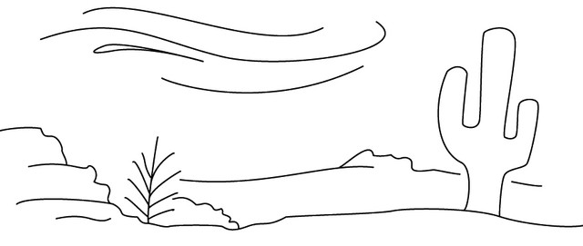
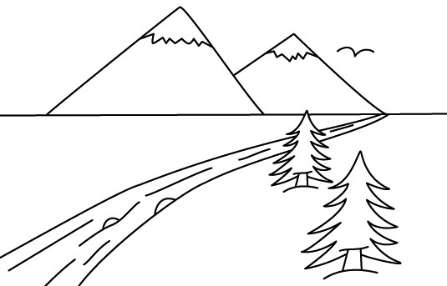
LESSON 134
Which would you choose? Why?

Slide 5
LESSON 134
Jeremiah 17:5–6
5 ¶ Thus saith the Lord; Cursed be the man that trusteth in man, and maketh flesh his arm, and whose heart departeth from the Lord.
6 For he shall be like the heath in the desert, and shall not see when good cometh; but shall inhabit the parched places in the wilderness, in a salt land and not inhabited.
What actions would bring about the curse of being like a scraggly tree in the desert?
What are some examples of the behaviors listed in verse 5? How might doing these things be similar to living in a desert?
Jeremiah 17:7–8
7 Blessed is the man that trusteth in the Lord, and whose hope the Lordis.
8 For he shall be as a tree planted by the waters, and that spreadeth out her roots by the river, and shall not see when heat cometh, but her leaf shall be green; and shall not be careful in the year of drought, neither shall cease from yielding fruit.
How did the Lord describe those who trust in Him?
What could the waters represent in this imagery?

Slide 6
LESSON 134
Jeremiah 17:21–22
21 Thus saith the Lord; Take heed to yourselves, and bear no burden on the sabbath day, nor bring it in by the gates of Jerusalem;
22 Neither carry forth a burden out of your houses on the sabbath day, neither do ye any work, but hallow ye the sabbath day, as I commanded your fathers.
What did the Lord command Jeremiah to tell the people?
Jeremiah 17:24–25
24 And it shall come to pass, if ye diligently hearken unto me, saith the Lord, to bring in no burden through the gates of this city on the sabbath day, but hallow the sabbath day, to do no work therein;
25 Then shall there enter into the gates of this city kings and princes sitting upon the throne of David, riding in chariots and on horses, they, and their princes, the men of Judah, and the inhabitants of Jerusalem: and this city shall remain for ever.
What did the Lord promise the Jews if they kept the Sabbath day holy?
What principle can we learn from these verses about keeping the Sabbath day holy?

Slide 7
LESSON 134
Jeremiah 18:1–19:13
“God uses the art of making pottery to teach Jeremiah that the Israelites can repent and avoid destruction”

Slide 8
LESSON 134
What can you do if you do not like the look of the pot you have just made?
Jeremiah 18:1–6
1 The word which came to Jeremiah from the Lord, saying,
2 Arise, and go down to the potter’s house, and there I will cause thee to hear my words.
3 Then I went down to the potter’s house, and, behold, he wrought a work on the wheels.
4 And the vessel that he made of clay was marred in the hand of the potter: so he made it again another vessel, as seemed good to the potter to make it.
5 Then the word of the Lord came to me, saying,
6 O house of Israel, cannot I do with you as this potter? saith the Lord. Behold, as the clay is in the potter’s hand, so are ye in mine hand, O house of Israel.
What did God teach Jeremiah about the house of Israel?

Slide 9
LESSON 134
Jeremiah 18:7–8
7 At what instant I shall speak concerning a nation, and concerning a kingdom, to pluck up, and to pull down, and to destroy it;
8 If that nation, against whom I have pronounced, turn from their evil, I will repent of the evil that I thought to do unto them.
What can the people do to be spared and reshaped by Him instead?
What can we do to allow God to mold or reshape our lives?
if we choose to repent, the Lord can mold and reshape our lives.

Slide 10
LESSON 134
Elder Hugh W. Pinnock of the Seventy.
“The Lord explained to Jeremiah that when we make mistakes, as ancient Israel was making, we can take what we have marred and begin again. The potter did not give up and throw the clay away, just because he had made a mistake. And we are not to feel hopeless and reject ourselves. Yes, our task is to overcome our problems, take what we have and are, and start again.
“Some of you who are listening have sinned in ways that are significant, embarrassing, and destructive. Yet, by following the simple instruction given by the Master, you can talk with your bishop, when necessary, and begin again as a renewed person” (“Beginning Again,” Ensign, May 1982, 12).
Which teachings from Elder Pinnock offer hope that we can overcome our mistakes and change for the better?

Slide 11
LESSON 134
Jeremiah 18:11–12
11 ¶ Now therefore go to, speak to the men of Judah, and to the inhabitants of Jerusalem, saying, Thus saith the Lord; Behold, I frame evil against you, and devise a device against you: return ye now every one from his evil way, and make your ways and your doings good.
12 And they said, There is no hope: but we will walk after our own devices, and we will every one do the imagination of his evil heart.
How did the Jews respond to Jeremiah’s message of hope?

Slide 12
LESSON 134
Jeremiah 19:14–28:17
“Jeremiah prophesies of false prophets and Judah’s coming destruction”

Slide 13
LESSON 134
Jeremiah 20:7–9
7 ¶ O Lord, thou hast deceived me, and I was deceived: thou art stronger than I, and hast prevailed: I am in derision daily, every one mocketh me.
8 For since I spake, I cried out, I cried violence and spoil; because the word of the Lord was made a reproach unto me, and a derision, daily.
9 Then I said, I will not make mention of him, nor speak any more in his name. But his word was in mine heart as a burning fire shut up in my bones, and I was weary with forbearing, and I could not stay.
Why did Jeremiah refuse to be silent even though at one time he wanted to stop declaring the Lord’s message?
What does it mean that the Lord’s word was like a “burning fire shut up in [Jeremiah’s] bones” (verse 9)?
What can we learn from Jeremiah’s example that can help us declare the gospel even when it is difficult?
As our testimonies of the gospel deepen, our desire to do the Lord’s will increases.

Slide 14
LESSON 134
Jeremiah 29
“Jeremiah writes a letter to the Israelite
captives in Babylon”

Slide 15
LESSON 134

