Slide 1
SEMINARY
Old Testament

Slide 2
LESSON 133
Jeremiah 7–16

Slide 3
LESSON 133
Jeremiah 7:1–16:13
“Jeremiah stands at the gate of the temple and calls the
people to repentance”

Slide 4
LESSON 133
__________________If I go to Church, pay my tithing, and do baptisms for the dead with my ward, then I will be ready for the Savior’s Second Coming.
__________________Partaking of the sacrament automatically cleanses me from sin each week.
Jeremiah 7:1-2
1 The word that came to Jeremiah from the Lord, saying,
2 Stand in the gate of the Lord’s house, and proclaim there this word, and say, Hear the word of the Lord, all ye of Judah, that enter in at these gates to worship the Lord.
Where was Jeremiah told to preach?

Slide 5
LESSON 133
Jeremiah 7:3–11
3 Thus saith the Lord of hosts, the God of Israel, Amend your ways and your doings, and I will cause you to dwell in this place.
4 Trust ye not in lying words, saying, The temple of the Lord, The temple of the Lord, The temple of the Lord, are these.
5 For if ye throughly amend your ways and your doings; if ye throughly execute judgment between a man and his neighbour;
6 If ye oppress not the stranger, the fatherless, and the widow, and shed not innocent blood in this place, neither walk after other gods to your hurt:
7 Then will I cause you to dwell in this place, in the land that I gave to your fathers, for ever and ever.
8 ¶ Behold, ye trust in lying words, that cannot profit.
9 Will ye steal, murder, and commit adultery, and swear falsely, and burn incense unto Baal, and walk after other gods whom ye know not;
10 And come and stand before me in this house, which is called by my name, and say, We are delivered to do all these abominations?
11 Is this house, which is called by my name, become a den of robbers in your eyes? Behold, even I have seen it, saith the Lord.
What did the Lord say to those who were coming to the temple? What does it mean to “amend your ways and your doings”?
What sins were the Jews committing?
How would you describe the spiritual condition of the people, even though they were coming to offer sacrifice at the temple?

Slide 6
LESSON 133
Jeremiah 7:21–23
21 ¶ Thus saith the Lord of hosts, the God of Israel; Put your burnt offerings unto your sacrifices, and eat flesh.
22 For I spake not unto your fathers, nor commanded them in the day that I brought them out of the land of Egypt, concerning burnt offerings or sacrifices:
23 But this thing commanded I them, saying, Obey my voice, and I will be your God, and ye shall be my people: and walk ye in all the ways that I have commanded you, that it may be well unto you.
What is more important to the Lord than sacrifices? What did He promise the people if they would obey His voice and walk in His ways?
What principles can we learn from the Lord’s words that Jeremiah delivered at the gate of the temple?
Religious worship and practices alone cannot save us if we do not keep God’s commandments; if we repent and obey God’s voice, then He will be our God and we will be His people; if we strive to walk in all of God’s ways, then it will be well with us.
What is the danger in believing that we can obey the Lord’s voice in some things but willfully disobey in others?

Slide 7
LESSON 133
Jeremiah 7:24–26, 30–31
Jeremiah 8:5–6, 12
Jeremiah 9:3–6
Jeremiah 11:9–10
Jeremiah 12:10–11; 13:27
Jeremiah 9:13-16
Jeremiah 15:5–7
Jeremiah 16:13

Slide 8
LESSON 133
Jeremiah 9:23–24
23 ¶ Thus saith the Lord, Let not the wise man glory in his wisdom, neither let the mighty man glory in his might, let not the rich man glory in his riches:
24 But let him that glorieth glory in this, that he understandeth and knoweth me, that I am the Lord which exercise lovingkindness, judgment, and righteousness, in the earth: for in these things I delight, saith the Lord.
What did the Lord want His people to glory in?
What truth can we learn from these verses?
It is more valuable to know the Lord and understand His attributes than to pursue worldly interests.
Why do you think it is more valuable to know the Lord and understand His attributes than to pursue worldly interests?

Slide 9
LESSON 133
Elder Neal A. Maxwell of the Quorum of the Twelve Apostles.
“The more we know of Jesus, the more we will love Him. The more we know of Jesus, the more we will trust Him. The more we know of Jesus, the more we will want to be like Him and to be with Him by becoming the manner of men and women that He wishes us to be (see 3 Ne. 27:27)” (“Plow in Hope,” Ensign, May 2001, 60).
In what ways are you seeking to better know the Savior and understand His attributes?

Slide 10
LESSON 133
Jeremiah 16:14–21
“Jeremiah prophesies of the gathering of the house of
Israel in the last days”

Slide 11
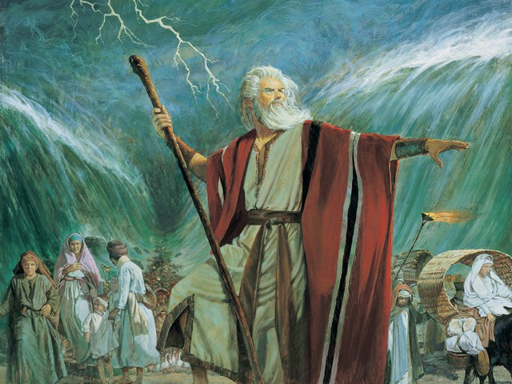
LESSON 133
What thoughts might you have had if you had been there to experience the parting of the Red Sea?
Jeremiah 16:14-15
14 ¶ Therefore, behold, the days come, saith the Lord, that it shall no more be said, The Lord liveth, that brought up the children of Israel out of the land of Egypt;
15 But, The Lord liveth, that brought up the children of Israel from the land of the north, and from all the lands whither he had driven them: and I will bring them again into their land that I gave unto their fathers.
What did Jeremiah prophesy that the Lord would do in the latter days?

Slide 12
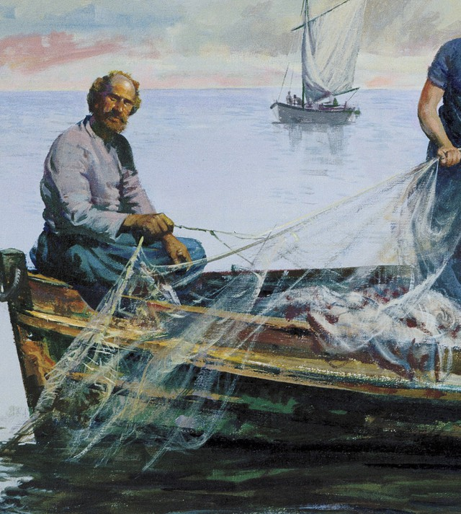
LESSON 133
Jeremiah 16:16
¶ Behold, I will send for many fishers, saith the Lord, and they shall fish them; and after will I send for many hunters, and they shall hunt them from every mountain, and from every hill, and out of the holes of the rocks.
Whom did the Lord say He would use to help gather Israel?
Who do you think the words fishers and hunters refer to?
What skills or characteristics do fishers and hunters need to be successful?
How are the skills and characteristics needed to fish and hunt similar to the skills and characteristics we need to be successful in missionary work?

Slide 13
LESSON 133
Jeremiah 16:21
Therefore, behold, I will this once cause them to know, I will cause them to know mine hand and my might; and they shall know that my name is The Lord.
What can we learn about our efforts to help others come to know the Lord?
As we labor diligently to share the gospel with others, we can help them come to know the power of the true and living God.
What are some examples of ways we can diligently seek to share the gospel with others?

Slide 14
LESSON 133

