Slide 1
SEMINARY
Old Testament

Slide 2
LESSON 128
Isaiah 53

Slide 3
LESSON 128
Isaiah 53:1-12
“Isaiah prophesies of the Atonement
of Jesus Christ”

Slide 4
LESSON 128
When might someone be tempted to say, “No one understands what I am going through”?
Isaiah 53:1-4
1 Who hath believed our report? and to whom is the arm of the Lord revealed?
2 For he shall grow up before him as a tender plant, and as a root out of a dry ground: he hath no form nor comeliness; and when we shall see him, there is no beauty that we should desire him.
3 He is despised and rejected of men; a man of sorrows, and acquainted with grief: and we hid as it were our faces from him; he was despised, and we esteemed him not.
4 ¶ Surely he hath borne our griefs, and carried our sorrows: yet we did esteem him stricken, smitten of God, and afflicted.
What words or phrases describe the difficulties Jesus Christ experienced during His life?
What might it mean that Jesus Christ grew up “as a root out of a dry ground”?
What do you think it means that “he hath no form nor comeliness; and … there is no beauty that we should desire him”?

Slide 5
LESSON 128
President Joseph Fielding Smith.
“There was nothing about [Jesus] to cause people to single him out. In appearance he was like men; and so it is expressed here by the prophet that he had no form or comeliness, that is, he was not so distinctive, so different from others that people would recognize him as the Son of God. He appeared as a mortal man” (Doctrines of Salvation, comp. Bruce R. McConkie, 3 vols. [1954–56], 1:23).
In what ways was Jesus Christ “despised and rejected of men” (verse 3) during His life?
Whose griefs and sorrows did Jesus Christ bear?
Jesus Christ bore our griefs and carried our sorrows.
Why is it important to know that the Savior has borne our griefs and carried our sorrows?

Slide 6
LESSON 128
Elder David. A. Bednar of the Quorum of the Twelve Apostles:
“There is no physical pain, no spiritual wound, no anguish of soul or heartache, no infirmity or weakness you or I ever confront in mortality that the Savior did not experience first. In a moment of weakness we may cry out, ‘No one knows what it is like. No one understands.’ But the Son of God perfectly knows and understands, for He has felt and borne our individual burdens. And because of His infinite and eternal sacrifice (see Alma 34:14), He has perfect empathy and can extend to us His arm of mercy. He can reach out, touch, succor, heal, and strengthen us” (“Bear Up Their Burdens with Ease,” Ensign or Liahona, May 2014, 90).

Slide 7
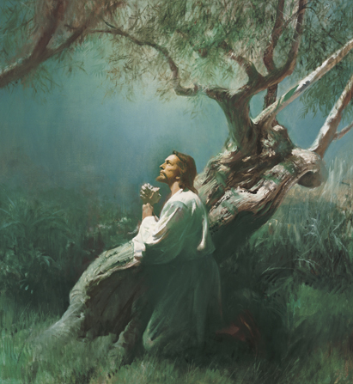
LESSON 128
Isaiah 53:5-6
5 But he was wounded for our transgressions, he was bruised for our iniquities: the chastisement of our peace was upon him; and with his stripes we are healed.
6 All we like sheep have gone astray; we have turned every one to his own way; and the Lord hath laid on him the iniquity of us all.
What else did Jesus Christ suffer for us?
How would you summarize Isaiah’s teachings in verse 5?
Jesus Christ suffered for the transgressions and iniquities of all so that we can be forgiven and healed.

Slide 8
LESSON 128
President James E. Faust of the First Presidency:
“He suffered so much pain, ‘indescribable anguish,’ and ‘overpowering torture’ [John Taylor, The Mediation and Atonement (1882), 150] for our sake. His profound suffering in the Garden of Gethsemane … caused Him ‘to tremble because of pain, and to bleed at every pore, and to suffer both body and spirit’ [D&C 19:18]. …
“… No one has ever suffered in any degree what He did” (“The Atonement: Our Greatest Hope,” Ensign,Nov. 2001, 19).
What feelings do you have for the Savior as you consider that He suffered the penalty for your sins? Why?

Slide 9
LESSON 128
Isaiah 53:7-11
7 He was oppressed, and he was afflicted, yet he opened not his mouth: he is brought as a lamb to the slaughter, and as a sheep before her shearers is dumb, so he openeth not his mouth.
8 He was taken from prison and from judgment: and who shall declare his generation? for he was cut off out of the land of the living: for the transgression of my people was he stricken.
9 And he made his grave with the wicked, and with the rich in his death; because he had done no violence, neither was any deceit in his mouth.
10 ¶ Yet it pleased the Lord to bruise him; he hath put him to grief: when thou shalt make his soul an offering for sin, he shall see his seed, he shall prolong his days, and the pleasure of the Lord shall prosper in his hand.
11 He shall see of the travail of his soul, and shall be satisfied: by his knowledge shall my righteous servant justify many; for he shall bear their iniquities.
What else did the Savior experience as part of His Atonement?
Whom did Jesus Christ see as He accomplished the Atonement?

Slide 10
LESSON 128
Isaiah 53:12
Therefore will I divide him a portion with the great, and he shall divide the spoil with the strong; because he hath poured out his soul unto death: and he was numbered with the transgressors; and he bare the sin of many, and made intercession for the transgressors.
What would Jesus Christ receive as a result of accomplishing the Atonement?
With whom will Jesus Christ share His inheritance?

Slide 11
LESSON 128

