Slide 1
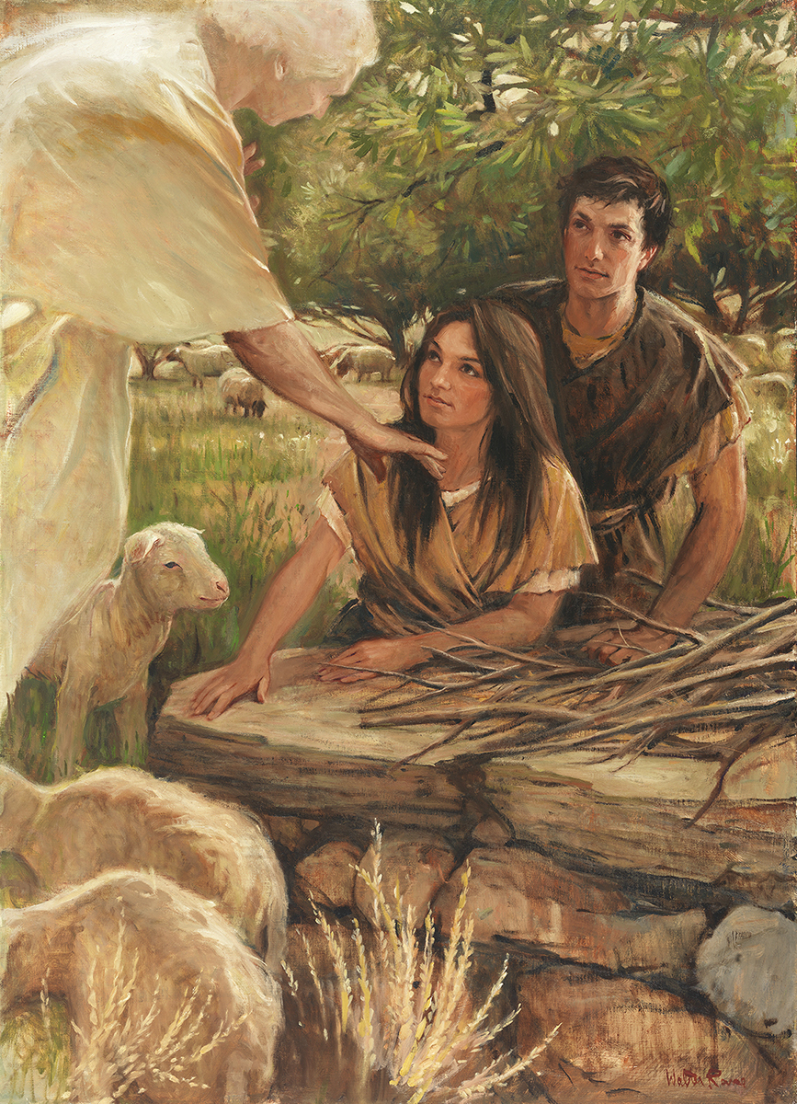
SEMINARY
Old Testament

Slide 2
LESSONS 111 & 112
Psalm 51
“David pleads for forgiveness and
the Lord’s help”

Slide 3
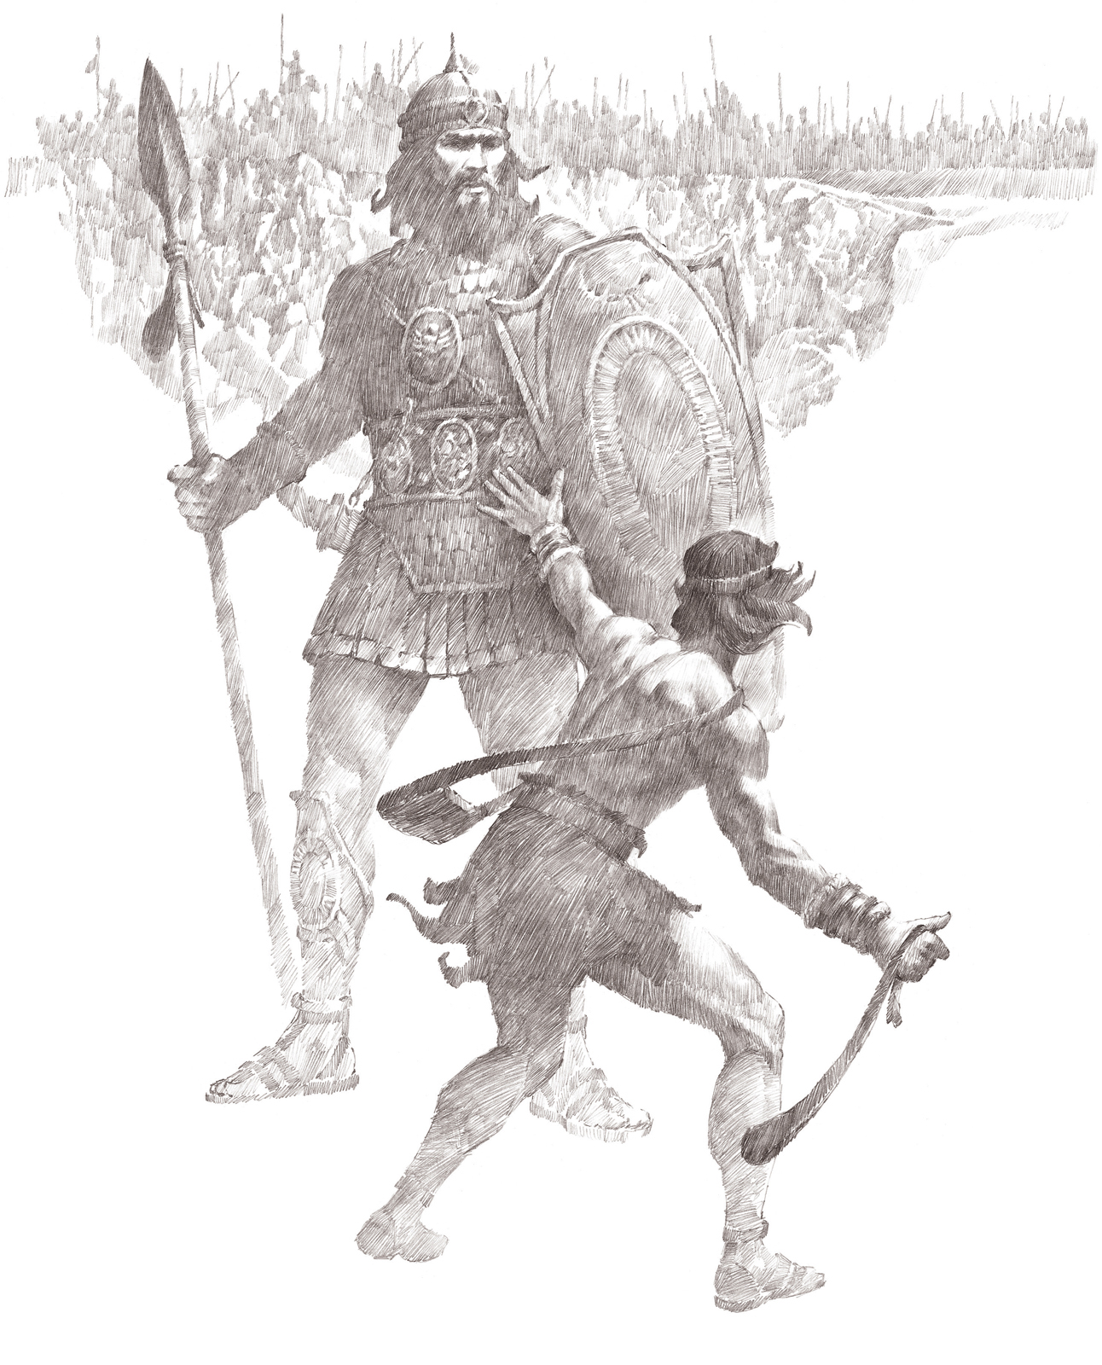
What are some of the great things David
did in his life?
What are some of the sinful things David
did in his life?

Slide 4
How did David demonstrate the attitude of one who is seeking to truly repent?
How did David describe forgiveness of sins?
What did David know about God that motivated him to seek forgiveness?
What are some of the answers to these questions that stood out to you?
What must we offer in order for the Savior to make us clean?
If we acknowledge our sins and offer the Savior a broken and contrite heart, then He can make us clean.
What does it mean to offer the Savior a broken and contrite heart?

Slide 5
Elder Bruce D. Porter (1952–2016) of the Seventy, Said:
“Those who have a broken heart and a contrite spirit are willing to do anything and everything that God asks of them, without resistance or resentment. We cease doing things our way and learn to do them God’s way instead. In such a condition of submissiveness, the Atonement can take effect and true repentance can occur”
How can we tell if we have a broken heart and a contrite spirit?

Slide 6
Psalm 119
“The Lord blesses those who
keep His laws”

Slide 7
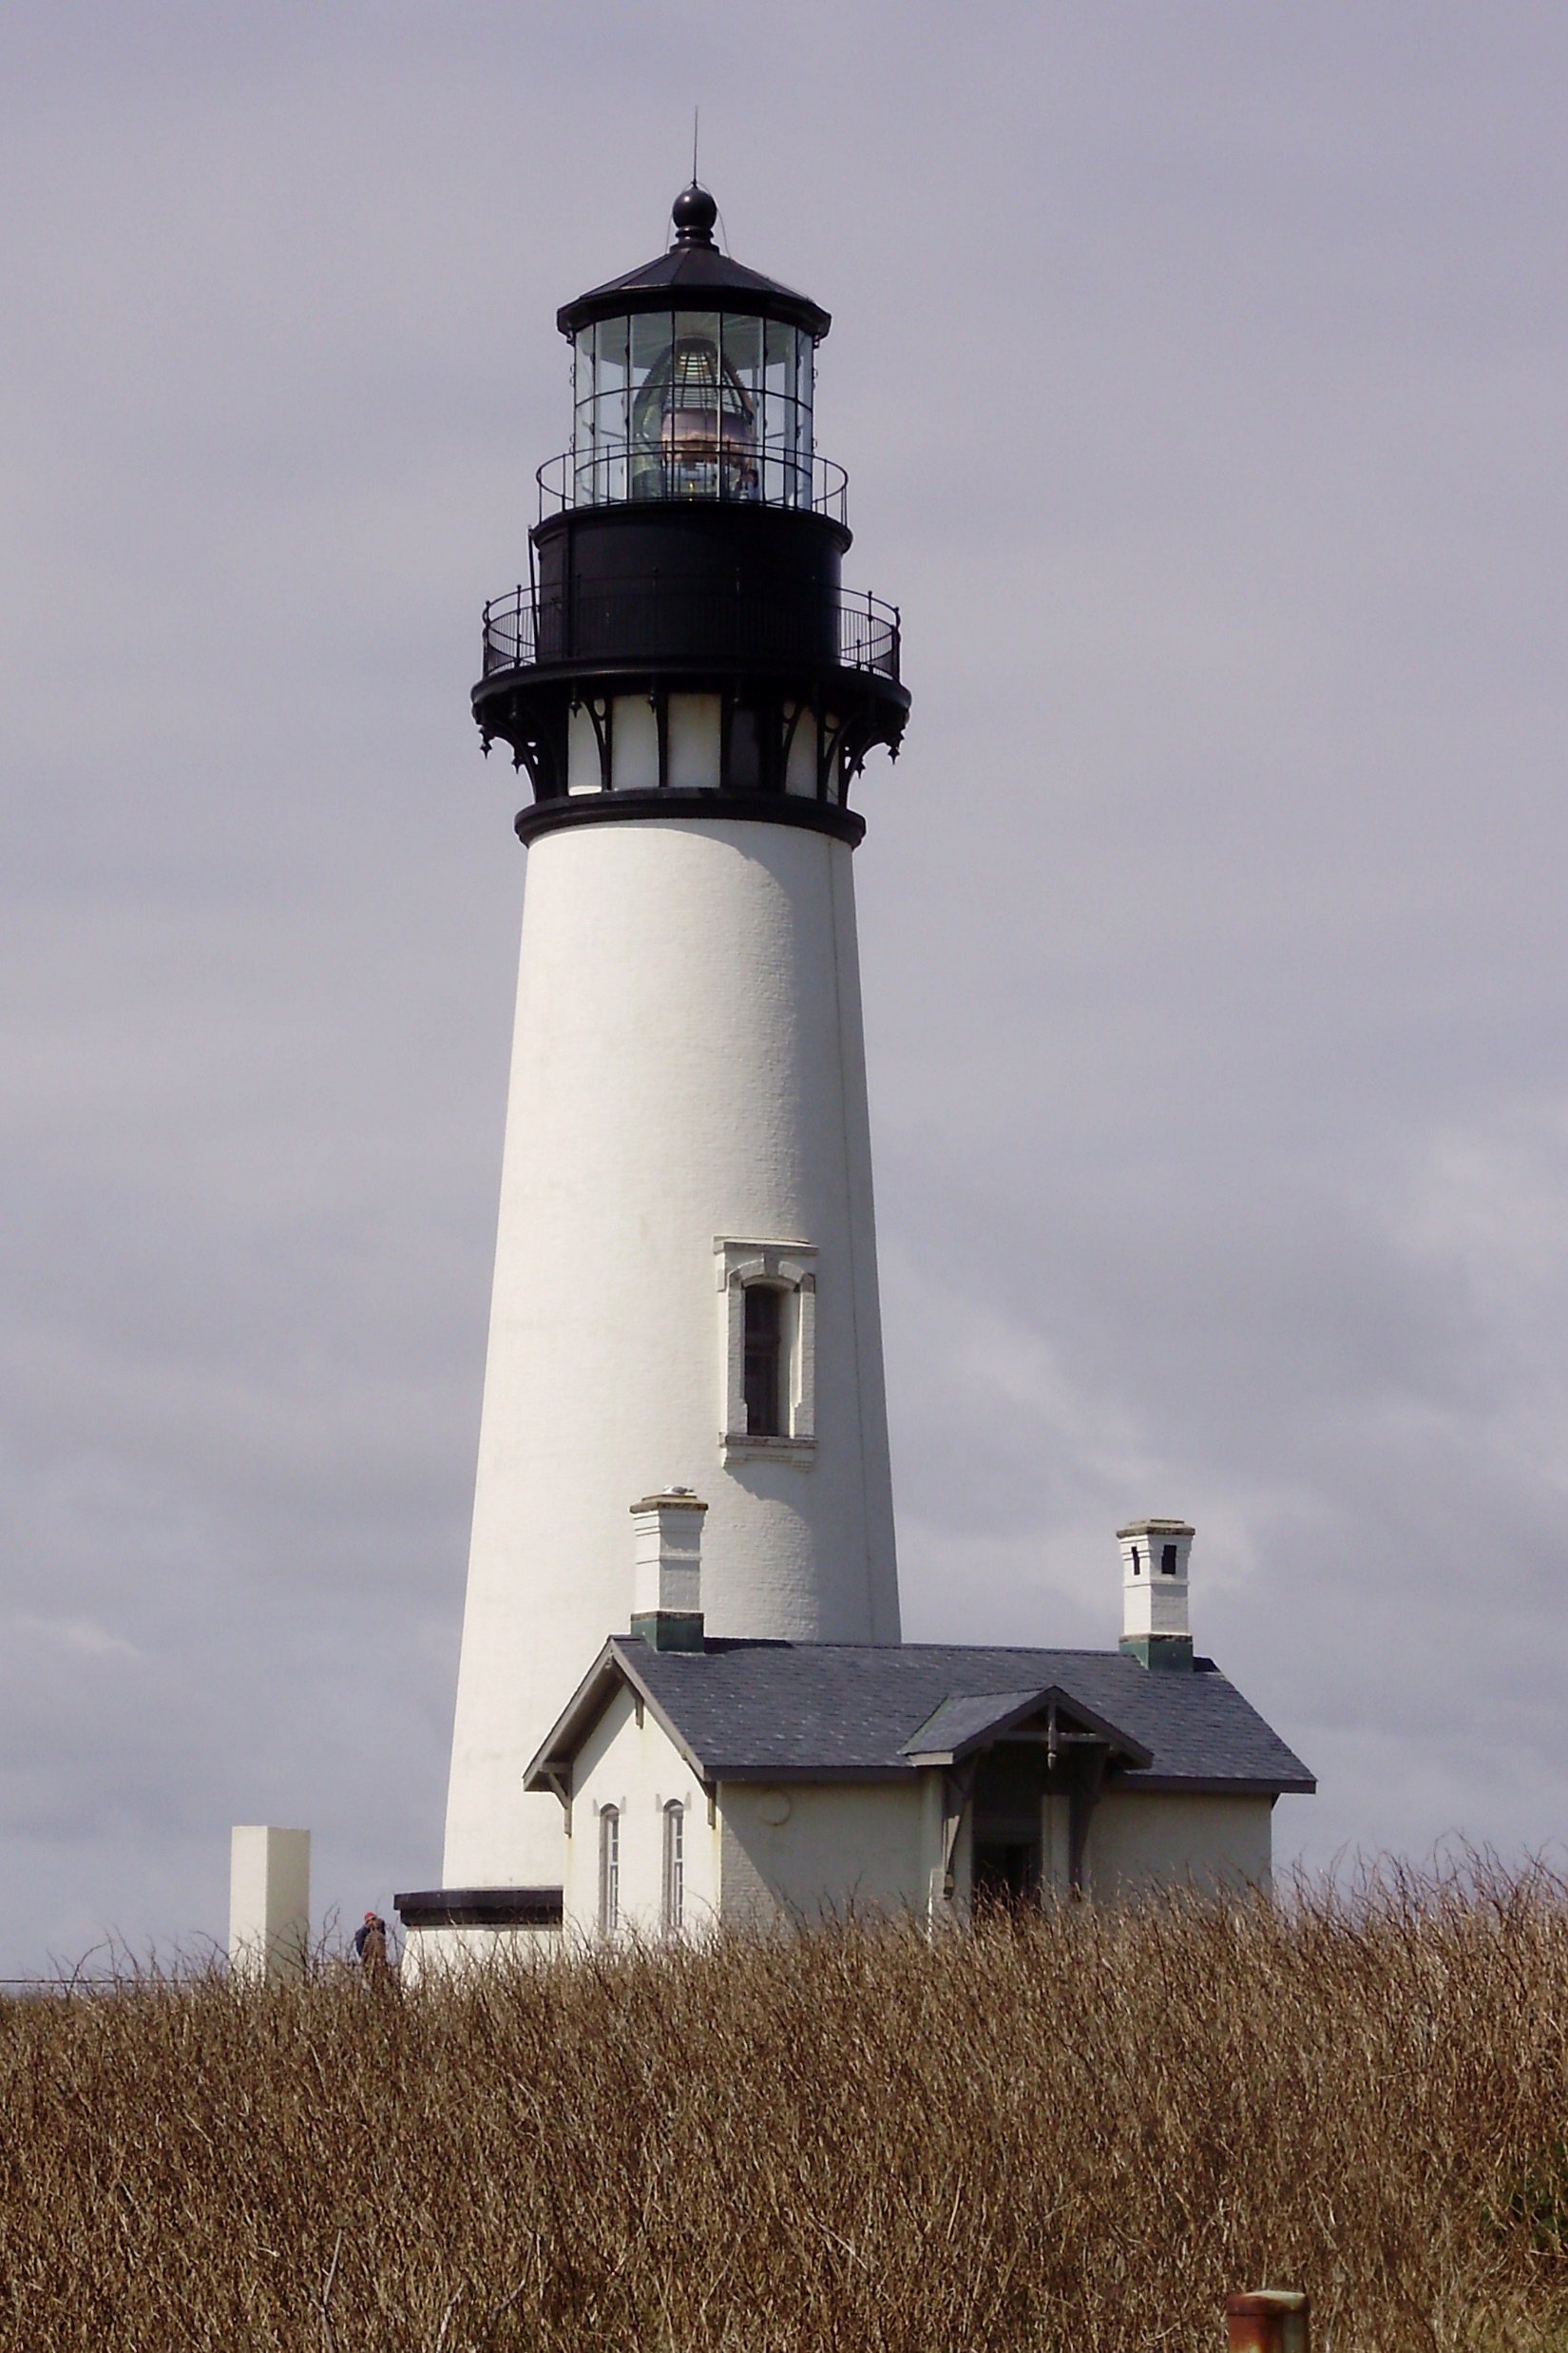
How can each of these objects provide someone with guidance and direction?
What are some situations in which youth today may need divine guidance and direction?

Slide 8
Psalm 119:1-8
1 Blessed are the undefiled in the way, who walk in the law of the Lord.
2 Blessed are they that keep his testimonies, and that seek him with the whole heart.
3 They also do no iniquity: they walk in his ways.
4 Thou hast commanded us to keep thy precepts diligently.
5 O that my ways were directed to keep thy statutes!
6 Then shall I not be ashamed, when I have respect unto all thy commandments.
7 I will praise thee with uprightness of heart, when I shall have learned thy righteous judgments.
8 I will keep thy statutes: O forsake me not utterly.
What makes a person blessed or happy?
What do you think it means to “walk in the law of the Lord” (Psalm 119:1)?
How can we learn “the law of the Lord”?

Slide 9
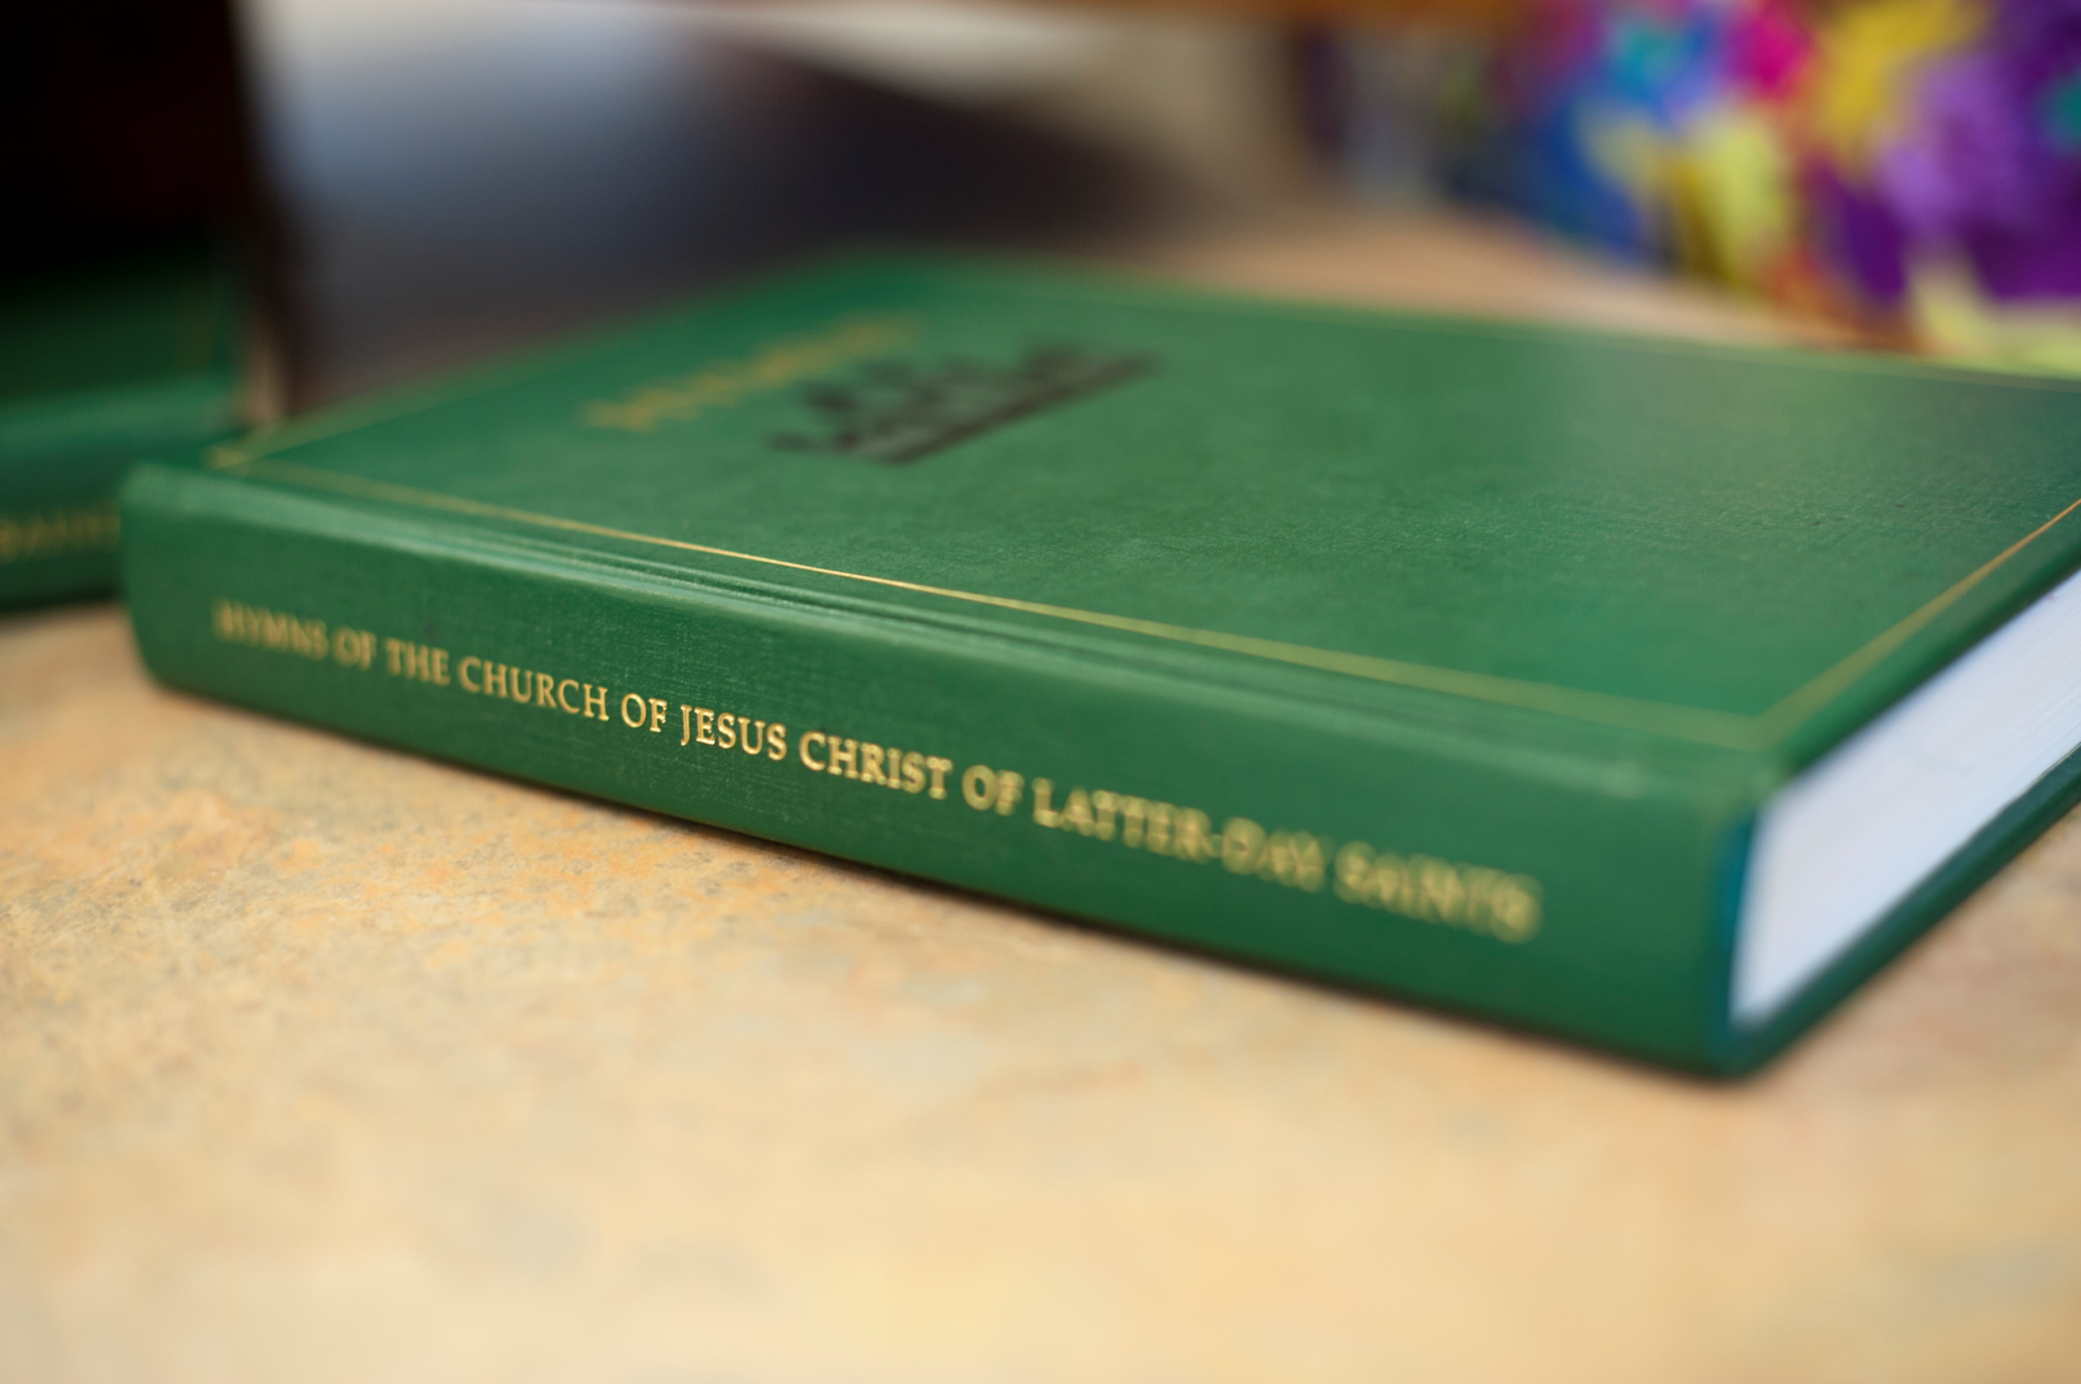
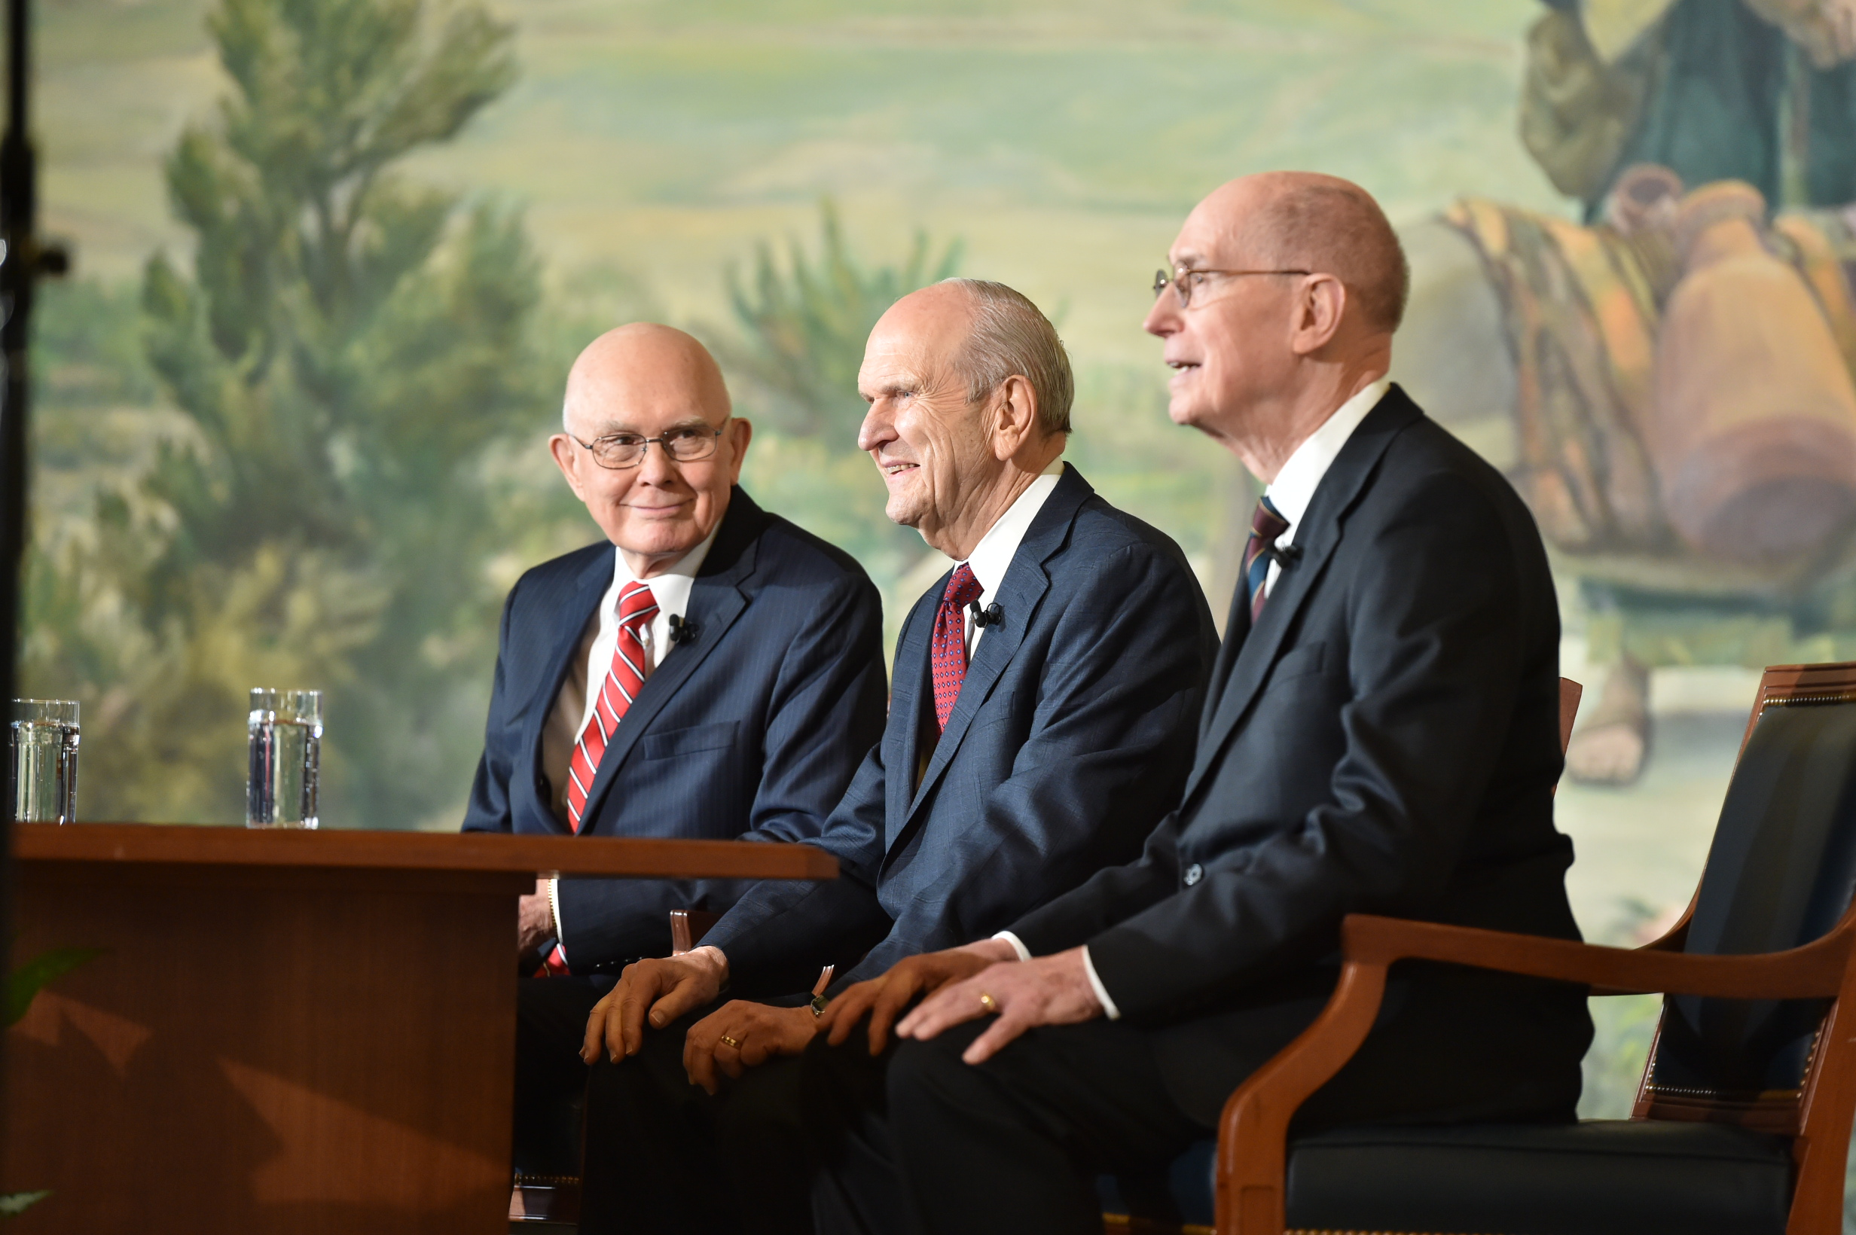

Slide 10
The Word of God is Like …
Read your assigned scripture passage together, looking for what the Psalmist compared to the word of God.
Take the object or the picture of the object from the front of the classroom that corresponds to your assigned scripture passage.
Discuss how the object is helpful in understanding the importance of the word of God.
Share examples or experiences that illustrate how the object is like the word of God.
Psalm 119:105
Thy word is a lamp unto my feet, and a light unto my path.
What did the Psalmist liken the word of God to?
How might the word of God be like a lamp or light to us as we study it?
As we study the word of God, we can receive guidance for our lives.
How can the word of God provide light and guidance for our lives?

Slide 11
Psalm 127
“Children are a cherished gift
from the Lord”

Slide 12
A friend says to you, “Having a family seems like a burden that would prevent me from doing other important things with my life. When I get older, I think I would be much happier if I did not have children.”
What are some priorities people might put ahead of having children?

Slide 13
Psalm 127:3-5.
3 Lo, children are an heritage of the Lord: and the fruit of the womb is his reward.
4 As arrows are in the hand of a mighty man; so are children of the youth.
5 Happy is the man that hath his quiver full of them: they shall not be ashamed, but they shall speak with the enemies in the gate.
What words did the Psalmist use to describe children?
What did the Psalmist say about the man who has a “quiver full” of children?
What truth do these verses teach about children?
Children are gifts from the Lord and can bring parents great happiness.

Slide 14
Elder Neil L. Andersen of the Quorum of the Twelve Apostles, said:
“It is a crowning privilege of a husband and wife who are able to bear children to provide mortal bodies for [the] spirit children of God. We believe in families, and we believe in children.
“When a child is born to a husband and wife, they are fulfilling part of our Heavenly Father’s plan to bring children to earth. …
“Families are central to God’s eternal plan. I testify of the great blessing of children and of the happiness they will bring us in this life and in the eternities”
Why do you think bearing children is “a crowning privilege” for a husband and wife?
How can children bring parents great happiness?
How can remembering that children are gifts from the Lord influence our attitude toward having and rearing children?

