Slide 1
SEMINARY
Old Testament

Slide 2
LESSON 110
Psalms (Part 1)

Slide 3
Psalms 22; 31; 34; 69
“The Psalmist praises and prophesies
of Jesus Christ”

Slide 4
“Jesus Himself quoted the book of Psalms more than any other Old Testament text. Beyond the Savior’s own use of these writings, the authors of the four Gospels [Matthew, Mark, Luke, and John] drew heavily on the psalms as they strove to document His life and ministry, particularly those excruciating hours of His arrest, trial, and Crucifixion” (Jeffrey R. Holland, For Times of Trouble: Spiritual Solace from the Psalms [2012], 7–8).
Elder
Jeffrey R. Holland

Slide 6
Psalm 23
The Psalmist declares, “The Lord
is my shepherd”

Slide 7
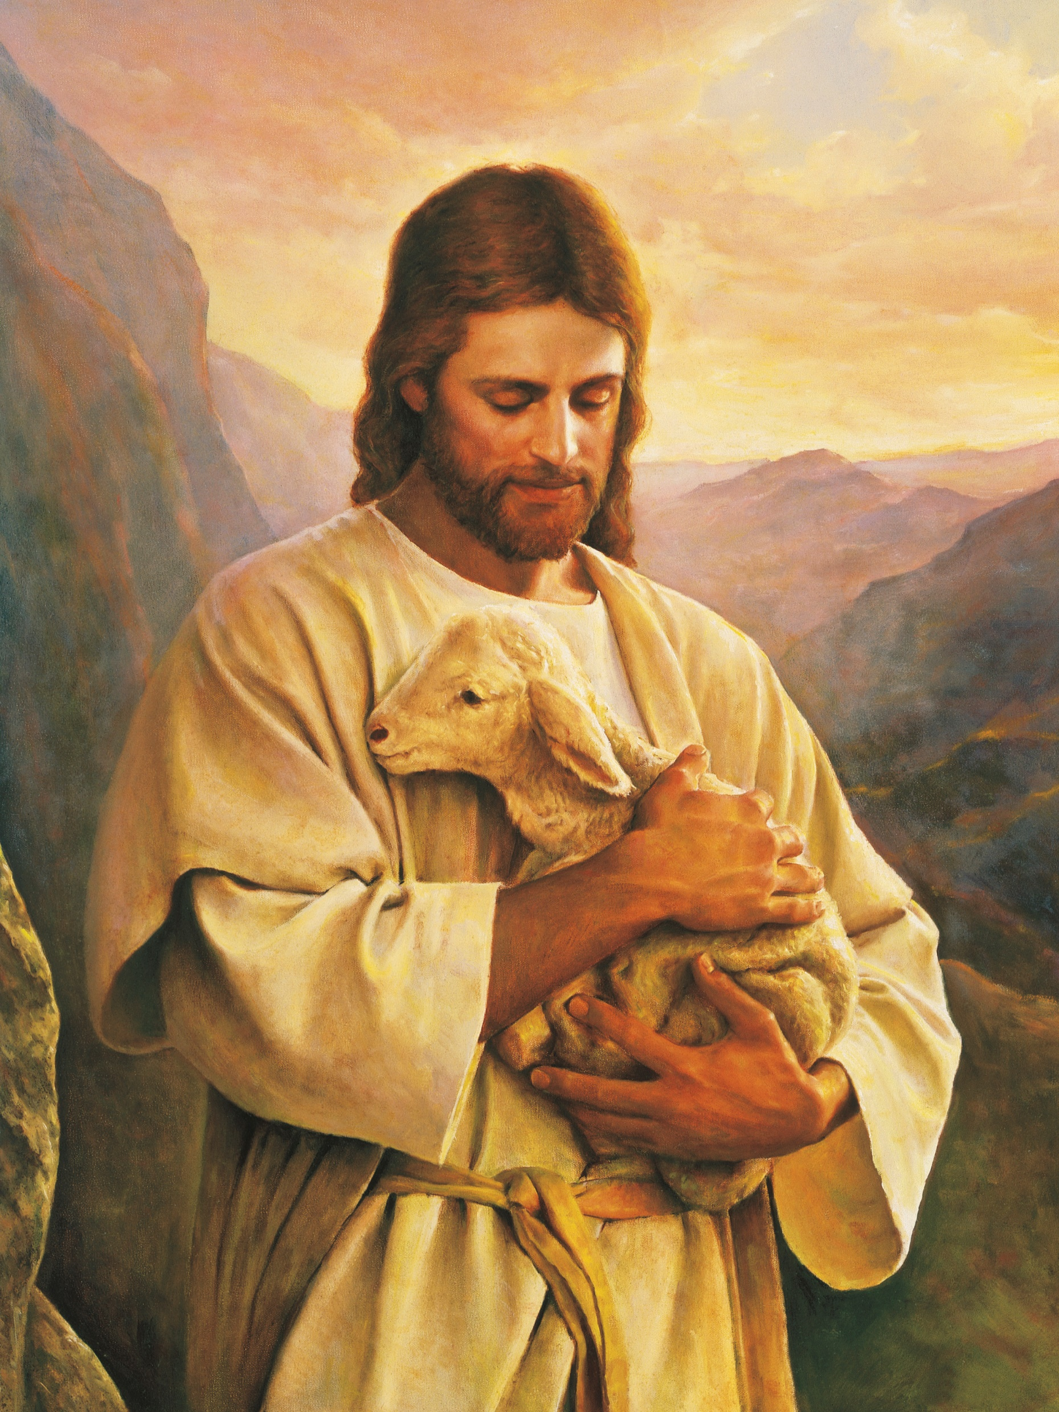
Psalm 23
1 The Lord is my shepherd; I shall not want.
2 He maketh me to lie down in green pastures: he leadeth me beside the still waters.
3 He restoreth my soul: he leadeth me in the paths of righteousness for his name’s sake.
4 Yea, though I walk through the valley of the shadow of death, I will fear no evil: for thou art with me; thy rod and thy staff they comfort me.
5 Thou preparest a table before me in the presence of mine enemies: thou anointest my head with oil; my cup runneth over.
6 Surely goodness and mercy shall follow me all the days of my life: and I will dwell in the house of the Lord for ever.
What is the Lord compared to in verses 1-4?
In what ways are we like sheep in need of a shepherd?

Slide 8
Psalm 24
“The Psalmist teaches what we must do to dwell in the Lord’s presence”

Slide 9
Why are there requirements for entering these or other places?
Psalm 24:3-5
3 Who shall ascend into the hill of the Lord? or who shall stand in his holy place?
4 He that hath clean hands, and a pure heart; who hath not lifted up his soul unto vanity, nor sworn deceitfully.
5 He shall receive the blessing from the Lord, and righteousness from the God of his salvation.
What do you think the phrases “the hill of the Lord” and “his holy place” refer to?
What must we do to qualify to worship in the Lord’s house and be prepared to dwell in His presence?
To be worthy to worship in the Lord’s house and to be prepared to dwell in His presence, we must have clean hands and a pure heart.
Why do you think we need to have clean hands and a pure heart in order to worship in the temple and dwell in the Lord’s presence?

Slide 10
Elder David A. Bednar of the Quorum of the Twelve Apostles, Said:
“Let me suggest that hands are made clean through the process of putting off the natural man and by overcoming sin and the evil influences in our lives through the Savior’s Atonement. Hearts are purified as we receive His strengthening power to do good and become better. All of our worthy desires and good works, as necessary as they are, can never produce clean hands and a pure heart. It is the Atonement of Jesus Christ that provides both a cleansing and redeeming power that helps us to overcome sin and a sanctifying and strengthening power that helps us to become better than we ever could by relying only upon our own strength”
How does the Savior help us in this process of having clean hands and pure hearts?

Slide 11
Psalm 33
“The earth is full of the
Lord’s goodness”

Slide 12
Psalm 33:1-9
1 Rejoice in the Lord, O ye righteous: for praise is comely for the upright.
2 Praise the Lord with harp: sing unto him with the psaltery and an instrument of ten strings.
3 Sing unto him a new song; play skilfully with a loud noise.
4 For the word of the Lord is right; and all his works are done in truth.
5 He loveth righteousness and judgment: the earth is full of the goodness of the Lord.
6 By the word of the Lord were the heavens made; and all the host of them by the breath of his mouth.
7 He gathereth the waters of the sea together as an heap: he layeth up the depth in storehouses.
8 Let all the earth fear the Lord: let all the inhabitants of the world stand in awe of him.
9 For he spake, and it was done; he commanded, and it stood fast.
Pondering about the Lord and His creations can lead us to …
praise and revere Him.
How would you complete this statement?

