Slide 1
SEMINARY
Old Testament

Slide 2
LESSONS 103 & 104
Ezra 1-3
“The Lord inspires King Cyrus to allow the Jews to return to Jerusalem to rebuild the temple”

Slide 3
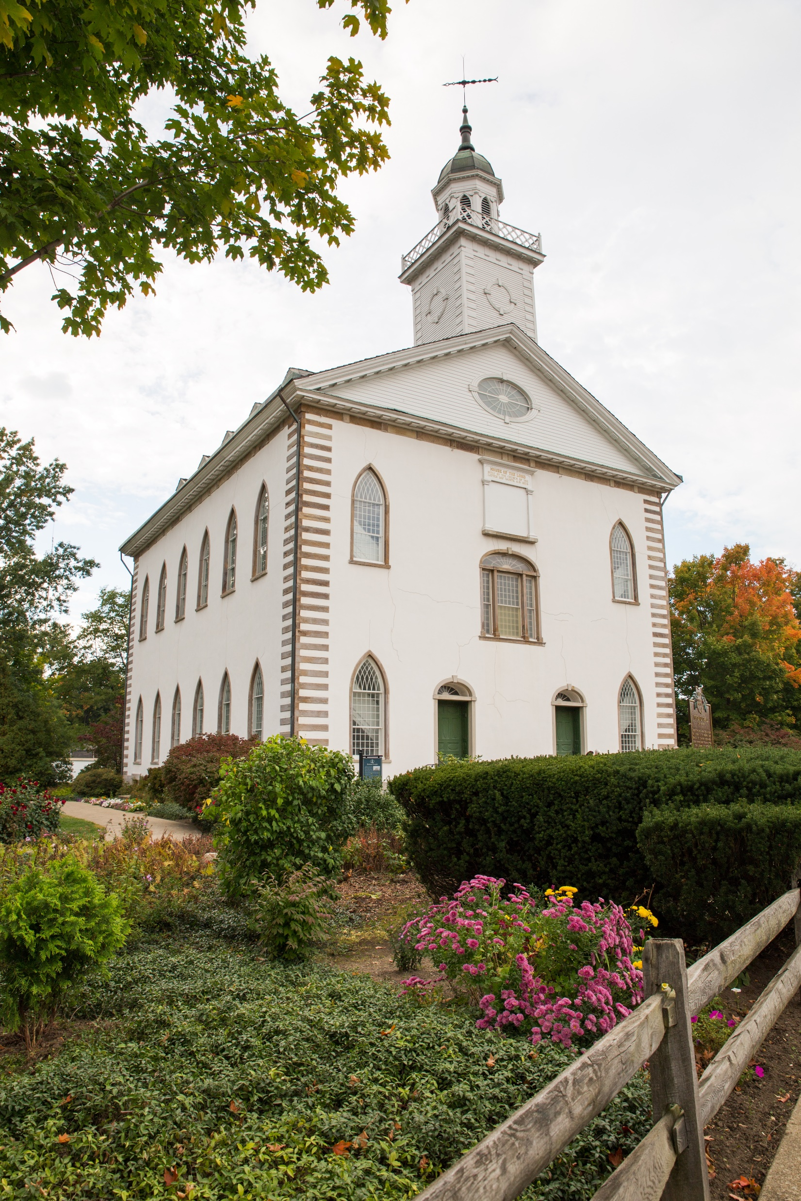
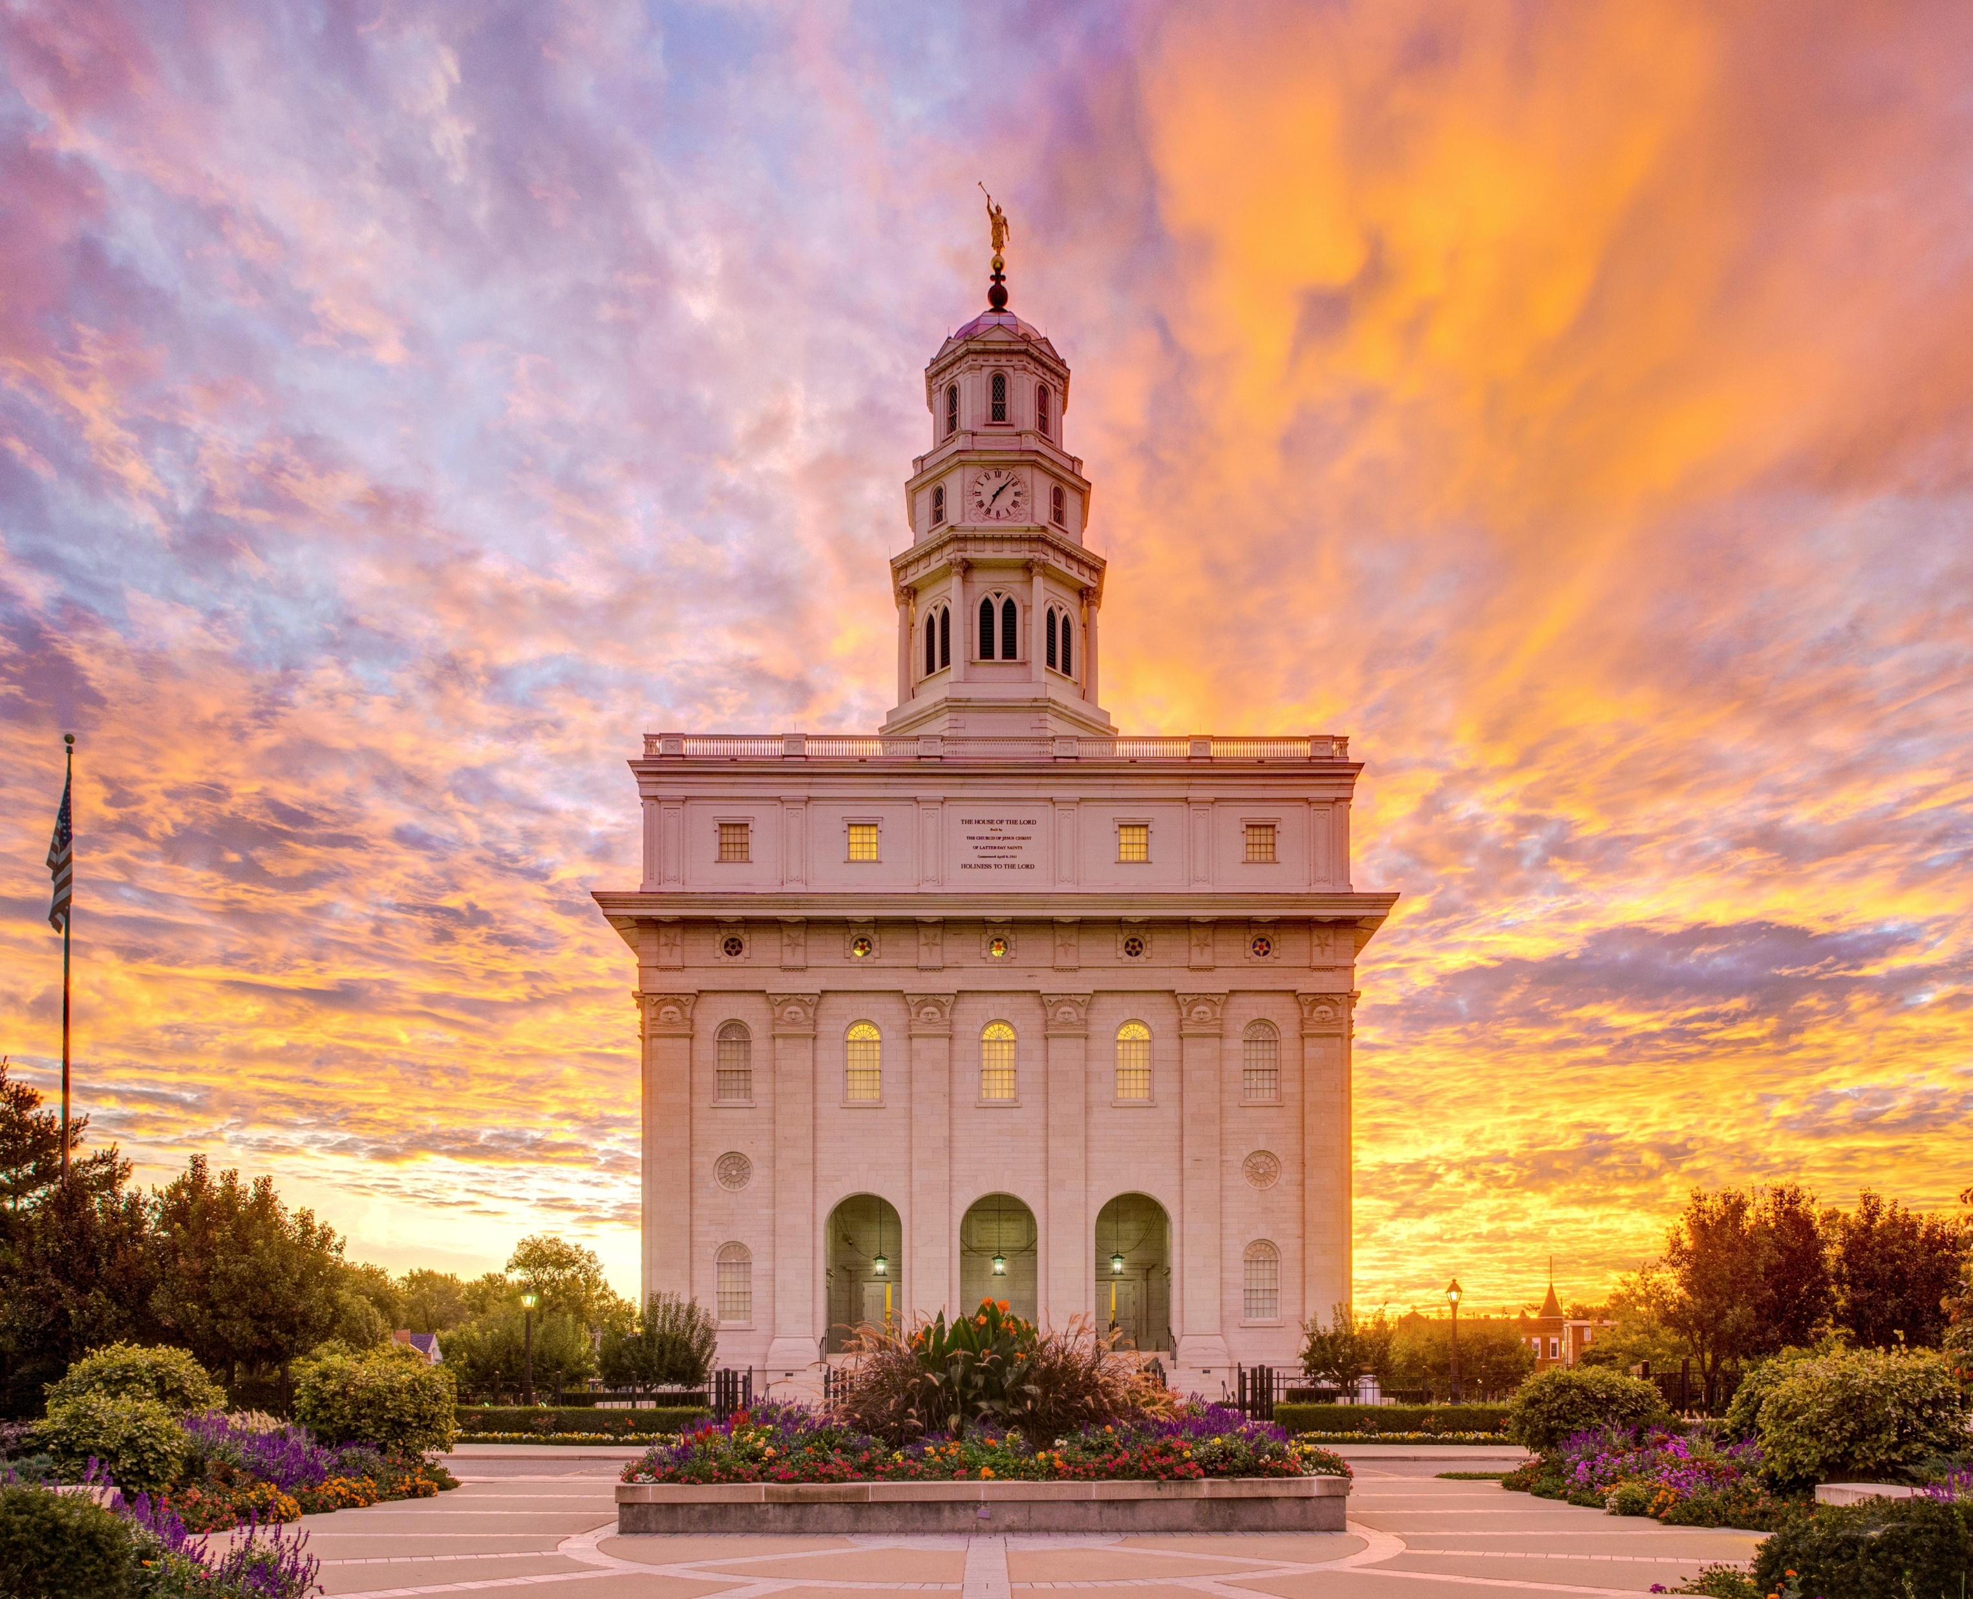
What does God’s commandment to build temples even in times of poverty or hardship teach us about temples?

Slide 4
Ezra 1:1-3
1 Now in the first year of Cyrus king of Persia, that the word of the Lord by the mouth of Jeremiah might be fulfilled, the Lord stirred up the spirit of Cyrus king of Persia, that he made a proclamation throughout all his kingdom, and put it also in writing, saying,
2 Thus saith Cyrus king of Persia, The Lord God of heaven hath given me all the kingdoms of the earth; and he hath charged me to build him an house at Jerusalem, which is in Judah.
3 Who is there among you of all his people? his God be with him, and let him go up to Jerusalem, which is in Judah, and build the house of the Lord God of Israel, (he is the God,) which is in Jerusalem.
What did Cyrus do?
Why did he do this?

Slide 5
Ezra 1:4,7-8
4 And whosoever remaineth in any place where he sojourneth, let the men of his place help him with silver, and with gold, and with goods, and with beasts, beside the freewill offering for the house of God that is in Jerusalem.
7 ¶ Also Cyrus the king brought forth the vessels of the house of the Lord, which Nebuchadnezzar had brought forth out of Jerusalem, and had put them in the house of his gods;
8 Even those did Cyrus king of Persia bring forth by the hand of Mithredath the treasurer, and numbered them unto Sheshbazzar, the prince of Judah.
What did Cyrus do to support the Jews in their efforts to rebuild the temple?

Slide 6
Ezra 3:10-13
10 And when the builders laid the foundation of the temple of the Lord, they set the priests in their apparel with trumpets, and the Levites the sons of Asaph with cymbals, to praise the Lord, after the ordinance of David king of Israel.
11 And they sang together by course in praising and giving thanks unto the Lord; because he is good, for his mercy endureth for ever toward Israel. And all the people shouted with a great shout, when they praised the Lord, because the foundation of the house of the Lord was laid.
12 But many of the priests and Levites and chief of the fathers, who were ancient men, that had seen the first house, when the foundation of this house was laid before their eyes, wept with a loud voice; and many shouted aloud for joy:
13 So that the people could not discern the noise of the shout of joy from the noise of the weeping of the people: for the people shouted with a loud shout, and the noise was heard afar off.
What emotions did the Jews experience as they began to rebuild the temple?
Why do you think their joy was so great?

Slide 7
Ezra 4-6
“The Jews overcome opposition and complete and dedicate the temple”

Slide 8
Ezra 4:1-2
-3
1 Now when the adversaries of Judah and Benjamin heard that the children of the captivity builded the temple unto the Lord God of Israel;
2 Then they came to Zerubbabel, and to the chief of the fathers, and said unto them, Let us build with you: for we seek your God, as ye do; and we do sacrifice unto him since the days of Esar-haddon king of Assur, which brought us up hither.
3 But Zerubbabel, and Jeshua, and the rest of the chief of the fathers of Israel, said unto them, Ye have nothing to do with us to build an house unto our God; but we ourselves together will build unto the Lord God of Israel, as king Cyrus the king of Persia hath commanded us.
How are the Samaritans described in verse 1?
What did the Samaritans want to do?
What did Zerubbabel and the leaders of the Jews tell these people?

Slide 9
Ezra 5:1-2
1 Then the prophets, Haggai the prophet, and Zechariah the son of Iddo, prophesied unto the Jews that were in Judah and Jerusalem in the name of the God of Israel, even unto them.
2 Then rose up Zerubbabel the son of Shealtiel, and Jeshua the son of Jozadak, and began to build the house of God which is at Jerusalem: and with them were the prophets of God helping them.
Why did the Jews resume rebuilding the temple?
What do you think it means that “the eye of their God was upon the elders of the Jews, that they could not cause them to cease”?
What can we learn from the Jews’ experience of rebuilding the temple in Jerusalem?
God watches over and helps those who seek to obey Him.
What are some ways in which God watches over and helps His people when they are faced with difficulties?

Slide 10
Ezra 6:16, 22
16 ¶ And the children of Israel, the priests, and the Levites, and the rest of the children of the captivity, kept the dedication of this house of God with joy,
22 And kept the feast of unleavened bread seven days with joy: for the Lord had made them joyful, and turned the heart of the king of Assyria unto them, to strengthen their hands in the work of the house of God, the God of Israel.
What principle can we identify from this verse about the blessings of building temples and participating in temple service?
As we participate in temple service, we will be blessed with joy.
President Thomas S. Monson (1927–2018) Said:
“Temples bring joy to our faithful members wherever they are built”

Slide 11
Ezra 7-8
“The Persian king provides Ezra with money and supplies to beautify the temple at Jerusalem”

Slide 12
Ezra 9-10
“Ezra mourns over the sins of the people and teaches them to confess and forsake their sins”

Slide 13
After a young man learns the seriousness of sexual sin, he feels a strong desire to repent but is not sure how to do it.
Ezra 9:1-3
1 Now when these things were done, the princes came to me, saying, The people of Israel, and the priests, and the Levites, have not separated themselves from the people of the lands, doing according to their abominations, even of the Canaanites, the Hittites, the Perizzites, the Jebusites, the Ammonites, the Moabites, the Egyptians, and the Amorites.
2 For they have taken of their daughters for themselves, and for their sons: so that the holy seed have mingled themselves with the people of those lands: yea, the hand of the princes and rulers hath been chief in this trespass.
3 And when I heard this thing, I rent my garment and my mantle, and plucked off the hair of my head and of my beard, and sat down astonied.
What did Ezra learn the people had done?
Why was it a transgression for the Israelites to intermarry with other groups of people?

Slide 14
Ezra 10:1-3
1 Now when Ezra had prayed, and when he had confessed, weeping and casting himself down before the house of God, there assembled unto him out of Israel a very great congregation of men and women and children: for the people wept very sore.
2 And Shechaniah the son of Jehiel, one of the sons of Elam, answered and said unto Ezra, We have trespassed against our God, and have taken strange wives of the people of the land: yet now there is hope in Israel concerning this thing.
3 Now therefore let us make a covenant with our God to put away all the wives, and such as are born of them, according to the counsel of my lord, and of those that tremble at the commandment of our God; and let it be done according to the law.
What did the people need to do to repent?

Slide 15
Ezra 10:10-12
10 And Ezra the priest stood up, and said unto them, Ye have transgressed, and have taken strange wives, to increase the trespass of Israel.
11 Now therefore make confession unto the Lord God of your fathers, and do his pleasure: and separate yourselves from the people of the land, and from the strange wives.
12 Then all the congregation answered and said with a loud voice, As thou hast said, so must we do.
What was Ezra’s message to the people?
What does the people’s response recorded in verse 12 reveal about them?
What can we learn from Ezra’s counsel to the people about what we must do to repent of our sins?
To repent, we must confess and forsake our sins.

Slide 16
Elder Richard G. Scott (1928–2015) of the Quorum of the Twelve Apostles, Said:
“I testify that of all the necessary steps to repentance, the most critically important is for you to have a conviction that forgiveness comes in and through Jesus Christ. It is essential to know that only on His terms can you be forgiven. You will be helped as you exercise faith in Christ.

