Slide 1
SEMINARY
Old Testament

Slide 2
LESSON 7
“Moses 1:24-42”

Slide 3
LESSON 7
Moses 1:24-26
Moses is filled with the Holy Ghost and converses with the Lord.

Slide 4
LESSON 7
How was Moses able to resist Satan’s temptations?
What blessings do you feel you have received when you have chosen to resist Satan’s temptations?
Moses 1:24-26
24 And it came to pass that when Satan had departed from the presence of Moses, that Moses lifted up his eyes unto heaven, being filled with the Holy Ghost, which beareth record of the Father and the Son;
25 And calling upon the name of God, he beheld his glory again, for it was upon him; and he heard a voice, saying: Blessed art thou, Moses, for I, the Almighty, have chosen thee, and thou shalt be made stronger than many waters; for they shall obey thy command as if thou wert God.
26 And lo, I am with thee, even unto the end of thy days; for thou shalt deliver my people from bondage, even Israel my chosen.

Slide 5
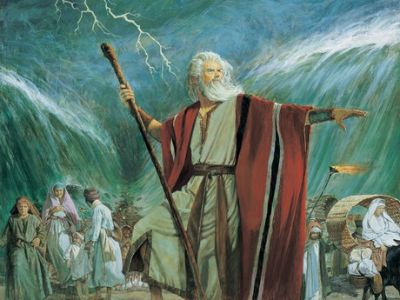
LESSON 7
What did the Lord say He had chosen Moses to do?
What phrases in verses 25-26 would help you have confidence if you were in Moses’s position? Why?

Slide 6
LESSON 7
Moses 1:27-39
“Moses learns the purpose for the Creation of the earth and its inhabitants”

Slide 7
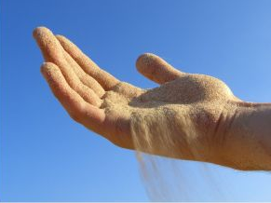
How many grains of sand do you think are in this container?
LESSON 7
How many grains of sand do you think are on a seashore?

Slide 8
LESSON 7
Moses 1:27-29
27 And it came to pass, as the voice was still speaking, Moses cast his eyes and beheld the earth, yea, even all of it; and there was not a particle of it which he did not behold, discerning it by the Spirit of God.
28 And he beheld also the inhabitants thereof, and there was not a soul which he beheld not; and he discerned them by the Spirit of God; and their numbers were great, even numberless as the sand upon the sea shore.
29 And he beheld many lands; and each land was called earth, and there were inhabitants on the face thereof.
How many of Heavenly Father’s children did Moses behold?
What questions might you ask if you had seen this vision?

Slide 9
LESSON 7
Moses 1:30
And it came to pass that Moses called upon God, saying: Tellme, I pray thee, why these things are so, and by what thou madest them?
What were the two questions Moses asked the Lord?
Why were the earth and its inhabitants created? By what power were they created?
Why is it important for Heavenly Father’s children to understand the purposes of the earth and our lives here?

Slide 10
LESSON 7
Moses 1:31-33
31 And behold, the glory of the Lord was upon Moses, so that Moses stood in the presence of God, and talked with him face to face. And the Lord God said unto Moses: For mine own purpose have I made these things. Here is wisdom and it remaineth in me.
32 And by the word of my power, have I created them, which is mine Only Begotten Son, who is full of grace and truth.
33 And worlds without number have I created; and I also created them for mine own purpose; and by the Son I created them, which is mine Only Begotten.
What doctrine do we learn from verses 32-33 concerning who created the earth and “worlds without number”?
Under the direction of Heavenly Father, Jesus Christ created worlds without number.

Slide 11
LESSON 7
Moses 1:34-38
34 And the first man of all men have I called Adam, which is many.
35 But only an account of this earth, and the inhabitants thereof, give I unto you. For behold, there are many worlds that have passed away by the word of my power. And there are many that now stand, and innumerable are they unto man; but all things are numbered unto me, for they are mine and I know them.
36 And it came to pass that Moses spake unto the Lord, saying: Be merciful unto thy servant, O God, and tell me concerning this earth, and the inhabitants thereof, and also the heavens, and then thy servant will be content.
37 And the Lord God spake unto Moses, saying: The heavens, they are many, and they cannot be numbered unto man; but they are numbered unto me, for they are mine.
38 And as one earth shall pass away, and the heavens thereof even so shall another come; and there is no end to my works, neither to my words.
How many worlds did God say had been created “by the Son” (Moses 1:33)?
Which of these worlds did the Lord say He was going to teach Moses more about?

Slide 12
LESSON 7
Moses 1:39
For behold, this is my work and my glory—to bring to pass the immortality and eternal life of man.
What is Heavenly Father’s purpose in creating the worlds and their inhabitants?
Heavenly Father’s purpose is to bring about the immortality and eternal life of man.
What is immortality?
How has the immortality of all mankind been made possible?
Because of the Atonement of Jesus Christ—which includes His Resurrection—every person who is born with a physical body will be resurrected and will live forever.
The condition of living forever in a resurrected state.

Slide 13
LESSON 7
What is eternal life?
Becoming like God and “[living] forever as families in [His] presence”
How can we receive eternal life?
Through His Atonement, Jesus Christ has made it possible for all who are obedient to the laws and ordinances of the gospel to receive eternal life.
How can it influence our lives now to know that Heavenly Father’s purpose is to bring to pass our immortality and eternal life?

Slide 14
LESSON 7
Moses 1:40-42
“Moses is instructed to write the words of God”

Slide 15
LESSON 7

