Slide 1
SEMINARY
Old Testament

Slide 2
LESSON 6
Moses 1:1-23

Slide 3
LESSON 6
Moses 1:1–11
“God speaks to Moses face to face, and Moses sees the glory of God”

Slide 4
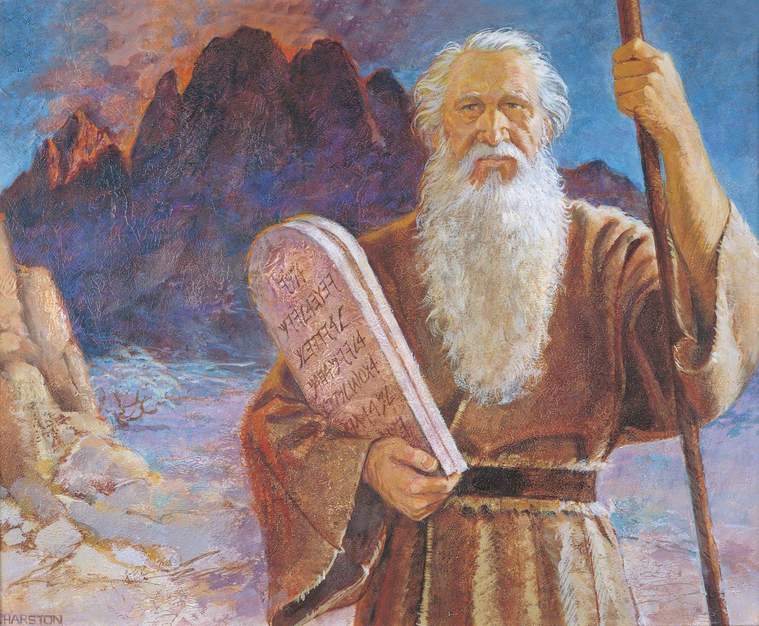
LESSON 6
How might our thoughts about ourselves influence our behavior?
Considering this background, how might Moses have described himself up to this point in his life?

Slide 5
LESSON 6
Moses 1:1-6
1 The words of God, which he spake unto Moses at a time when Moses was caught up into an exceedingly high mountain,
2 And he saw God face to face, and he talked with him, and the glory of God was upon Moses; therefore Moses could endure his presence.
3 And God spake unto Moses, saying: Behold, I am the Lord God Almighty, and Endless is my name; for I am without beginning of days or end of years; and is not this endless?
4 And, behold, thou art my son; wherefore look, and I will show thee the workmanship of mine hands; but not all, for my works are without end, and also my words, for they never cease.
5 Wherefore, no man can behold all my works, except he behold all my glory; and no man can behold all my glory, and afterwards remain in the flesh on the earth.
6 And I have a work for thee, Moses, my son; and thou art in the similitude of mine Only Begotten; and mine Only Begotten is and shall be the Savior, for he is full of grace and truth; but there is no God beside me, and all things are present with me, for I know them all.

Slide 6
LESSON 6
What did Moses learn about God?
What did Moses learn about himself that can help us understand who we are?
We are children of Heavenly Father.
How do you think knowing that he was a son of God might have affected Moses?

Slide 7
LESSON 6
What does it mean to you to know that you are a child of Heavenly Father?
What does it mean to you to know that you are a child of Heavenly Father?
What experiences have helped you to know that you are a child of Heavenly Father?
What experiences have helped you to know that you are a child of Heavenly Father?
How can this knowledge affect the way you view yourself? How can it affect the way you view others?
How can this knowledge affect the way you view yourself? How can it affect the way you view others?
How might remembering that we are Heavenly Father’s children help us to make better choices each day?
How might remembering that we are Heavenly Father’s children help us to make better choices each day?

Slide 8
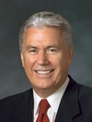
LESSON 6
“You are something divine—more beautiful and glorious than you can possibly imagine. This knowledge changes everything. It changes your present. It can change your future. And it can change the world. …
“Because of the revealed word of a merciful God, …you have felt the eternal glory of that divine spirit within you. You are no ordinary beings, my beloved young friends all around the world. You are glorious and eternal. …
“It is my prayer and blessing that when you look at your reflection, you will be able to see beyond imperfections and self-doubts and recognize who you truly are: glorious sons and daughters of the Almighty God” (Dieter F. Uchtdorf, “The Reflection in the Water” [Church Educational System fireside for young adults, Nov. 1, 2009], lds.org/media-library).
Elder
Dieter F. Uchtdorf

Slide 9
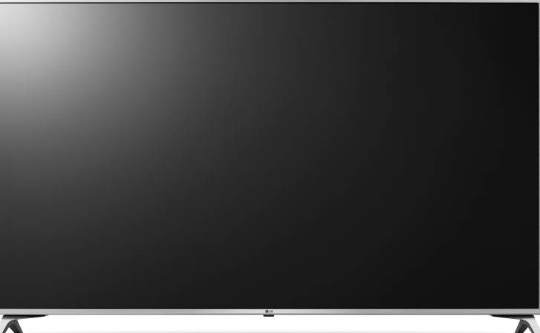
LESSON 6

Slide 10
LESSON 6
Moses 1:7,8
-11
7 And now, behold, this one thing I show unto thee, Moses, my son, for thou art in the world, and now I show it unto thee.
8 And it came to pass that Moses looked, and beheld the world upon which he was created; and Moses beheld the world and the ends thereof, and all the children of men which are, and which were created; of the same he greatly marveled and wondered.
9 And the presence of God withdrew from Moses, that his glory was not upon Moses; and Moses was left unto himself. And as he was left unto himself, he fell unto the earth.
10 And it came to pass that it was for the space of many hours before Moses did again receive his natural strength like unto man; and he said unto himself: Now, for this cause I know that man is nothing, which thing I never had supposed.
11 But now mine own eyes have beheld God; but not my natural, but my spiritual eyes, for my natural eyes could not have beheld; for I should have withered and died in his presence; but his glory was upon me; and I beheld his face, for I was transfigured before him.
What did Moses learn about himself after the presence of God had withdrawn from him?
What evidence do we have that we are of great importance to our Father in Heaven?

Slide 11
LESSON 6
Moses 1:12–23
“Satan tempts Moses to worship him”

Slide 12
LESSON 6
How did Moses resist Satan?
Moses 1:12
And it came to pass that when Moses had said these words, behold, Satan came tempting him, saying: Moses, son of man, worship me.
What did Satan call Moses?
Why do you think Satan wanted Moses to think about his earthly parentage rather than his heavenly parentage?
In what ways do Satan and others try to tempt us to think of ourselves as something other than sons or daughters of God?

Slide 13
LESSON 6
Moses 1:13-15
13 And it came to pass that Moses looked upon Satan and said: Who art thou? For behold, I am a son of God, in the similitude of his Only Begotten; and where is thy glory, that I should worship thee?
14 For behold, I could not look upon God, except his glory should come upon me, and I were transfigured before him. But I can look upon thee in the natural man. Is it not so, surely?
15 Blessed be the name of my God, for his Spirit hath not altogether withdrawn from me, or else where is thy glory, for it is darkness unto me? And I can judge between thee and God; for God said unto me: Worship God, for him only shalt thou serve.
How did Moses use his previous spiritual experience with God to detect Satan’s deception?
What does Moses’s response teach us about what we can do when Satan tries to deceive us?
We can resist Satan’s deceptions as we remember our previous spiritual experiences and trust what we have learned from them.

Slide 14
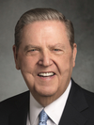
LESSON 6
“In moments of fear or doubt or troubling times, hold the ground you have already won, even if that ground is limited. … When those moments come and issues surface, the resolution of which is not immediately forthcoming, hold fast to what you already know and stand strong until additional knowledge comes. … The size of your faith or the degree of your knowledge is not the issue—it is the integrity you demonstrate toward the faith you do have and the truth you already know” (Jeffrey R. Holland, “Lord, I Believe,” Ensign or Liahona, May 2013, 93–94).
Elder
Jeffrey R. Holland

Slide 15
What does Moses’s experience teach us about discerning between good and evil?
LESSON 6
What do you think it means to demonstrate integrity toward the truth you already know?
When we have the Spirit with us, we are better able to discern between good and evil.
When we have the Spirit with us, we are better able to discern between good and evil?

Slide 16
LESSON 6
Moses 1:16-18
, 19-22
16 Get thee hence, Satan; deceive me not; for God said unto me: Thou art after the similitude of mine Only Begotten.
17 And he also gave me commandments when he called unto me out of the burning bush, saying: Call upon God in the name of mine Only Begotten, and worship me.
18 And again Moses said: I will not cease to call upon God, I have other things to inquire of him: for his glory has been upon me, wherefore I can judge between him and thee. Depart hence, Satan.
19 And now, when Moses had said these words, Satan cried with a loud voice, and ranted upon the earth, and commanded, saying: I am the Only Begotten, worship me.
20 And it came to pass that Moses began to fear exceedingly; and as he began to fear, he saw the bitterness of hell. Nevertheless, calling upon God, he received strength, and he commanded, saying: Depart from me, Satan, for this one God only will I worship, which is the God of glory.
21 And now Satan began to tremble, and the earth shook; and Moses received strength, and called upon God, saying: In the name of the Only Begotten, depart hence, Satan.
22 And it came to pass that Satan cried with a loud voice, with weeping, and wailing, and gnashing of teeth; and he departed hence, even from the presence of Moses, that he beheld him not.

Slide 17
LESSON 6
What did Moses receive when he called upon God? What did this strength from God allow Moses to do?
When we are faithful and call upon God, we will receive strength to overcome Satan’s influence.
How can calling upon God in the name of the Son help you to recognize and resist Satan’s temptations?
When today might you need to remember and act on one of the principles or doctrines you learned in Moses 1?
How can remembering and acting on this principle or doctrine benefit you?

