Slide 1
SEMINARY
Old Testament

Slide 2
LESSON 57
Leviticus 1–7

Slide 3
Leviticus 1-3
“The Lord instructs Israel how to
offer various offerings”

Slide 4
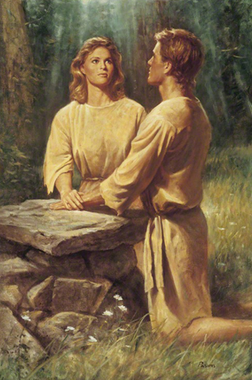
Why are we expected to sacrifice so much as members of The Church of Jesus Christ of Latter-day Saints?
When did Heavenly Father first command His children to perform animal sacrifices?
What did those sacrifices primarily represent?

Slide 5
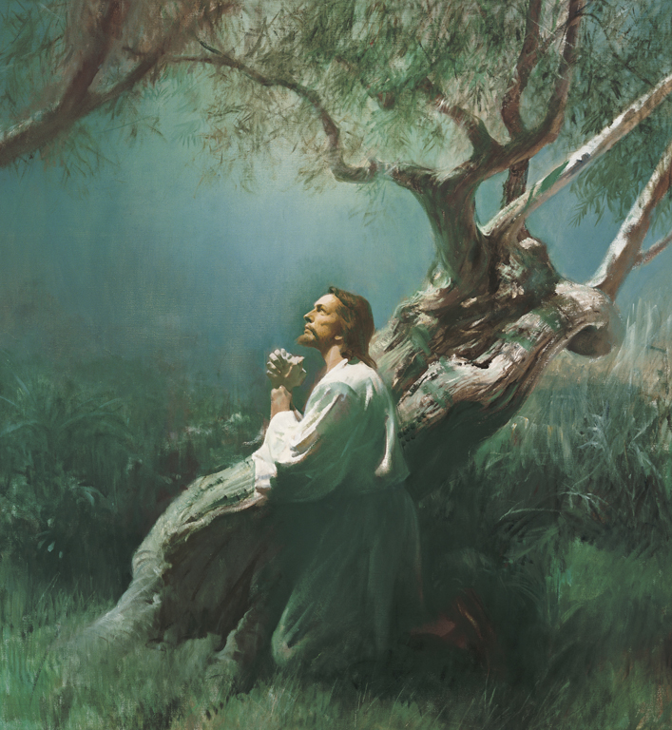
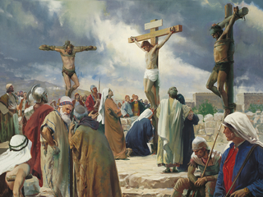

Slide 6
Leviticus 1:2-9
2 Speak unto the children of Israel, and say unto them, If any man of you bring an offering unto the Lord, ye shall bring your offering of the cattle, even of the herd, and of the flock.
3 If his offering be a burnt sacrifice of the herd, let him offer a male without blemish: he shall offer it of his own voluntary will at the door of the tabernacle of the congregation before the Lord.
4 And he shall put his hand upon the head of the burnt offering; and it shall be accepted for him to make atonement for him.
5 And he shall kill the bullock before the Lord: and the priests, Aaron’s sons, shall bring the blood, and sprinkle the blood round about upon the altar that is by the door of the tabernacle of the congregation.
6 And he shall flay the burnt offering, and cut it into his pieces.
7 And the sons of Aaron the priest shall put fire upon the altar, and lay the wood in order upon the fire:
8 And the priests, Aaron’s sons, shall lay the parts, the head, and the fat, in order upon the wood that is on the fire which is upon the altar:
9 But his inwards and his legs shall he wash in water: and the priest shall burn all on the altar, to be a burnt sacrifice, an offering made by fire, of a sweet savour unto the Lord.

Slide 7
Matthew 27:26–31, 35;
Luke 22:41–44;
John 6:38;
John 19:34;
1 Peter 1:18–19
Doctrine and Covenants 19:18–19.

Slide 8
Why do you think the word all may be important in this verse?
What can the word all teach us about Jesus Christ’s sacrifice?
How would you respond to this question?
We can become more like our Savior as we choose to give everything in sacrifice to Heavenly Father.

Slide 9
Leviticus 4-7
“The Lord instructs Israel in offering sin and trespass offerings”

Slide 10
Leviticus 4:4, 27–29.
4 And he shall bring the bullock unto the door of the tabernacle of the congregation before the Lord; and shall lay his hand upon the bullock’s head, and kill the bullock before the Lord.
27 ¶ And if any one of the common people sin through ignorance, while he doeth somewhat against any of the commandments of the Lord concerning things which ought not to be done, and be guilty;
28 Or if his sin, which he hath sinned, come to his knowledge: then he shall bring his offering, a kid of the goats, a female without blemish, for his sin which he hath sinned.
29 And he shall lay his hand upon the head of the sin offering, and slay the sin offering in the place of the burnt offering.
What do you think might be the significance of placing your hands upon the animal’s head?
How might you feel about killing the animal? Why?

Slide 11
Leviticus 4:5-7, 30
5 And the priest that is anointed shall take of the bullock’s blood, and bring it to the tabernacle of the congregation:
6 And the priest shall dip his finger in the blood, and sprinkle of the blood seven times before the Lord, before the veil of the sanctuary.
7 And the priest shall put some of the blood upon the horns of the altar of sweet incense before the Lord, which is in the tabernacle of the congregation; and shall pour all the blood of the bullock at the bottom of the altar of the burnt offering, which is at the door of the tabernacle of the congregation.
30 And the priest shall take of the blood thereof with his finger, and put it upon the horns of the altar of burnt offering, and shall pour out all the blood thereof at the bottom of the altar.
What would the priest do with the blood of the sin offering?

Slide 12
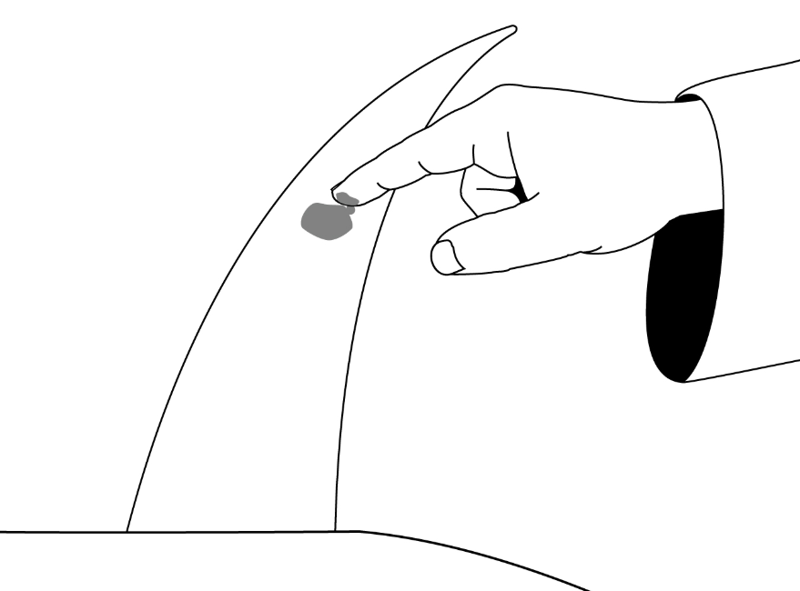

Slide 13
What do you think the act of putting blood on the horns of the altars may have symbolized?
Leviticus 4:20,31
20 And he shall do with the bullock as he did with the bullock for a sin offering, so shall he do with this: and the priest shall make an atonement for them, and it shall be forgiven them.
31 And he shall take away all the fat thereof, as the fat is taken away from off the sacrifice of peace offerings; and the priest shall burn it upon the altar for a sweet savour unto the Lord; and the priest shall make an atonement for him, and it shall be forgiven him.
What can the ancient practice of making sin offerings teach us about the Savior’s atoning sacrifice?
Through the atoning sacrifice of Jesus Christ, we can be forgiven of our sins.
What is an ordinance in our day that directs our minds and hearts toward the Savior and helps us to receive His forgiveness?
How does the ordinance of the sacrament help us to focus on the Savior and receive His forgiveness?

Slide 14
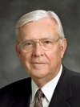
“After the Savior’s ultimate sacrifice, … the ordinance of the sacrament replaced the ordinance of sacrifice. … This change moved the focus of the sacrifice from a person’s animal to the person himself. In a sense, the sacrifice changed from the offering to the offerer. …
“… Instead of the Lord requiring our animals or grain, now He wants us to give up all that is ungodly. … Elder Neal A. Maxwell [1926–2004] of the Quorum of the Twelve Apostles said: ‘Real, personal sacrifice never was placing an animal on the altar. Instead, it is a willingness to put the
Elder
M. Russell Ballard
animal in us upon the altar and letting it be consumed!’ (‘Deny Yourselves of All Ungodliness,’ Ensign, May 1995, 68).
“… When we overcome our own selfish desires and put God first in our lives and covenant to serve Him regardless of the cost, we are then living the law of sacrifice” (M. Russell Ballard, “The Law of Sacrifice,” Ensign, Oct. 1998, 10).
What does the Lord want us to offer Him?
In what ways can we give up “all that is ungodly” or offer “the animal in us” to the Lord?

