Slide 1
SEMINARY
Old Testament

Slide 2
LESSON 17
Genesis 6:13-9:29

Slide 3
Genesis 6:13-7:24
“Noah obeys the Lord’s commandment
to build an ark”

Slide 4
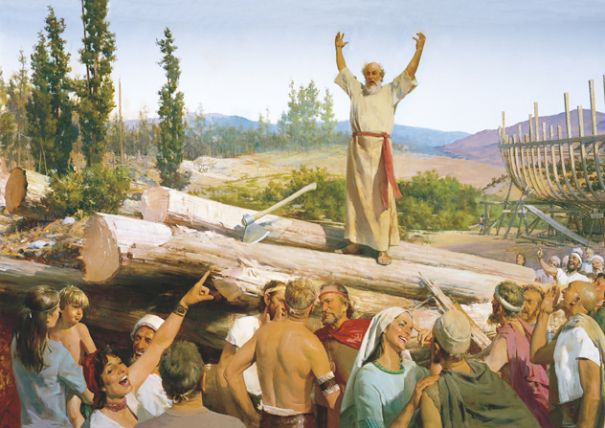
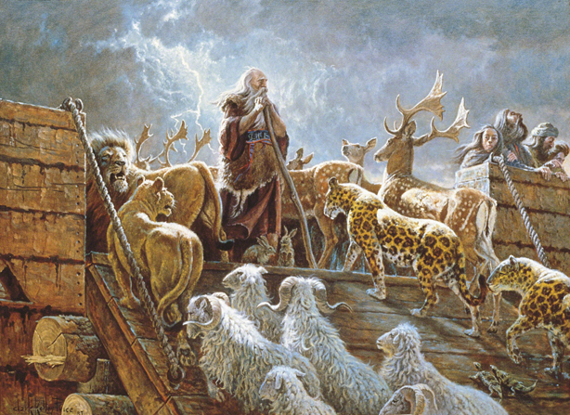
What types of expressions do you see on the faces of the people whom Noah tried to warn?
What do these pictures suggest about how the people responded to the Lord’s instructions?

Slide 5
Genesis 6:13-16
13 And God said unto Noah, The end of all flesh is come before me; for the earth is filled with violence through them; and, behold, I will destroy them with the earth.
14 ¶ Make thee an ark of gopher wood; rooms shalt thou make in the ark, and shalt pitch it within and without with pitch.
15 And this is the fashion which thou shalt make it of: The length of the ark shall be three hundred cubits, the breadth of it fifty cubits, and the height of it thirty cubits.
16 A window shalt thou make to the ark, and in a cubit shalt thou finish it above; and the door of the ark shalt thou set in the side thereof; with lower, second, and third stories shalt thou make it.
What challenges might Noah have faced in constructing the ark?

Slide 6
Genesis 6:17-22
17 And, behold, I, even I, do bring a flood of waters upon the earth, to destroy all flesh, wherein is the breath of life, from under heaven; and every thing that is in the earth shall die.
18 But with thee will I establish my covenant; and thou shalt come into the ark, thou, and thy sons, and thy wife, and thy sons’ wives with thee.
19 And of every living thing of all flesh, two of every sort shalt thou bring into the ark, to keep them alive with thee; they shall be male and female.
20 Of fowls after their kind, and of cattle after their kind, of every creeping thing of the earth after his kind, two of every sort shall come unto thee, to keep them alive.
21 And take thou unto thee of all food that is eaten, and thou shalt gather it to thee; and it shall be for food for thee, and for them.
22 Thus did Noah; according to all that God commanded him, so did he.
What additional challenges might Noah have faced as he obeyed these instructions from the Lord?

Slide 7
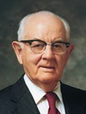
“As yet there was no evidence of rain and flood. His people mocked and called him a fool. His preaching fell on deaf ears. His warnings were considered irrational. There was no precedent; never had it been known that a deluge [or flood] could cover the earth. How foolish to build an ark on dry ground with the sun shining and life moving forward as usual!” (Spencer W. Kimball, Teachings of Presidents of the Church: Spencer W. Kimball [2006], 140–41).
President
Spencer W. Kimball
What are some ways Noah demonstrated faith in the Lord?
If we act in faith by obeying the Lord’s commands …
How would Noah be blessed by acting in faith to build the ark when there appeared to be no danger?
What are some things the Lord has asked us to do that might appear foolish to others?
Why do we need faith to obey the Lord?

Slide 8
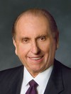
“Noah had the unwavering faith to follow God’s commandments. May we ever do likewise. May we remember that the wisdom of God ofttimes appears as foolishness to men; but the greatest lesson we can learn in mortality is that when God speaks and we obey, we will always be right” (Thomas S. Monson, “Models to Follow,” Ensign or Liahona, Nov. 2002, 61).
President
Thomas S. Monson

Slide 9
True
Noah took seven of some animals on the ark.
Genesis 7:2-3
____________
False
____________
Noah was 60 years old when the Flood came.
Genesis 7:6, 11
True
____________
Rain was the only source of water that flooded the earth.
Genesis 7:11
True
____________
The rain did not cease for 40 days.
Genesis 7:12
True
____________
Eight people were saved on the ark.
Genesis 7:7, 13
False
____________
In addition to Noah’s family and the animals on the ark, one other family also survived the Flood by staying on the top of a mountain.
Genesis 7:19-23

Slide 10
What might you have thought and felt as the floodwater rose?
What might you have thought and felt as the waters rose?
How would you complete the statement on the board?
If we act in faith by obeying the Lord’s commands, we can receive His blessings and protection.

Slide 11
Genesis 8:1-9:17
“Noah and his family leave the ark, and the Lord establishes His covenant with Noah”

Slide 12
Genesis 9:8-11
, 12-17
8 ¶ And God spake unto Noah, and to his sons with him, saying,
9 And I, behold, I establish my covenant with you, and with your seed after you;
10 And with every living creature that is with you, of the fowl, of the cattle, and of every beast of the earth with you; from all that go out of the ark, to every beast of the earth.
11 And I will establish my covenant with you; neither shall all flesh be cut off any more by the waters of a flood; neither shall there any more be a flood to destroy the earth.
12 And God said, This is the token of the covenant which I make between me and you and every living creature that is with you, for perpetual generations:
13 I do set my bow in the cloud, and it shall be for a token of a covenant between me and the earth.
14 And it shall come to pass, when I bring a cloud over the earth, that the bow shall be seen in the cloud:
15 And I will remember my covenant, which is between me and you and every living creature of all flesh; and the waters shall no more become a flood to destroy all flesh.
16 And the bow shall be in the cloud; and I will look upon it, that I may remember the everlasting covenant between God and every living creature of all flesh that is upon the earth.
17 And God said unto Noah, This is the token of the covenant, which I have established between me and all flesh that is upon the earth.
What does a rainbow have to do with the covenant God made with Noah?
God uses tokens as reminders of covenants.

Slide 13
Genesis 8:18-29
“Noah curses Canaan, the son of Ham”

