Slide 1
SEMINARY
El Libro de Mormón

Slide 2
LESSON 34
2 Nephi 21–24

Slide 3
LESSON 34
2 Nephi 21:1–5, 10–12
“Isaiah foresees the Restoration of the gospel of Jesus Christ in the latter days”

Slide 4
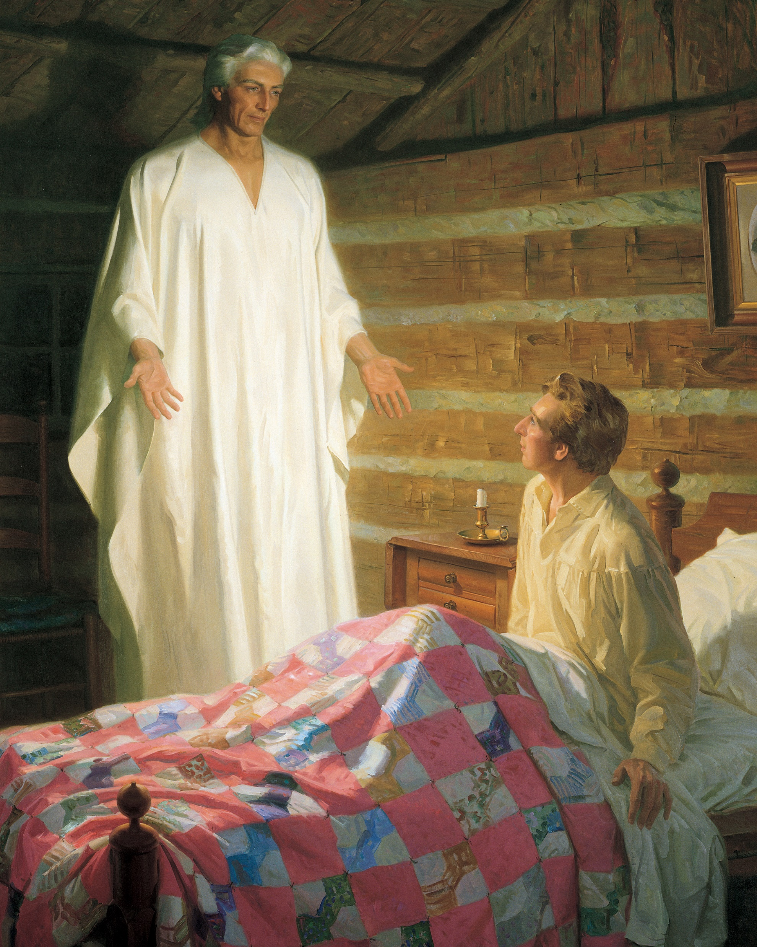
LESSON 34
2 Nephi 21:1, 10
1 And there shall come forth a rod out of the stem of Jesse, and a branch shall grow out of his roots.
10 And in that day there shall be a root of Jesse, which shall stand for an ensign of the people; to it shall the Gentiles seek; and his rest shall be glorious.

Slide 5
LESSON 34
Doctrine and Covenants 113:1-6.
1 Who is the Stem of Jesse spoken of in the 1st, 2d, 3d, 4th, and 5th verses of the 11th chapter of Isaiah?
2 Verily thus saith the Lord: It is Christ.
3 What is the rod spoken of in the first verse of the 11th chapter of Isaiah, that should come of the Stem of Jesse?
4 Behold, thus saith the Lord: It is a servant in the hands of Christ, who is partly a descendant of Jesse as well as of Ephraim, or of the house of Joseph, on whom there is laid much power.
5 What is the root of Jesse spoken of in the 10th verse of the 11th chapter?
6 Behold, thus saith the Lord, it is a descendant of Jesse, as well as of Joseph, unto whom rightly belongs the priesthood, and the keys of the kingdom, for an ensign, and for the gathering of my people in the last days.
Stem of Jesse—Jesus Christ Rod—a servant of Christ “on whom there is laid much power” Root of Jesse—an individual in the latter days who will hold the priesthood and “the keys of the kingdom”

Slide 6
LESSON 34
Elder Bruce R. McConkie of the Quorum of the Twelve Apostles:
“Are we amiss in saying that the prophet here mentioned is Joseph Smith, to whom the priesthood came, who received the keys of the kingdom, and who raised the ensign for the gathering of the Lord’s people in our dispensation? And is he not also the ‘servant in the hands of Christ, who is partly a descendant of Jesse as well as of Ephraim, or of the house of Joseph, on whom there is laid much power’?” (The Millennial Messiah: The Second Coming of the Son of Man [1982], 339-40).
2 Nephi 21:10, 12
10 And in that day there shall be a root of Jesse, which shall stand for an ensign of the people; to it shall the Gentiles seek; and his rest shall be glorious.
11 And it shall come to pass in that day that the Lord shall set his hand again the second time to recover the remnant of his people which shall be left, from Assyria, and from Egypt, and from Pathros, and from Cush, and from Elam, and from Shinar, and from Hamath, and from the islands of the sea.
12 And he shall set up an ensign for the nations, and shall assemble the outcasts of Israel, and gather together the dispersed of Judah from the four corners of the earth.

Slide 7
LESSON 34
How did the work of Joseph Smith fulfill the prophecy concerning the root of Jesse?
In what ways do we gather today as members of the Church? In what ways do we lift an ensign to help others know where to gather?
the Lord has restored His gospel and His Church through the Prophet Joseph Smith and is now gathering His people in the last days.

Slide 8
LESSON 34
2 Nephi 21:6-9; 22
“Isaiah describes the Millennium”

Slide 9
LESSON 34
What do the descriptions in 2 Nephi 21:6-8 suggest about the conditions on the earth during the Millennium?
Why will the earth be a place of peace during the Millennium?
During the Millennium, the earth will be a place of peace because it will be full of the knowledge of the Lord.
How can the knowledge of the Lord help us live more peacefully now?
How can we develop that same attitude today?

Slide 10
LESSON 34
2 Nephi 23-24
“Isaiah teaches that the wicked will perish and that the Lord will have mercy on His people”

Slide 11
LESSON 34
2 Nephi 24:12-16
12 How art thou fallen from heaven, O Lucifer, son of the morning! Art thou cut down to the ground, which did weaken the nations!
13 For thou hast said in thy heart: I will ascend into heaven, I will exalt my throne above the stars of God; I will sit also upon the mount of the congregation, in the sides of the north;
14 I will ascend above the heights of the clouds; I will be like the Most High.
15 Yet thou shalt be brought down to hell, to the sides of the pit.
16 They that see thee shall narrowly look upon thee, and shall consider thee, and shall say: Is this the man that made the earth to tremble, that did shake kingdoms?
What phrases in these verses show Satan’s arrogance?
How does 2 Nephi 24:16 describe how we would feel about Satan if we could see him for what he is?

Slide 12
LESSON 34
President Ezra Taft Benson:
“In the premortal council, it was pride that felled Lucifer, ‘a son of the morning.’ (2 Ne. 24:12–15; see also D&C 76:25–27; Moses 4:3.) . . . In the pre-earthly council, Lucifer placed his proposal in competition with the Father’s plan as advocated by Jesus Christ. (See Moses 4:1–3.) He wished to be honored above all others. (See 2 Ne. 24:13.) In short, his prideful desire was to dethrone God. (See D&C 29:36; 76:28.)” (“Beware of Pride,” Ensign, May 1989, 4–5).

Slide 13
LESSON 34

