Slide 1
SEMINARY
El Libro de Mormón

Slide 2
LESSON 21
1 Nephi 20–22

Slide 3
LESSON 21
1 Nephi 20
“The Lord chastises His people and invites
them to return to Him”

Slide 4
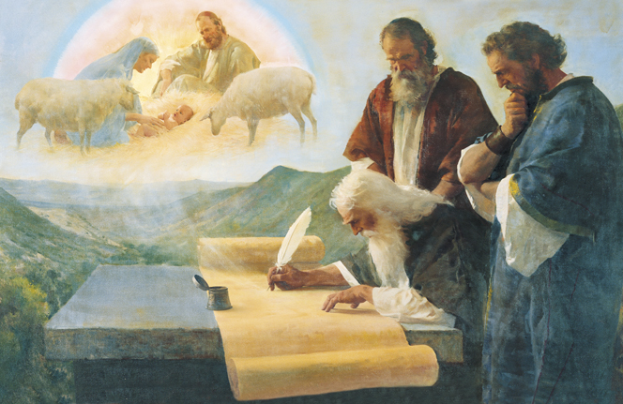

Slide 5
LESSON 21
1Nephi 20:1-2
1 Hearken and hear this, O house of Jacob, who are called by the name of Israel, and are come forth out of the waters of Judah, or out of the waters of baptism, who swear by the name of the Lord, and make mention of the God of Israel, yet they swear not in truth nor in righteousness.
2 Nevertheless, they call themselves of the holy city, but they do not stay themselves upon the God of Israel, who is the Lord of Hosts; yea, the Lord of Hosts is his name.
How were some members of Nephi’s family similar to the people Isaiah called to repentance?
Genesis 32:28
And he said, Thy name shall be called no more Jacob, but Israel: for as a prince hast thou power with God and with men, and hast prevailed.
1 Nephi 20:22
And notwithstanding he hath done all this, and greater also, there is no peace, saith the Lord, unto the wicked.
Why do you think the wicked have no peace?

Slide 6
LESSON 21
1 Nephi 20:14, 16, 20
14 All ye, assemble yourselves, and hear; who among them hath declared these things unto them? The Lord hath loved him; yea, and he will fulfil his word which he hath declared by them; and he will do his pleasure on Babylon, and his arm shall come upon the Chaldeans.
16 Come ye near unto me; I have not spoken in secret; from the beginning, from the time that it was declared have I spoken; and the Lord God, and his Spirit, hath sent me.
20 Go ye forth of Babylon, flee ye from the Chaldeans, with a voice of singing declare ye, tell this, utter to the end of the earth; say ye: The Lord hath redeemed his servant Jacob.
What did the Lord want His covenant people to do and say?
The Lord invites those who have been disobedient to repent and return to Him.

Slide 7
LESSON 21
President Dieter F. Uchtdorf of the First Presidency.
“Satan . . . wants us to feel that we are beyond forgiveness (see Revelation 12:10). Satan wants us to think that when we have sinned we have gone past a ‘point of no return’— that it is too late to change our course. . . . “. . . The Atonement of Jesus Christ is the gift of God to His children to correct and overcome the consequences of sin. God loves all of His children, and He will never cease to love and to hope for us. . . . “Christ came to save us. If we have taken a wrong course, the Atonement of Jesus Christ can give us the assurance that sin is not a point of no return. A safe return is possible if we will follow God’s plan for our salvation. . . . “. . . There is always a point of safe return; there is always hope” (“Point of Safe Return,” Ensign or Liahona, May 2007, 99, 101).
How is President Uchtdorf’s message similar to Isaiah’s message?
The Lord invites those who have been disobedient to repent and return to Him.

Slide 8
LESSON 21
1 Nephi 21:1–17
“Isaiah prophesies that Jesus Christ will not forget His covenant people”

Slide 9
Why do you think people sometimes feel that the Lord has forgotten them?
LESSON 21
The Lord loves us, and He will never forget us
1 Nephi 21:14
But, behold, Zion hath said: The Lord hath forsaken me, and my Lord hath forgotten me—but he will show that he hath not.
1 Nephi 21:15-16
15 For can a woman forget her sucking child, that she should not have compassion on the son of her womb? Yea, they may forget, yet will I not forget thee, O house of Israel.
16 Behold, I have graven thee upon the palms of my hands; thy walls are continually before me.
What does Isaiah teach by comparing the Savior to a mother of an infant?
What does the word graven imply?
What does it mean to you to be graven “upon the palms of [the Savior’s] hands”?
What experiences have helped you know that the Lord has not forgotten you?

Slide 10
LESSON 21
1 Nephi 21:18–26; 22:1-22
“Nephi explains Isaiah’s prophecy of the scattering and gathering of Israel”

Slide 11
LESSON 21
1 Nephi 21:22-23
22 Thus saith the Lord God: Behold, I will lift up mine hand to the Gentiles, and set up my standard to the people; and they shall bring thy sons in their arms, and thy daughters shall be carried upon their shoulders.
23 And kings shall be thy nursing fathers, and their queens thy nursing mothers; they shall bow down to thee with their face towards the earth, and lick up the dust of thy feet; and thou shalt know that I am the Lord; for they shall not be ashamed that wait for me.
1 Nephi 22:6-8
6 Nevertheless, after they shall be nursed by the Gentiles, and the Lord has lifted up his hand upon the Gentiles and set them up for a standard, and their children have been carried in their arms, and their daughters have been carried upon their shoulders, behold these things of which are spoken are temporal; for thus are the covenants of the Lord with our fathers; and it meaneth us in the days to come, and also all our brethren who are of the house of Israel.
7 And it meaneth that the time cometh that after all the house of Israel have been scattered and confounded, that the Lord God will raise up a mighty nation among the Gentiles, yea, even upon the face of this land; and by them shall our seed be scattered.
8 And after our seed is scattered the Lord God will proceed to do a marvelous work among the Gentiles, which shall be of great worth unto our seed; wherefore, it is likened unto their being nourished by the Gentiles and being carried in their arms and upon their shoulders.
What is the “marvelous work” mentioned in 1 Nephi 22:7-8?
How can sharing the gospel be like carrying others in our arms or on our shoulders?

Slide 12
LESSON 21
Elder Bruce R. McConkie of the Quorum of the Twelve Apostles:
“Why was Israel scattered? The answer is clear; it is plain; of it there is no doubt. Our Israelite forebears were scattered because they rejected the gospel, defiled the priesthood, forsook the church, and departed from the kingdom. . . . “What, then, is involved in the gathering of Israel? The gathering of Israel consists in believing and accepting and living in harmony with all that the Lord once offered his ancient chosen people. . . . It consists of believing the gospel, joining the Church, and coming into the kingdom. . . . It may also consist of assembling to an appointed place or land of worship” (A New Witness for the Articles of Faith [1985], 515).

Slide 13
LESSON 21
1 Nephi 22:9–12.
9 And it shall also be of worth unto the Gentiles; and not only unto the Gentiles but unto all the house of Israel, unto the making known of the covenants of the Father of heaven unto Abraham, saying: In thy seed shall all the kindreds of the earth be blessed.
10 And I would, my brethren, that ye should know that all the kindreds of the earth cannot be blessed unless he shall make bare his arm in the eyes of the nations.
11 Wherefore, the Lord God will proceed to make bare his arm in the eyes of all the nations, in bringing about his covenants and his gospel unto those who are of the house of Israel.
In 1 Nephi 22:11, what does Nephi say the Lord will do in the last days to show His power?
How does gathering people into the Church bring them out of captivity and darkness?
According to 1 Nephi 22:25, what blessings come to those who are gathered by the Lord? What do you think it means to “be one fold”?
The Lord promised to restore the gospel and gather Israel in the latter days.
How do you think those who are gathered (converts) will feel about those who have gathered them (those who have shared the gospel with them)?
What can you do to share the gospel of Jesus Christ with others?

Slide 14
LESSON 21

