Slide 1
SEMINARY
El Libro de Mormón

Slide 2
LESSON 17
1 Nephi 16

Slide 3
LESSON 17
1 Nephi 16:1-6
“Nephi responds to the murmuring
of his brothers”

Slide 4
LESSON 17
1 Nephi 16:2-5
2 And it came to pass that I said unto them that I knew that I had spoken hard things against the wicked, according to the truth; and the righteous have I justified, and testified that they should be lifted up at the last day; wherefore, the guilty taketh the truth to be hard, for it cutteth them to the very center.
3 And now my brethren, if ye were righteous and were willing to hearken to the truth, and give heed unto it, that ye might walk uprightly before God, then ye would not murmur because of the truth, and say: Thou speakest hard things against us.
4 And it came to pass that I, Nephi, did exhort my brethren, with all diligence, to keep the commandments of the Lord.
5 And it came to pass that they did humble themselves before the Lord; insomuch that I had joy and great hopes of them, that they would walk in the paths of righteousness.
What do you think it means that “the guilty taketh the truth to be hard”? What do you think is the meaning of the phrase “it cutteth them to the very center”?
What are some ways we might respond if a truth is hard to bear?
How did Nephi’s brothers respond to his instruction?
What does 1 Nephi 16:5 suggest about how we should respond when the truth “cut[s us] to the very center”?

Slide 5
LESSON 17
1 Nephi 16:7−33
“The Lord guides Lehi’s family
through the Liahona”

Slide 6
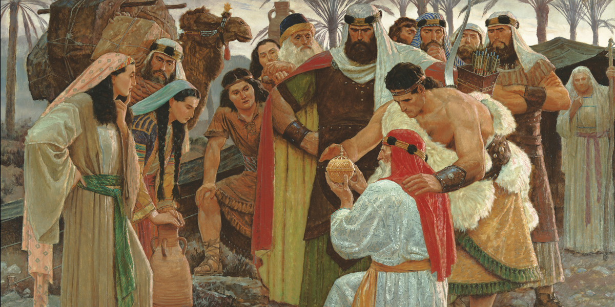
LESSON 17

Slide 7
LESSON 17
In what ways do you think such a gift would have been helpful to Lehi and his family in their circumstances?
1 Nephi 16:16-19.
16 And we did follow the directions of the ball, which led us in the more fertile parts of the wilderness.
17 And after we had traveled for the space of many days, we did pitch our tents for the space of a time, that we might again rest ourselves and obtain food for our families.
18 And it came to pass that as I, Nephi, went forth to slay food, behold, I did break my bow, which was made of fine steel; and after I did break my bow, behold, my brethren were angry with me because of the loss of my bow, for we did obtain no food.
19 And it came to pass that we did return without food to our families, and being much fatigued, because of their journeying, they did suffer much for the want of food.
How did the Liahona benefit Lehi’s family?
After Lehi’s family received the Liahona, was their journey easy or difficult? What does Nephi relate in 1 Nephi 16:17–19 to support your answer?
Why do you think righteous people, such as Lehi and Nephi, sometimes have to face trials?

Slide 8
LESSON 17
1 Nephi 16:23-25, 30-32
23 And it came to pass that I, Nephi, did make out of wood a bow, and out of a straight stick, an arrow; wherefore, I did arm myself with a bow and an arrow, with a sling and with stones. And I said unto my father: Whither shall I go to obtain food?
24 And it came to pass that he did inquire of the Lord, for they had humbled themselves because of my words; for I did say many things unto them in the energy of my soul.
25 And it came to pass that the voice of the Lord came unto my father; and he was truly chastened because of his murmuring against the Lord, insomuch that he was brought down into the depths of sorrow.
30 And it came to pass that I, Nephi, did go forth up into the top of the mountain, according to the directions which were given upon the ball.
31 And it came to pass that I did slay wild beasts, insomuch that I did obtain food for our families.
32 And it came to pass that I did return to our tents, bearing the beasts which I had slain; and now when they beheld that I had obtained food, how great was their joy! And it came to pass that they did humble themselves before the Lord, and did give thanks unto him.
What can we learn by comparing these two responses to the same trial?
Why is it significant that Nephi went to his father for direction, even though Lehi had been murmuring?
What additional principles can we learn from Nephi’s response to his family’s adversity?
If we do all we can and also seek the Lord’s direction, then He will help us through our difficulties.

Slide 9
LESSON 17
1 Nephi 16:26-29
26 And it came to pass that the voice of the Lord said unto him: Look upon the ball, and behold the things which are written.
27 And it came to pass that when my father beheld the things which were written upon the ball, he did fear and tremble exceedingly, and also my brethren and the sons of Ishmael and our wives.
28 And it came to pass that I, Nephi, beheld the pointers which were in the ball, that they did work according to the faith and diligence and heed which we did give unto them.
29 And there was also written upon them a new writing, which was plain to be read, which did give us understanding concerning the ways of the Lord; and it was written and changed from time to time, according to the faith and diligence which we gave unto it. And thus we see that by small means the Lord can bring about great things.
What is the difference between casually following the direction of the Lord and following the Lord’s direction with faith and diligence?
What principle is taught in these three passages?
By small means, the Lord can bring about great things.
What “small means” has the Lord provided to give us guidance?

Slide 10
LESSON 17
What are two or three ways that . . . is like the Liahona?
What are some things that might cause us to miss important messages from . . . ?
When have you been blessed by following the guidance of . . . ?
Group 1: A Patriarchal Blessing
President Thomas S. Monson Said: “The same Lord who provided a Liahona for Lehi provides for you and for me today a rare and valuable gift to give direction to our lives, to mark the hazards to our safety, and to chart the way, even safe passage—not to a promised land, but to our heavenly home. The gift to which I refer is known as your patriarchal blessing. . . . “. . . Your blessing is not to be folded neatly and tucked away. It is not to be framed or published. Rather, it is to be read. It is to be loved. It is to be followed. Your patriarchal blessing will see you through the darkest night. It will guide you through life’s dangers. . . .Your patriarchal blessing is to you a personal Liahona to chart your course and guide your way” (“Your Patriarchal Blessing: A Liahona of Light,” Ensign, Nov. 1986, 65–66).

Slide 11
LESSON 17
Group 2: The Scriptures and the Words of Latter-Day Prophets
Elder W. Rolfe Kerr of the Seventy Said: “The words of Christ can be a personal Liahona for each of us, showing us the way. Let us not be slothful because of the easiness of the way. Let us in faith take the words of Christ into our minds and into our hearts as they are recorded in sacred scripture and as they are uttered by living prophets, seers, and revelators. Let us with faith and diligence feast upon the words of Christ, for the words of Christ will be our spiritual Liahona telling us all things what we should do” (“The Words of Christ—Our Spiritual Liahona,” Ensign or Liahona, May 2004, 37).
Group 3: The Holy Ghost
Elder David A. Bednar of the Quorum of the Twelve Apostles Said: “As we strive to align our attitudes and actions with righteousness, then the Holy Ghost becomes for us today what the Liahona was for Lehi and his family in their day. The very factors that caused the Liahona to work for Lehi will likewise invite the Holy Ghost into our lives. And the very factors that caused the Liahona not to work anciently will likewise cause us to withdraw ourselves from the Holy Ghost today” (“That We May Always Have His Spirit to Be with Us,” Ensign or Liahona, May 2006, 30).

Slide 12
LESSON 17

