Slide 1
SEMINARY
El Libro de Mormón

Slide 2
LESSON 13
1 Nephi 10–11

Slide 3
LESSON 13
1Nephi 10:1-16
“Lehi prophesies of the
Messiah”

Slide 4
When would the Savior come?
LESSON 13
1 Nephi 10:4-6
4 Yea, even six hundred years from the time that my father left Jerusalem, a prophet would the Lord God raise up among the Jews—even a Messiah, or, in other words, a Savior of the world.
5 And he also spake concerning the prophets, how great a number had testified of these things, concerning this Messiah, of whom he had spoken, or this Redeemer of the world.
6 Wherefore, all mankind were in a lost and in a fallen state, and ever would be save they should rely on this Redeemer.
What would happen to mankind if they did not rely on the Savior?

Slide 5
LESSON 13
1 Nephi 10:17–22; 11:1–6
“Nephi seeks to see, hear, and know the truths his father taught”

Slide 6
LESSON 13
How is it possible that the three young men could attend the same meeting but have such different experiences?
1Nephi 10:19
For he that diligently seeketh shall find; and the mysteries of God shall be unfolded unto them, by the power of the Holy Ghost, as well in these times as in times of old, and as well in times of old as in times to come; wherefore, the course of the Lord is one eternal round.
Who can know the mysteries of God?
By what power are the mysteries of God revealed?
What must we do to receive revelation by the power of the Holy Ghost?
What do you think it means to diligently seek?
What did Nephi do that demonstrated he was diligently seeking to see, hear, and know the things his father had taught?
God reveals truth to
all those who diligently seek Him.

Slide 7
LESSON 13
1Nephi 11:7-36
“Nephi witnesses the condescension
of God”

Slide 8
LESSON 13
What did Nephi say was the meaning of the tree?
How did Nephi and the angel describe the love of God?
1 Nephi 11:16-17
16 And he said unto me: Knowest thou the condescension of God?
17 And I said unto him: I know that he loveth his children; nevertheless, I do not know the meaning of all things.
What did Nephi know?
What didn’t he know?
Elder Bruce R. McConkie of the Quorum of the Twelve Apostles:
“The condescension of God lies in the fact that he, an exalted Being, steps down from his eternal throne to become the Father of a mortal Son” (The Mortal Messiah [1979], 1:314).

Slide 9
LESSON 13
Elder Gerald N. Lund, formerly of the Seventy:
“Here was Jesus—a member of the Godhead, the Firstborn of the Father, the Creator, Jehovah of the Old Testament—now leaving His divine and holy station; divesting Himself of all that glory and majesty and entering the body of a tiny infant; helpless, completely dependent on His mother and earthly father. That He should not come to the finest of earthly palaces and be . . . showered with jewels but should come to a lowly stable is astonishing. Little wonder that the angel should say to Nephi, ‘Behold the condescension of God!’” (Jesus Christ, Key to the Plan of Salvation [1991], 16).
How does the Savior’s birth show His love for us?

Slide 10
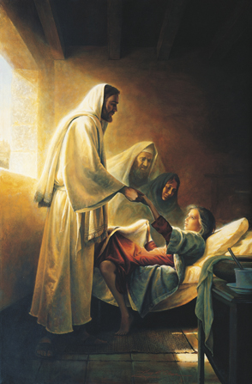
LESSON 13
1 Nephi 11:28,31
28 And I beheld that he went forth ministering unto the people, in power and great glory; and the multitudes were gathered together to hear him; and I beheld that they cast him out from among them.
31 And he spake unto me again, saying: Look! And I looked, and I beheld the Lamb of God going forth among the children of men. And I beheld multitudes of people who were sick, and who were afflicted with all manner of diseases, and with devils and unclean spirits; and the angel spake and showed all these things unto me. And they were healed by the power of the Lamb of God; and the devils and the unclean spirits were cast out.
Whom did Nephi see the Savior ministering to and healing?
How do the Savior’s actions show His love?

Slide 11
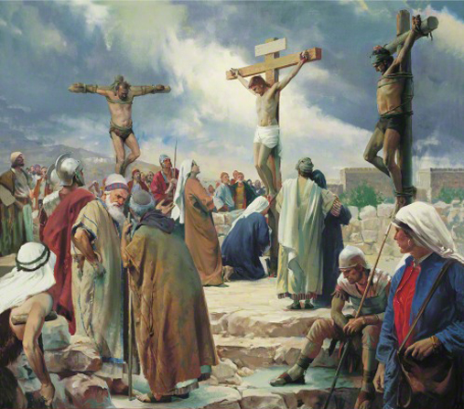
LESSON 13
1Nephi 11:32-33
32 And it came to pass that the angel spake unto me again, saying: Look! And I looked and beheld the Lamb of God, that he was taken by the people; yea, the Son of the everlasting God was judged of the world; and I saw and bear record.
33 And I, Nephi, saw that he was lifted up upon the cross and slain for the sins of the world.
The condescension of Jesus Christ demonstrates God’s love for us.

Slide 12
LESSON 13

