Slide 1
SEMINARY
El Libro de Mormón

Slide 2
LESSON 12
1 Nephi 8

Slide 3
LESSON 12
1Nephi 8:1-18
“Lehi experiences a vision in which he partakes of the fruit of the tree of life and invites his family to do the same”

Slide 4
LESSON 12
1 Nephi 8:2
And it came to pass that while my father tarried in the wilderness he spake unto us, saying: Behold, I have dreamed a dream; or, in other words, I have seen a vision.
What objects were the focus of Lehi’s vision?
The tree of life and its fruit.
What words and phrases did Lehi use to describe the fruit?

Slide 5
LESSON 12
Elder Neal A. Maxwell of the Quorum of the Twelve Apostles.
“The tree of life . . . is the love of God (see 1 Ne. 11:25).The love of God for His children is most profoundly expressed in His gift of Jesus as our Redeemer: ‘God so loved the world, that he gave his only begotten Son’ (John 3:16). To partake of the love of God is to partake of Jesus’ Atonement and the emancipations and joys which it can bring” (“Lessons from Laman and Lemuel,” Ensign, Nov. 1999, 8).
According to Elder Maxwell, the tree of life represents the love of God shown to us especially through what gift?
How does the Atonement of Jesus Christ free us from bondage and bring us joy?

Slide 6
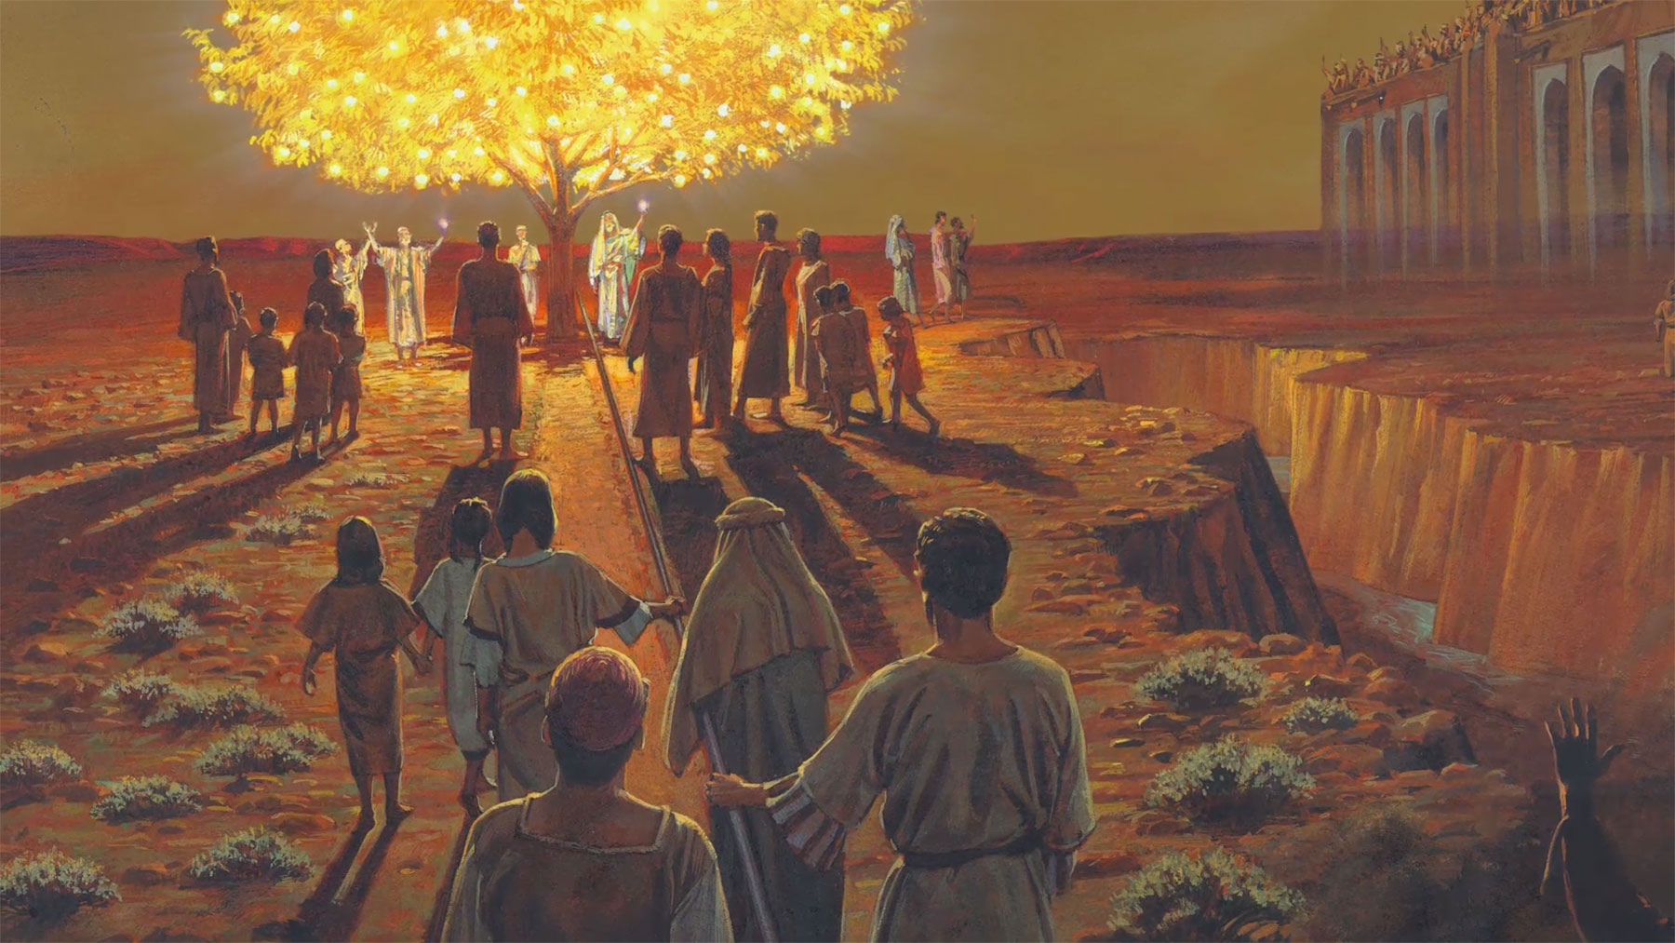
LESSON 12

Slide 7
LESSON 12
What feelings did Lehi experience after partaking of the fruit?
How can we “partake” of the Atonement?
Why does partaking of the Atonement fill our souls with “exceedingly great joy”?
Coming unto Jesus Christ and partaking of the Atonement brings happiness and joy.
When has the Savior’s Atonement brought happiness and joy to your life?

Slide 8
LESSON 12
1 Nephi 8:19-35
“In his vision, Lehi sees various groups of people and their success or failure in reaching the tree of life”

Slide 9
LESSON 12
Symbol in Lehi’s Vision Interpretation Shared by Nephi
1 Nephi 8:10-12—The tree with white fruit
1 Nephi 11:21–25 (The love of God; the blessings of the Atonement of Jesus Christ)
1 Nephi 8:13—The river of filthy water
1 Nephi 8:19—The rod of iron
1 Nephi 12:16; 15:26-29 (Filthiness; the depths of hell)
1 Nephi 8:23—The mists of darkness
1 Nephi 11:25 (The word of God)
1 Nephi 8:26—The great and spacious building
1 Nephi 12:17 (The temptations of the devil)
1 Nephi 11:35–36; 12:18 (The pride and vain imaginations of the world)

Slide 10
LESSON 12
You may think that Lehi’s dream or vision has no special meaning for you, but it does. You are in it; all of us are in it. . . . “Lehi’s dream or vision . . . has in it everything a Latter-day Saint needs to understand the test of life” (“Finding Ourselves in Lehi’s Dream,” Ensign, Aug. 2010, 22).

Slide 11
LESSON 12
Group 2
What obstacles did the people in Lehi’s vision face?
What do those obstacles represent?
What form do those obstacles take today?
What principles do you see in these verses?
Group 2
What helped the people reach the tree and partake of the fruit?
In what ways is an iron rod like the word of God?
How does the word of God help us overcome obstacles on the path to eternal life?
What principles do you see in these verses?

Slide 12
LESSON 12
Pride, worldliness, and submitting to temptations can keep us from receiving the blessings of the Atonement.
If we hold fast to the word of God, it will help us overcome temptation and worldly influences.
Holding fast to the word of God helps us grow closer to the Lord and receive the blessings of the Atonement.
In 1 Nephi 8:24 and 30, what words describe people’s efforts to hold on to the iron rod and reach the tree?
What do you think it means to “press forward”?
What do you think it means to cling and continually hold fast to the word of God?
Why should we study the scriptures every day?

Slide 13
LESSON 12

