Slide 1
SEMINARY
New Testament

Slide 2
LESSON 8
Matthew 4

Slide 3
LESSON 8
Matthew 4:1-11
“Jesus resists the devil’s temptations”

Slide 4
LESSON 8
How did you do? Why were you able, or unable, to maintain your focus?
What did you think about during the 30 seconds?
How is this experience like our efforts to stay focused on obeying Heavenly Father’s commandments?
Why does Satan tempt us to sin?
Matthew 4:1-2
1 Then was Jesus led up of the Spirit into the wilderness to be tempted of the devil.
2 And when he had fasted forty days and forty nights, he was afterward an hungred.
How would fasting and communing with Heavenly Father have helped Jesus prepare for His earthly ministry?
After Jesus had spent this time in fasting and communion with His Father, what did Satan seek to do?

Slide 5
LESSON 8
Matthew 4:5, 8
5 Then the devil taketh him up into the holy city, and setteth him on a pinnacle of the temple,
8 Again, the devil taketh him up into an exceeding high mountain, and sheweth him all the kingdoms of the world, and the glory of them;
What desire did Satan try to appeal to when he tempted Jesus, who had been fasting, to turn the stones into bread?
What was false about Satan’s offer to give Jesus the kingdoms of the world?
What else does this account illustrate about the devil’s strategies to tempt us to sin?
What was similar about the Savior’s responses to each temptation?

Slide 6
LESSON 8

Slide 7
LESSON 8
Matthew 4:12-17
“Jesus dwells in Galilee”

Slide 8
LESSON 8
Matthew 4:18-22
“Jesus calls Peter and others to
follow Him”

Slide 9
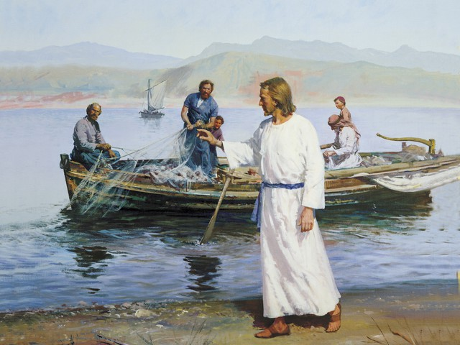
LESSON 8
What are they doing with the net?
In what ways are we like Peter and Andrew?

Slide 10
LESSON 8
Matthew 4:18-22.
18 ¶ And Jesus, walking by the sea of Galilee, saw two brethren, Simon called Peter, and Andrew his brother, casting a net into the sea: for they were fishers.
19 And he saith unto them, Follow me, and I will make you fishers of men.
20 And they straightway left their nets, and followed him.
21 And going on from thence, he saw other two brethren, James the son of Zebedee, and John his brother, in a ship with Zebedee their father, mending their nets; and he called them.
22 And they immediately left the ship and their father, and followed him.
What did the Savior call Peter, Andrew, James, and John to do? What is a “[fisher] of men”?
What would these men be sacrificing to follow the Savior and assist in His work? Why might this be difficult for them?
What did you notice about the response of these men? What does their immediate response to the Savior’s invitation show about their character?
Would these men do more good in their lives as fishermen or as “fishers of men”? Why?

Slide 11
LESSON 8
President Ezra Taft Benson.
“Men and women who turn their lives over to God will discover that He can make a lot more out of their lives than they can. He will deepen their joys, expand their vision, quicken their minds, strengthen their muscles, lift their spirits, multiply their blessings, increase their opportunities, comfort their souls, raise up friends, and pour out peace. Whoever will lose his life in the service of God will find eternal life” (“Jesus Christ—Gifts and Expectations,” Ensign, Dec. 1988, 4).
When have you, or someone you know, experienced similar blessings for leaving behind worldly concerns in order to follow the Savior?
Why do you think it is important to respond immediately to the Savior’s invitations to follow Him?
How can you better respond to the Savior’s invitations to follow Him?

Slide 12
LESSON 8
Matthew 4:23-25
“Jesus goes about Galilee teaching,
preaching, and healing”

Slide 13
LESSON 8

