Slide 1
SEMINARY
New Testament

Slide 2
LESSON 7
Matthew 3

Slide 3
LESSON 7
Matthew 3:1-12
“John the Baptist preaches in Judea”

Slide 4
LESSON 7
What would you think about this student’s apologies?
How might this student’s actions be similar to trying to repent insincerely?
Matthew 3:1-4
1 In those days came John the Baptist, preaching in the wilderness of Judæa,
2 And saying, Repent ye: for the kingdom of heaven is at hand.
3 For this is he that was spoken of by the prophet Esaias, saying, The voice of one crying in the wilderness, Prepare ye the way of the Lord, make his paths straight.
4 And the same John had his raiment of camel’s hair, and a leathern girdle about his loins; and his meat was locusts and wild honey.
Who was John the Baptist?
What was John doing?
What did John exhort his listeners to do?
How do you think declaring repentance and baptizing with water helped prepare the way of the Lord?

Slide 5
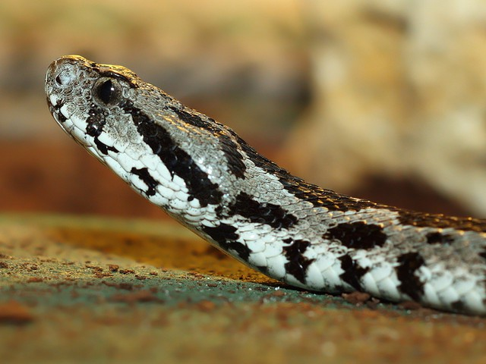
LESSON 7
Matthew 3:5-6
5 Then went out to him Jerusalem, and all Judæa, and all the region round about Jordan,
6 And were baptized of him in Jordan, confessing their sins.
7 ¶ But when he saw many of the Pharisees and Sadducees come to his baptism, he said unto them, O generation of vipers, who hath warned you to flee from the wrath to come?
How did people respond to John’s message?
Whom did John speak to?
What did John call the Pharisees and Sadducees?
Why do you think John referred to the Pharisees and Sadducees as vipers?

Slide 6
LESSON 7
Joseph Smith Translation, Matthew 3:34-36
34 Why is it that ye receive not the preaching of him whom God hath sent? If ye receive not this in your hearts, ye receive not me; and if ye receive not me, ye receive not him of whom I am sent to bear record; and for your sins ye have no cloak.
35 Repent, therefore, and bring forth fruits meet for repentance;
36 And think not to say within yourselves, We are the children of Abraham, and we only have power to bring seed unto our father Abraham; for I say unto you that God is able of these stones to raise up children into Abraham.
If the Pharisees and Sadducees rejected his preaching, whom would they also reject?
How would you summarize John’s message to them?
Bring forth fruits meet for repentance

Slide 7
LESSON 7
Did the student appropriately demonstrate the principle of repentance through his or her desires and actions? Why not?
How would you summarize what it means to “bring forth … fruits meet for repentance”?
We demonstrate true repentance to the Lord as we change our desires and actions to follow His teachings.
What desires and actions indicate that we have truly repented of our sins?
Cheating in school, being mean to siblings, being unkind to or bullying other students, using bad language, and viewing pornography.

Slide 8
LESSON 7
Matthew 3:10
10 And now also the axe is laid unto the root of the trees: therefore every tree which bringeth not forth good fruit is hewn down, and cast into the fire.
11 I indeed baptize you with water unto repentance: but he that cometh after me is mightier than I, whose shoes I am not worthy to bear: he shall baptize you with the Holy Ghost, and with fire:
What would Jesus do that John could not?

Slide 9
LESSON 7
Matthew 3:13-17
“Jesus Christ is baptized, and the Father acclaims Him as His Beloved Son”

Slide 10
LESSON 7
Matthew 3:13-17
13 ¶ Then cometh Jesus from Galilee to Jordan unto John, to be baptized of him.
14 But John forbad him, saying, I have need to be baptized of thee, and comest thou to me?
15 And Jesus answering said unto him, Suffer it to be so now: for thus it becometh us to fulfil all righteousness. Then he suffered him.
16 And Jesus, when he was baptized, went up straightway out of the water: and, lo, the heavens were opened unto him, and he saw the Spirit of God descending like a dove, and lighting upon him:
17 And lo a voice from heaven, saying, This is my beloved Son, in whom I am well pleased.
Who baptized Jesus?
Why did Jesus travel from Galilee to the Jordan River to be baptized by John the Baptist?
What phrase in verse 16 indicates how Jesus was baptized?
Why was John initially reluctant to baptize the Savior?
Why did Jesus say He needed to be baptized?
What do you think this phrase means?

Slide 11
LESSON 7
Matthew 3:16-17
16 And Jesus, when he was baptized, went up straightway out of the water: and, lo, the heavens were opened unto him, and he saw the Spirit of God descending like a dove, and lighting upon him:
17 And lo a voice from heaven, saying, This is my beloved Son, in whom I am well pleased.
Where was each member of the Godhead during the Savior’s baptism?
What doctrine do these verses teach us about the Godhead?
The Father, the Son, and the Holy Ghost are three distinct and separate beings.

Slide 12
LESSON 7

