Slide 1
SEMINARY
New Testament

Slide 2
LESSON 5
“Context and Overview of the
New Testament”

Slide 3
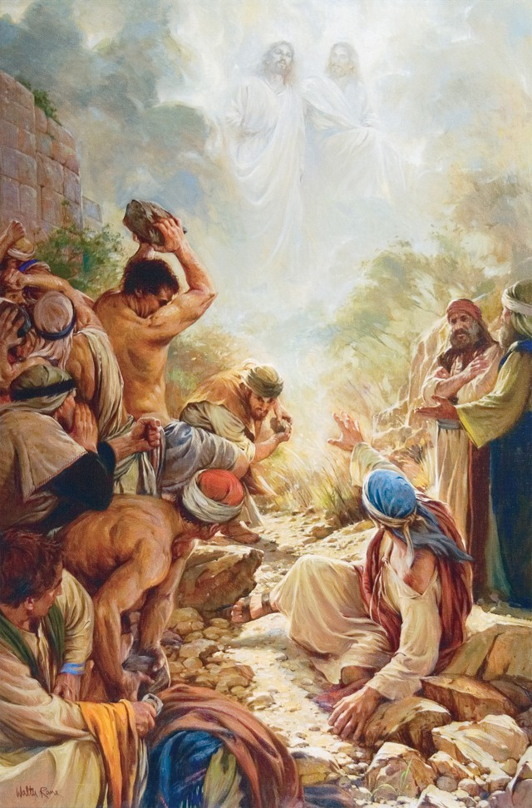
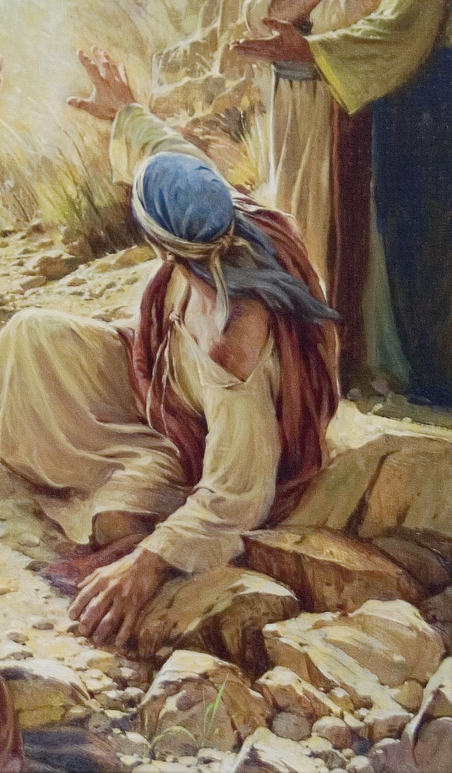
LESSON 5
How does seeing the full picture help you understand what is happening?
How can we liken uncovering this picture to understanding the scriptures?

Slide 4
LESSON 5
Jewish religious leaders during the Savior’s ministry
2 Nephi 10:3-5
3 Wherefore, as I said unto you, it must needs be expedient that Christ—for in the last night the angel spake unto me that this should be his name—should come among the Jews, among those who are the more wicked part of the world; and they shall crucify him—for thus it behooveth our God, and there is none other nation on earth that would crucify their God.
4 For should the mighty miracles be wrought among other nations they would repent, and know that he be their God.
5 But because of priestcrafts and iniquities, they at Jerusalem will stiffen their necks against him, that he be crucified.
What words or phrases did Jacob use to describe the spiritual condition among some of the Jews?
Matthew 23:16, 24
16 Woe unto you, ye blind guides, which say, Whosoever shall swear by the temple, it is nothing; but whosoever shall swear by the gold of the temple, he is a debtor!
24 Ye blind guides, which strain at a gnat, and swallow a camel.
How did the Savior describe these Jewish religious leaders?
What did the Savior teach about these leaders by calling them “blind guides”?

Slide 5
LESSON 5
Additions to the law of Moses and other false philosophies
Law of Moses
Oral Law
Elder Bruce R. McConkie of the Quorum of the Twelve Apostles:
“They took the plain and simple things of pure religion and added to them a host of their own interpretations; they embellished them with added rites and performances; and they took a happy, joyous way of worship and turned it into a restrictive, curtailing, depressive system of rituals and performances. The living spirit of the Lord’s law became in their hands the dead letter of Jewish ritualism” (The Mortal Messiah, 4 vols. [1979–81], 1:238).
What had the Jewish religious leaders done to God’s law with their added interpretations?

Slide 6
LESSON 5
Matthew 12:14
¶ Then the Pharisees went out, and held a council against him, how they might destroy him.
What did these religious leaders conspire to do to Jesus?
1 Corinthians 15:12
Now if Christ be preached that he rose from the dead, how say some among you that there is no resurrection of the dead?
Foreign rule and the expectation of a Messiah to deliver Israel
Babylon, Persia, Macedonia (Greece), and Rome.
What did these ancient empires have in common?

Slide 7
LESSON 5
Except for one period of independence, by New Testament times the Jews had lived as a conquered people for over 500 years. A revolt led by the Maccabees, a family of Jewish patriots, led to independence about 160 years before Christ’s birth. However, by the time of Christ’s birth, Rome had conquered Israel. King Herod (also known as Herod the Great), who had married into the Maccabee family, was appointed by Rome to rule over Israel. The Jews resented Roman rule and eagerly looked forward to a promised Messiah who they believed would deliver them from the Romans. Because many Jews expected a Messiah who would deliver them from foreign rule, they rejected Jesus Christ as their Savior.
What did many Jews expect from the coming Messiah?
Why do you think this false expectation led many Jews to reject Jesus as the Messiah?

Slide 8
LESSON 5
Luke 2:25-33
25 And, behold, there was a man in Jerusalem, whose name was Simeon; and the same man was just and devout, waiting for the consolation of Israel: and the Holy Ghost was upon him.
26 And it was revealed unto him by the Holy Ghost, that he should not see death, before he had seen the Lord’s Christ.
27 And he came by the Spirit into the temple: and when the parents brought in the child Jesus, to do for him after the custom of the law,
28 Then took he him up in his arms, and blessed God, and said,
29 Lord, now lettest thou thy servant depart in peace, according to thy word:
30 For mine eyes have seen thy salvation,
31 Which thou hast prepared before the face of all people;
32 A light to lighten the Gentiles, and the glory of thy people Israel.
33 And Joseph and his mother marvelled at those things which were spoken of him.
Why was Jesus sent to earth?
Jesus Christ was sent to bring salvation to all people.
What did Jesus Christ do to allow all people to be saved?

Slide 9
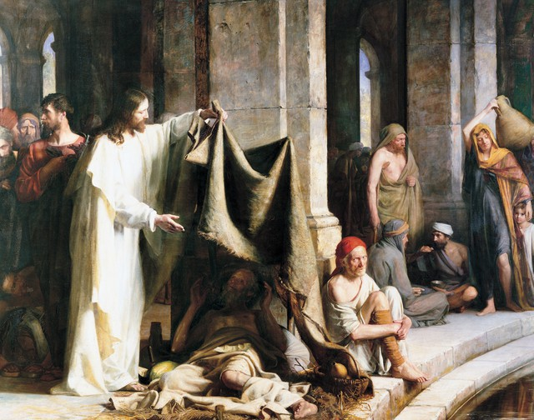
LESSON 5
A brief preview of the New Testament
Why did your descriptions differ?
Why is it helpful to have more than one witness of an event?

Slide 10
LESSON 5
Matthew, Mark, Luke, and John.
Why is it helpful to have more than one gospel or testimony of the life and teachings of Jesus Christ?

