Slide 1
SEMINARY
New Testament

Slide 2
LESSON 2
The Plan of Salvation

Slide 3
LESSON 2
Jesus Christ’s role in the premortal life
How would you respond if someone asked you why Jesus Christ is important to you?

Slide 4
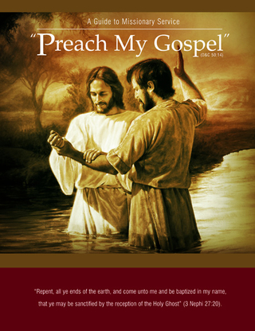
LESSON 2
Jesus Christ is central to Heavenly Father’s plan of salvation
Premortal Life
Mortal Life
Postmortal Life
“We lived as spirit children of our Father in Heaven before we were born on this earth. We were not, however, like our Heavenly Father, nor could we ever become like Him and enjoy all the blessings that He enjoys without the experience of living in mortality with a physical body.
“God’s whole purpose﻿—His work and His glory﻿—is to enable each of us to enjoy all His blessings. He has provided a perfect plan to accomplish His purpose. We understood and accepted this plan before we came to the earth. …
“In order to progress and become like God, each of us had to obtain a body and be tested during a time of probation on the earth” (Preach My Gospel: A Guide to Missionary Service [2004], 48, 49).
What limitations did we experience in our premortal life?

Slide 5
LESSON 2
Moses 4:1-3
1 And I, the Lord God, spake unto Moses, saying: That Satan, whom thou hast commanded in the name of mine Only Begotten, is the same which was from the beginning, and he came before me, saying—Behold, here am I, send me, I will be thy son, and I will redeem all mankind, that one soul shall not be lost, and surely I will do it; wherefore give me thine honor.
2 But, behold, my Beloved Son, which was my Beloved and Chosen from the beginning, said unto me—Father, thy will be done, and the glory be thine forever.
3 Wherefore, because that Satan rebelled against me, and sought to destroy the agency of man, which I, the Lord God, had given him, and also, that I should give unto him mine own power; by the power of mine Only Begotten, I caused that he should be cast down;
What did Satan demand of Heavenly Father?
What did Heavenly Father say about Jesus Christ?
What was Jesus Christ chosen to do?
Jesus Christ was chosen in the premortal life to be the Redeemer of mankind.

Slide 6
LESSON 2
Hebrews 1:1-2
1 God, who at sundry times and in divers manners spake in time past unto the fathers by the prophets,
2 Hath in these last days spoken unto us by his Son, whom he hath appointed heir of all things, by whom also he made the worlds;
What was Jesus Christ’s role in the creation of the earth?
Under the direction of Heavenly Father, Jesus Christ created the earth.
How does knowing that Jesus Christ created this earth, and millions of others like it, affect your feelings about Him?

Slide 7
LESSON 2
Jesus Christ’s role in mortal life
“In mortality we live in a condition where we are subject to both physical and spiritual death. God has a perfect, glorified, immortal body of flesh and bones. To become like God and return to His presence, we too must have a perfect, immortal body of flesh and bones. However, because of the Fall of Adam and Eve, every person on earth has an imperfect, mortal body and will eventually die. If not for the Savior Jesus Christ, death would end all hope for a future existence with Heavenly Father.
“Along with physical death, sin is a major obstacle that keeps us from becoming like our Father in Heaven and returning to His presence. In our mortal condition we often yield to temptation, break God’s commandments, and sin. … Although it sometimes appears otherwise, sin always leads to unhappiness. Sin causes feelings of guilt and shame. Because of our sins, we are unable to return to live with Heavenly Father unless we are first forgiven and cleansed.
“… As with physical death, we cannot overcome the effects of sin by ourselves” (Preach My Gospel, 50).

Slide 8
LESSON 2
Matthew 1:21
And she shall bring forth a son, and thou shalt call his name Jesus: for he shall save his people from their sins.
What did the angel say Jesus would do?
Jesus Christ came to save us from our sins.
What did Jesus Christ do that allows us to be saved from our sins?

Slide 9
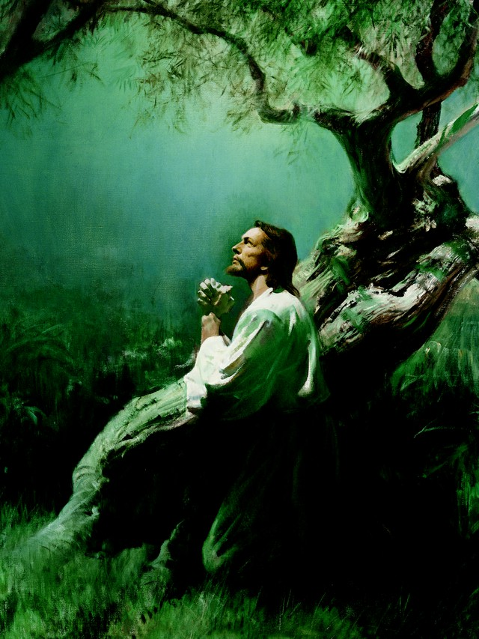
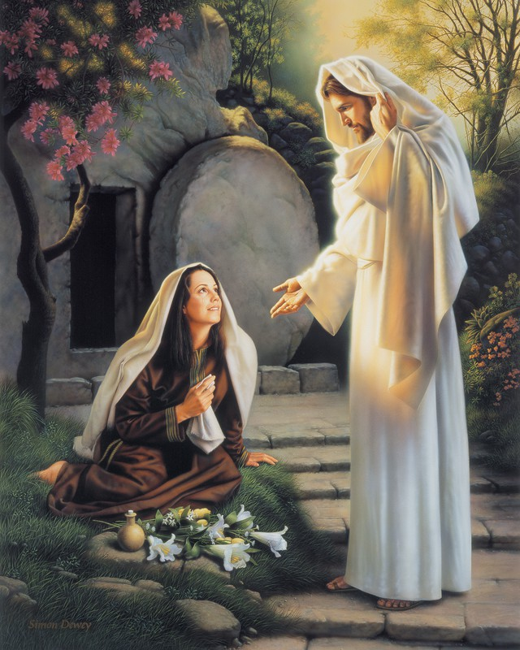
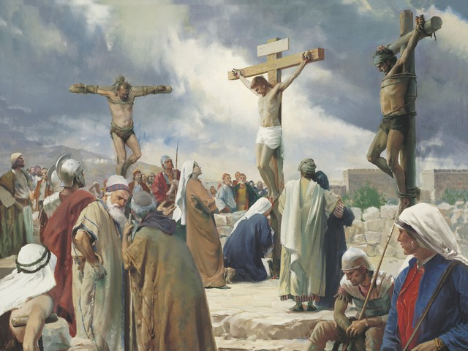
LESSON 2
What must we do to be saved from our sins through the Atonement of Jesus Christ?

Slide 10
LESSON 2
Jesus Christ’s role in the postmortal life
Where are those who have passed away?
1 Peter 3:18-20; 4:6
18 For Christ also hath once suffered for sins, the just for the unjust, that he might bring us to God, being put to death in the flesh, but quickened by the Spirit:
19 By which also he went and preached unto the spirits in prison;
20 Which sometime were disobedient, when once the longsuffering of God waited in the days of Noah, while the ark was a preparing, wherein few, that is, eight souls were saved by water.
6 For for this cause was the gospel preached also to them that are dead, that they might be judged according to men in the flesh, but live according to God in the spirit.

Slide 11
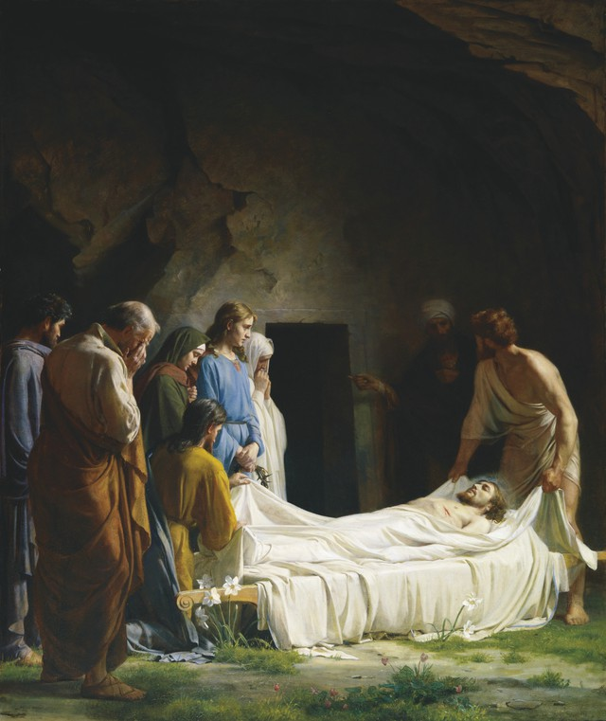
LESSON 2
What did Jesus Christ do immediately following His death?
Doctrine and Covenants 138:18-19, 30-32
18 While this vast multitude waited and conversed, rejoicing in the hour of their deliverance from the chains of death, the Son of God appeared, declaring liberty to the captives who had been faithful;
19 And there he preached to them the everlasting gospel, the doctrine of the resurrection and the redemption of mankind from the fall, and from individual sins on conditions of repentance.
30 But behold, from among the righteous, he organized his forces and appointed messengers, clothed with power and authority, and commissioned them to go forth and carry the light of the gospel to them that were in darkness, even to all the spirits of men; and thus was the gospel preached to the dead.
31 And the chosen messengers went forth to declare the acceptable day of the Lord and proclaim liberty to the captives who were bound, even unto all who would repent of their sins and receive the gospel.
32 Thus was the gospel preached to those who had died in their sins, without a knowledge of the truth, or in transgression, having rejected the prophets.

Slide 12
LESSON 2
What did Jesus Christ do to allow the gospel to be preached to everyone in the spirit world?
How do these efforts illustrate the love of Heavenly Father and Jesus Christ for all people?
What happened on the third day after the Savior’s death?
What does it mean to be resurrected?
1 Corinthians 15:20-22
How are we affected by Jesus Christ’s Resurrection?
20 But now is Christ risen from the dead, and become the first fruits of them that slept.
21 For since by man came death, by man came also the resurrection of the dead.
22 For as in Adam all die, even so in Christ shall all be made alive.
Because of the Resurrection of Jesus Christ, all people will be resurrected.

Slide 13
LESSON 2
Revelation 20:12
And I saw the dead, small and great, stand before God; and the books were opened: and another book was opened, which is the book of life: and the dead were judged out of those things which were written in the books, according to their works.
What will happen to each of us after we are resurrected?
John 5:22
For the Father judgeth no man, but hath committed all judgment unto the Son:
Who will judge us?
Jesus Christ will judge all mankind.

Slide 14
LESSON 2
John 3:16-17
16 ¶ For God so loved the world, that he gave his only begotten Son, that whosoever believeth in him should not perish, but have everlasting life.
17 For God sent not his Son into the world to condemn the world; but that the world through him might be saved.
What must we do to receive eternal life?
How would you summarize John 3:16 as a principle?
If we exercise faith in Jesus Christ and live according to His gospel, then we can receive eternal life.

Slide 15
LESSON 2

