Slide 1
SEMINARY
New Testament

Slide 2
LESSON 19
Matthew 16

Slide 3
LESSON 19
Matthew 16:1-12
“The Pharisees and the Sadducees seek a
sign from the Savior”

Slide 4
LESSON 19
Through the appearance of an angel
Through the Holy Ghost
Through believing the words of a friend or family member
Through witnessing a miracle

Slide 5
LESSON 19
Matthew 16:1
The Pharisees also with the Sadducees came, and tempting desired him that he would shew them a sign from heaven.
What did the Pharisees and Sadducees want from Jesus?
What do you think it means that the Pharisees and Sadducees were “tempting” Jesus when they asked for a sign?
Matthew 16:2-4.
2 He answered and said unto them, When it is evening, ye say, It will be fair weather: for the sky is red.
3 And in the morning, It will be foul weather to day: for the sky is red and lowring. O ye hypocrites, ye can discern the face of the sky; but can ye not discern the signs of the times?
4 A wicked and adulterous generation seeketh after a sign; and there shall no sign be given unto it, but the sign of the prophet Jonas. And he left them, and departed.
What sign did the Lord say He would provide?

Slide 6
LESSON 19
Jonah 1:17
¶ Now the Lord had prepared a great fish to swallow up Jonah. And Jonah was in the belly of the fish three days and three nights.
What did the Savior do after He rebuked the Pharisees and Sadducees?
What can we learn from this experience about the improper way to seek spiritual truth?
We do not receive spiritual truth by seeking for signs.

Slide 7
LESSON 19
Matthew 16:13-20
“Peter testifies of Jesus Christ and is promised the keys of the kingdom”

Slide 8
LESSON 19
Matthew 16:13-14
13 ¶ When Jesus came into the coasts of Cæsarea Philippi, he asked his disciples, saying, Whom do men say that I the Son of man am?
14 And they said, Some say that thou art John the Baptist: some, Elias; and others, Jeremias, or one of the prophets.
What did the Savior ask His disciples? How did they answer?
What can their response tell us about how well people understood who Jesus was at this point in His ministry?
Matthew 16:15-17
15 He saith unto them, But whom say ye that I am?
16 And Simon Peter answered and said, Thou art the Christ, the Son of the living God.
17 And Jesus answered and said unto him, Blessed art thou, Simon Bar-jona: for flesh and blood hath not revealed it unto thee, but my Father which is in heaven.
What was the second question the Savior asked? How did Peter respond?
How did Peter know that Jesus Christ is the Son of God?

Slide 9
LESSON 19
President Joseph Fielding Smith:
“The Spirit of God speaking to the spirit of man has power to impart truth with greater effect and understanding than the truth can be imparted by personal contact even with heavenly beings. Through the Holy Ghost the truth is woven into the very fibre and sinews of the body so that it cannot be forgotten” (Teachings of Presidents of the Church: Joseph Fielding Smith [2013], 183–84).
What are some things we can do to prepare ourselves to receive revelation through the Holy Ghost?
How did you come to know that Jesus Christ is the Son of God and your Savior? What did you do to prepare to receive that witness from the Holy Ghost?

Slide 10
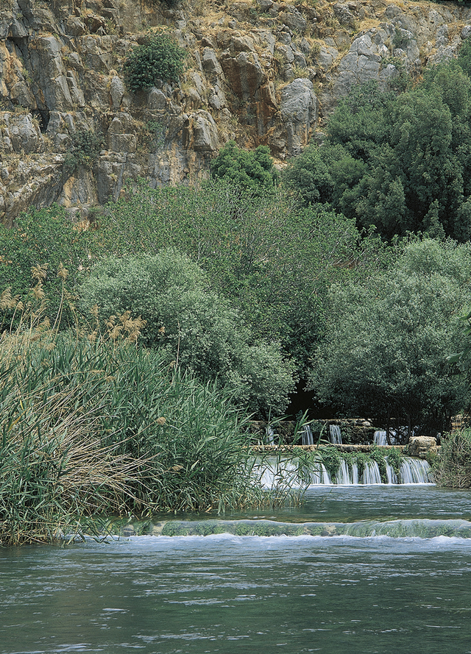
LESSON 19
I heard that your church claims to be the only true church of Jesus Christ. Is that what you believe?
My church also believes in Jesus Christ, so why do you think that your church is the only true one?
Matthew 16:18-20
18 And I say also unto thee, That thou art Peter, and upon this rock I will build my church; and the gates of hell shall not prevail against it.
19 And I will give unto thee the keys of the kingdom of heaven: and whatsoever thou shalt bind on earth shall be bound in heaven: and whatsoever thou shalt loose on earth shall be loosed in heaven.
20 Then charged he his disciples that they should tell no man that he was Jesus the Christ.
What do you think the Savior meant when He said He would build His Church “upon this rock”?

Slide 11
LESSON 19
Prophet Joseph Smith:
“Jesus in His teachings says, ‘Upon this rock I will build my Church. …’ [Matthew 16:18.] What rock? Revelation” (Teachings of Presidents of the Church: Joseph Smith [2007], 195).
“The Church of Jesus Christ of Latter-day Saints was founded upon direct revelation, as the true Church of God has ever been, according to the Scriptures (Amos 3:7, and Acts 1:2)” (Teachings: Joseph Smith, 195).
How would you summarize the Savior’s teaching about His Church recorded in verse 18?
Jesus Christ’s Church is built upon revelation from God.
How can knowing that The Church of Jesus Christ of Latter-day Saints is built on revelation from God strengthen your testimony of the gospel?
What did the Savior promise to give Peter?

Slide 12
LESSON 19
President Dallin H. Oaks the First Presidency.
“‘Priesthood keys are the authority God has given to priesthood [holders] to direct, control, and govern the use of His priesthood on earth’ [Handbook 2: Administering the Church (2010), 2.1.1]. Every act or ordinance performed in the Church is done under the direct or indirect authorization of one holding the keys for that function” (“The Keys and Authority of the Priesthood,” Ensign or Liahona, May 2014, 49).
What did Jesus say that Peter would be able to do because of the keys he would be given?
How would you summarize why the Lord gives priesthood keys to His prophets and Apostles?
Priesthood keys are necessary to administer the Lord’s Church upon the earth.

Slide 13
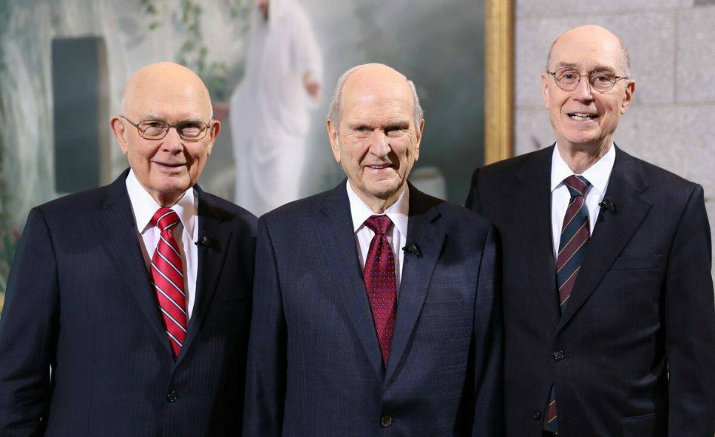
LESSON 19

Slide 14
LESSON 19
Matthew 16:21-28
“Jesus teaches what it means to
follow Him”

Slide 15
LESSON 19

