Slide 1
SEMINARY
New Testament

Slide 2
LESSON 18
Matthew 15

Slide 3
LESSON 18
Matthew 15:1-20
“The scribes and Pharisees ask why Jesus’s disciples do not wash their hands before they eat”

Slide 4
LESSON 18
1) A young woman is encouraged by her friends to wear an inappropriate outfit to a school dance. The young woman knows that the outfit does not meet the Lord’s standards of modesty, even though it is generally accepted in her culture to wear outfits like it.
2) A young man belongs to a Latter-day Saint family that loves sporting events. When popular sporting events are shown on television, the family routinely sets aside family prayer, scripture study, family home evening, and Sunday Church meetings in order to watch the events.
3) A young couple is preparing for marriage. They live in a place where it is widely accepted to participate in premarital sexual relations. Some people have told this couple that they are old-fashioned and odd because they are waiting to be married before engaging in sexual intimacy.
What do these scenarios have in common?

Slide 5
LESSON 18
Matthew 15:1-3
1 Then came to Jesus scribes and Pharisees, which were of Jerusalem, saying,
2 Why do thy disciples transgress the tradition of the elders? for they wash not their hands when they eat bread.
3 But he answered and said unto them, Why do ye also transgress the commandment of God by your tradition?
What tradition were Jesus’s disciples not following?
What did the Savior say the scribes and Pharisees were doing by participating in their traditions?

Slide 6
LESSON 18
Matthew 15:7-9
7 Ye hypocrites, well did Esaias prophesy of you, saying,
8 This people draweth nigh unto me with their mouth, and honoureth me with their lips; but their heart is far from me.
9 But in vain they do worship me, teaching for doctrines the commandments of men.
What had the scribes and Pharisees led people to do?
What principle can we learn from these verses about what we must do if we desire to draw near to God?
If we desire to draw near to God, we must place His commandments above any traditions and customs we may have.
What could the individual or individuals in this scenario do to obey God’s commandments?
How would doing this help the individual or individuals draw nearer to God?
When have you chosen to obey God’s commandments rather than participate in a commonly accepted tradition or custom?

Slide 7
LESSON 18
Matthew 15:10-11
10 ¶ And he called the multitude, and said unto them, Hear, and understand:
11 Not that which goeth into the mouth defileth a man; but that which cometh out of the mouth, this defileth a man.
What did the Savior say defiles us?
Matthew 15:17-20.
17 Do not ye yet understand, that whatsoever entereth in at the mouth goeth into the belly, and is cast out into the draught?
18 But those things which proceed out of the mouth come forth from the heart; and they defile the man.
19 For out of the heart proceed evil thoughts, murders, adulteries, fornications, thefts, false witness, blasphemies:
20 These are the things which defile a man: but to eat with unwashen hands defileth not a man.
What did the Savior mean when He said, “That which cometh out of the mouth … defileth a man”?

Slide 8
LESSON 18
If we choose to entertain evil or inappropriate thoughts and desires, then
those thoughts and desires will defile us.
In what ways can we become defiled or spiritually unclean if we choose to entertain evil or inappropriate thoughts and desires?
In what way do the words that come out of our mouths, as well as our actions, reflect the thoughts and desires of our hearts?

Slide 9
LESSON 18
Matthew 15:21-28
“The Savior heals the daughter of a
Gentile woman”

Slide 10
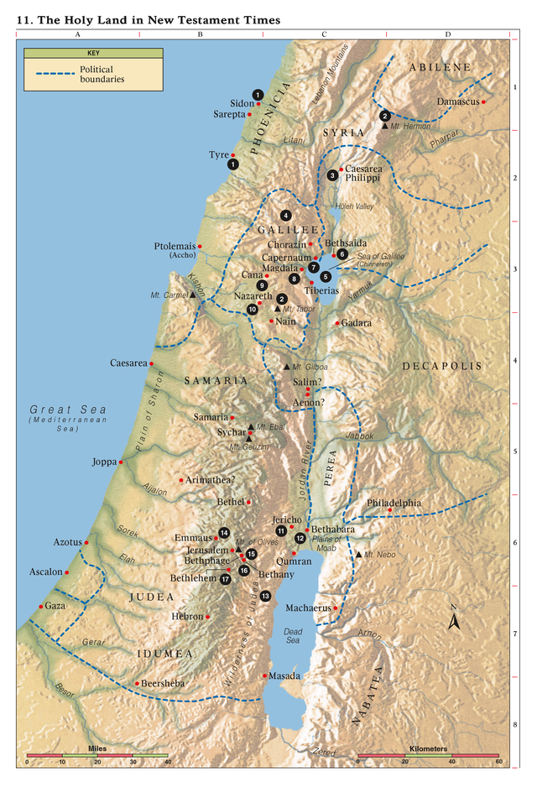
LESSON 18
Matthew 15:21-27
21 ¶ Then Jesus went thence, and departed into the coasts of Tyre and Sidon.
22 And, behold, a woman of Canaan came out of the same coasts, and cried unto him, saying, Have mercy on me, O Lord, thou Son of David; my daughter is grievously vexed with a devil.
23 But he answered her not a word. And his disciples came and besought him, saying, Send her away; for she crieth after us.
24 But he answered and said, I am not sent but unto the lost sheep of the house of Israel.
25 Then came she and worshipped him, saying, Lord, help me.
26 But he answered and said, It is not meet to take the children’s bread, and to cast it to dogs.
27 And she said, Truth, Lord: yet the dogs eat of the crumbs which fall from their masters’ table.
What righteous desire did the Canaanite woman have?
What did the woman do and say that demonstrated her faith in Jesus Christ?

Slide 11
What principle can we learn from this account about what can happen as we exercise our faith in Jesus Christ?
LESSON 18
Matthew 15:28
Then Jesus answered and said unto her, O woman, great is thy faith: be it unto thee even as thou wilt. And her daughter was made whole from that very hour.
What did the Savior do for this woman? Why?
As we exercise faith in Jesus Christ, we can receive blessings according to our righteous desires.
What else can we do to exercise faith in Jesus Christ?

Slide 12
LESSON 18
Elder Dallin H. Oaks of the Quorum of the Twelve Apostles:
“When we have faith in the Lord Jesus Christ, we must have trust in him. We must trust him enough that we are content to accept his will, knowing that he knows what is best for us. …
“… Faith, no matter how strong it is, cannot produce a result contrary to the will of him whose power it is. … We cannot have true faith in the Lord without also having complete trust in the Lord’s will and in the Lord’s timing” (“Faith in the Lord Jesus Christ,” Ensign, May 1994, 99, 100).
How can Elder Oaks’s explanation of what it means to exercise faith in Jesus Christ help us when the Lord does not immediately bless us according to our righteous desires?
When have you (or someone you know) received your righteous desires (according to the Lord’s will and timing) as you exercised faith in Jesus Christ?

Slide 13
LESSON 18
Matthew 15:29-39
“Jesus feeds more than four thousand followers from seven loaves and a few fishes”

Slide 14
LESSON 18

