Slide 1
SEMINARY
New Testament

Slide 2
LESSON 17
Matthew 14

Slide 3
LESSON 17
Matthew 14:1-21
“Jesus seeks solitude and then feeds more than five thousand people”

Slide 4
LESSON 17
What are some different ways people try to endure and overcome sadness?
Matthew 14:12-13
12 And his disciples came, and took up the body, and buried it, and went and told Jesus.
13 ¶ When Jesus heard of it, he departed thence by ship into a desert place apart: and when the people had heard thereof, they followed him on foot out of the cities.
What did Jesus do when He heard about John’s death?
What happened when Jesus tried to be alone?
How would you feel if you were sad and wanted to be alone, but others were seeking your attention?

Slide 5
LESSON 17
Matthew 14:14
And Jesus went forth, and saw a great multitude, and was moved with compassion toward them, and he healed their sick.
What example did the Savior set for us to follow when we experience sadness?
By showing compassion for others even when we are experiencing sadness, we follow the example of Jesus Christ.
Why can it be difficult to show compassion for others when we are suffering?
How can showing compassion for others help us when we ourselves are suffering?
When have you or someone you know experienced great sadness and still demonstrated compassion for another? In what ways did serving someone else help?

Slide 6
LESSON 17
Matthew 14:15-21
15 ¶ And when it was evening, his disciples came to him, saying, This is a desert place, and the time is now past; send the multitude away, that they may go into the villages, and buy themselves victuals.
16 But Jesus said unto them, They need not depart; give ye them to eat.
17 And they say unto him, We have here but five loaves, and two fishes.
18 He said, Bring them hither to me.
19 And he commanded the multitude to sit down on the grass, and took the five loaves, and the two fishes, and looking up to heaven, he blessed, and brake, and gave the loaves to his disciples, and the disciples to the multitude.
20 And they did all eat, and were filled: and they took up of the fragments that remained twelve baskets full.
21 And they that had eaten were about five thousand men, beside women and children.
How did Jesus continue to show compassion for the people who had followed Him?

Slide 7
LESSON 17
Matthew 14:22-36
“Jesus walks on the sea during a storm”

Slide 8
LESSON 17
A young woman feels helpless as she watches her mother suffer from a terminal illness. She begins to question if Heavenly Father is aware of her family’s pain. She desperately wants to believe in God, but her doubts are beginning to overwhelm her.
A young man has recently joined the Church. Many of his old friends have been openly critical of his decision to join the Church. He is starting to wonder whether he should continue to be an active and faithful member of the Church.
What are other ways people may experience doubt or fear as they seek to follow Jesus Christ?
Matthew 14:23-26
23 And when he had sent the multitudes away, he went up into a mountain apart to pray: and when the evening was come, he was there alone.
24 But the ship was now in the midst of the sea, tossed with waves: for the wind was contrary.
25 And in the fourth watch of the night Jesus went unto them, walking on the sea.
What happened to the disciples while they were crossing the Sea of Galilee?
What does it mean that “the wind was contrary”?

Slide 9
Even though God might not always spare us from struggles, He knows what we are experiencing and will, in His own time, come to our aid.
LESSON 17
Mark 6:47-48
47 And when even was come, the ship was in the midst of the sea, and he alone on the land.
48 And he saw them toiling in rowing; for the wind was contrary unto them: and about the fourth watch of the night he cometh unto them, walking upon the sea, and would have passed by them.
Could Jesus have spared the disciples from their struggles sooner?
What might have been the purpose of letting the disciples struggle for a time before they were delivered?
What truth can we learn about our own struggles from these accounts of the disciples trying to cross the sea?
What good can come from our struggling for a time rather than being immediately delivered from our trials by the Lord?

Slide 10
How did the disciples react when they saw Jesus?
LESSON 17
Matthew 14:26-28
26 And when the disciples saw him walking on the sea, they were troubled, saying, It is a spirit; and they cried out for fear.
27 But straightway Jesus spake unto them, saying, Be of good cheer; it is I; be not afraid.
28 And Peter answered him and said, Lord, if it be thou, bid me come unto thee on the water.
How did Jesus respond to their fear?
What did Peter desire to do when he heard the Lord’s voice?
Matthew 14:29-30.
29 And he said, Come. And when Peter was come down out of the ship, he walked on the water, to go to Jesus.
30 But when he saw the wind boisterous, he was afraid; and beginning to sink, he cried, saying, Lord, save me.
Why did Peter begin to sink?

Slide 11
LESSON 17
What can we learn from Peter’s experience about how to avoid being overcome by our fears and doubts?
if we keep our eyes fixed on Jesus Christ and maintain our faith in Him, we will not be overcome by our fears and doubts.
President Howard W. Hunter
“It is my firm belief that if as individual people, as families, communities, and nations, we could, like Peter, fix our eyes on Jesus, we too might walk triumphantly over ‘the swelling waves of disbelief’ and remain ‘unterrified amid the rising winds of doubt.’ But if we turn away our eyes from him in whom we must believe, as it is so easy to do and the world is so much tempted to do, if we look to the power and fury of those terrible and destructive elements around us rather than to him who can help and save us, then we shall inevitably sink in a sea of conflict and sorrow and despair” (“The Beacon in the Harbor of Peace,” Ensign,Nov. 1992, 19).
How do you think we can “fix our eyes” on Jesus Christ, as Peter did initially?
When have you seen an individual’s faith in Jesus Christ enable him or her to avoid being overcome by fear or doubt?

Slide 12
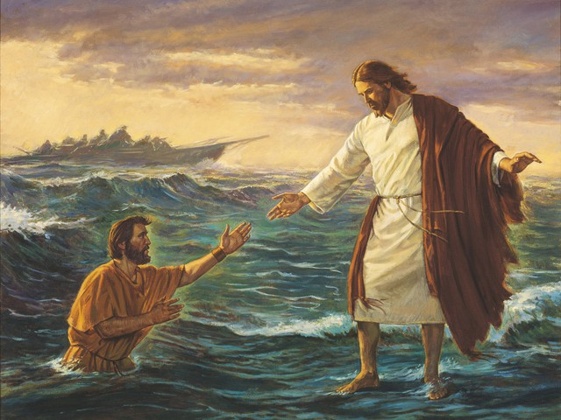
LESSON 17
What did Peter do when he realized he was sinking?
What can we learn from this account about what the Lord will do if we seek His help when our faith wanes?
If we seek God’s help when our faith wanes, He can lift us from our fears and doubts.
Matthew 14:33
Then they that were in the ship came and worshipped him, saying, Of a truth thou art the Son of God.

Slide 13
LESSON 17

