Slide 1
SEMINARY
New Testament

Slide 2
LESSON 16
Matthew 13:24-58

Slide 3
LESSON 16
Matthew 13:24-30, 36-43
“The Savior teaches and explains the parable of the wheat and the tares”

Slide 4
Why should I choose to be righteous when some people around me don’t seem to experience negative consequences of their unrighteous choices?
LESSON 16
Have you ever been frustrated or upset because there is so much evil in the world?
Why doesn’t the Lord just remove the evil that surrounds us?
Matthew 13:24-30, 36-43
24 ¶ Another parable put he forth unto them, saying, The kingdom of heaven is likened unto a man which sowed good seed in his field:
25 But while men slept, his enemy came and sowed tares among the wheat, and went his way.
26 But when the blade was sprung up, and brought forth fruit, then appeared the tares also.
27 So the servants of the householder came and said unto him, Sir, didst not thou sow good seed in thy field? from whence then hath it tares?
28 He said unto them, An enemy hath done this. The servants said unto him, Wilt thou then that we go and gather them up?
29 But he said, Nay; lest while ye gather up the tares, ye root up also the wheat with them.
30 Let both grow together until the harvest: and in the time of harvest I will say to the reapers, Gather ye together first the tares, and bind them in bundles to burn them: but gather the wheat into my barn.
36 Then Jesus sent the multitude away, and went into the house: and his disciples came unto him, saying, Declare unto us the parable of the tares of the field.
37 He answered and said unto them, He that soweth the good seed is the Son of man;
38 The field is the world; the good seed are the children of the kingdom; but the tares are the children of the wicked one;
39 The enemy that sowed them is the devil; the harvest is the end of the world; and the reapers are the angels.
40 As therefore the tares are gathered and burned in the fire; so shall it be in the end of this world.
41 The Son of man shall send forth his angels, and they shall gather out of his kingdom all things that offend, and them which do iniquity;
42 And shall cast them into a furnace of fire: there shall be wailing and gnashing of teeth.
43 Then shall the righteous shine forth as the sun in the kingdom of their Father. Who hath ears to hear, let him hear.

Slide 5
LESSON 16
What happened to the wheat and the tares?
Why do you think the sower of good seed told his servants to allow the wheat and tares to “grow together until the harvest”?
According to Joseph Smith Translation, Matthew 13:29, which was gathered first﻿—the wheat or the tares?
Who sowed, or planted, the good seed?
Who sowed, or planted, the tares?
What did the wheat and tares represent?
What will happen to the righteous and the wicked in the last days?
The Lord will gather the righteous during the last days and then destroy the wicked at His coming.
How might this truth bring us comfort while we live in an evil world?

Slide 6
LESSON 16
Elder David A. Bednar of the Quorum of the Twelve Apostles:
“The Lord gathers His people when they accept Him and keep His commandments. …
“… The Lord gathers His people to worship, to build up the Church, for a defense, and to receive counsel and instruction. …
“The Prophet Joseph Smith declared that in all ages the divine purpose of gathering is to build temples so that the Lord’s children can receive the highest ordinances and thereby gain eternal life [see Teachings of Presidents of the Church: Joseph Smith[2007], 416–17]” (“The Spirit and Purposes of Gathering” [Brigham Young University–Idaho devotional, Oct. 31, 2006], byui.edu).
What do we need to do to be gathered by the Lord?
What blessings have come into your life as you have been gathered by the Lord?

Slide 7
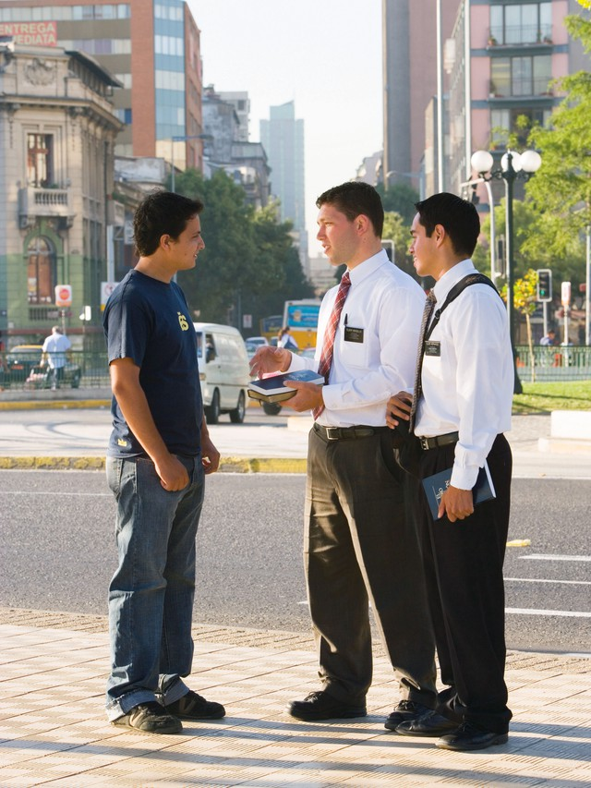
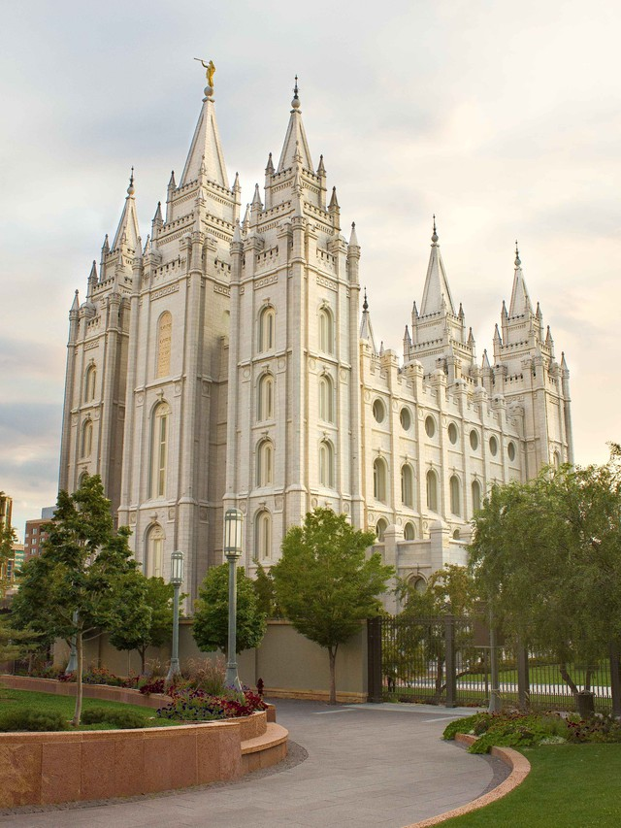
LESSON 16
What can we do to assist the Savior in gathering Heavenly Father’s children?
What blessings have you received as you have helped the Lord gather the righteous through missionary work or temple work?

Slide 8
LESSON 16
Matthew 13:31–35, 44–52
“Jesus uses parables to teach about the
kingdom of heaven”

Slide 9
LESSON 16
Matthew 13:31-32
Matthew 13:33;
Matthew 13:44;
Matthew 13:45-46;
Matthew 13:47-50.
31 ¶ Another parable put he forth unto them, saying, The kingdom of heaven is like to a grain of mustard seed, which a man took, and sowed in his field:
32 Which indeed is the least of all seeds: but when it is grown, it is the greatest among herbs, and becometh a tree, so that the birds of the air come and lodge in the branches thereof.
¶ Another parable spake he unto them; The kingdom of heaven is like unto leaven, which a woman took, and hid in three measures of meal, till the whole was leavened.
¶ Again, the kingdom of heaven is like unto treasure hid in a field; the which when a man hath found, he hideth, and for joy thereof goeth and selleth all that he hath, and buyeth that field.
45 ¶ Again, the kingdom of heaven is like unto a merchant man, seeking goodly pearls:
46 Who, when he had found one pearl of great price, went and sold all that he had, and bought it.
47 ¶ Again, the kingdom of heaven is like unto a net, that was cast into the sea, and gathered of every kind:
48 Which, when it was full, they drew to shore, and sat down, and gathered the good into vessels, but cast the bad away.
49 So shall it be at the end of the world: the angels shall come forth, and sever the wicked from among the just,
50 And shall cast them into the furnace of fire: there shall be wailing and gnashing of teeth.

Slide 10
LESSON 16
The restored Church of Jesus Christ will grow from a small beginning to fill the whole earth.
President Joseph F. Smith:
“While it may be said, and it is in a measure true, that we are but a handful in comparison with our fellowmen in the world, yet we may be compared with the leaven of which the Savior spoke, that will eventually leaven the whole world” (Gospel Doctrine,5th ed. [1939], 74).
What can we do as Latter-day Saints to help the Savior’s Church grow?
Because the blessings of the gospel are of eternal value, they are worth any sacrifice.

Slide 11
LESSON 16
Blessings of the gospel
Sacrifices to obtain blessings
When have you or someone you know sacrificed something in order to receive a blessing of the gospel?
What blessing of the gospel do you desire to obtain?
Why do you desire that blessing?
How might you have to sacrifice to receive that blessing?

Slide 12
LESSON 16
Matthew 13:53-58
“Jesus teaches in Nazareth and is rejected
by His own people”

Slide 13
LESSON 16

