Slide 1
SEMINARY
New Testament

Slide 2
LESSON 12
Matthew 7

Slide 3
LESSON 12
Matthew 7:1-5
“As part of His Sermon on the Mount, Jesus Christ teaches His disciples about judging righteously”

Slide 4
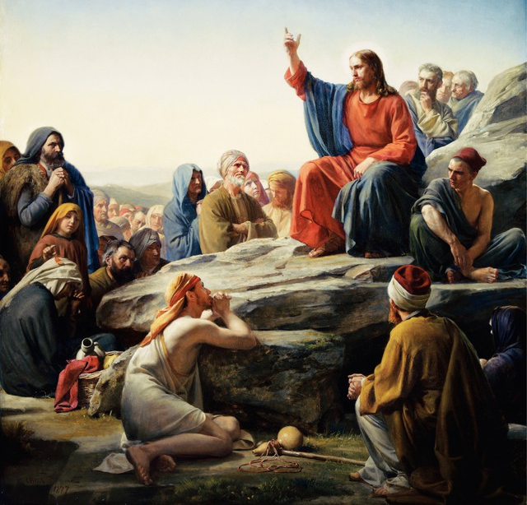
LESSON 12
Should we or should we not judge others?
Matthew 7:1
Judge not, that ye be not judged.
What did the Savior teach about judging?
What do you think it means to judge righteously?
Matthew 7:2
For with what judgment ye judge, ye shall be judged: and with what measure ye mete, it shall be measured to you again.
What will happen if we judge others righteously?
If we judge others righteously, God will extend the same mercy and fairness to us.

Slide 5
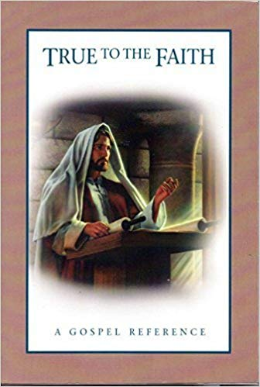
LESSON 12
“Sometimes people feel that it is wrong to judge others in any way. While it is true that you should not condemn others or judge them unrighteously, you will need to make judgments of ideas, situations, and people throughout your life. …
“Judgment is an important use of your agency and requires great care, especially when you make judgments about other people. All your judgments must be guided by righteous standards. Remember that only God, who knows each individual’s heart, can make final judgments of individuals (see Revelation 20:12; 3 Nephi 27:14; D&C 137:9). …
“… As much as you can, judge people’s situations rather than judging the people themselves. Whenever possible, refrain from making judgments until you have an adequate knowledge of the facts. Always be sensitive to the Holy Spirit, who can guide your decisions” (True to the Faith: A Gospel Reference [2004], 90–91).
What types of judgments should we make?
How can we judge righteously?

Slide 6
LESSON 12
Matthew 7:3
And why beholdest thou the mote that is in thy brother’s eye, but considerest not the beam that is in thine own eye?
What might the mote and beam represent in the Savior’s analogy?
How would you restate the Savior’s teaching in verse 3?
Would you like your classmate with the beam to remove a speck of wood from your eye? Why not?
What would you need to do to see clearly enough to remove the speck of wood from your classmate’s eye?

Slide 7
LESSON 12
President Dieter F. Uchtdorf of the First Presidency:
“This business of beams and motes seems to be closely related to our inability to see ourselves clearly. I’m not sure why we are able to diagnose and recommend remedies for other people’s ills so well, while we often have difficulty seeing our own” (“Lord, Is It ? ” Ensign or Liahona, Nov. 2014, 56).
Matthew 7:4-5
4 Or how wilt thou say to thy brother, Let me pull out the mote out of thine eye; and, behold, a beam is in thine own eye?
5 Thou hypocrite, first cast out the beam out of thine own eye; and then shalt thou see clearly to cast out the mote out of thy brother’s eye.
Should our concern and correction be focused on others’ faults or on our own? Why?
What principle can we learn from these verses that can help us avoid judging others unrighteously?
If we focus on removing our own sins and weaknesses, then we will be less likely to judge others unrighteously.

Slide 8
LESSON 12
Matthew 7:6-14
“The Savior teaches about seeking
personal revelation”

Slide 9
LESSON 12
Matthew 7:7
¶ Ask, and it shall be given you; seek, and ye shall find; knock, and it shall be opened unto you:
What were the disciples told to say to people who wanted to receive knowledge from God?
What principle can we learn from verse 7 about how we can come to understand sacred knowledge from God?
As we ask, seek, and knock in our search for truth, Heavenly Father will answer and bless us with personal revelation.
What do the words ask, seek, and knock indicate we must do to receive personal revelation?
Matthew 7:12-14
12 Therefore all things whatsoever ye would that men should do to you, do ye even so to them: for this is the law and the prophets.
13 ¶ Enter ye in at the strait gate: for wide is the gate, and broad is the way, that leadeth to destruction, and many there be which go in thereat:
14 Because strait is the gate, and narrow is the way, which leadeth unto life, and few there be that find it.

Slide 10
LESSON 12
Matthew 7:15-27
“The Savior promises salvation to those
who do the Father’s will”

Slide 11
LESSON 12
Why is it important to be able to discern if an individual or a group is promoting an idea that is contrary to Heavenly Father’s plan?
Matthew 7:15
¶ Beware of false prophets, which come to you in sheep’s clothing, but inwardly they are ravening wolves.
What did the Lord warn the disciples of? How did He say these false prophets might be disguised?
Matthew 7:16-20
16 Ye shall know them by their fruits. Do men gather grapes of thorns, or figs of thistles?
17 Even so every good tree bringeth forth good fruit; but a corrupt tree bringeth forth evil fruit.
18 A good tree cannot bring forth evil fruit, neither can a corrupt tree bring forth good fruit.
19 Every tree that bringeth not forth good fruit is hewn down, and cast into the fire.
20 Wherefore by their fruits ye shall know them.
What is one way we can discern whether someone is a false prophet or false teacher?
We can discern false prophets by their fruits.

Slide 12
LESSON 12
Matthew 7:24-27
24 ¶ Therefore whosoever heareth these sayings of mine, and doeth them, I will liken him unto a wise man, which built his house upon a rock:
25 And the rain descended, and the floods came, and the winds blew, and beat upon that house; and it fell not: for it was founded upon a rock.
26 And every one that heareth these sayings of mine, and doeth them not, shall be likened unto a foolish man, which built his house upon the sand:
27 And the rain descended, and the floods came, and the winds blew, and beat upon that house; and it fell: and great was the fall of it.
What actions did the Savior say would make someone like a wise man who built on rock?
What actions did the Savior say would make someone like a foolish man who built on sand?
What principles about acting on the Lord’s teachings can we learn from these analogies?
If we hear and act on the Lord’s teachings, then He will strengthen us to endure our trials. If we hear the Lord’s teachings but do not follow them, then we will not have the support we need when trials come.

Slide 13
LESSON 12

