Slide 1
SEMINARY
New Testament

Slide 2
LESSON 11
Matthew 6

Slide 3
LESSON 11
Matthew 6:1-18
“The Savior teaches His disciples to do
righteous works”

Slide 4
LESSON 11
Matthew 6:1-2
1 Take heed that ye do not your alms before men, to be seen of them: otherwise ye have no reward of your Father which is in heaven.
2 Therefore when thou doest thin alms, do not sound a trumpet before thee, as the hypocrites do in the synagogues and in the streets, that they may have glory of men. Verily I say unto you, They have their reward.
Why do some people perform alms?
What did the Savior call these people?
What do you think the phrase “they have their reward” means?

Slide 5
LESSON 11
Matthew 6:3-4
3 But when thou doest alms, let not thy left hand know what thy right hand doeth:
4 That thine alms may be in secret: and thy Father which seeth in secret himself shall reward thee openly.
Why do you think the Lord would want His disciples to perform acts of service “in secret”?
What does doing righteous acts in secret suggest about a person’s motivation for doing them?
What did the Savior promise to those who performed righteous acts for the right reasons?
What principle can we learn from the Savior’s teachings about performing acts of devotion?
If we perform acts of devotion to please Heavenly Father rather than to seek the attention of others, then He will reward us openly.

Slide 6
LESSON 11
Matthew 6:5-6
5 ¶ And when thou prayest, thou shalt not be as the hypocrites are: for they love to pray standing in the synagogues and in the corners of the streets, that they may be seen of men. Verily I say unto you, They have their reward.
6 But thou, when thou prayest, enter into thy closet, and when thou hast shut thy door, pray to thy Father which is in secret; and thy Father which seeth in secret shall reward thee openly.
Matthew 6:16-18.
16 ¶ Moreover when ye fast, be not, as the hypocrites, of a sad countenance: for they disfigure their faces, that they may appear unto men to fast. Verily I say unto you, They have their reward.
17 But thou, when thou fastest, anoint thine head, and wash thy face;
18 That thou appear not unto men to fast, but unto thy Father which is in secret: and thy Father, which seeth in secret, shall reward thee openly.
Which religious practices did Jesus emphasize should be performed in secret?
Why do hypocrites pray and fast?

Slide 7
LESSON 11
Matthew 6:19-24
“Jesus Christ teaches the multitude to lay up
treasures in heaven”

Slide 8
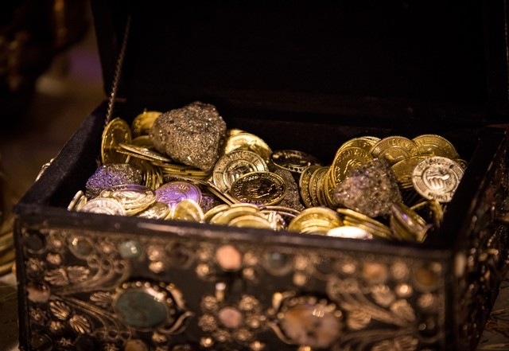
LESSON 11
Matthew 6:19-21
19 ¶ Lay not up for yourselves treasures upon earth, where moth and rust doth corrupt, and where thieves break through and steal:
20 But lay up for yourselves treasures in heaven, where neither moth nor rust doth corrupt, and where thieves do not break through nor steal:
21 For where your treasure is, there will your heart be also.
What is something you consider to be a treasure?
What type of treasures did the Savior teach His disciples to seek?
What did the Savior say the difference was between treasures stored up on earth and treasures stored up in heaven?

Slide 9
LESSON 11
Treasures on earth
Treasures in heaven
Matthew 6:22-24
22 The light of the body is the eye: if therefore thine eye be single, thy whole body shall be full of light.
23 But if thine eye be evil, thy whole body shall be full of darkness. If therefore the light that is in thee be darkness, how great is that darkness!
24 ¶ No man can serve two masters: for either he will hate the one, and love the other; or else he will hold to the one, and despise the other. Ye cannot serve God and mammon.
What did the Savior teach in verses 22-23 that can help us lay up treasures in heaven?
What can we do to keep our eye single to the glory of God?
What truth did the Savior teach at the end of verse 24 that can help us remember to lay up treasures in heaven?
We cannot serve both God and mammon.

Slide 10
LESSON 11
Matthew 6:25-34
“The Savior instructs His disciples to seek first the kingdom of God”

Slide 11
LESSON 11
Matthew 6:31-34
31 Therefore take no thought, saying, What shall we eat? or, What shall we drink? or, Wherewithal shall we be clothed?
32 (For after all these things do the Gentiles seek:) for your heavenly Father knoweth that ye have need of all these things.
33 But seek ye first the kingdom of God, and his righteousness; and all these things shall be added unto you.
34 Take therefore no thought for the morrow: for the morrow shall take thought for the things of itself. Sufficient unto the day is the evil thereof.
What did the Savior teach His disciples to seek first in their lives?
What did Jesus Christ promise those who are seeking to build up the kingdom of God (or His Church) rather than seeking to attain the things of the world?
If we seek first to build up the kingdom of God, then He will bless us with what He knows we need.

Slide 12
LESSON 11
President Ezra Taft Benson:
“We must put God in the forefront of everything else in our lives. …
“When we put God first, all other things fall into their proper place or drop out of our lives. Our love of the Lord will govern the claims for our affection, the demands on our time, the interests we pursue, and the order of our priorities.
“We should put God ahead of everyone else in our lives” (“The Great Commandment—Love the Lord,” Ensign, May 1988, 4).
When have you experienced Heavenly Father’s blessings as you have sought to put Him first in your life?

Slide 13
LESSON 11

