Slide 1
SEMINARY
Old Testament

Slide 2
LESSON 92
2 Samuel 1-10

Slide 3
LESSON 92
2 Samuel 1-6
“David becomes king of all of Israel and brings the ark of the covenant to Jerusalem”

Slide 4
LESSON 92
Why was tying the tie easier when you asked someone for guidance?
What did David ask, and what did the Lord tell him?
What did David do, and what was the result?
2 Samuel 5:22-25
22 ¶ And the Philistines came up yet again, and spread themselves in the valley of Rephaim.
23 And when David inquired of the Lord, he said, Thou shalt not go up; but fetch a compass behind them, and come upon them over against the mulberry trees.
24 And let it be, when thou hearest the sound of a going in the tops of the mulberry trees, that then thou shalt bestir thyself: for then shall the Lord go out before thee, to smite the host of the Philistines.
25 And David did so, as the Lord had commanded him; and smote the Philistines from Geba until thou come to Gazer.
What did the Lord tell David to do?
Why was David successful in his military campaign against the Philistines?
What principle can we learn from David’s example of inquiring of the Lord and following the Lord’s direction?
If we inquire of the Lord and follow His direction, then He can guide us and help us succeed in our righteous endeavors.

Slide 5
LESSON 92
When have you or someone you know sought and received direction from the Lord and then acted in faith on the direction received?
What blessings or strength came from acting on the Lord’s direction?
2 Samuel 6:3-7
3 And they set the ark of God upon a new cart, and brought it out of the house of Abinadab that was in Gibeah: and Uzzah and Ahio, the sons of Abinadab, drave the new cart.
4 And they brought it out of the house of Abinadab which was at Gibeah, accompanying the ark of God: and Ahio went before the ark.
5 And David and all the house of Israel played before the Lord on all manner of instruments made of fir wood, even on harps, and on psalteries, and on timbrels, and on cornets, and on cymbals.
6 ¶ And when they came to Nachon’s threshingfloor, Uzzah put forth his hand to the ark of God, and took hold of it; for the oxen shook it.
7 And the anger of the Lord was kindled against Uzzah; and God smote him there for his error; and there he died by the ark of God.
Why do you think the consequence for trying to steady the ark when the oxen stumbled was so severe?

Slide 6
LESSON 92
“The ark was the symbol of God’s presence, His glory and majesty. When first given to Israel, the ark was placed in the Holy of Holies in the tabernacle, and not even the priest was allowed to approach it. Only the high priest, a type of Christ, could approach it, and then only after going through an elaborate ritual of personal cleansing and propitiation [regaining God’s favor by repenting] for his sins” (Doctrine and Covenants Student Manual, 2nd ed. [Church Educational System manual, 2001], 188). When moving the ark, priests were required to use poles running through rings on the sides to carry it. According to Numbers 4:15, the consequence for touching the ark without authorization was death.

Slide 7
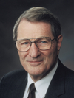
LESSON 92
“Some may reason that [Uzzah] was only trying—though mistakenly—to help out. But given the numerous times the Lord had saved and spared Israel, including the high dramas of the Red Sea and of the manna from heaven, surely He [the Lord] knew how to keep the ark in balance!” (Neal A. Maxwell, Meek and Lowly [1987], 15).
Elder
Neal A. Maxwell
Why do you think Uzzah was punished for steadying the ark?

Slide 8
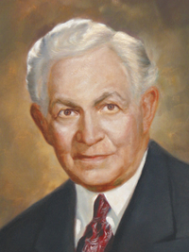
LESSON 92
“It is a little dangerous for us to go out of our own sphere and try unauthoritatively to direct the efforts of a brother. You remember the case of Uzzah who stretched forth his hand to steady the ark. He seemed justified when the oxen stumbled in putting forth his hand to steady that symbol of the covenant. We today think his punishment was very severe. Be that as it may, the incident conveys a lesson of life. Let us look around us and see how quickly men who attempt unauthoritatively to steady the ark die spiritually. Their souls become embittered, their minds distorted, their judgment faulty, and their spirit depressed. Such is the pitiable condition of men who, neglecting their own responsibilities, spend their time in finding fault with others” (David O. McKay, in Conference Report, Apr. 1936, 60).
Elder
David O. McKay
What are the consequences of seeking to “steady the ark,” or trying to direct or correct Church leaders?
What principle can we learn from the account of Uzzah?
Those who attempt to direct God’s work without His authority bring spiritual death upon themselves.
How are people today trying to correct or direct God’s work even though they lack the authority to do so?

Slide 9
LESSON 92
2 Samuel 7-10
“David obeys the command to not build a temple and is blessed in his reign as king”

Slide 10
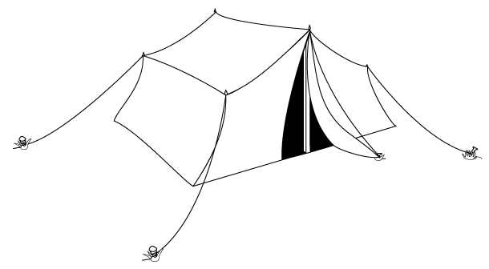
LESSON 92
2 Samuel 7:1-2
1 And it came to pass, when the king sat in his house, and the Lord had given him rest round about from all his enemies;
2 That the king said unto Nathan the prophet, See now, I dwell in an house of cedar, but the ark of God dwelleth within curtains.
What did David not feel right about?
What do you think David wanted to do?

Slide 11
LESSON 92
2 Samuel 7:5, 12-13
5 Go and tell my servant David, Thus saith the Lord, Shalt thou build me an house for me to dwell in?
12 ¶ And when thy days be fulfilled, and thou shalt sleep with thy fathers, I will set up thy seed after thee, which shall proceed out of thy bowels, and I will establish his kingdom.
13 He shall build an house for my name, and I will stablish the throne of his kingdom for ever.

