Slide 1
SEMINARY
Old Testament

Slide 2
LESSON 89
Prophets and Revelation
(Part 3)

Slide 3
LESSON 89
They [prophets] denounce sin, warn of its consequences, and help us avoid deception.
Doctrine and Mastery 5.1
5.1. A prophet is a person who has been called by God to speak for Him (see Jeremiah 1:4–5; Amos 3:7; John 15:16; D&C 1:37–38). Prophets testify of Jesus Christ and teach His gospel. They make known God’s will and true character. They denounce sin, warn of its consequences, and help us avoid deception (see Ezekiel 3:16–17; Ephesians 4:11–14). At times, they prophesy of future events. Prophets are able to perform these responsibilities because they receive authority and revelation from God.
What two things make it possible for prophets to fulfill their roles and responsibilities?

Slide 4
LESSON 89
Ezekiel 3:16-17.
16 And it came to pass at the end of seven days, that the word of the Lord came unto me, saying,
17 Son of man, I have made thee a watchman unto the house of Israel: therefore hear the word at my mouth, and give them warning from me.
What responsibility did the Lord give Ezekiel?

Slide 5
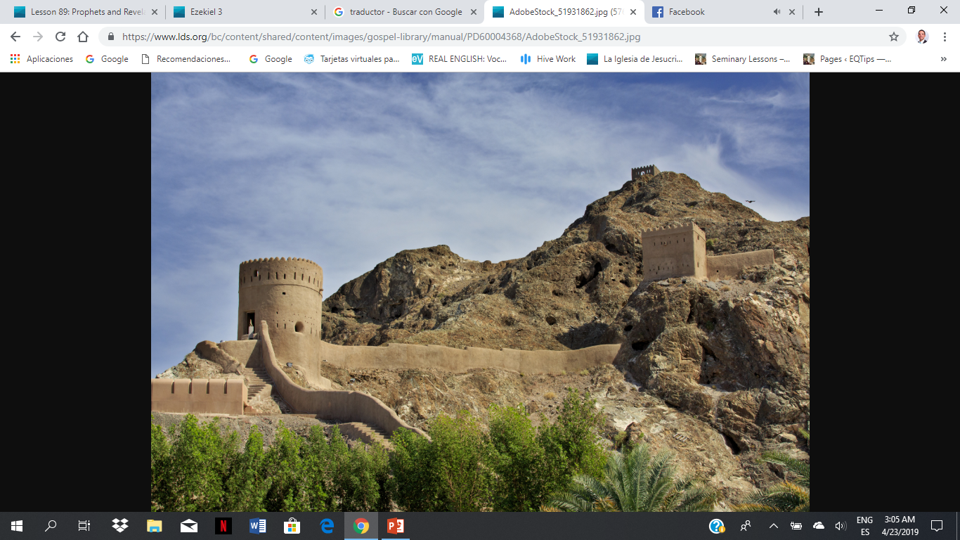
LESSON 89
In what ways can a prophet be compared to a watchman on a tower?
How might viewing prophets as watchmen increase our willingness to follow them?
How does Ezekiel 3:16-17 help teach the key statement of doctrine in paragraph 5.1 of the Doctrinal Mastery Core Document?

Slide 6
LESSON 89
Segment 2 (10 minutes)

Slide 7
LESSON 89
Warnings and Counsel from Latter-day Prophets
What are some promised blessings for heeding this warning or counsel?
How could ignoring this warning or counsel put us in spiritual danger?
If it is not too personal or sacred, consider sharing ways that you or someone you know have been blessed by following this warning or counsel from our prophets and apostles?

Slide 8
LESSON 89
Practice Exercise (20 minutes)

Slide 9
LESSON 89
Your friend Leilani has become interested in the Church and has been meeting with the missionaries. During one of the lessons, the missionaries show Leilani a picture of the current First Presidency and Quorum of the Twelve Apostles.
After the discussion is over, Leilani tells you that she noticed that most of the leaders of the Church look like they are elderly. She says, “I understand what the missionaries were saying about God calling prophets in our time, and I think it is amazing that your Church teaches that there are living prophets, but can elderly Church leaders really understand or relate to the issues and challenges that young people face today?”
What are some ways that you could invite Leilani to act in faith in order to obtain a testimony that those who are in the First Presidency and Quorum of the Twelve Apostles are truly prophets of God?
What are some ways that you have been able to see that Church leaders understand the issues and challenges that young people face today?
How could you use these experiences to help answer Leilani’s question?

Slide 10
LESSON 89
Ezekiel 3:16-17.
16 And it came to pass at the end of seven days, that the word of the Lord came unto me, saying,
17 Son of man, I have made thee a watchman unto the house of Israel: therefore hear the word at my mouth, and give them warning from me.
How might this doctrinal mastery passage be helpful to Leilani?

Slide 11
LESSON 89
Prophets and Apostles Understand the Issues of Today
President M. Russell Ballard Said:
“I have heard that some people think the Church leaders live in a ‘bubble.’ What they forget is that we are men and women of experience, and we have lived our lives in so many places and worked with many people from different backgrounds. Our current assignments literally take us around the globe, where we meet the political, religious, business, and humanitarian leaders of the world. Although we have visited the White House in Washington, D.C., and leaders of nations throughout the world, we have also visited the most humble homes on earth, where we have met and ministered to the poor.
“When you thoughtfully consider our lives and ministry, you will most likely agree that we see and experience the world in ways few others do. You will realize that we live less in a ‘bubble’ than most people.
“Others say we are too old. …
“However, there is something about the individual and combined wisdom of the Brethren that should provide some comfort. We have experienced it all, including the consequences of different public laws and policies, disappointments, tragedies, and deaths in our own families. We are not out of touch with your lives” (M. Russell Ballard, “Be Still, and Know That I Am God” [Church Educational System devotional for young adults, May 4, 2014], broadcasts.lds.org).

Slide 12
LESSON 89
Prophets and Apostles Are Prepared through Extended Service
President Russell M. Nelson Said:
“The Apostle with the longest seniority in the office of Apostle presides. That system of seniority will usually bring older men to the office of President of the Church. It provides continuity, seasoned maturity, experience, and extensive preparation, as guided by the Lord. …
“… Senior leaders are constantly being tutored such that one day they are ready to sit in the highest councils. They learn how to hear the voice of the Lord through the whisperings of the Spirit” (Russell M. Nelson, “Sustaining the Prophets,” Ensign or Liahona, Nov. 2014, 75).

Slide 13
LESSON 89
Prophets and Apostles Are Tutored by the Lord
Elder David A. Bednar Said:
“Some people have suggested younger, more vigorous leaders are needed in the Church to address effectively the serious challenges of our modern world. But the Lord does not use contemporary philosophies and practices of leadership to accomplish His purposes (see Isaiah 55:8–9). We can expect the President and other senior leaders of the Church will be older and spiritually seasoned men. …
“I have observed in my Brethren at least a part of the Lord’s purpose for having older men of maturity and judgment serve in senior leadership positions of the Church. These men have had a sustained season of tutoring by the Lord, whom they represent, serve, and love. They have learned to understand the divine language of the Holy Spirit and the Lord’s patterns for receiving revelation. These ordinary men have undergone a most extraordinary developmental process that has sharpened their vision, informed their insight, engendered love for people from all nations and circumstances, and affirmed the reality of the Restoration” (David A. Bednar, “Chosen to Bear Testimony of My Name,” Ensign or Liahona, Nov. 2015, 129).

Slide 14
LESSON 89

