Slide 1
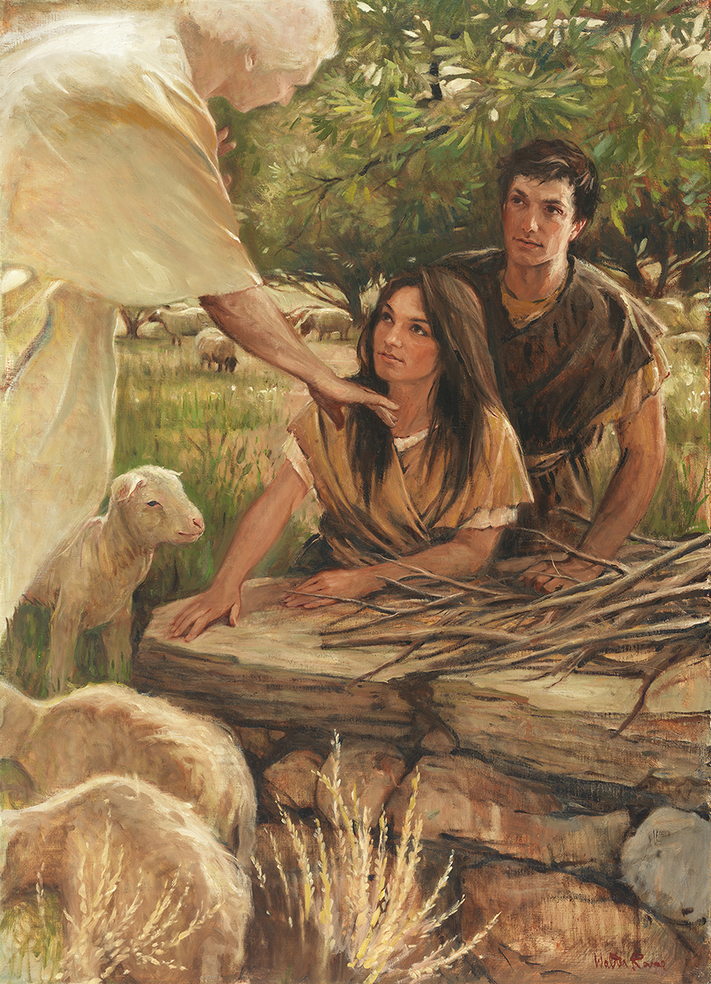
SEMINARY
SEMINARY
SEMINARY
SEMINARY
SEMINARY
SEMINARY
SEMINARY
Old Testament

Slide 2
LESSON 88
1 Samuel 17

Slide 3
LESSON 88
1 Samuel 17:1-40
“David is chosen to fight Goliath”

Slide 4
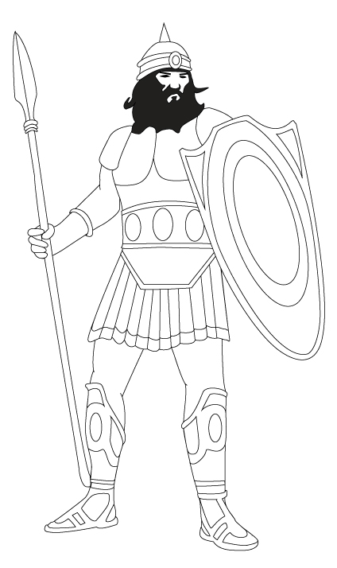
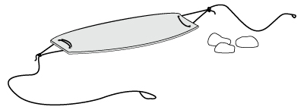
LESSON 88

Slide 5

LESSON 88
1 Samuel 17: 4–7
4 ¶ And there went out a champion out of the camp of the Philistines, named Goliath, of Gath, whose height was six cubits and a span.
5 And he had an helmet of brass upon his head, and he was armed with a coat of mail; and the weight of the coat was five thousand shekels of brass.
6 And he had greaves of brass upon his legs, and a target of brass between his shoulders.
7 And the staff of his spear was like a weaver’s beam; and his spear’s head weighed six hundred shekels of iron: and one bearing a shield went before him.
How tall was Goliath?

Slide 6
LESSON 88
1 Samuel 17: 8-11
8 And he stood and cried unto the armies of Israel, and said unto them, Why are ye come out to set your battle in array? am not I a Philistine, and ye servants to Saul? choose you a man for you, and let him come down to me.
9 If he be able to fight with me, and to kill me, then will we be your servants: but if I prevail against him, and kill him, then shall ye be our servants, and serve us.
10 And the Philistine said, I defy the armies of Israel this day; give me a man, that we may fight together.
11 When Saul and all Israel heard those words of the Philistine, they were dismayed, and greatly afraid.
What challenge did Goliath give to the Israelites?
How might you have responded to Goliath’s challenge if you had been in the camp of the Israelites?
How did the Israelite soldiers respond to Goliath’s challenge?

Slide 7
LESSON 88
1 Samuel 17:19-26.
19 Now Saul, and they, and all the men of Israel, were in the valley of Elah, fighting with the Philistines.
20 ¶ And David rose up early in the morning, and left the sheep with a keeper, and took, and went, as Jesse had commanded him; and he came to the trench, as the host was going forth to the fight, and shouted for the battle.
21 For Israel and the Philistines had put the battle in array, army against army.
22 And David left his carriage in the hand of the keeper of the carriage, and ran into the army, and came and saluted his brethren.
23 And as he talked with them, behold, there came up the champion, the Philistine of Gath, Goliath by name, out of the armies of the Philistines, and spake according to the same words: and David heard them.
24 And all the men of Israel, when they saw the man, fled from him, and were sore afraid.
25 And the men of Israel said, Have ye seen this man that is come up? surely to defy Israel is he come up: and it shall be, that the man who killeth him, the king will enrich him with great riches, and will give him his daughter, and make his father’s house free in Israel.
26 And David spake to the men that stood by him, saying, What shall be done to the man that killeth this Philistine, and taketh away the reproach from Israel? for who is this uncircumcised Philistine, that he should defy the armies of the living God?
How was David’s reaction to Goliath’s challenge different from the reaction of the Israelite soldiers?

Slide 8
LESSON 88
1 Samuel 17:32-37
32 ¶ And David said to Saul, Let no man’s heart fail because of him; thy servant will go and fight with this Philistine.
33 And Saul said to David, Thou art not able to go against this Philistine to fight with him: for thou art but a youth, and he a man of war from his youth.
34 And David said unto Saul, Thy servant kept his father’s sheep, and there came a lion, and a bear, and took a lamb out of the flock:
35 And I went out after him, and smote him, and delivered it out of his mouth: and when he arose against me, I caught him by his beard, and smote him, and slew him.
36 Thy servant slew both the lion and the bear: and this uncircumcised Philistine shall be as one of them, seeing he hath defied the armies of the living God.
37 David said moreover, The Lord that delivered me out of the paw of the lion, and out of the paw of the bear, he will deliver me out of the hand of this Philistine. And Saul said unto David, Go, and the Lord be with thee.
How might Saul’s response to David in verse 33 be similar to what we sometimes feel when we face challenges?
What did David say when Saul told him that he was too young to fight with Goliath?
Why did David believe he could defeat Goliath?
Remembering how the Lord has helped us in the past will …
strengthen our faith to endure or
overcome our present challenges.
Why do you think remembering how the Lord has helped us in the past will help us with our present challenges?

Slide 9
LESSON 88
1 Samuel 17:38-40
38 ¶ And Saul armed David with his armour, and he put an helmet of brass upon his head; also he armed him with a coat of mail.
39 And David girded his sword upon his armour, and he assayed to go; for he had not proved it. And David said unto Saul, I cannot go with these; for I have not proved them. And David put them off him.
40 And he took his staff in his hand, and chose him five smooth stones out of the brook, and put them in a shepherd’s bag which he had, even in a scrip; and his sling was in his hand: and he drew near to the Philistine.
Why did David decide not to use King Saul’s armor?
What did David do to prepare for the battle?

Slide 10
LESSON 88
1 Samuel 17:41-58
“With the strength of the Lord,
David slays Goliath”

Slide 11
LESSON 88
1 Samuel 17:41-44
And the Philistine came on and drew near unto David; and the man that bare the shield went before him.
What did Goliath think of David?
How might you have responded to Goliath’s insults?
1 Samuel 17:45-47
45 Then said David to the Philistine, Thou comest to me with a sword, and with a spear, and with a shield: but I come to thee in the name of the Lord of hosts, the God of the armies of Israel, whom thou hast defied.
46 This day will the Lord deliver thee into mine hand; and I will smite thee, and take thine head from thee; and I will give the carcases of the host of the Philistines this day unto the fowls of the air, and to the wild beasts of the earth; that all the earth may know that there is a God in Israel.
47 And all this assembly shall know that the Lord saveth not with sword and spear: for the battle is the Lord’s, and he will give you into our hands.
How would you summarize David’s response to Goliath?
What did David say the assembly would know after he defeated Goliath?
What does David’s response reveal about him?

Slide 12
LESSON 88
1 Samuel 17:48-51
48 And it came to pass, when the Philistine arose, and came and drew nigh to meet David, that David hasted, and ran toward the army to meet the Philistine.
49 And David put his hand in his bag, and took thence a stone, and slang it, and smote the Philistine in his forehead, that the stone sunk into his forehead; and he fell upon his face to the earth.
50 So David prevailed over the Philistine with a sling and with a stone, and smote the Philistine, and slew him; but there was no sword in the hand of David.
51 Therefore David ran, and stood upon the Philistine, and took his sword, and drew it out of the sheath thereof, and slew him, and cut off his head therewith. And when the Philistines saw their champion was dead, they fled.
How did David exercise his faith in the Lord?
What principles can we learn from this story?
As we exercise faith in the Lord, He will help us with our challenges.
What are some ways we can exercise our faith in the Lord when we experience challenges?

Slide 13
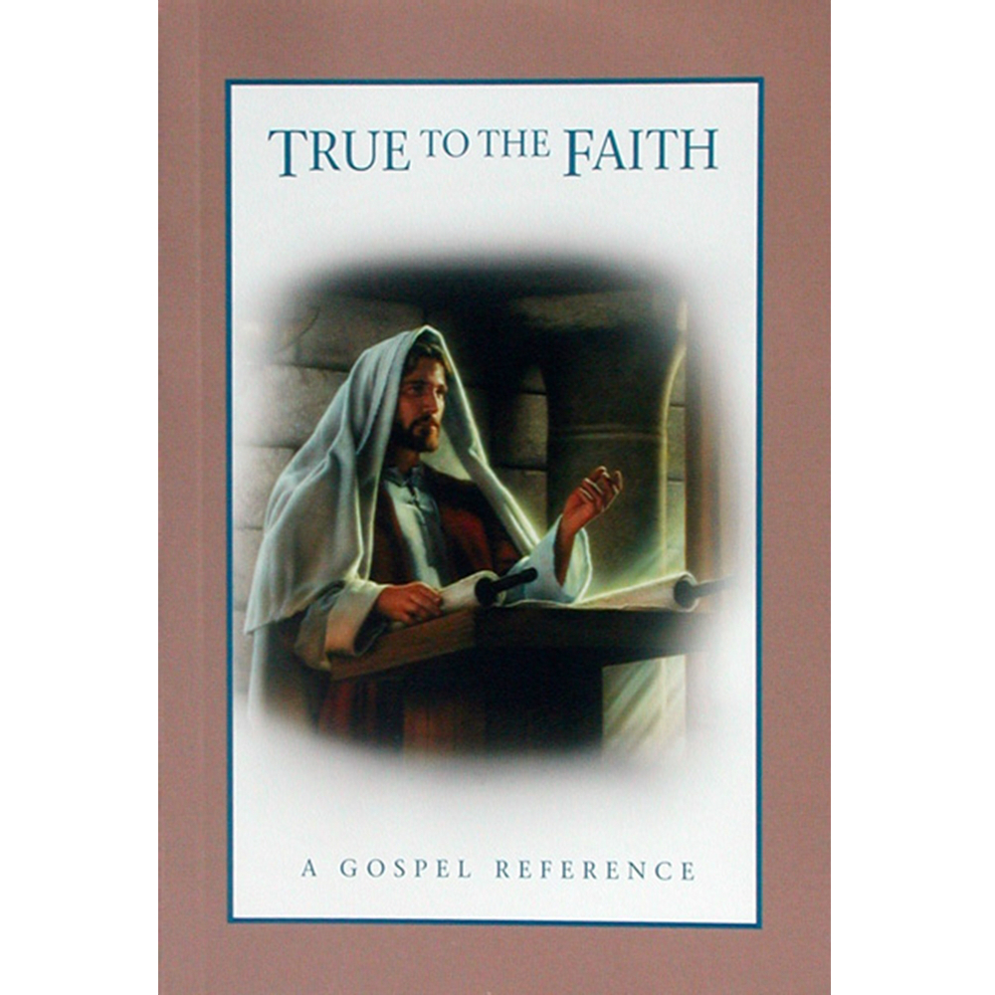
LESSON 88
“Faith is much more than passive belief. You express your faith through action—by the way you live. …
“… Your faith can lead you to do good works, obey the commandments, and repent of your sins” (True to the Faith: A Gospel Reference [2004], 54, 55).
A young man’s parents decide to get a divorce.
A young woman is struggling to overcome some addictions.
A young woman knows she needs to forgive someone who caused her harm.
A young man has health problems that limit the activities he can participate in.
What will you do to better exercise your faith in Jesus Christ as you face your challenges?

Slide 14
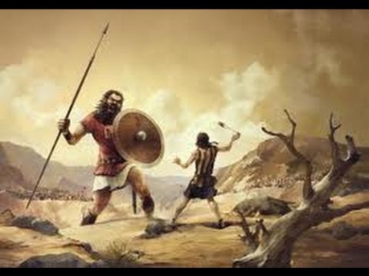
LESSON 88

