Slide 1
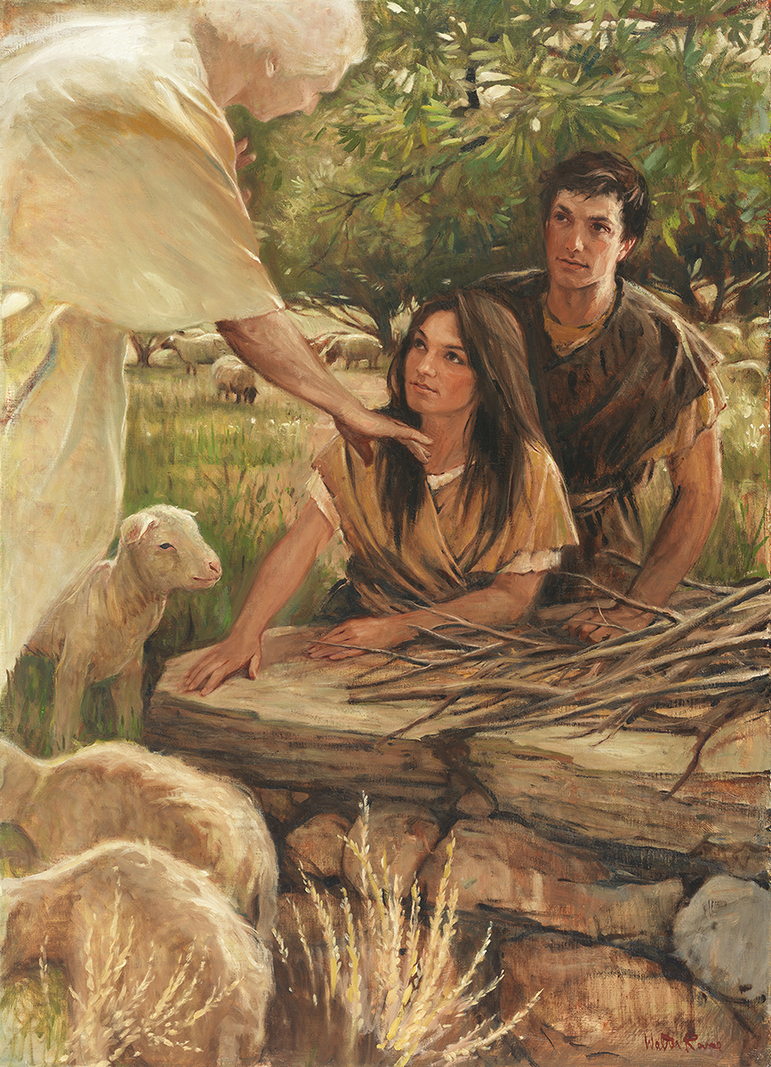
SEMINARY
Old Testament

Slide 2
LESSON 87
1 Samuel 16

Slide 3
LESSON 87
1 Samuel 16: 1-13
“The Lord inspires Samuel to anoint David as the next king of Israel”

Slide 4
LESSON 87
Without seeing what is inside, which bag would you choose?
Why would you make that choice?
1 Samuel 15:26
And Samuel said unto Saul, I will not return with thee: for thou hast rejected the word of the Lord, and the Lord hath rejected thee from being king over Israel.
Why did the Lord reject Saul as king?
1 Samuel 16:1
And the Lord said unto Samuel, How long wilt thou mourn for Saul, seeing I have rejected him from reigning over Israel? fill thine horn with oil, and go, I will send thee to Jesse the Beth-lehemite: for I have provided me a king among his sons.
What did the Lord tell Samuel to do?

Slide 5
LESSON 87
1 Samuel 16:2-5
2 And Samuel said, How can I go? if Saul hear it, he will kill me. And the Lord said, Take an heifer with thee, and say, I am come to sacrifice to the Lord.
3 And call Jesse to the sacrifice, and I will shew thee what thou shalt do: and thou shalt anoint unto me him whom I name unto thee.
4 And Samuel did that which the Lord spake, and came to Beth-lehem. And the elders of the town trembled at his coming, and said, Comest thou peaceably?
5 And he said, Peaceably: I am come to sacrifice unto the Lord: sanctify yourselves, and come with me to the sacrifice. And he sanctified Jesse and his sons, and called them to the sacrifice.
What was Samuel worried about?
What did the Lord tell Samuel to do so Saul would not be suspicious?
How would Samuel know whom to anoint as the next king of Israel?

Slide 6
LESSON 87
1 Samuel 16:7
But the Lord said unto Samuel, Look not on his countenance, or on the height of his stature; because I have refused him: for the Lord seeth not as man seeth; for man looketh on the outward appearance, but the Lord looketh on the heart.
Why did God tell Samuel to not look at Eliab’s height or physical appearance as a way to decide whether he should be the new king?
What does this verse teach us about how God sees and judges us?
God judges us by our hearts rather than our outward appearance.
What do you think it means that God judges us by our hearts?

Slide 7
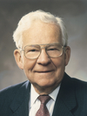
LESSON 87
“When the Lord measures an individual, … He measures the heart as an indicator of the person’s capacity and potential to bless others.
“Why the heart? Because the heart is a synonym for one’s entire make-up. …
“The measure of our hearts is the measure of our total performance. As used by the Lord, the ‘heart’ of a person describes his effort to better self, or others, or the conditions he confronts” (Marvin J. Ashton, “The Measure of Our Hearts,” Ensign, Nov. 1988, 15).
Elder
Marvin J. Ashton
What does the Lord measure when He judges us by our hearts?
Why is it important for you to know that God judges you by your heart and not your physical appearance?
How does knowing this increase your love for the Lord?

Slide 8
LESSON 87
1 Samuel 16: 8-13
8 Then Jesse called Abinadab, and made him pass before Samuel. And he said, Neither hath the Lord chosen this.
9 Then Jesse made Shammah to pass by. And he said, Neither hath the Lord chosen this.
10 Again, Jesse made seven of his sons to pass before Samuel. And Samuel said unto Jesse, The Lord hath not chosen these.
11 And Samuel said unto Jesse, Are here all thy children? And he said, There remaineth yet the youngest, and, behold, he keepeth the sheep. And Samuel said unto Jesse, Send and fetch him: for we will not sit down till he come hither.
12 And he sent, and brought him in. Now he was ruddy, and withal of a beautiful countenance, and goodly to look to. And the Lord said, Arise, anoint him: for this is he.
13 Then Samuel took the horn of oil, and anointed him in the midst of his brethren: and the Spirit of the Lord came upon David from that day forward. So Samuel rose up, and went to Ramah.

Slide 9
LESSON 87
1 Samuel 16:14-23
“David is selected as Saul’s
armor-bearer”

Slide 10
LESSON 87
1 Samuel 16:14
¶ But the Spirit of the Lord departed from Saul, and an evil spirit from the Lord troubled him.
What happened to Saul?
1 Samuel 16:15-16
15 And Saul’s servants said unto him, Behold now, an evil spirit from God troubleth thee.
16 Let our lord now command thy servants, which are before thee, to seek out a man, who is a cunning player on an harp: and it shall come to pass, when the evil spirit from God is upon thee, that he shall play with his hand, and thou shalt be well.
What did the servants suggest could help Saul feel better?
1 Samuel 16:17-18
17 And Saul said unto his servants, Provide me now a man that can play well, and bring him to me.
18 Then answered one of the servants, and said, Behold, I have seen a son of Jesse the Beth-lehemite, that is cunning in playing, and a mighty valiant man, and a man of war, and prudent in matters, and a comely person, and the Lord is with him.

Slide 11
LESSON 87
Who did one of the servants suggest should play the harp for Saul?
Why would David be a good choice to help Saul?
1 Samuel 16:23
23 And it came to pass, when the evil spirit from God was upon Saul, that David took an harp, and played with his hand: so Saul was refreshed, and was well, and the evil spirit departed from him.
What happened when David played music for Saul?
What kind of music do you think has the power to drive away evil influences?

Slide 12

LESSON 87

