Slide 1
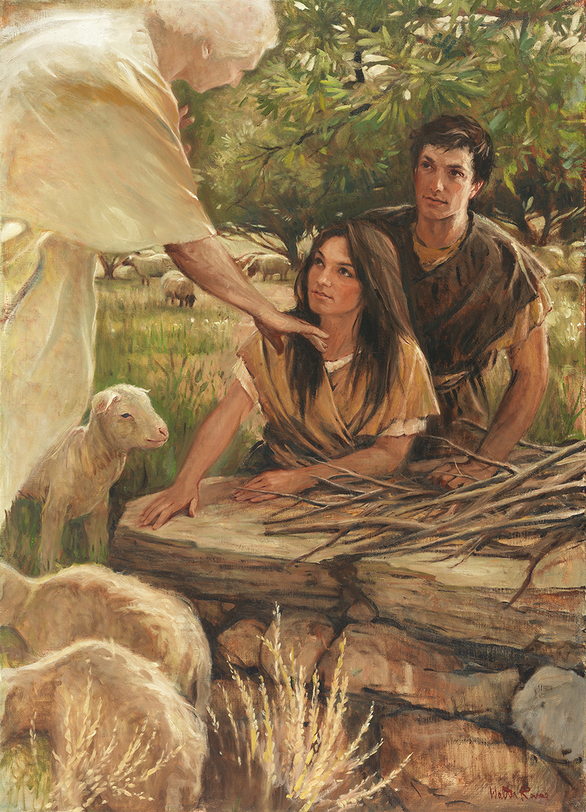
SEMINARY
Old Testament

Slide 2
LESSON 86
1 Samuel 9–15

Slide 3
LESSON 86
1 Samuel 9
“The Lord leads Saul to Samuel”

Slide 4
LESSON 86
To what or whom would you go for advice? Why?
1 Samuel 9:1–2
1 Now there was a man of Benjamin, whose name was Kish, the son of Abiel, the son of Zeror, the son of Bechorath, the son of Aphiah, a Benjamite, a mighty man of power.
2 And he had a son, whose name was Saul, a choice young man, and a goodly: and there was not among the children of Israel a goodlier person than he: from his shoulders and upward he washigher than any of the people.
What were some of Saul’s characteristics?
1 Samuel 9:6
And he said unto him, Behold now, there is in this city a man of God, and he is an honourable man; all that he saith cometh surely to pass: now let us go thither; peradventure he can shew us our way that we should go.
What did Saul’s servant suggest?

Slide 5
LESSON 86
1 Samuel 9:9
(Beforetime in Israel, when a man went to inquire of God, thus he spake, Come, and let us go to the seer: for he that is now called a Prophet was beforetime called a Seer.)
1 Samuel 9:18-21
18 Then Saul drew near to Samuel in the gate, and said, Tell me, I pray thee, where the seer’s house is.
19 And Samuel answered Saul, and said, I am the seer: go up before me unto the high place; for ye shall eat with me to day, and to morrow I will let thee go, and will tell thee all that is in thine heart.
20 And as for thine asses that were lost three days ago, set not thy mind on them; for they are found. And on whom is all the desire of Israel? Is it not on thee, and on all thy father’s house?
21 And Saul answered and said, Am not I a Benjamite, of the smallest of the tribes of Israel? and my family the least of all the families of the tribe of Benjamin? wherefore then speakest thou so to me?
How did the people refer to this man of God?
What did Samuel tell Saul about his father’s donkeys? What can Samuel’s instruction teach us about the power of seers?
What did Samuel tell Saul about the will of the Lord for him?
How had Samuel shown them the way that they should go?
What principle can we identify from Saul’s experience regarding seeking the Lord’s direction through His prophets and seers?
If we seek the Lord’s direction through His prophets and seers, they will show us the way we should go.

Slide 6
LESSON 86
1 Samuel 10-12
“Samuel anoints Saul king of Israel and exhorts the Israelites to follow the Lord”

Slide 7
LESSON 86
1 Samuel 13-14
“Saul disobeys the Lord and
offers a burnt offering”

Slide 8
LESSON 86
1 Samuel 13:6-8
6 When the men of Israel saw that they were in a strait, (for the people were distressed,) then the people did hide themselves in caves, and in thickets, and in rocks, and in high places, and in pits.
7 And some of the Hebrews went over Jordan to the land of Gad and Gilead. As for Saul, he was yet in Gilgal, and all the people followed him trembling.
8 ¶ And he tarried seven days, according to the set time that Samuel had appointed: but Samuel came not to Gilgal; and the people were scattered from him.
How did some Israelites respond when they saw the Philistine army?
1 Samuel 13:9
And Saul said, Bring hither a burnt offering to me, and peace offerings. And he offered the burnt offering.
What did Saul do? Why do you think he did this?

Slide 9
LESSON 86
1 Samuel 13:10-12
10 And it came to pass, that as soon as he had made an end of offering the burnt offering, behold, Samuel came; and Saul went out to meet him, that he might salute him.
11 ¶ And Samuel said, What hast thou done? And Saul said, Because I saw that the people were scattered from me, and that thou camest not within the days appointed, and that the Philistines gathered themselves together at Michmash;
12 Therefore said I, The Philistines will come down now upon me to Gilgal, and I have not made supplication unto the Lord: I forced myself therefore, and offered a burnt offering.
What reasons did Saul give to try to justify his disobedience to the Lord’s commandments?
Even though we may try to justify our disobedience to the Lord’s commandments, …

Slide 10
LESSON 86
1 Samuel 13:13-14
13 And Samuel said to Saul, Thou hast done foolishly: thou hast not kept the commandment of the Lord thy God, which he commanded thee: for now would the Lord have established thy kingdom upon Israel for ever.
14 But now thy kingdom shall not continue: the Lord hath sought him a man after his own heart, and the Lord hath commanded him to be captain over his people, because thou hast not kept that which the Lord commanded thee.
What kinds of pressures do you feel in your life?
What was the consequence of Saul’s disobedience?
How would you complete the statement on the board using what you have learned from Saul’s experience?
Even though we may try to justify our disobedience
to the Lord’s commandments, He will hold us
accountable and we will receive the consequences of our choices.
How might understanding this truth help someone overcome the temptation to try to justify disobeying the Lord’s commandments?
What can you do to avoid allowing these pressures to influence you to disobey God’s commandments?

Slide 11
LESSON 86
1 Samuel 15
“The Lord rejects Saul as king because of his disobedience”

Slide 12
LESSON 86
Because I (keep this commandment), it is okay if I (do not keep this commandment).
1 Samuel 15:7-9
7 And Saul smote the Amalekites from Havilah until thou comest to Shur, that is over against Egypt.
8 And he took Agag the king of the Amalekites alive, and utterly destroyed all the people with the edge of the sword.
9 But Saul and the people spared Agag, and the best of the sheep, and of the oxen, and of the fatlings, and the lambs, and all that was good, and would not utterly destroy them: but every thing that was vile and refuse, that they destroyed utterly.
How would you describe Saul’s obedience to the Lord’s command to destroy all the Amalekites and their livestock?

Slide 13
LESSON 86
Saul’s Disobedience
1 Samuel 15:13-24
What did Saul say he had done?
(verse 13.)
How did Saul try to justify the fact that he and his soldiers had been only partially obedient to the Lord’s commandment?
(verse 15.)
How had Saul changed since he was anointed as king?
(verse 17.)
Even after being rebuked by Samuel, what did Saul do?
(verse 21.)
(verse 22.)
What did Samuel teach was more important than making animal sacrifices?
What reason did Saul give for his disobedience?
(verse 24.)
What principles can we learn from Saul’s mistake?

Slide 14
LESSON 86
The greatest offering we can give to the Lord is our complete obedience to Him. Seeking to please others rather than the Lord can lead us to disobey His commandments.
How does obedience to the Lord’s commandments help us become like Him?

Slide 15
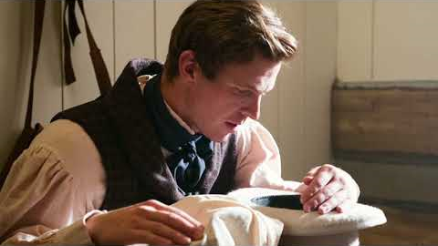
LESSON 86

Slide 16
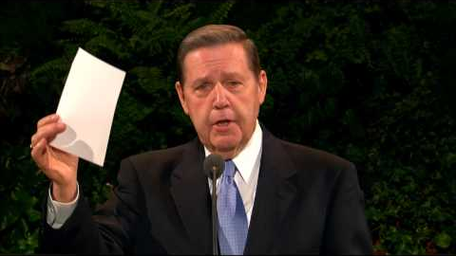
LESSON 86

