Slide 1
SEMINARY
Old Testament

Slide 2
LESSON 84
Prophets and Revelation
(Part 2)

Slide 3
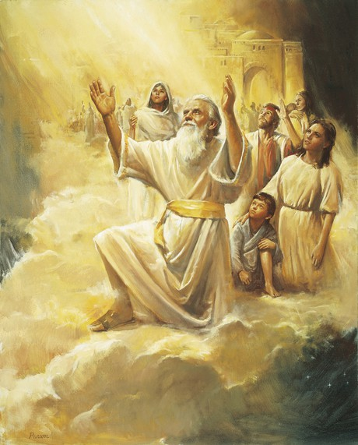
LESSON 84
Moses 7:41, 44
41 And it came to pass that the Lord spake unto Enoch, and told Enoch all the doings of the children of men; wherefore Enoch knew, and looked upon their wickedness, and their misery, and wept and stretched forth his arms, and his heart swelled wide as eternity; and his bowels yearned; and all eternity shook.
44 And as Enoch saw this, he had bitterness of soul, and wept over his brethren, and said unto the heavens: I will refuse to be comforted; but the Lord said unto Enoch: Lift up your heart, and be glad; and look.
What was Enoch’s response to the wickedness and destruction he saw?
What did the Lord tell Enoch to do?

Slide 4
LESSON 84
Moses 7:47
And behold, Enoch saw the day of the coming of the Son of Man, even in the flesh; and his soul rejoiced, saying: The Righteous is lifted up, and the Lamb is slain from the foundation of the world; and through faith I am in the bosom of the Father, and behold, Zion is with me.
What did Enoch see?
Moses 7:67
And the Lord showed Enoch all things, even unto the end of the world; and he saw the day of the righteous, the hour of their redemption, and received a fulness of joy;
What effect did seeing and learning about the Savior’s mission and the plan of salvation have on Enoch?
Why do you think Enoch could be filled with joy rather than experiencing “bitterness of soul” (verse 44) after learning about the Savior’s mission and the plan of salvation?
When we view difficult circumstances with an eternal perspective, we can experience joy rather than bitterness of soul.

Slide 5
LESSON 84
Practice Exercise (20 minutes)

Slide 6
LESSON 84
Helping Others Acquire Spiritual Knowledge
Paragraphs 13-17
13. When others come to us asking questions or investigating Church doctrine, practices, or history, how might we best assist them in their quest for truth? The following are some of the ways we can help them:
14. Listen carefully and prayerfully: Listen attentively before you respond, seeking to clarify and understand the actual questions they are asking. Thoughtfully seek to understand the true intent of their questions and their feelings and beliefs.
15. Teach and testify of gospel truths: Share applicable teachings from the scriptures and modern prophets and how they have made a difference in your life. Help those with whom you speak examine or reframe their questions in the context of the gospel and the plan of salvation.
16. Invite them to act in faith: Remember that the Lord requires us to seek spiritual knowledge for ourselves. We must therefore invite others to act in faith through prayer, obedience to the commandments, and diligent study of the word of God, using divinely appointed sources, particularly the Book of Mormon. If applicable, invite them to remember experiences they may have had when they felt the Holy Ghost and to hold fast to eternal truths they have learned until additional knowledge comes.
17. Follow through: Offer to search for answers, and then follow through by sharing what you learn. You could also search for answers together. Express confidence in the Lord’s promise to provide personal revelation.

Slide 7
LESSON 84
Jeremiah 1:4-5.
4 Then the word of the Lord came unto me, saying,
5 Before I formed thee in the belly I knew thee; and before thou camest forth out of the womb I sanctified thee, and I ordained thee a prophet unto the nations.
When did the Lord choose prophets to be in their appointed positions?
How could the doctrine taught in this passage help Alex see his question with an eternal perspective?
What are some ways you could invite Alex to act in faith that would help him continue to find peace about his question?

Slide 8
LESSON 84

