Slide 1
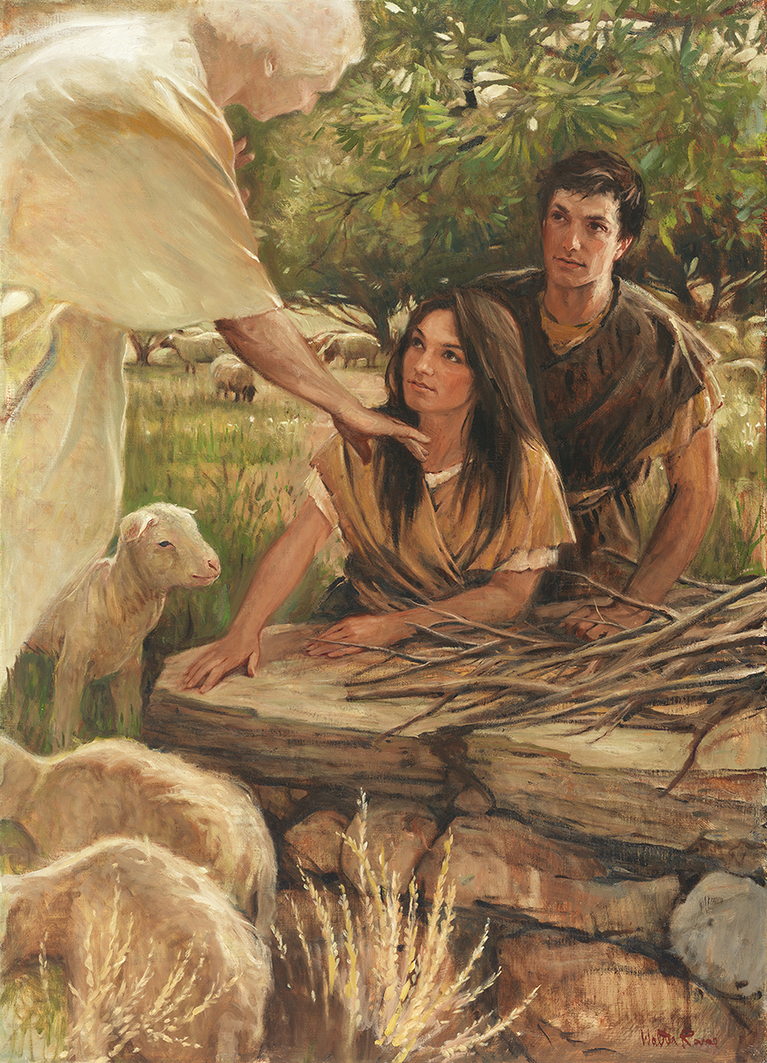
SEMINARY
Old Testament

Slide 2
LESSON 83
1 Samuel 3

Slide 3
LESSON 83
1 Samuel 3:1–14
“The Lord calls Samuel”

Slide 4
LESSON 83
1 Samuel 3:1
And the child Samuel ministered unto the Lord before Eli. And the word of the Lord was precious in those days; there was no open vision.
What do you think it means that “the word of the Lord was precious in those days”?
What might this tell us about the spiritual condition of the people at this time?
1 Samuel 3:2-6.
2 And it came to pass at that time, when Eli was laid down in his place, and his eyes began to wax dim, that he could not see;
3 And ere the lamp of God went out in the temple of the Lord, where the ark of God was, and Samuel was laid down to sleep;
4 That the Lord called Samuel: and he answered, Here am I.
5 And he ran unto Eli, and said, Here am I; for thou calledst me. And he said, I called not; lie down again. And he went and lay down.
6 And the Lord called yet again, Samuel. And Samuel arose and went to Eli, and said, Here am I; for thou didst call me. And he answered, I called not, my son; lie down again.
Why do you think Samuel did not recognize the voice?

Slide 5
LESSON 83
1 Samuel 3:7–10
7 Now Samuel did not yet know the Lord, neither was the word of the Lord yet revealed unto him.
8 And the Lord called Samuel again the third time. And he arose and went to Eli, and said, Here am I; for thou didst call me. And Eli perceived that the Lord had called the child.
9 Therefore Eli said unto Samuel, Go, lie down: and it shall be, if he call thee, that thou shalt say, Speak, Lord; for thy servant heareth. So Samuel went and lay down in his place.
10 And the Lord came, and stood, and called as at other times, Samuel, Samuel. Then Samuel answered, Speak; for thy servant heareth.
Why did Samuel initially not recognize the voice?
What did Eli counsel Samuel to do if he heard the voice again?

Slide 6
LESSON 83
1 Samuel 3:11–14
11 ¶ And the Lord said to Samuel, Behold, I will do a thing in Israel, at which both the ears of every one that heareth it shall tingle.
12 In that day I will perform against Eli all things which I have spoken concerning his house: when I begin, I will also make an end.
13 For I have told him that I will judge his house for ever for the iniquity which he knoweth; because his sons made themselves vile, and he restrained them not.
14 And therefore I have sworn unto the house of Eli, that the iniquity of Eli’s house shall not be purged with sacrifice nor offering for ever.
Why do you think the Lord spoke to Samuel and not to Eli?

Slide 7
LESSON 83
If we are willing and receptive, we can grow in our ability to recognize the voice of the Lord.
Trusted leaders and parents can help us learn to recognize the voice of the Lord.
As we increase our ability to receive and understand personal revelation, we will be able to recognize the voice of the Lord more easily and receive His guidance and instruction.
1 Nephi 17:45
What can prevent me from recognizing the Lord’s voice?
Alma 5:57
What is one thing I need to do if I want to learn to recognize the Lord’s voice?
Doctrine and Covenants 1:38
Who may speak for the Lord?
Doctrine and Covenants 8:2–3; 11:12–13
How can I recognize when the Lord speaks to me through the Spirit?
Doctrine and Covenants 18:34–36
What is one way I can hear the voice of the Lord daily?

Slide 8
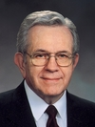

LESSON 83
“The Spirit does not get our attention by shouting or shaking us with a heavy hand. Rather it whispers. It caresses so gently that if we are preoccupied we may not feel it at all. …
“Occasionally it will press just firmly enough for us to pay heed. But most of the time, if we do not heed the gentle feeling, the Spirit will withdraw and wait until we come seeking and listening” (Boyd K. Packer, “The Candle of the Lord,” Ensign, Jan. 1983, 53).
President
Boyd K. Packer
What are some preoccupations that may deter us from hearing and recognizing the gentle whisper of the Lord’s voice?
What does it mean to “pay heed”?
“We need to be acquainted with the promptings of the Holy Ghost, and we need to practice and apply gospel teachings until they become natural and automatic. These promptings become the foundation of our testimonies” (Allan F. Packer, “Finding Strength in Challenging Times!” Ensign or Liahona, May 2009, 17).

Slide 9
LESSON 83
1 Samuel 3:15–18
“Samuel tells Eli of his experience”

Slide 10
LESSON 83
1 Samuel 3:15–18
15 ¶ And Samuel lay until the morning, and opened the doors of the house of the Lord. And Samuel feared to shew Eli the vision.
16 Then Eli called Samuel, and said, Samuel, my son. And he answered, Here am I.
17 And he said, What is the thing that the Lord hath said unto thee? I pray thee hide it not from me: God do so to thee, and more also, if thou hide any thing from me of all the things that he said unto thee.
18 And Samuel told him every whit, and hid nothing from him. And he said, It is the Lord: let him do what seemeth him good.
Why do you think it might have been difficult for Samuel to tell Eli what the Lord had said?
What can Samuel’s decision to tell Eli teach us about Samuel?

Slide 11
LESSON 83
1 Samuel 3:19–21
“The people recognize Samuel
as a prophet”

Slide 12
LESSON 83
What message does it send if I throw something you value on the ground?
1 Samuel 3:19–21
19 ¶ And Samuel grew, and the Lord was with him, and did let none of his words fall to the ground.
20 And all Israel from Dan even to Beer-sheba knew that Samuel was established to be a prophet of the Lord.
21 And the Lord appeared again in Shiloh: for the Lord revealed himself to Samuel in Shiloh by the word of the Lord.
What do you think it means that “the Lord … did let none of [Samuel’s] words fall to the ground” (verse 19)?

Slide 13
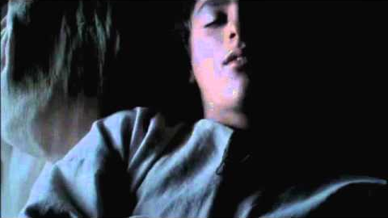
LESSON 83

