Slide 1
SEMINARY
Old Testament

Slide 2
LESSON 80
Judges 10–21

Slide 3
LESSON 80
Judges 10-21
“The Lord calls other judges, including Samson, to deliver the Israelites from their enemies”

Slide 4
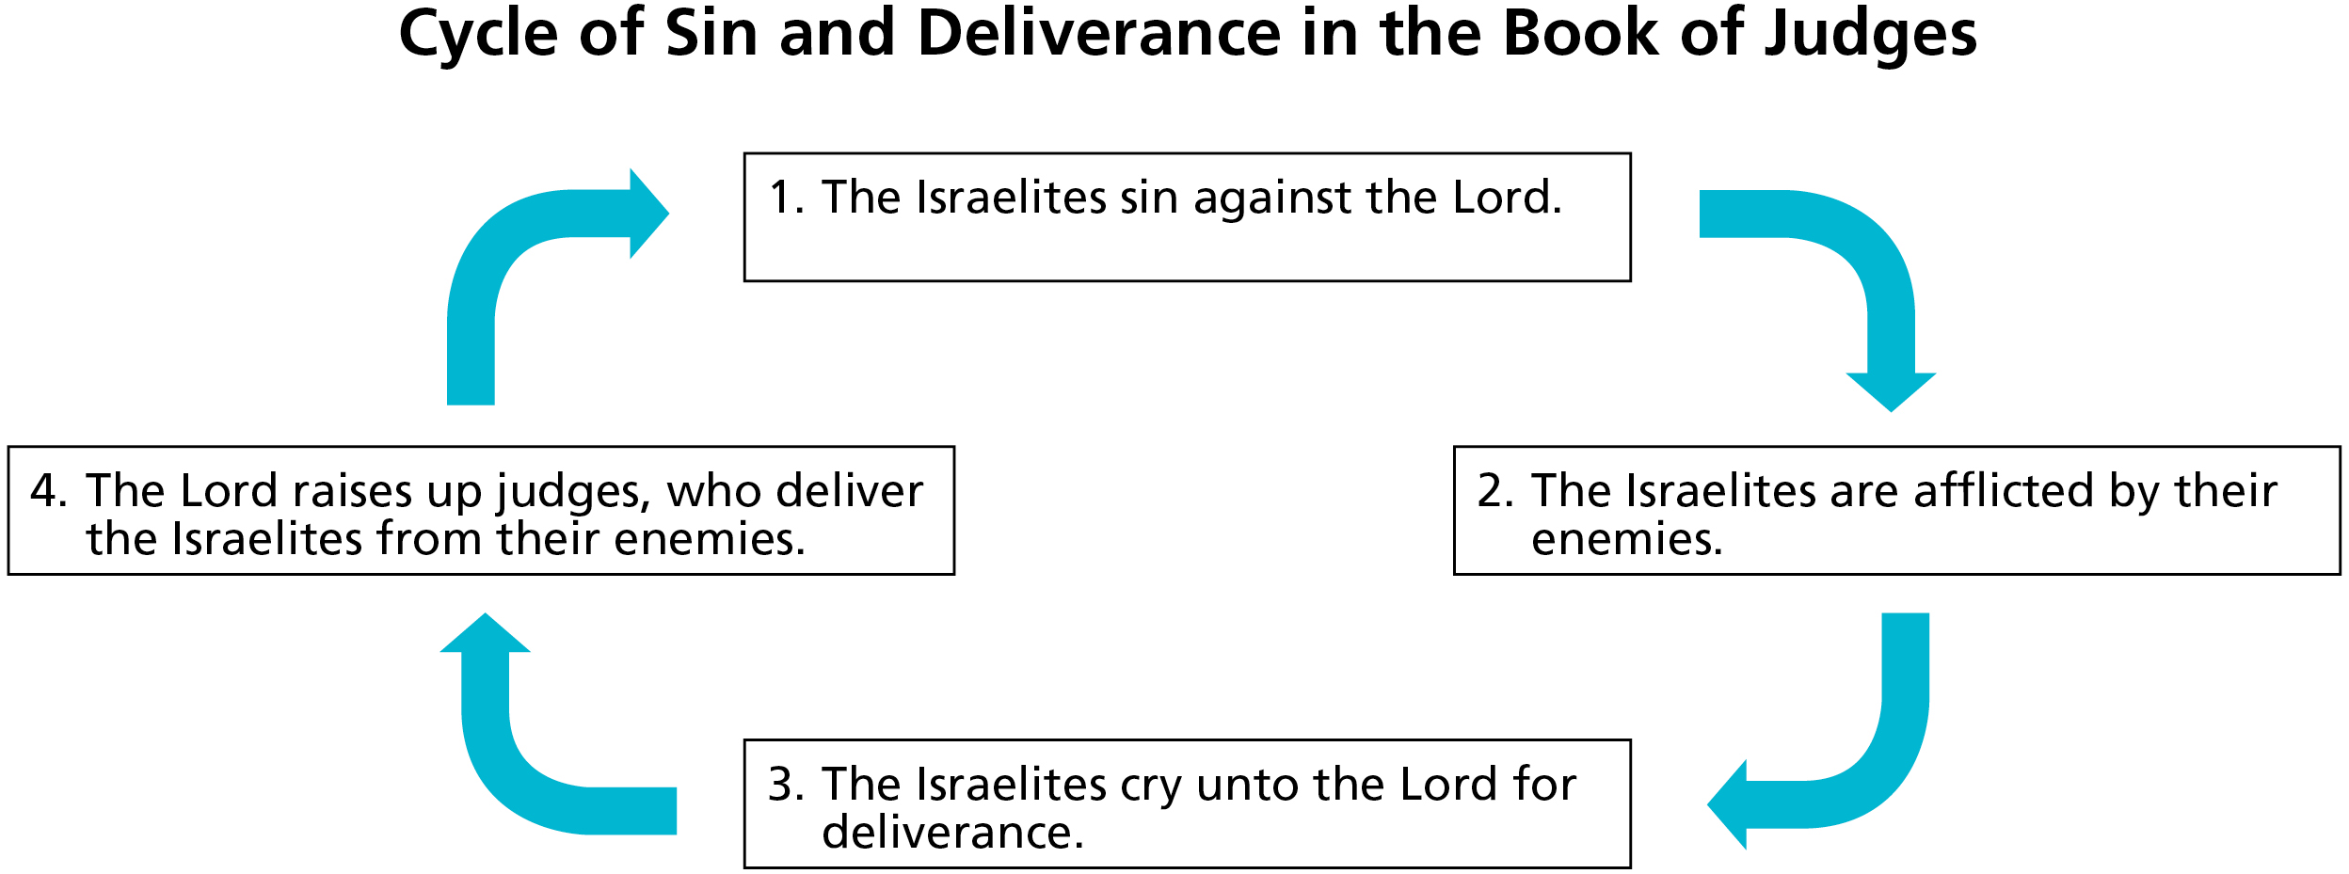
LESSON 80
What are some things you feel Heavenly Father would like you to accomplish in your life?

Slide 5
LESSON 80
Judges 13:1-5
1 And the children of Israel did evil again in the sight of the Lord; and the Lord delivered them into the hand of the Philistines forty years.
2 ¶ And there was a certain man of Zorah, of the family of the Danites, whose name was Manoah; and his wife was barren, and bare not.
3 And the angel of the Lord appeared unto the woman, and said unto her, Behold now, thou art barren, and bearest not: but thou shalt conceive, and bear a son.
4 Now therefore beware, I pray thee, and drink not wine nor strong drink, and eat not any unclean thing:
5 For, lo, thou shalt conceive, and bear a son; and no razor shall come on his head: for the child shall be a Nazarite unto God from the womb: and he shall begin to deliver Israel out of the hand of the Philistines.
What does it mean that the child would be a Nazarite?
How might the Israelites be blessed by a leader whose life would be dedicated to God?

Slide 6
LESSON 80
Judges 14:1-3
1 And Samson went down to Timnath, and saw a woman in Timnath of the daughters of the Philistines.
2 And he came up, and told his father and his mother, and said, I have seen a woman in Timnath of the daughters of the Philistines: now therefore get her for me to wife.
3 Then his father and his mother said unto him, Is there never a woman among the daughters of thy brethren, or among all my people, that thou goest to take a wife of the uncircumcised Philistines? And Samson said unto his father, Get her for me; for she pleaseth me well.
What did Samson desire?
What was wrong with this desire?
What do we learn about Samson from verses 1-3?

Slide 7
LESSON 80
If we place our own desires ahead of the Lord’s will, then …
Judges 14:5-6
5 ¶ Then went Samson down, and his father and his mother, to Timnath, and came to the vineyards of Timnath: and, behold, a young lion roared against him.
6 And the Spirit of the Lord came mightily upon him, and he rent him as he would have rent a kid, and he had nothing in his hand: but he told not his father or his mother what he had done.
What do these verses teach us about Samson’s physical strength?
What was the source of Samson’s physical strength?

Slide 8
LESSON 80
What Motivated Samson?
After Samson’s wife reveals the riddle’s answer to the Philistines, Samson separates himself from her.
(Judges 14:16–20; 15:1–2).
When Samson learns that his father-in-law, a Philistine, gave Samson’s wife to another man, Samson burns the Philistines’ crops.
(see Judges 15:1-5).
The Philistines seek revenge against Samson by burning his wife and father-in-law. Samson responds by smiting the Philistines “with a great slaughter”
(Judges 15:6-8).
The Philistines come against Samson to bind him and “do to him as he hath done to us.” Samson responds, “As they did unto me, so have I done unto them.” He slays one thousand more Philistines.
(Judges 15:10–16).

Slide 9
LESSON 80
What desires or emotions do you think motivated Samson’s actions?
How did Samson’s choices to act in anger and seek revenge affect him and his family?
What principle can we learn from Samson’s actions about the consequences of choices that are based on anger or vengeance?
Anger and vengeance can lead us to make choices that hurt others and ourselves.

Slide 10
LESSON 80
Judges 16:15-20
15 ¶ And she said unto him, How canst thou say, I love thee, when thine heart is not with me? thou hast mocked me these three times, and hast not told me wherein thy great strength lieth.
16 And it came to pass, when she pressed him daily with her words, and urged him, so that his soul was vexed unto death;
17 That he told her all his heart, and said unto her, There hath not come a razor upon mine head; for I have been a Nazarite unto God from my mother’s womb: if I be shaven, then my strength will go from me, and I shall become weak, and be like any other man.
18 And when Delilah saw that he had told her all his heart, she sent and called for the lords of the Philistines, saying, Come up this once, for he hath shewed me all his heart. Then the lords of the Philistines came up unto her, and brought money in their hand.
19 And she made him sleep upon her knees; and she called for a man, and she caused him to shave off the seven locks of his head; and she began to afflict him, and his strength went from him.
20 And she said, The Philistines be upon thee, Samson. And he awoke out of his sleep, and said, I will go out as at other times before, and shake myself. And he wist not that the Lord was departed from him.
What did Samson not realize he had lost?
What can we learn from Samson’s experience?
If the Spirit of the Lord departs from us, we will lose blessings.
What blessings or abilities might we lose when the Lord’s Spirit is not with us?

Slide 11
LESSON 80
Judges 16:28-30
28 And Samson called unto the Lord, and said, O Lord God, remember me, I pray thee, and strengthen me, I pray thee, only this once, O God, that I may be at once avenged of the Philistines for my two eyes.
29 And Samson took hold of the two middle pillars upon which the house stood, and on which it was borne up, of the one with his right hand, and of the other with his left.
30 And Samson said, Let me die with the Philistines. And he bowed himself with all his might; and the house fell upon the lords, and upon all the people that were therein. So the dead which he slew at his death were more than they which he slew in his life.
Why did Samson want to kill the Philistines in the building?
How well do you think Samson accomplished the Lord’s will in his life?
How would you complete this statement?
If we place our own desires ahead of the Lord’s will, then we will not reach our divine potential.
How could Samson’s life have been different if he had sought to do the Lord’s will rather than his own?

Slide 12
LESSON 80

