Slide 1
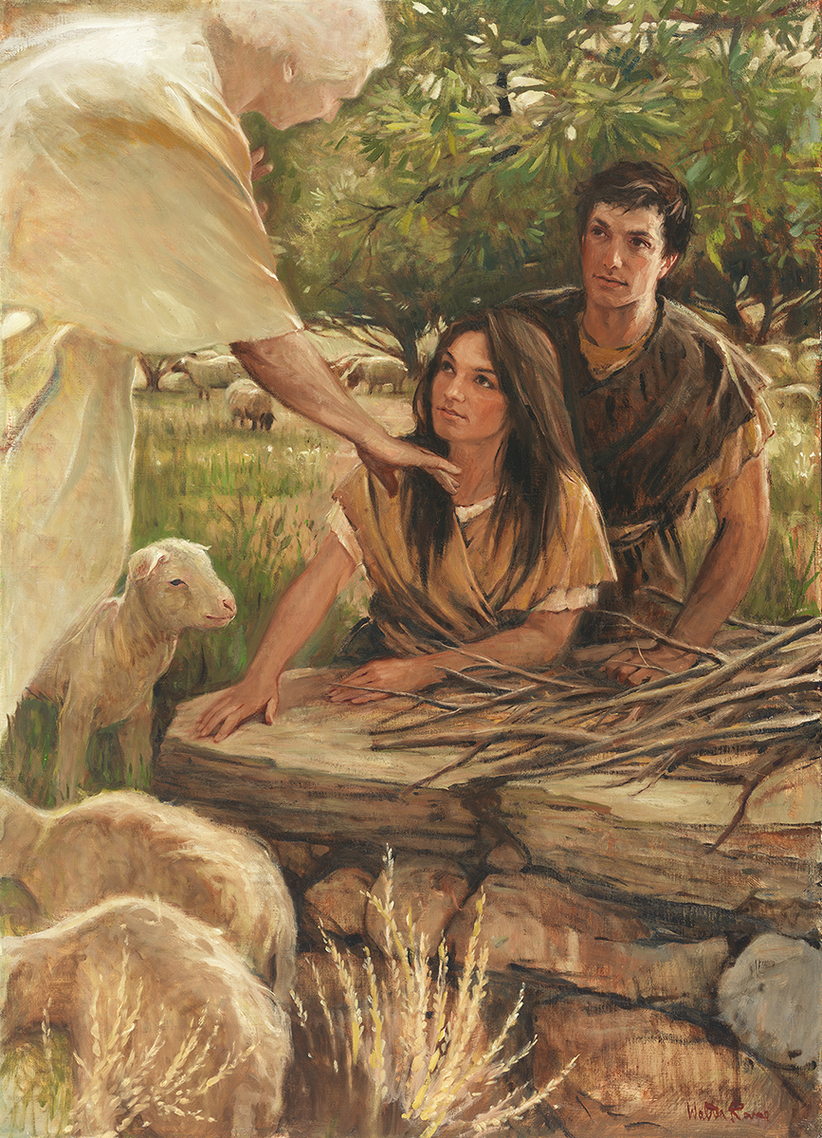
SEMINARY
SEMINARY
Old Testament
SEMINARY

Slide 2
LESSON 78
Judges 1–9

Slide 3
LESSON 78
Judges 1–6:16
“The Israelites settle in the promised land and begin to worship false gods”

Slide 4

LESSON 78
What point might this
picture be trying to make?

Slide 5
LESSON 78
Judges 1:21, 27-33
21 And the children of Benjamin did not drive out the Jebusites that inhabited Jerusalem; but the Jebusites dwell with the children of Benjamin in Jerusalem unto this day.
27 ¶ Neither did Manasseh drive out the inhabitants of Beth-shean and her towns, nor Taanach and her towns, nor the inhabitants of Dor and her towns, nor the inhabitants of Ibleam and her towns, nor the inhabitants of Megiddo and her towns: but the Canaanites would dwell in that land.
28 And it came to pass, when Israel was strong, that they put the Canaanites to tribute, and did not utterly drive them out.
29 ¶ Neither did Ephraim drive out the Canaanites that dwelt in Gezer; but the Canaanites dwelt in Gezer among them.
30 ¶ Neither did Zebulun drive out the inhabitants of Kitron, nor the inhabitants of Nahalol; but the Canaanites dwelt among them, and became tributaries.
31 ¶ Neither did Asher drive out the inhabitants of Accho, nor the inhabitants of Zidon, nor of Ahlab, nor of Achzib, nor of Helbah, nor of Aphik, nor of Rehob:
32 But the Asherites dwelt among the Canaanites, the inhabitants of the land: for they did not drive them out.
33 ¶ Neither did Naphtali drive out the inhabitants of Beth-shemesh, nor the inhabitants of Beth-anath; but he dwelt among the Canaanites, the inhabitants of the land: nevertheless the inhabitants of Beth-shemesh and of Beth-anath became tributaries unto them.
What can we learn from Judges 1:21, 27-33?

Slide 6
LESSON 78
Judges 2:1-3
1 And an angel of the Lord came up from Gilgal to Bochim, and said, I made you to go up out of Egypt, and have brought you unto the land which I sware unto your fathers; and I said, I will never break my covenant with you.
2 And ye shall make no league with the inhabitants of this land; ye shall throw down their altars: but ye have not obeyed my voice: why have ye done this?
3 Wherefore I also said, I will not drive them out from before you; but they shall be as thorns in your sides, and their gods shall be a snare unto you.
What did the new generation of Israelites do?
If we choose to associate with evil influences and temptations, then …
Judges 2:11-13
11 ¶ And the children of Israel did evil in the sight of the Lord, and served Baalim:
12 And they forsook the Lord God of their fathers, which brought them out of the land of Egypt, and followed other gods, of the gods of the people that were round about them, and bowed themselves unto them, and provoked the Lord to anger.
13 And they forsook the Lord, and served Baal and Ashtaroth.

Slide 7
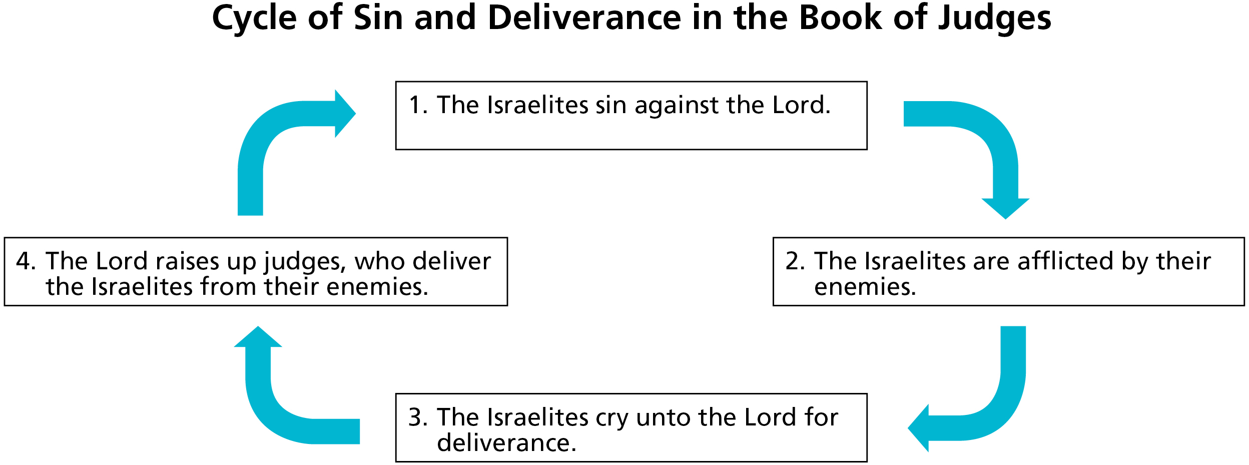
LESSON 78
Baalim
Baal
How would you complete the principle on the board?
If we choose to associate with evil influences and temptations, then
they may lead us to sin.

Slide 8
LESSON 78
Judges 6:17-40
“In obedience to the Lord, Gideon removes false idols and prepares for battle”

Slide 9
LESSON 78
Judges 6:25-26
25 ¶ And it came to pass the same night, that the Lord said unto him, Take thy father’s young bullock, even the second bullock of seven years old, and throw down the altar of Baal that thy father hath, and cut down the grove that is by it:
26 And build an altar unto the Lord thy God upon the top of this rock, in the ordered place, and take the second bullock, and offer a burnt sacrifice with the wood of the grove which thou shalt cut down.
What did the Lord command Gideon to do?
Why do you think it was important for Gideon to destroy the altar of the false god Baal, which the Israelites had made, before he gathered an army to drive out the Midianites?
What principle can we learn from the Lord’s instruction to Gideon?
Why is it important to not just remove evil habits or practices from our lives but to replace them with righteous practices?

Slide 10
LESSON 78
Judges 7
“The Lord delivers the Midianites into the hands of the Israelites”

Slide 11
LESSON 78
Judges 7:12
And the Midianites and the Amalekites and all the children of the east lay along in the valley like grasshoppers for multitude; and their camels were without number, as the sand by the sea side for multitude.
Judges 7:1-3
1 Then Jerubbaal, who is Gideon, and all the people that were with him, rose up early, and pitched beside the well of Harod: so that the host of the Midianites were on the north side of them, by the hill of Moreh, in the valley.
2 And the Lord said unto Gideon, The people that are with thee are too many for me to give the Midianites into their hands, lest Israel vaunt themselves against me, saying, Mine own hand hath saved me.
3 Now therefore go to, proclaim in the ears of the people, saying, Whosoever is fearful and afraid, let him return and depart early from mount Gilead. And there returned of the people twenty and two thousand; and there remained ten thousand.
What might you have thought when the Lord said you had too many soldiers in your army?
Why did the Lord tell Gideon to reduce the size of Israel’s army?

Slide 12
LESSON 78
How many were in the army originally?
(32,000.)
How many remained?
(10,000.)
Judges 7:4-8.
4 And the Lord said unto Gideon, The people are yet too many; bring them down unto the water, and I will try them for thee there: and it shall be, that of whom I say unto thee, This shall go with thee, the same shall go with thee; and of whomsoever I say unto thee, This shall not go with thee, the same shall not go.
5 So he brought down the people unto the water: and the Lord said unto Gideon, Every one that lappeth of the water with his tongue, as a dog lappeth, him shalt thou set by himself; likewise every one that boweth down upon his knees to drink.
6 And the number of them that lapped, putting their hand to their mouth, were three hundred men: but all the rest of the people bowed down upon their knees to drink water.
7 And the Lord said unto Gideon, By the three hundred men that lapped will I save you, and deliver the Midianites into thine hand: and let all the other people go every man unto his place.
8 So the people took victuals in their hand, and their trumpets: and he sent all the rest of Israel every man unto his tent, and retained those three hundred men: and the host of Midian was beneath him in the valley.
What might you think about the Lord reducing your army from 32,000 to 300?

Slide 13

LESSON 78
Judges 7:15-18
15 ¶ And it was so, when Gideon heard the telling of the dream, and the interpretation thereof, that he worshipped, and returned into the host of Israel, and said, Arise; for the Lord hath delivered into your hand the host of Midian.
16 And he divided the three hundred men into three companies, and he put a trumpet in every man’s hand, with empty pitchers, and lamps within the pitchers.
17 And he said unto them, Look on me, and do likewise: and, behold, when I come to the outside of the camp, it shall be that, as I do, so shall ye do.
18 When I blow with a trumpet, I and all that are with me, then blow ye the trumpets also on every side of all the camp, and say, The sword of the Lord, and of Gideon.
What instructions did Gideon give?

Slide 14
LESSON 78
Judges 7:19-23
19 ¶ So Gideon, and the hundred men that were with him, came unto the outside of the camp in the beginning of the middle watch; and they had but newly set the watch: and they blew the trumpets, and brake the pitchers that were in their hands.
20 And the three companies blew the trumpets, and brake the pitchers, and held the lamps in their left hands, and the trumpets in their right hands to blow withal: and they cried, The sword of the Lord, and of Gideon.
21 And they stood every man in his place round about the camp: and all the host ran, and cried, and fled.
22 And the three hundred blew the trumpets, and the Lord set every man’s sword against his fellow, even throughout all the host: and the host fled to Beth-shittah in Zererath, and to the border of Abel-meholah, unto Tabbath.
23 And the men of Israel gathered themselves together out of Naphtali, and out of Asher, and out of all Manasseh, and pursued after the Midianites.
What principle can we learn from this account about what happens when we faithfully follow the Lord’s commands?
If we follow the Lord’s commands with exactness and always acknowledge our dependence on Him, then He will help us overcome our challenges.

Slide 15
LESSON 78
Judges 8-9
“Israel enjoys peace for many years but returns to idolatry after Gideon dies”

Slide 16

LESSON 78

Slide 17
LESSON 78

Slide 18
LESSON 78

Slide 19
LESSON 78

Slide 20
LESSON 78

