Slide 1
SEMINARY
Old Testament

Slide 2
LESSON 77
Joshua 11–24

Slide 3
LESSON 77
Joshua 11–22
“The promised land is divided among the tribes of Israel”

Slide 4
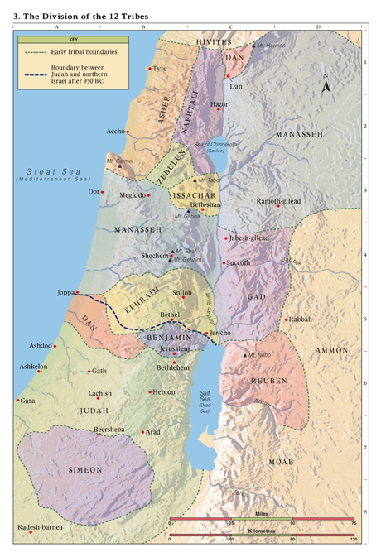
LESSON 77
How many years do you have until it is time for you to leave home?
What are some of your concerns about leaving your home and living somewhere new?
How many years do you have until it is time for you to leave home?
Joshua 11:23
So Joshua took the whole land, according to all that the Lord said unto Moses; and Joshua gave it for an inheritance unto Israel according to their divisions by their tribes. And the land rested from war.
What are some of your concerns about leaving your home and living somewhere new?

Slide 5
LESSON 77
Joshua 21:43–45
43 ¶ And the Lord gave unto Israel all the land which he sware to give unto their fathers; and they possessed it, and dwelt therein.
44 And the Lord gave them rest round about, according to all that he sware unto their fathers: and there stood not a man of all their enemies before them; the Lord delivered all their enemies into their hand.
45 There failed not ought of any good thing which the Lord had spoken unto the house of Israel; all came to pass.
How had the Lord blessed the Israelites?

Slide 6
LESSON 77
Joshua 22:4-5
4 And now the Lord your God hath given rest unto your brethren, as he promised them: therefore now return ye, and get you unto your tents, and unto the land of your possession, which Moses the servant of the Lord gave you on the other side Jordan.
5 But take diligent heed to do the commandment and the law, which Moses the servant of the Lord charged you, to love the Lord your God, and to walk in all his ways, and to keep his commandments, and to cleave unto him, and to serve him with all your heart and with all your soul.
What did Joshua counsel them to do?

Slide 7
LESSON 77
Joshua 23
“Joshua calls Israel together and warns them to not worship other gods but to cleave to the Lord”

Slide 8
LESSON 77
God | Israelites
He fought and will continue to fight for Israel
Be very courageous
He gave Israel land for an inheritance
Keep the law of Moses
He will expel the other nations from the land
Don’t serve or worship other gods
He has kept and will continue to keep His promises to Israel
Cleave unto the Lord
Love the Lord

Slide 9
LESSON 77
What can we do to have the Lord with us and strengthen us?
If we cleave unto the Lord and obey Him, then He will be with us and strengthen us.
What behaviors or actions might you see in a person who is trying to cleave unto the Lord?
How have you seen the Lord bless that person for being devoted to Him?
How can this principle be helpful to you as you prepare to leave home?

Slide 10
LESSON 77
Joshua 23:12-16.
12 Else if ye do in any wise go back, and cleave unto the remnant of these nations, even these that remain among you, and shall make marriages with them, and go in unto them, and they to you:
13 Know for a certainty that the Lord your God will no more drive out any of these nations from before you; but they shall be snares and traps unto you, and scourges in your sides, and thorns in your eyes, until ye perish from off this good land which the Lord your God hath given you.
14 And, behold, this day I am going the way of all the earth: and ye know in all your hearts and in all your souls, that not one thing hath failed of all the good things which the Lord your God spake concerning you; all are come to pass unto you, and not one thing hath failed thereof.
15 Therefore it shall come to pass, that as all good things are come upon you, which the Lord your God promised you; so shall the Lord bring upon you all evil things, until he have destroyed you from off this good land which the Lord your God hath given you.
16 When ye have transgressed the covenant of the Lord your God, which he commanded you, and have gone and served other gods, and bowed yourselves to them; then shall the anger of the Lord be kindled against you, and ye shall perish quickly from off the good land which he hath given unto you.

Slide 11
LESSON 77
What consequences did Joshua say Israel would experience if they chose to serve or cleave unto other nations or gods?
What could happen to us if we cleave to other gods?
If we cleave to other gods, we will bring negative consequences upon ourselves and lose the blessings of the Lord
How could this principle be a helpful warning to someone preparing to make important life choices?
What are some things people might cleave unto instead of the Lord?

Slide 12
LESSON 77
Joshua 24
“Before Joshua dies, he encourages Israel to serve the Lord”

Slide 13
LESSON 77
How do you feel about that person?
Joshua 24:2-13
2 And Joshua said unto all the people, Thus saith the Lord God of Israel, Your fathers dwelt on the other side of the flood in old time, even Terah, the father of Abraham, and the father of Nachor: and they served other gods.
3 And I took your father Abraham from the other side of the flood, and led him throughout all the land of Canaan, and multiplied his seed, and gave him Isaac.
4 And I gave unto Isaac Jacob and Esau: and I gave unto Esau mount Seir, to possess it; but Jacob and his children went down into Egypt.
5 I sent Moses also and Aaron, and I plagued Egypt, according to that which I did among them: and afterward I brought you out.
6 And I brought your fathers out of Egypt: and ye came unto the sea; and the Egyptians pursued after your fathers with chariots and horsemen unto the Red sea.
7 And when they cried unto the Lord, he put darkness between you and the Egyptians, and brought the sea upon them, and covered them; and your eyes have seen what I have done in Egypt: and ye dwelt in the wilderness a long season.
8 And I brought you into the land of the Amorites, which dwelt on the other side Jordan; and they fought with you: and I gave them into your hand, that ye might possess their land; and I destroyed them from before you.
9 Then Balak the son of Zippor, king of Moab, arose and warred against Israel, and sent and called Balaam the son of Beor to curse you:
10 But I would not hearken unto Balaam; therefore he blessed you still: so I delivered you out of his hand.
11 And ye went over Jordan, and came unto Jericho: and the men of Jericho fought against you, the Amorites, and the Perizzites, and the Canaanites, and the Hittites, and the Girgashites, the Hivites, and the Jebusites; and I delivered them into your hand.
12 And I sent the hornet before you, which drave them out from before you, even the two kings of the Amorites; but not with thy sword, nor with thy bow.
13 And I have given you a land for which ye did not labour, and cities which ye built not, and ye dwell in them; of the vineyards and oliveyards which ye planted not do ye eat.

Slide 14
LESSON 77
What feelings might you have had toward God after being reminded of what He had done for you?
Joshua 24:14-16
14 ¶ Now therefore fear the Lord, and serve him in sincerity and in truth: and put away the gods which your fathers served on the other side of the flood, and in Egypt; and serve ye the Lord.
15 And if it seem evil unto you to serve the Lord, choose you this day whom ye will serve; whether the gods which your fathers served that were on the other side of the flood, or the gods of the Amorites, in whose land ye dwell: but as for me and my house, we will serve the Lord.
16 And the people answered and said, God forbid that we should forsake the Lord, to serve other gods;
How do you think remembering what the Lord had done for them might have affected the Israelites’ determination to accept Joshua’s invitation?
How could remembering what the Lord has done for us affect our determination to love and serve Him?

Slide 15
LESSON 77
Joshua 24:15
And if it seem evil unto you to serve the Lord, choose you this day whom ye will serve; whether the gods which your fathers served that were on the other side of the flood, or the gods of the Amorites, in whose land ye dwell: but as for me and my house, we will serve the Lord.
What might the phrase “this day” indicate about when we should choose to be devoted to the Lord?
What phrase in this verse indicates that Joshua chose this path for himself, regardless of what others might choose?
What principle about agency can we learn from this verse?
We can choose to serve the Lord regardless of what others choose.
What are some specific circumstances where we can choose to serve the Lord regardless of what others choose?

Slide 16
LESSON 77

