Slide 1
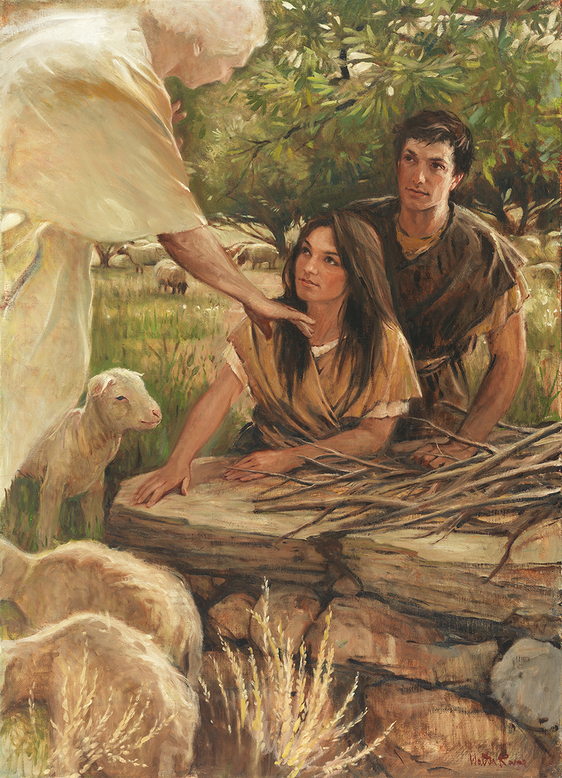
SEMINARY
Old Testament

Slide 2
LESSON 75
Joshua 3–5

Slide 3
LESSON 75
Joshua 3
“Joshua miraculously leads the Israelites across the Jordan River”

Slide 4
LESSON 75
“What mean these stones?
Joshua 3:1-6
1 And Joshua rose early in the morning; and they removed from Shittim, and came to Jordan, he and all the children of Israel, and lodged there before they passed over.
2 And it came to pass after three days, that the officers went through the host;
3 And they commanded the people, saying, When ye see the ark of the covenant of the Lord your God, and the priests the Levites bearing it, then ye shall remove from your place, and go after it.
4 Yet there shall be a space between you and it, about two thousand cubits by measure: come not near unto it, that ye may know the way by which ye must go: for ye have not passed this way heretofore.
5 And Joshua said unto the people, Sanctify yourselves: for to morrow the Lord will do wonders among you.
6 And Joshua spake unto the priests, saying, Take up the ark of the covenant, and pass over before the people. And they took up the ark of the covenant, and went before the people.
What did the officers tell the people to do?
What did Joshua tell the people to do?
What did Joshua tell the priests to do?
Why do you think the people were instructed to sanctify themselves before they crossed the Jordan River? What difference would their preparation make in their response to the Lord’s miracles?

Slide 5
LESSON 75
Joshua 3:7
¶ And the Lord said unto Joshua, This day will I begin to magnify thee in the sight of all Israel, that they may know that, as I was with Moses, so I will be with thee.
How do you think the Lord’s words recorded in verse 7 may have affected Joshua?
Joshua 3:8-11, 13
8 And thou shalt command the priests that bear the ark of the covenant, saying, When ye are come to the brink of the water of Jordan, ye shall stand still in Jordan.
9 ¶ And Joshua said unto the children of Israel, Come hither, and hear the words of the Lord your God.
10 And Joshua said, Hereby ye shall know that the living God is among you, and that he will without fail drive out from before you the Canaanites, and the Hittites, and the Hivites, and the Perizzites, and the Girgashites, and the Amorites, and the Jebusites.
11 Behold, the ark of the covenant of the Lord of all the earth passeth over before you into Jordan.
13 And it shall come to pass, as soon as the soles of the feet of the priests that bear the ark of the Lord, the Lord of all the earth, shall rest in the waters of Jordan, that the waters of Jordan shall be cut off from the waters that come down from above; and they shall stand upon an heap.

Slide 6
LESSON 75
What would those who were carrying the ark have to do before the river stopped?
Would you be willing to step into the water?
What quality did the priests demonstrate by stepping into the water before the water stopped flowing downstream?
Joshua 3:14-17
14 ¶ And it came to pass, when the people removed from their tents, to pass over Jordan, and the priests bearing the ark of the covenant before the people;
15 And as they that bare the ark were come unto Jordan, and the feet of the priests that bare the ark were dipped in the brim of the water, (for Jordan overfloweth all his banks all the time of harvest,)
16 That the waters which came down from above stood and rose up upon an heap very far from the city Adam, that is beside Zaretan: and those that came down toward the sea of the plain, even the salt sea, failed, and were cut off: and the people passed over right against Jericho.
17 And the priests that bare the ark of the covenant of the Lords tood firm on dry ground in the midst of Jordan, and all the Israelites passed over on dry ground, until all the people were passed clean over Jordan.

Slide 7
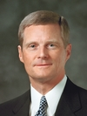
LESSON 75
What principle can we learn from the priests’ actions that can help us when we are faced with obstacles and challenges?
Moving forward in faith invites God to perform miracles in our behalf.
“Recall how the Israelites came to the river Jordan and were promised the waters would part, and they would be able to cross over on dry ground. Interestingly, the waters did not part as the children of Israel stood on the banks of the river waiting for something to happen; rather, the soles of their feet were wet before the water parted. The faith of the Israelites was manifested in the fact that they walked into the water before it parted. They walked into the river Jordan with a future-facing assurance of things hoped for” (David A. Bednar, “Seek Learning by Faith,” Ensign, Sept. 2007, 63).
Elder
David A. Bednar
What do you think it means to move forward in faith?
When have you or someone you know experienced miracles or blessings after moving forward in faith?

Slide 8
LESSON 75
Joshua 4
“The Israelites commemorate the miraculous crossing of the Jordan River”

Slide 9
LESSON 75
What is the purpose of a memorial?
What is the memorial you named intended to remind you of? How can you benefit from remembering these things?
Joshua 4:1-5, 6-7
1 And it came to pass, when all the people were clean passed over Jordan, that the Lord spake unto Joshua, saying,
2 Take you twelve men out of the people, out of every tribe a man,
3 And command ye them, saying, Take you hence out of the midst of Jordan, out of the place where the priests’ feet stood firm, twelve stones, and ye shall carry them over with you, and leave them in the lodging place, where ye shall lodge this night.
4 Then Joshua called the twelve men, whom he had prepared of the children of Israel, out of every tribe a man:
5 And Joshua said unto them, Pass over before the ark of the Lord your God into the midst of Jordan, and take ye up every man of you a stone upon his shoulder, according unto the number of the tribes of the children of Israel:
6 That this may be a sign among you, that when your children ask their fathers in time to come, saying, What mean ye by these stones?
7 Then ye shall answer them, That the waters of Jordan were cut off before the ark of the covenant of the Lord; when it passed over Jordan, the waters of Jordan were cut off: and these stones shall be for a memorial unto the children of Israel for ever.

Slide 10
LESSON 75
Joshua 4:20-24
20 And those twelve stones, which they took out of Jordan, did Joshua pitch in Gilgal.
21 And he spake unto the children of Israel, saying, When your children shall ask their fathers in time to come, saying, What mean these stones?
22 Then ye shall let your children know, saying, Israel came over this Jordan on dry land.
23 For the Lord your God dried up the waters of Jordan from before you, until ye were passed over, as the Lord your God did to the Red sea, which he dried up from before us, until we were gone over:
24 That all the people of the earth might know the hand of the Lord, that it is mighty: that ye might fear the Lord your God for ever.
What answers did you find to the question “What mean these stones?”
What effect should remembering this miraculous event have had on the Israelites?

Slide 11
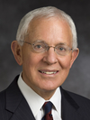
LESSON 75
As we remember what the Lord has done for us,
our reverence for Him increases and
our testimonies are strengthened.
How can remembering previous miracles and spiritual experiences increase our reverence for God and strengthen our testimonies?
“Remembering enables us to see God’s hand in our past, just as prophecy and faith assure us of God’s hand in our future” (Marlin K. Jensen, “Remember and Perish Not,” Ensign or Liahona, May 2007, 38).
How can these principles help you as you face challenges in your life?

Slide 12
LESSON 75
Joshua 5
“The Israelites cease to eat manna and begin to partake of the good of the promised land”

Slide 13
LESSON 75
0
Joshua 5:12
¶ And the manna ceased on the morrow after they had eaten of the old corn of the land; neither had the children of Israel manna any more; but they did eat of the fruit of the land of Canaan that year.
Why do you think the Lord stopped providing manna to the Israelites once they arrived in the promised land?
Joshua 5:13-15
13 ¶ And it came to pass, when Joshua was by Jericho, that he lifted up his eyes and looked, and, behold, there stood a man over against him with his sword drawn in his hand: and Joshua went unto him, and said unto him, Art thou for us, or for our adversaries?
14 And he said, Nay; but as captain of the host of the Lord am I now come. And Joshua fell on his face to the earth, and did worship, and said unto him, What saith my lord unto his servant?
15 And the captain of the Lord’s host said unto Joshua, Loose thy shoe from off thy foot; for the place whereon thou standest is holy. And Joshua did so.

Slide 14
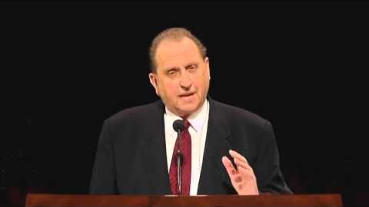
LESSON 75

Slide 15
LESSON 75

Slide 16
LESSON 75

