Slide 1
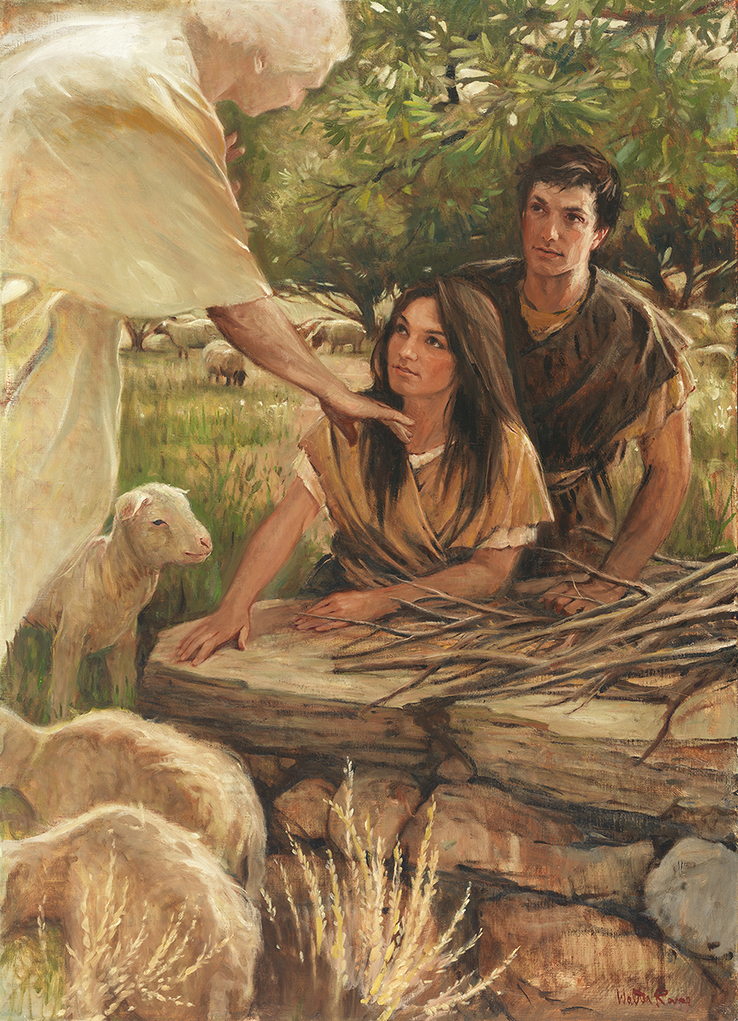
SEMINARY
Old Testament

Slide 2
LESSON 74
Joshua 1–2

Slide 3
LESSON 74
Joshua 1:1-9
“The Lord directs Joshua to bring Israel into the promised land and promises to be with him”

Slide 4
LESSON 74
What are some other tasks or assignments the Lord asks us to do that some Church members might fear?
Joshua 1:1-4, 6
1 Now after the death of Moses the servant of the Lord it came to pass, that the Lord spake unto Joshua the son of Nun, Moses’ minister, saying,
2 Moses my servant is dead; now therefore arise, go over this Jordan, thou, and all this people, unto the land which I do give to them, even to the children of Israel.
3 Every place that the sole of your foot shall tread upon, that have I given unto you, as I said unto Moses.
4 From the wilderness and this Lebanon even unto the great river, the river Euphrates, all the land of the Hittites, and unto the great sea toward the going down of the sun, shall be your coast.
6 Be strong and of a good courage: for unto this people shalt thou divide for an inheritance the land, which I sware unto their fathers to give them.
What did the Lord command Joshua to do?

Slide 5
LESSON 74
Joshua 1:5-7, 9
5 There shall not any man be able to stand before thee all the days of thy life: as I was with Moses, so I will be with thee: I will not fail thee, nor forsake thee.
6 Be strong and of a good courage: for unto this people shalt thou divide for an inheritance the land, which I sware unto their fathers to give them.
7 Only be thou strong and very courageous, that thou mayest observe to do according to all the law, which Moses my servant commanded thee: turn not from it to the right hand or to the left, that thou mayest prosper whithersoever thou goest.
9 Have not I commanded thee? Be strong and of a good courage; be not afraid, neither be thou dismayed: for the Lord thy God is with thee whithersoever thou goest.
What instruction do you see repeated in these verses?
What promise from the Lord might have helped Joshua “be strong and of a good courage”?
What principle can we learn from these verses?
Knowing that the Lord is with us can help us be strong and of a good courage.

Slide 6
LESSON 74
Why can we “be strong and of a good courage” when the Lord is with us?
What can we do to invite the Lord to be with us?
Joshua 1:8
This book of the law shall not depart out of thy mouth; but thou shalt meditate therein day and night, that thou mayest observe to do according to all that is written therein: for then thou shalt make thy way prosperous, and then thou shalt have good success.
What is the “book of the law”?
Meditate:
contemplate,
ponder,
reflect,
consider,
think,
Study.
What else did the Lord command Joshua to do according to verse 8?
What did the Lord promise if Joshua meditated on the scriptures and lived according to the teachings therein?
How would you summarize the Lord’s words recorded in verse 8 as a principle?

Slide 7
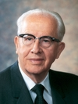
LESSON 74
“The Lord was not promising Joshua material wealth and fame, but that his life would prosper in righteousness and that he would have success in that which matters most in life, namely the quest to find true joy. (See 2 Nephi 2:25.)” (Ezra Taft Benson, “The Power of the Word,” Ensign, May 1986, 81).
President
Ezra Taft Benson
How has meditating on the scriptures helped you prosper in righteousness and have success in finding true joy?

Slide 8
LESSON 74
Joshua 1:10–18
“Joshua prepares the Israelites to
cross the Jordan River”

Slide 9
LESSON 74
If the prophet asked you to leave your family for a certain amount of time and expose yourself to hardship and maybe even danger, would you go?
Joshua 1:16–18
16 ¶ And they answered Joshua, saying, All that thou commandest us we will do, and whithersoever thou sendest us, we will go.
17 According as we hearkened unto Moses in all things, so will we hearken unto thee: only the Lord thy God be with thee, as he was with Moses.
18 Whosoever he be that doth rebel against thy commandment, and will not hearken unto thy words in all that thou commandest him, he shall be put to death: only be strong and of a good courage.
What does the response of these men say about their character?
Why do you think these men were willing to follow Joshua’s counsel and direction?

Slide 10
LESSON 74
Joshua 2
“Joshua sends spies to Jericho, where Rahab gives them a place to hide; the spies promise to preserve Rahab’s family”

Slide 11
LESSON 74
Joshua 2:9-11
9 And she said unto the men, I know that the Lord hath given you the land, and that your terror is fallen upon us, and that all the inhabitants of the land faint because of you.
10 For we have heard how the Lord dried up the water of the Red sea for you, when ye came out of Egypt; and what ye did unto the two kings of the Amorites, that were on the other side Jordan, Sihon and Og, whom ye utterly destroyed.
11 And as soon as we had heard these things, our hearts did melt, neither did there remain any more courage in any man, because of you: for the Lord your God, he is God in heaven above, and in earth beneath.
Who did Rahab testify of?

Slide 12
LESSON 74
Joshua 2:17-21
17 And the men said unto her, We will be blameless of this thine oath which thou hast made us swear.
18 Behold, when we come into the land, thou shalt bind this line of scarlet thread in the window which thou didst let us down by: and thou shalt bring thy father, and thy mother, and thy brethren, and all thy father’s household, home unto thee.
19 And it shall be, that whosoever shall go out of the doors of thy house into the street, his blood shall be upon his head, and we will be guiltless: and whosoever shall be with thee in the house, his blood shall be on our head, if any hand be upon him.
20 And if thou utter this our business, then we will be quit of thine oath which thou hast made us to swear.
21 And she said, According unto your words, so be it. And she sent them away, and they departed: and she bound the scarlet line in the window.
How would the invading Israelite army know not to destroy Rahab’s family?

Slide 13
LESSON 74
Joshua, Reubenites-Gadites-Manassehites, Spies, Rahab.
How did each of these people or groups of people show their faith in the Lord?
What can we learn about faith from the examples of these people?
We can show our faith in the Lord through our righteous actions.

Slide 14
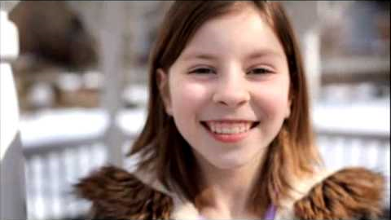
LESSON 74

