Slide 1
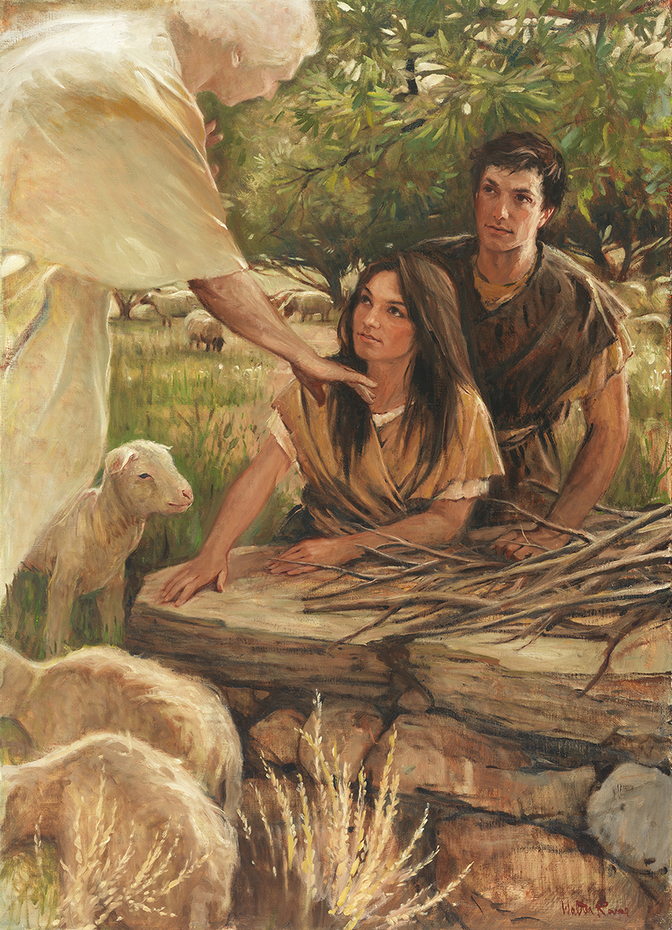
SEMINARY
Old Testament

Slide 2
LESSON 73
Deuteronomy 27–34

Slide 3
LESSON 73
Deuteronomy 27–28
“Moses explains the consequences of obedience and disobedience to God’s laws”

Slide 4
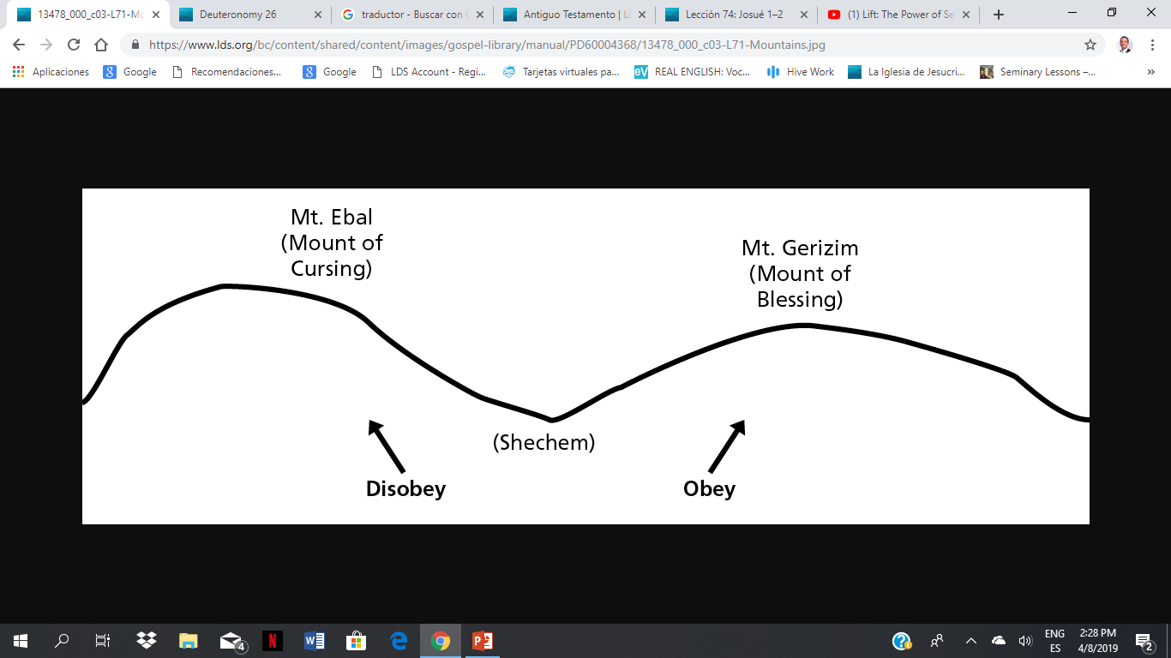
LESSON 73
What could I do to help you choose the bag with the treat in it?
How did knowing what was in both bags influence your ability to choose?

Slide 5
LESSON 73
Deuteronomy 28:1, 15
1 And it shall come to pass, if thou shalt hearken diligently unto the voice of the Lord thy God, to observe and to do all his commandments which I command thee this day, that the Lord thy God will set thee on high above all nations of the earth:
15 ¶ But it shall come to pass, if thou wilt not hearken unto the voice of the Lord thy God, to observe to do all his commandments and his statutes which I command thee this day; that all these curses shall come upon thee, and overtake thee:
What did the Lord command the people to do to obtain the blessings and avoid the curses?

Slide 6
LESSON 73
Let's read:
Deuteronomy 28:2–14
Deuteronomy 28:15–25
Disobey
If
Obey
How would you summarize what we can learn from the Israelites’ experience about obeying God’s commandments?
If we choose to obey all of God’s commandments, He will bless us in all areas of our lives. If we choose not to obey all of God’s commandments, we lose the blessings He desires to give us.
Why do you think that in order to be prepared to meet God, we need to keep all of His commandments?

Slide 7
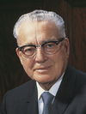
LESSON 73
“The most important of all the commandments of God is that one that you are having the most difficulty keeping today. If it is one of dishonesty, if it is one of unchastity, if it is one of falsifying, not telling the truth, today is the day for you to work on that until you have been able to conquer that weakness. … Then you start on the next one that is most difficult for you to keep” (Teachings of Presidents of the Church: Harold B. Lee [2000], 30).
President
Harold B. Lee

Slide 8
LESSON 73
Deuteronomy 29–30
“Moses warns the people of the consequences of breaking their covenant with God”

Slide 9
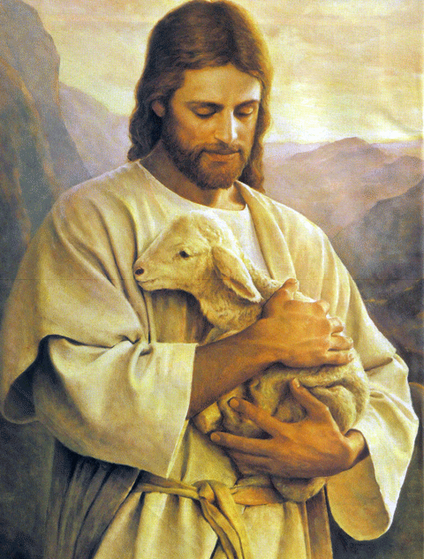
LESSON 73
How can the lost lamb in this painting represent each of us?
What qualities or attributes
of the Savior come to
mind as you contemplate
this picture?

Slide 10
LESSON 73
Deuteronomy 29:25-28
25 Then men shall say, Because they have forsaken the covenant of the Lord God of their fathers, which he made with them when he brought them forth out of the land of Egypt:
26 For they went and served other gods, and worshipped them, gods whom they knew not, and whom he had not given unto them:
27 And the anger of the Lord was kindled against this land, to bring upon it all the curses that are written in this book:
28 And the Lord rooted them out of their land in anger, and in wrath, and in great indignation, and cast them into another land, as it is this day.
What would happen if the Israelites broke their covenant?

Slide 11
LESSON 73
Deuteronomy 30:1-6.
1 And it shall come to pass, when all these things are come upon thee, the blessing and the curse, which I have set before thee, and thou shalt call them to mind among all the nations, whither the Lord thy God hath driven thee,
2 And shalt return unto the Lord thy God, and shalt obey his voice according to all that I command thee this day, thou and thy children, with all thine heart, and with all thy soul;
3 That then the Lord thy God will turn thy captivity, and have compassion upon thee, and will return and gather thee from all the nations, whither the Lord thy God hath scattered thee.
4 If any of thine be driven out unto the outmost parts of heaven, from thence will the Lord thy God gather thee, and from thence will he fetch thee:
5 And the Lord thy God will bring thee into the land which thy fathers possessed, and thou shalt possess it; and he will do thee good, and multiply thee above thy fathers.
6 And the Lord thy God will circumcise thine heart, and the heart of thy seed, to love the Lord thy God with all thine heart, and with all thy soul, that thou mayest live.
What did scattered Israel need to do in order to be gathered? What are the promised results recorded in verse 3?
What can these verses teach us about deliverance from the captivity of sin?
As we return to the Lord with all our hearts and souls, He will deliver us from the captivity of sin.
What does it mean to return to the Lord with all our hearts and souls?

Slide 12
LESSON 73
Deuteronomy 31–34
“Moses gives his final counsel to Israel
and is translated”

Slide 13
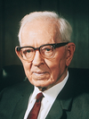
LESSON 73
Deuteronomy 34:5-6
5 ¶ So Moses the servant of the Lord died there in the land of Moab, according to the word of the Lord.
6 And he buried him in a valley in the land of Moab, over against Beth-peor: but no man knoweth of his sepulchre unto this day.
What do these verses say happened to Moses?
“Moses was likewise taken up [like Elijah], though the scriptures say that the Lord buried him upon the mountain. Of course, the writer of that wrote according to his understanding; but Moses, like Elijah, was taken up without tasting death, because he had a mission to perform” (Joseph Fielding Smith, Doctrines of Salvation, comp. Bruce R. McConkie [1955], 2:107).
President
Joseph Fielding Smith

Slide 14
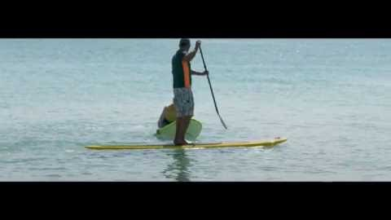
LESSON 73

Slide 15
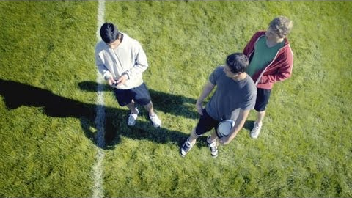
LESSON 73

